Slide 1
CSCI561 Fall 2017 Week 12 Discussion
Prof Sheila Tejada stejada@usc.edu
Prof Wei-min Shen shen@isi.edu
Prof Ning Wang nwang@ict.usc.edu

Slide 2
Uncertainty: Coping with What You Don’t Grasp
Outside scope of awareness
Too complex to reason about in complete detail
Too expensive or risky to ensure certainty
Problem/information has inherent randomness

Slide 3

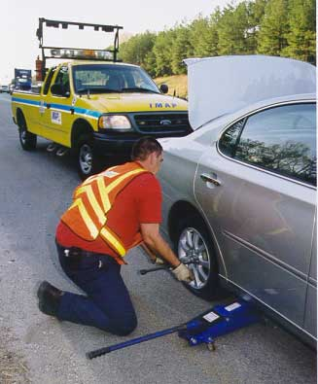
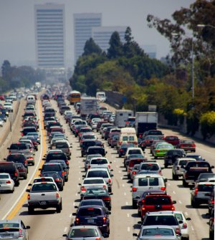
Example When to Leave for Airport?
Requires understanding how long it is likely to take to get there (mean), and how likely there is to be a significant deviation from this expectation (variance)
Decision making under significant uncertainty
A range of possible causes for this uncertainty
Partial observability
State of roads, other drivers’ plans, etc.
Noisy sensors (introducing errors, not just lack of info)
Traffic reports, etc.
Uncertainty in action outcomes
Flat tire, accident, etc.
Uncertainty about how traffic will evolve over time
Complexity of modeling and predicting traffic

Slide 4
Logic and Uncertainty
Logic generally talks in terms of certainty
A fact is either true or false
Although may be unknown as a very generic form of uncertainty
A rule applies to all cases or not
But often need more shades of meaning than this
Risk either stating things as true that are false or leaving as unknown something about which key information is known
Need at times to be able to talk instead about how (un)certain you are about something

Slide 5
Probability
“Probability is the chance that something is likely to happen or be the case.” (Wikipedia)
This is objective probability: P(heads)=P(tails)=1/2
Our focus will be on subjective probability:
An agent’s estimated likelihood of the truth of a sentence
Modal/meta-level knowledge about a sentence, rather than knowledge directly about the world
E.g., “It will take 25 minutes to get to the airport” vs. ‘I believe that the chance is .35 that the sentence “It will take 25 minutes to get to the airport” is true’

Slide 6
Probability
Probabilistic assertions summarize effects of
Laziness: failure to enumerate exceptions, qualifications, etc.
Ignorance: lack of relevant facts, initial conditions, etc.
Approach is to summarize over all of these effects even without fully understanding them
“Quantifying ignorance”

Slide 7
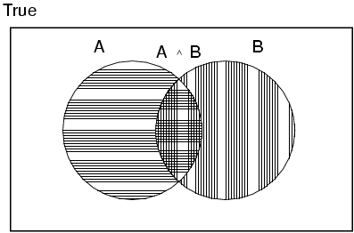
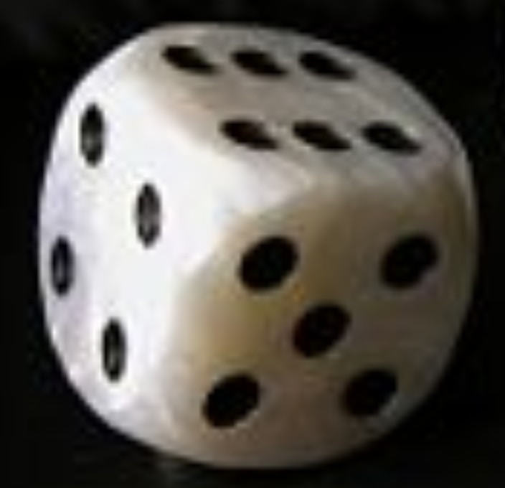

Basic Concepts of Probability
P(x) is a real number in [0, 1]
that represents the likelihood that x is true
P(x)=1 ⇒ Certainty
P(true)=1
P(x)=0 ⇒ Impossibility
P(false)=0
0<P(x)<1 ⇒ Uncertainty (varying levels)
For a fair coin, P(heads)=P(tails)=.5
For a fair die, P(1)=…=P(6)=.166…
P(A ∨ B) = P(A) + P(B) - P(A ∧ B)
Notes:
How many have had a previous introduction to probability?

Slide 8
More on Probability
P(x∧y)=P(x)P(y) if x and y are independent
P(heads¹∧heads²)=P(heads¹)P(heads²)=.5*.5=.25
P(AinCourse∧Raining)=P(AinCourse)P(Raining)
No general way to compute when not independent, except…
P(x∧y)=0 if x and y are mutually exclusive
P(AinCourse∧BinCourse)=0
P(x∧¬x)=0
Makes P(x∨y)=P(x)+P(y) by Axiom 3

Slide 9
More on Probability
P(x)=P(y) if x=y (logically equivalent)
P(x₁∨…∨x_{n})=1 if the x_{i}’s are exhaustive
P(heads ∨ tails)=1
P(x∨¬x)=1
P(¬x)=1-P(x)
1=P(x∨¬x)=P(x)+P(¬x)-P(x∧¬x)
1=P(x)+P(¬x)-0
In general, summing probabilities over any partition yields 1

Slide 10
Atomic Events
An atomic event is a complete specification of state of the world about which agent is uncertain
E.g., if the world consists of only two Boolean random variables, Cavity and Toothache, then there are 4 distinct atomic events:
Cavity=false ∧ Toothache=false
Cavity=false ∧ Toothache=true
Cavity=true ∧ Toothache=false
Cavity=true ∧ Toothache=true
Atomic events are analogous to models in logic
Each atomic event entails the truth of every proposition with respect to that world
E.g., in AE4, cavity⇒toothache is true
The set of possible atomic events is a partition

Slide 11
Joint Probability Distribution
A joint probability distribution for a set of random variables gives the probability of every atomic event on those random variables
P(Weather,AinClass) = a 4 × 2 matrix of values:
Weather = sunny rainy cloudy snow
AinClass = true 0.144 0.02 0.016 0.02
AinClass = false 0.576 0.08 0.064 0.08
A full joint probability distribution covers all of the random variables used to describe the world
Weather, Temperature, Cavity, Toothache, AinClass, etc.
Every question about world is answerable by full joint distribution

Slide 12

Probabilistic Inference by Enumeration
Can perform probabilistic inference by enumerating over (full) joint probability distribution
Start with the joint probability distribution P(Cavity,Toothache,Catch)
For any proposition φ, sum p for atomic events where true
P(φ) = Σ_{ω:ω╞φ} P(ω)
P(toothache)
= .108 + .012 + .016 + .064 = .2
P(cavity)
= .108 + .012 + .72 +.08 = .2
Catch refers to Dentist’s
instrument catching on tooth
Called marginal probability of toothache
The overall process is called marginalization or summing out: [P(Y) = Σ_{z}P(Y,z)]

Slide 13
Inference of Complex Propositions
Sum over all action events in which proposition is true
P(toothache ∨ cavity)
= .108 + .012 + .016 + .064 + .072 + .008 = .28
P(toothache ∧ cavity)
= .108 + .012 = .12
P(toothache ⇒ cavity) = P(¬toothache ∨ cavity)
= .108 +.012 +.072 + .008 + .144 + .576 = .92
P(cavity ⇒ toothache) = P(¬cavity ∨ toothache)
= .108 +.012 +.016 + .064 + .144 + .576 = .92

Slide 14
Probabilities and Evidence
Degrees of belief (subjective probabilities) are centrally affected by evidence
Prior probability refers to degree of belief before see any evidence
P(sunny)=.5
P(aincourse)=.45
Conditional probability refers to degree of belief conditioned on seeing (only) particular evidence
P(sunny | losangeles, july)=.9
P(sunny | pittsburgh)=.1
P(aincourse | aonmidterm)=.6

Slide 15
Inference w/Conditional Probabilities
Can compute conditional probabilities by enumerating over joint distribution via: P(a | b) = P(a ∧ b) / P(b)
P(cavity | toothache)
= P(cavity ∧ toothache)/P(toothache)
= (.108 + .012)/(.108 + .012 + .016 + .064) = .12/.2 = .6
P(¬cavity | toothache)
= P(¬cavity ∧ toothache)/P(toothache)
= (.016 + .064)/(.108 + .012 + .016 + .064) = .08/.2 = .4
1/P(toothache) is the normalization constant (α) for the distribution
P(Cavity | toothache)
Ensures it sums to 1

Slide 16
Normalized Inference Procedure
General inference procedure for cond. distributions:
P(X | e) = P(X,e)/P(e) = αP(X,e) = αΣ_{y}P(X,e,y)
X is a single query variable
e is a vector of values of the evidence variables E
y is a vector of values for the remaining unobserved variables Y
P(X,e,y) is a subset of values from the joint probability distribution
P(Cavity | toothache)
= P(Cavity,toothache)/P(toothache)
= αP(Cavity,toothache)
= α[P(Cavity,toothache,catch)+P(Cavity,toothache,¬catch)]
= (1/.2)[⟨.108,0.016⟩ + ⟨.012,.064⟩] = 5⟨.12,.08⟩ = ⟨.6,.4⟩
Only problem, but a big one, is that this does not scale well
If there are n Boolean variables, space and time are O(2^{n})

Slide 17
Multiple Sources of Evidence
As more sources of evidence accumulate, the conditional probability of cavity will adjust
E.g., if catch is also given, then have:
P(cavity | toothache,catch)
= P(cavity ∧ toothache ∧ catch)/P(toothache ∧ catch) = .87 (up from .6)
In general, as evidence accumulates over time, such as data from an x-ray, the conditional probability of cavity would continue to evolve
Probabilistic reasoning is inherently non-monotonic
However, if evidence is irrelevant, may simply ignore
P(cavity | toothache,sunny)
= P(cavity | toothache) = 0.6
Such reasoning about independence can be essential in making probabilistic reasoning tractable

Slide 18
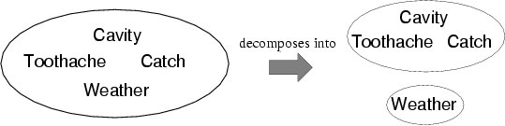
Independence
A and B are independent iff
P(A|B) = P(A) or P(B|A) = P(B) or P(A, B) = P(A) P(B)
E.g., P(Toothache, Catch, Cavity, Weather)
= P(Toothache, Catch, Cavity) P(Weather)
Reduces 2x2x2x4=32 entries to 2x2x2+4=12
For n independent coin tosses, O(2^{n})→O(n)
Absolute (or marginal) independence is powerful but rare
E.g., dentistry is a large field with hundreds of variables, none of which are absolutely independent from the others

Slide 19
Conditional Independence
Two dependent variables may become conditionally independent when conditioned on a third variable
Consider Catch and Toothache
P(catch)=.34 while P(catch | toothache)=.62, so dependent
The problem is that while neither causes the other, they correlate because both caused by single underlying hidden variable (cavity)
If condition both Catch and Toothache on Cavity, conditional probabilities become independent
P(toothache, catch | cavity) = P(toothache | cavity) P(catch | cavity) = .54
P(toothache, catch | ¬cavity) = P(toothache | ¬cavity) P(catch | ¬cavity) = .02
Catch is conditionally independent of Toothache given Cavity:
P(Toothache, Catch | Cavity) = P(Toothache | Cavity) P(Catch | Cavity)
Additional equivalent statements:
P(Catch | Toothache,Cavity) = P(Catch | Cavity)
P(Toothache | Catch, Cavity) = P(Toothache | Cavity)

Slide 20
Conditional Independence
General rule is P(X,Y | Z) = P(X | Z) P(Y | Z)
Or P(X | Y,Z) = P(X | Z) or P(Y | X,Z) = P(Y | Z)
With conditional independence can decompose individual large tables into sets of smaller ones, e.g.:
P(Toothache, Catch, Cavity)
= P(Toothache, Catch | Cavity) P(Cavity) [product rule]
= P(Toothache | Cavity) P(Catch | Cavity) P(Cavity) [cond. independence]
The use of conditional independence can reduce the size of the representation of the joint distribution from exponential in n to linear in n
For example, if there are many symptoms all caused by cavities
One of the most significant recent advances in AI, as has made probabilistic reasoning tractable where previously understood not to be so
Conditional independence is our most basic and robust form of knowledge about uncertain environments

Slide 21
Bayes' Rule
Product rule: P(a ∧ b) = P(a | b) P(b) = P(b | a) P(a)
⇒ Bayes' rule: P(a | b) = P(b | a) P(a) / P(b)
Or in distribution form (and with normalization factor)
P(Y | X) = P(X | Y) P(Y) / P(X) = αP(X | Y) P(Y)
Useful for deriving diagnostic probabilities from causal probabilities:
P(Cause | Effect) = P(Effect | Cause) P(Cause) / P(Effect)

Slide 22
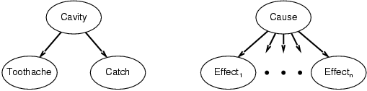
Combining Evidence (for Diagnosis)
P(Cavity | toothache,catch)
= αP(toothache ∧ catch | Cavity) P(Cavity) [Bayes’ Rule]
= αP(toothache | Cavity) P(catch | Cavity) P(Cavity) [Cond. Ind.]
This is an example of a naïve Bayes model:
P(Cause,Effect₁, … ,Effect_{n}) = P(Cause) π_{i}P(Effect_{i}|Cause)
Cost of diagnostic reasoning now grows linearly rather than exponentially in number of conditionally independent effects
Called naïve, because often used when the effects are not completely conditionally independent given the cause

Slide 23
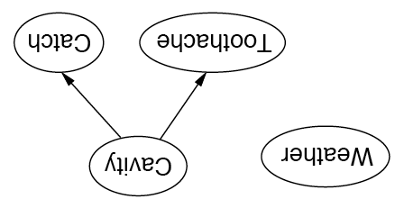
Independence in Bayesian Networks
Topology of network encodes (conditional) independence assertions:
Weather is independent of the other variables
Toothache and Catch are conditionally independent given Cavity

Slide 24
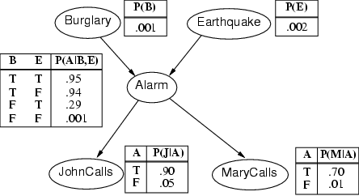
Alarm Example
Only one value needed for X_{i} in each row because, for boolean variables, P(false)=1-P(true)
All factors (possibly infinite) not explicitly mentioned are implicitly incorporated into probabilities
Bird could fly through window pane, power could fail, …
Notes:
Qualification problem

Slide 25
Semantics
If correct, the network represents the full joint distribution: P(x₁, … ,x_{n}) = π_{i=1} P(x_{i} | parents(X_{i}))
n

Slide 26
n
P(x₁, … ,x_{n}) = π_{i=1} P(x_{i} | parents(X_{i}))
E.g., the probability of a complete false alarm (no burglary or earthquake) with two calls is:
P(j, m, a, ¬b, ¬e)
= P(j | a) P(m | a) P(a | ¬b, ¬e) P(¬b) P(¬e)
= .9 x .7 x .001 x .999 x .998 ≈ .000063

Slide 27
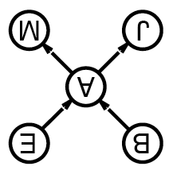
Enumeration in Bayesian Networks
Compute probabilities from Bayesian network as if from FJPT, but without explicitly constructing the table
Otherwise would lose benefit of decomposing full table into network
Consider simple query on burglary network
P(b | j,m)
= P(b,j,m)/P(j,m)
= αP(b,j,m)
= αΣ_{e}Σ_{a}P(b,e,a,j,m)
= αΣ_{e}Σ_{a}P(b) P(e) P(a | b,e) P(j | a) P(m | a)
= αP(b)Σ_{e} P(e) Σ_{a} P(a | b,e) P(j | a) P(m | a)
Compute by proceeding through terms in a depth-first fashion, multiplying and adding CPT entries as we go

Slide 28
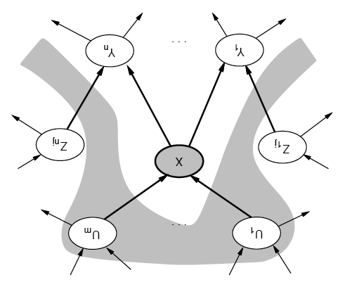
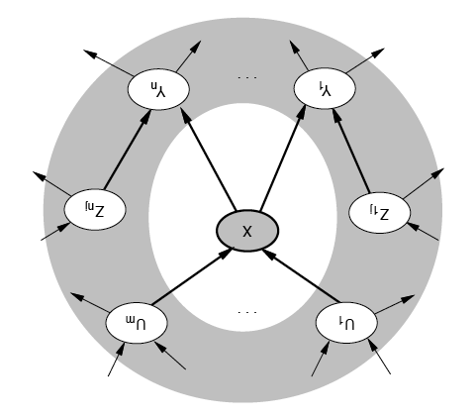
Conditional Independence of Nodes
A node is conditionally independent of its nondescendents given its parents
A node is conditionally independent of all others given its Markov blanket
Parents, children and children’s parents

Slide 29
Probability formulas
Conditional probability: P(a | b) = P(a ∧ b) / P(b)
Product rule: P(a ∧ b) = P(a | b) P(b) = P(b | a) P(a)
⇒ Bayes' rule: P(a | b) = P(b | a) P(a) / P(b)

Slide 30
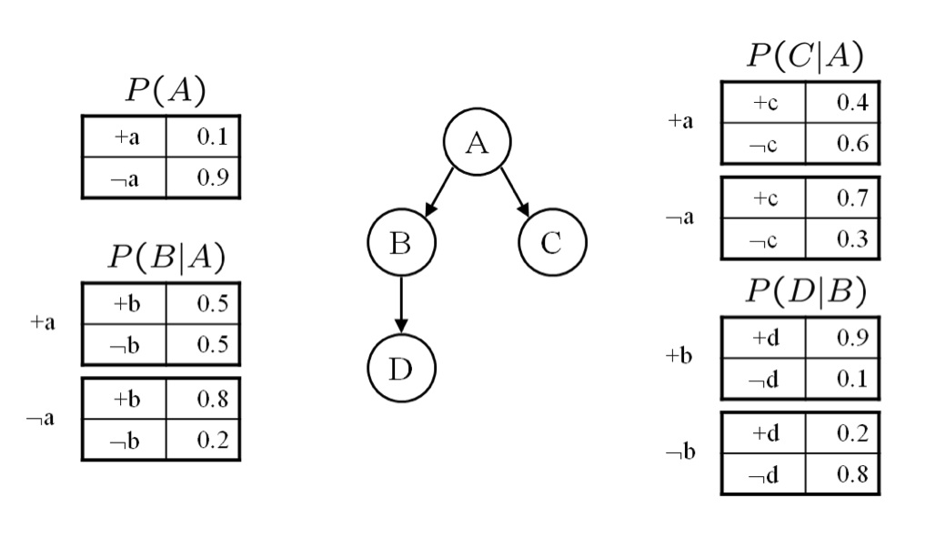
Bayesian Networks
Given this network calculate the following probabilities. Give both the formula and calculations with values. These questions are designed so that they can be answered with a minimum of computation. If you find yourself doing a copious amount of computation for each part, step back and consider whether there is simpler way to deduce the answer.
1. P(a,¬b,c,¬d)
P (a)P (¬b|a)P (c|a)P (¬d|¬b)
= 0.1 × 0.5 × 0.4 × 0.8 = 0.016

Slide 31
Bayesian Networks
2. P(b)
P(b) = ∑_{A={a,¬a}} P(A)P(b|A)
= 0.1 × 0.5 + 0.9 × 0.8 = 0.77
3. P(a|b)
P (a|b) = P (a,b)/ P (b) = P (a)P (b|a) / P (b)
= 0.1×0.5 / .77 = 0.064935

Slide 32
Bayesian Networks
4. P(d|a)
P (d|a) = ∑_{B={b,¬b}} P (d|B)p(B|a)
= 0.9 × 0.5 + 0.2 × 0.5 = 0. 55
5. P(d|a,c)
From the conditional independence properties of the graph, D ⊥ C|{A}. Hence, P(d|a,c) = p(d|a)
= 0.55

Slide 33
What you should know
What are the sources for uncertainty?
How can we use probability to reason about uncertainty?
What is a random variable? Atomic events? How are they used for inference?
What is independence? What is conditional independence? Why are they needed for reasoning about uncertainty?
What is Bayes rule? How is this addressing combining evidence for diagnosis?
Bayesian networks provide a natural representation for (causally induced) conditional independence
Topology + CPTs = compact representation of joint distribution

Slide 34
Want more?
Try exercise 13.4,7,8,13,15, 14.2,8 in AIMA

