Slide 1
CSCI561 FALL 2017 Week 6 Discussion
Prof Sheila Tejada stejada@usc.edu
Prof Wei-min Shen shen@isi.edu
Prof Ning Wang nwang@ict.usc.edu

Slide 2
Logic “Representation” of the Real World
Symbol Systems The Real World
Objects:
BLOCKA
BLOCKB
BLOCKC
……
Relations:
P₁:(IS_ON BLOCKA BLOCKB)
P₂:(IS_RED BLOCKA)
……
“Knowledge Base”
“Robot Brain”

Slide 3
Truth Depends on Interpretation
Representation 1 The Real World
A
ON(A,B) T
B
ON(B,A) F
ON(A,B) F A
ON(B,A) T B
Representation 2

Slide 4
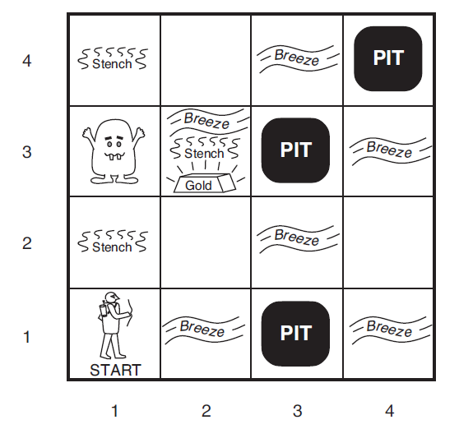
Logic concepts
Entailment ⊨
Inference ⊢

Slide 5
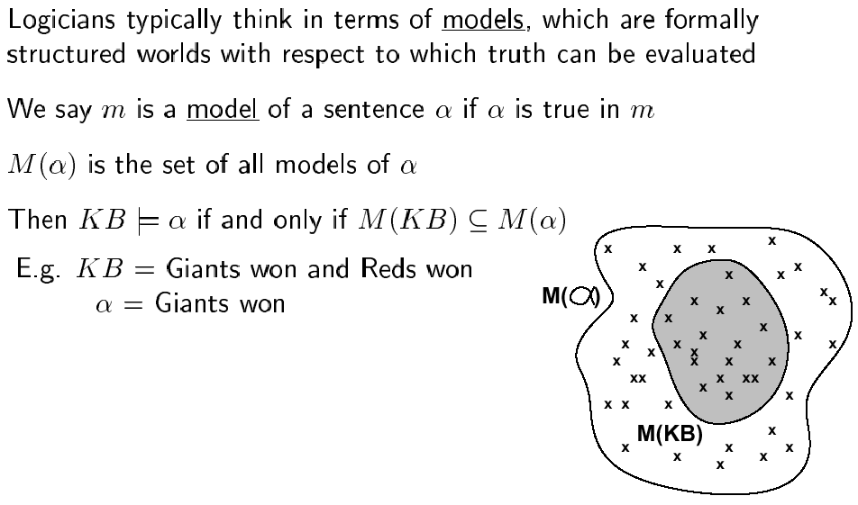
Models (“possible worlds”)
α = “intelligence must have a body”
Models (possible worlds):
earth,
mars,
…...

Slide 6
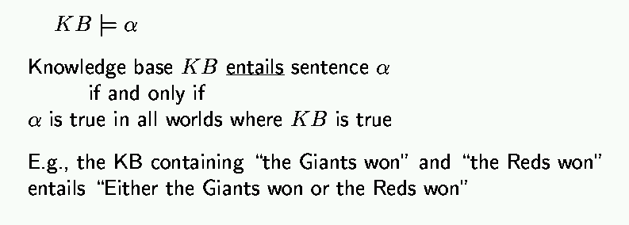
Entailment
Entailment means it is impossible for this case to occur:
premises are true and the consequence is false.

Slide 7
Logic as a Representation of a World
e.g., “John has three brains”
entails
Representation: Sentences
Sentence
Refers to
(Semantics)
follows
Facts
World
Facts
Really? Need to do a scan of John’s head!

Slide 8

Entailment in Wumpus World
α₁ = ¬P_{1,2}
α₂ = ¬P_{2,2}
1
2
?
?

Slide 9
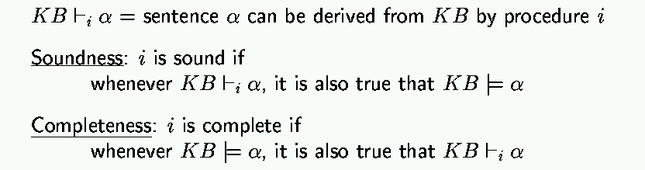
Inference

Slide 10

“Entail” =\= “Inference”
“KB inference α”: derived by a procedure
sound
complete
In robot’s head
(or on paper)
“KB entails α”
Model of KB is a subset of Model of α
In the real worlds:
Model of Symbols: M(KB), M(α), …
“possible worlds”?

Slide 11
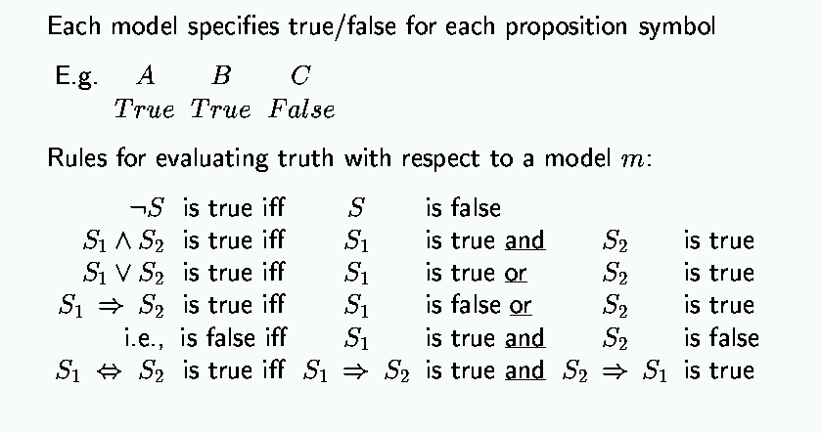
Propositional logic

Slide 12
Exercise 7.4
False |= True.
True |= False.
(A∧B)|=(A ⇔ B).
A ⇔ B |= A ∨ B .
A ⇔ B|=¬A∨B.
(A∧B) ⇒ C|=(A ⇒ C)∨(B ⇒ C). (C∨(¬A∧¬B))≡((A ⇒ C)∧(B ⇒ C)).
(A∨B)∧(¬C∨¬D∨E)|=(A∨B).
(A∨B)∧(¬C∨¬D∨E)|=(A∨B)∧(¬D∨E).
(A∨B)∧¬(A ⇒ B) is satisfiable.
(A ⇔ B)∧(¬A∨B) Is satisfiable.
(A ⇔ B) ⇔ C has the same number of models as (A ⇔ B) for any fixed set of proposition symbols that includes A, B, C.
Notes:
In all cases, the question can be resolved easily by referring to the definition of entail- ment.
False |= True is true because False has no models and hence entails every sentence AND because True is true in all models and hence is entailed by every sentence.
True |= False is false.
(A ∧ B) |= (A ⇔ B) is true because the left-hand side has exactly one model that is one of the two models of the right-hand side.
A ⇔ B|=A∨BisfalsebecauseoneofthemodelsofA ⇔ BhasbothAandB false, which does not satisfy A ∨ B.
A ⇔ B|=¬A∨BistruebecausetheRHSisA ⇒ B,oneoftheconjunctsinthe definition of A ⇔ B.
(A∧B) ⇒ C |= (A ⇒ C)∨(B ⇒ C) is true because the RHS is false only when both disjuncts are false, i.e., when A and B are true and C is false, in which case the LHS is also false. This may seem counterintuitive, and would not hold if ⇒ is interpreted as “causes.”
(C ∨(¬A∧¬B)) ≡ ((A ⇒ C)∧(B ⇒ C)) is true; proof by truth table enumeration, or by application of distributivity (Fig 7.11).
(A∨B)∧(¬C∨¬D∨E)|=(A∨B)istrue;removingaconjunctonlyallowsmore models.
(A∨B)∧(¬C∨¬D∨E)|=(A∨B)∧(¬D∨E)isfalse;removingadisjunctallows fewer models.
(A∨B)∧¬(A ⇒ B)issatisfiable;modelhasAand¬B. (A ⇔ B) ∧ (¬A ∨ B) is satisfiable; RHS is entailed by LHS so models are those of A ⇔ B.
l.(A ⇔ B) ⇔ Cdoeshavethesamenumberofmodelsas(A ⇔ B);halfthe models of (A ⇔ B) satisfy (A ⇔ B) ⇔ C, as do half the non-models, and there are the same numbers of models and non-models.

Slide 13
Exercise 7.4
False ⊨ True.
Notes:
In all cases, the question can be resolved easily by referring to the definition of entail- ment.
False |= True is true because False has no models and hence entails every sentence AND because True is true in all models and hence is entailed by every sentence.
True |= False is false.
(A ∧ B) |= (A ⇔ B) is true because the left-hand side has exactly one model that is one of the two models of the right-hand side.
A ⇔ B|=A∨BisfalsebecauseoneofthemodelsofA ⇔ BhasbothAandB false, which does not satisfy A ∨ B.
A ⇔ B|=¬A∨BistruebecausetheRHSisA ⇒ B,oneoftheconjunctsinthe definition of A ⇔ B.
(A∧B) ⇒ C |= (A ⇒ C)∨(B ⇒ C) is true because the RHS is false only when both disjuncts are false, i.e., when A and B are true and C is false, in which case the LHS is also false. This may seem counterintuitive, and would not hold if ⇒ is interpreted as “causes.”
(C ∨(¬A∧¬B)) ≡ ((A ⇒ C)∧(B ⇒ C)) is true; proof by truth table enumeration, or by application of distributivity (Fig 7.11).
(A∨B)∧(¬C∨¬D∨E)|=(A∨B)istrue;removingaconjunctonlyallowsmore models.
(A∨B)∧(¬C∨¬D∨E)|=(A∨B)∧(¬D∨E)isfalse;removingadisjunctallows fewer models.
(A∨B)∧¬(A ⇒ B)issatisfiable;modelhasAand¬B. (A ⇔ B) ∧ (¬A ∨ B) is satisfiable; RHS is entailed by LHS so models are those of A ⇔ B.
l.(A ⇔ B) ⇔ Cdoeshavethesamenumberofmodelsas(A ⇔ B);halfthe models of (A ⇔ B) satisfy (A ⇔ B) ⇔ C, as do half the non-models, and there are the same numbers of models and non-models.

Slide 14
Exercise 7.4
False ⊨ True. TRUE
False has no models and hence entails every sentence
True is true in all models and hence is entailed by every sentence.
Notes:
In all cases, the question can be resolved easily by referring to the definition of entail- ment.
False |= True is true because False has no models and hence entails every sentence AND because True is true in all models and hence is entailed by every sentence.
True |= False is false.
(A ∧ B) |= (A ⇔ B) is true because the left-hand side has exactly one model that is one of the two models of the right-hand side.
A ⇔ B|=A∨BisfalsebecauseoneofthemodelsofA ⇔ BhasbothAandB false, which does not satisfy A ∨ B.
A ⇔ B|=¬A∨BistruebecausetheRHSisA ⇒ B,oneoftheconjunctsinthe definition of A ⇔ B.
(A∧B) ⇒ C |= (A ⇒ C)∨(B ⇒ C) is true because the RHS is false only when both disjuncts are false, i.e., when A and B are true and C is false, in which case the LHS is also false. This may seem counterintuitive, and would not hold if ⇒ is interpreted as “causes.”
(C ∨(¬A∧¬B)) ≡ ((A ⇒ C)∧(B ⇒ C)) is true; proof by truth table enumeration, or by application of distributivity (Fig 7.11).
(A∨B)∧(¬C∨¬D∨E)|=(A∨B)istrue;removingaconjunctonlyallowsmore models.
(A∨B)∧(¬C∨¬D∨E)|=(A∨B)∧(¬D∨E)isfalse;removingadisjunctallows fewer models.
(A∨B)∧¬(A ⇒ B)issatisfiable;modelhasAand¬B. (A ⇔ B) ∧ (¬A ∨ B) is satisfiable; RHS is entailed by LHS so models are those of A ⇔ B.
l.(A ⇔ B) ⇔ Cdoeshavethesamenumberofmodelsas(A ⇔ B);halfthe models of (A ⇔ B) satisfy (A ⇔ B) ⇔ C, as do half the non-models, and there are the same numbers of models and non-models.

Slide 15
Exercise 7.4
True ⊨ False.
Notes:
In all cases, the question can be resolved easily by referring to the definition of entail- ment.
False |= True is true because False has no models and hence entails every sentence AND because True is true in all models and hence is entailed by every sentence.
True |= False is false.
(A ∧ B) |= (A ⇔ B) is true because the left-hand side has exactly one model that is one of the two models of the right-hand side.
A ⇔ B|=A∨BisfalsebecauseoneofthemodelsofA ⇔ BhasbothAandB false, which does not satisfy A ∨ B.
A ⇔ B|=¬A∨BistruebecausetheRHSisA ⇒ B,oneoftheconjunctsinthe definition of A ⇔ B.
(A∧B) ⇒ C |= (A ⇒ C)∨(B ⇒ C) is true because the RHS is false only when both disjuncts are false, i.e., when A and B are true and C is false, in which case the LHS is also false. This may seem counterintuitive, and would not hold if ⇒ is interpreted as “causes.”
(C ∨(¬A∧¬B)) ≡ ((A ⇒ C)∧(B ⇒ C)) is true; proof by truth table enumeration, or by application of distributivity (Fig 7.11).
(A∨B)∧(¬C∨¬D∨E)|=(A∨B)istrue;removingaconjunctonlyallowsmore models.
(A∨B)∧(¬C∨¬D∨E)|=(A∨B)∧(¬D∨E)isfalse;removingadisjunctallows fewer models.
(A∨B)∧¬(A ⇒ B)issatisfiable;modelhasAand¬B. (A ⇔ B) ∧ (¬A ∨ B) is satisfiable; RHS is entailed by LHS so models are those of A ⇔ B.
l.(A ⇔ B) ⇔ Cdoeshavethesamenumberofmodelsas(A ⇔ B);halfthe models of (A ⇔ B) satisfy (A ⇔ B) ⇔ C, as do half the non-models, and there are the same numbers of models and non-models.

Slide 16
Exercise 7.4
True ⊨ False. FALSE
False is not true in any models
Notes:
In all cases, the question can be resolved easily by referring to the definition of entail- ment.
False |= True is true because False has no models and hence entails every sentence AND because True is true in all models and hence is entailed by every sentence.
True |= False is false.
(A ∧ B) |= (A ⇔ B) is true because the left-hand side has exactly one model that is one of the two models of the right-hand side.
A ⇔ B|=A∨BisfalsebecauseoneofthemodelsofA ⇔ BhasbothAandB false, which does not satisfy A ∨ B.
A ⇔ B|=¬A∨BistruebecausetheRHSisA ⇒ B,oneoftheconjunctsinthe definition of A ⇔ B.
(A∧B) ⇒ C |= (A ⇒ C)∨(B ⇒ C) is true because the RHS is false only when both disjuncts are false, i.e., when A and B are true and C is false, in which case the LHS is also false. This may seem counterintuitive, and would not hold if ⇒ is interpreted as “causes.”
(C ∨(¬A∧¬B)) ≡ ((A ⇒ C)∧(B ⇒ C)) is true; proof by truth table enumeration, or by application of distributivity (Fig 7.11).
(A∨B)∧(¬C∨¬D∨E)|=(A∨B)istrue;removingaconjunctonlyallowsmore models.
(A∨B)∧(¬C∨¬D∨E)|=(A∨B)∧(¬D∨E)isfalse;removingadisjunctallows fewer models.
(A∨B)∧¬(A ⇒ B)issatisfiable;modelhasAand¬B. (A ⇔ B) ∧ (¬A ∨ B) is satisfiable; RHS is entailed by LHS so models are those of A ⇔ B.
l.(A ⇔ B) ⇔ Cdoeshavethesamenumberofmodelsas(A ⇔ B);halfthe models of (A ⇔ B) satisfy (A ⇔ B) ⇔ C, as do half the non-models, and there are the same numbers of models and non-models.

Slide 17
Exercise 7.4
(A∧B) ⊨ (A ⇔ B).
Notes:
In all cases, the question can be resolved easily by referring to the definition of entail- ment.
False |= True is true because False has no models and hence entails every sentence AND because True is true in all models and hence is entailed by every sentence.
True |= False is false.
(A ∧ B) |= (A ⇔ B) is true because the left-hand side has exactly one model that is one of the two models of the right-hand side.
A ⇔ B|=A∨BisfalsebecauseoneofthemodelsofA ⇔ BhasbothAandB false, which does not satisfy A ∨ B.
A ⇔ B|=¬A∨BistruebecausetheRHSisA ⇒ B,oneoftheconjunctsinthe definition of A ⇔ B.
(A∧B) ⇒ C |= (A ⇒ C)∨(B ⇒ C) is true because the RHS is false only when both disjuncts are false, i.e., when A and B are true and C is false, in which case the LHS is also false. This may seem counterintuitive, and would not hold if ⇒ is interpreted as “causes.”
(C ∨(¬A∧¬B)) ≡ ((A ⇒ C)∧(B ⇒ C)) is true; proof by truth table enumeration, or by application of distributivity (Fig 7.11).
(A∨B)∧(¬C∨¬D∨E)|=(A∨B)istrue;removingaconjunctonlyallowsmore models.
(A∨B)∧(¬C∨¬D∨E)|=(A∨B)∧(¬D∨E)isfalse;removingadisjunctallows fewer models.
(A∨B)∧¬(A ⇒ B)issatisfiable;modelhasAand¬B. (A ⇔ B) ∧ (¬A ∨ B) is satisfiable; RHS is entailed by LHS so models are those of A ⇔ B.
l.(A ⇔ B) ⇔ Cdoeshavethesamenumberofmodelsas(A ⇔ B);halfthe models of (A ⇔ B) satisfy (A ⇔ B) ⇔ C, as do half the non-models, and there are the same numbers of models and non-models.

Slide 18
Exercise 7.4
(A∧B) ⊨ (A ⇔ B). TRUE
The left-hand side (A∧B) has exactly one model: A=True and B=True then (A∧B)=True
That model is one of the two models of the right-hand side (A ⇔ B). Two models:
A=True and B=True then (A ⇔ B) =True
A=False and B=False then (A ⇔ B) =True
Notes:
In all cases, the question can be resolved easily by referring to the definition of entail- ment.
False |= True is true because False has no models and hence entails every sentence AND because True is true in all models and hence is entailed by every sentence.
True |= False is false.
(A ∧ B) |= (A ⇔ B) is true because the left-hand side has exactly one model that is one of the two models of the right-hand side.
A ⇔ B|=A∨BisfalsebecauseoneofthemodelsofA ⇔ BhasbothAandB false, which does not satisfy A ∨ B.
A ⇔ B|=¬A∨BistruebecausetheRHSisA ⇒ B,oneoftheconjunctsinthe definition of A ⇔ B.
(A∧B) ⇒ C |= (A ⇒ C)∨(B ⇒ C) is true because the RHS is false only when both disjuncts are false, i.e., when A and B are true and C is false, in which case the LHS is also false. This may seem counterintuitive, and would not hold if ⇒ is interpreted as “causes.”
(C ∨(¬A∧¬B)) ≡ ((A ⇒ C)∧(B ⇒ C)) is true; proof by truth table enumeration, or by application of distributivity (Fig 7.11).
(A∨B)∧(¬C∨¬D∨E)|=(A∨B)istrue;removingaconjunctonlyallowsmore models.
(A∨B)∧(¬C∨¬D∨E)|=(A∨B)∧(¬D∨E)isfalse;removingadisjunctallows fewer models.
(A∨B)∧¬(A ⇒ B)issatisfiable;modelhasAand¬B. (A ⇔ B) ∧ (¬A ∨ B) is satisfiable; RHS is entailed by LHS so models are those of A ⇔ B.
l.(A ⇔ B) ⇔ Cdoeshavethesamenumberofmodelsas(A ⇔ B);halfthe models of (A ⇔ B) satisfy (A ⇔ B) ⇔ C, as do half the non-models, and there are the same numbers of models and non-models.

Slide 19
Exercise 7.4
A ⇔ B ⊨ A ∨ B.
Notes:
In all cases, the question can be resolved easily by referring to the definition of entail- ment.
False |= True is true because False has no models and hence entails every sentence AND because True is true in all models and hence is entailed by every sentence.
True |= False is false.
(A ∧ B) |= (A ⇔ B) is true because the left-hand side has exactly one model that is one of the two models of the right-hand side.
A ⇔ B|=A∨BisfalsebecauseoneofthemodelsofA ⇔ BhasbothAandB false, which does not satisfy A ∨ B.
A ⇔ B|=¬A∨BistruebecausetheRHSisA ⇒ B,oneoftheconjunctsinthe definition of A ⇔ B.
(A∧B) ⇒ C |= (A ⇒ C)∨(B ⇒ C) is true because the RHS is false only when both disjuncts are false, i.e., when A and B are true and C is false, in which case the LHS is also false. This may seem counterintuitive, and would not hold if ⇒ is interpreted as “causes.”
(C ∨(¬A∧¬B)) ≡ ((A ⇒ C)∧(B ⇒ C)) is true; proof by truth table enumeration, or by application of distributivity (Fig 7.11).
(A∨B)∧(¬C∨¬D∨E)|=(A∨B)istrue;removingaconjunctonlyallowsmore models.
(A∨B)∧(¬C∨¬D∨E)|=(A∨B)∧(¬D∨E)isfalse;removingadisjunctallows fewer models.
(A∨B)∧¬(A ⇒ B)issatisfiable;modelhasAand¬B. (A ⇔ B) ∧ (¬A ∨ B) is satisfiable; RHS is entailed by LHS so models are those of A ⇔ B.
l.(A ⇔ B) ⇔ Cdoeshavethesamenumberofmodelsas(A ⇔ B);halfthe models of (A ⇔ B) satisfy (A ⇔ B) ⇔ C, as do half the non-models, and there are the same numbers of models and non-models.

Slide 20
Exercise 7.4
A ⇔ B ⊨ A ∨ B. FALSE
(A ⇔ B) has two models:
A=True and B=True then (A ⇔ B) =True
A=False and B=False then (A ⇔ B) =True
(A V B) is not True in this model
A=False and B=False then (A V B) = False
Notes:
In all cases, the question can be resolved easily by referring to the definition of entail- ment.
False |= True is true because False has no models and hence entails every sentence AND because True is true in all models and hence is entailed by every sentence.
True |= False is false.
(A ∧ B) |= (A ⇔ B) is true because the left-hand side has exactly one model that is one of the two models of the right-hand side.
A ⇔ B|=A∨BisfalsebecauseoneofthemodelsofA ⇔ BhasbothAandB false, which does not satisfy A ∨ B.
A ⇔ B|=¬A∨BistruebecausetheRHSisA ⇒ B,oneoftheconjunctsinthe definition of A ⇔ B.
(A∧B) ⇒ C |= (A ⇒ C)∨(B ⇒ C) is true because the RHS is false only when both disjuncts are false, i.e., when A and B are true and C is false, in which case the LHS is also false. This may seem counterintuitive, and would not hold if ⇒ is interpreted as “causes.”
(C ∨(¬A∧¬B)) ≡ ((A ⇒ C)∧(B ⇒ C)) is true; proof by truth table enumeration, or by application of distributivity (Fig 7.11).
(A∨B)∧(¬C∨¬D∨E)|=(A∨B)istrue;removingaconjunctonlyallowsmore models.
(A∨B)∧(¬C∨¬D∨E)|=(A∨B)∧(¬D∨E)isfalse;removingadisjunctallows fewer models.
(A∨B)∧¬(A ⇒ B)issatisfiable;modelhasAand¬B. (A ⇔ B) ∧ (¬A ∨ B) is satisfiable; RHS is entailed by LHS so models are those of A ⇔ B.
l.(A ⇔ B) ⇔ Cdoeshavethesamenumberofmodelsas(A ⇔ B);halfthe models of (A ⇔ B) satisfy (A ⇔ B) ⇔ C, as do half the non-models, and there are the same numbers of models and non-models.

Slide 21
Exercise 7.4
(A ⇔ B)∧(¬A∨B) is satisfiable.
Notes:
In all cases, the question can be resolved easily by referring to the definition of entail- ment.
False |= True is true because False has no models and hence entails every sentence AND because True is true in all models and hence is entailed by every sentence.
True |= False is false.
(A ∧ B) |= (A ⇔ B) is true because the left-hand side has exactly one model that is one of the two models of the right-hand side.
A ⇔ B|=A∨BisfalsebecauseoneofthemodelsofA ⇔ BhasbothAandB false, which does not satisfy A ∨ B.
A ⇔ B|=¬A∨BistruebecausetheRHSisA ⇒ B,oneoftheconjunctsinthe definition of A ⇔ B.
(A∧B) ⇒ C |= (A ⇒ C)∨(B ⇒ C) is true because the RHS is false only when both disjuncts are false, i.e., when A and B are true and C is false, in which case the LHS is also false. This may seem counterintuitive, and would not hold if ⇒ is interpreted as “causes.”
(C ∨(¬A∧¬B)) ≡ ((A ⇒ C)∧(B ⇒ C)) is true; proof by truth table enumeration, or by application of distributivity (Fig 7.11).
(A∨B)∧(¬C∨¬D∨E)|=(A∨B)istrue;removingaconjunctonlyallowsmore models.
(A∨B)∧(¬C∨¬D∨E)|=(A∨B)∧(¬D∨E)isfalse;removingadisjunctallows fewer models.
(A∨B)∧¬(A ⇒ B)issatisfiable;modelhasAand¬B. (A ⇔ B) ∧ (¬A ∨ B) is satisfiable; RHS is entailed by LHS so models are those of A ⇔ B.
l.(A ⇔ B) ⇔ Cdoeshavethesamenumberofmodelsas(A ⇔ B);halfthe models of (A ⇔ B) satisfy (A ⇔ B) ⇔ C, as do half the non-models, and there are the same numbers of models and non-models.

Slide 22
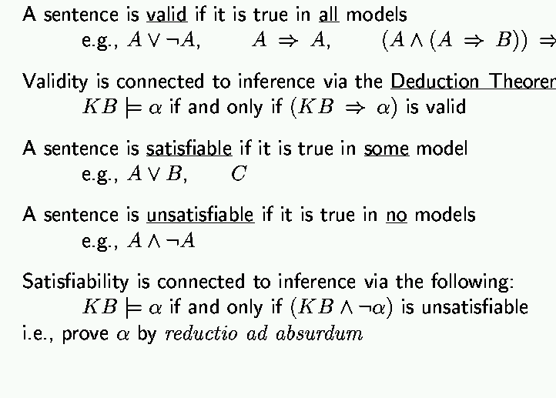
Validity and satisfiability
B
m

Slide 23
Exercise 7.4
(A ⇔ B)∧(¬A∨B) is satisfiable. TRUE
This sentence (A ⇔ B)∧(¬A∨B) is True, when A=True and B=True
Notes:
In all cases, the question can be resolved easily by referring to the definition of entail- ment.
False |= True is true because False has no models and hence entails every sentence AND because True is true in all models and hence is entailed by every sentence.
True |= False is false.
(A ∧ B) |= (A ⇔ B) is true because the left-hand side has exactly one model that is one of the two models of the right-hand side.
A ⇔ B|=A∨BisfalsebecauseoneofthemodelsofA ⇔ BhasbothAandB false, which does not satisfy A ∨ B.
A ⇔ B|=¬A∨BistruebecausetheRHSisA ⇒ B,oneoftheconjunctsinthe definition of A ⇔ B.
(A∧B) ⇒ C |= (A ⇒ C)∨(B ⇒ C) is true because the RHS is false only when both disjuncts are false, i.e., when A and B are true and C is false, in which case the LHS is also false. This may seem counterintuitive, and would not hold if ⇒ is interpreted as “causes.”
(C ∨(¬A∧¬B)) ≡ ((A ⇒ C)∧(B ⇒ C)) is true; proof by truth table enumeration, or by application of distributivity (Fig 7.11).
(A∨B)∧(¬C∨¬D∨E)|=(A∨B)istrue;removingaconjunctonlyallowsmore models.
(A∨B)∧(¬C∨¬D∨E)|=(A∨B)∧(¬D∨E)isfalse;removingadisjunctallows fewer models.
(A∨B)∧¬(A ⇒ B)issatisfiable;modelhasAand¬B. (A ⇔ B) ∧ (¬A ∨ B) is satisfiable; RHS is entailed by LHS so models are those of A ⇔ B.
l.(A ⇔ B) ⇔ Cdoeshavethesamenumberofmodelsas(A ⇔ B);halfthe models of (A ⇔ B) satisfy (A ⇔ B) ⇔ C, as do half the non-models, and there are the same numbers of models and non-models.

Slide 24
Exercise 7.4
False |= True.
True |= False.
(A∧B)|=(A ⇔ B).
A ⇔ B |= A ∨ B .
A ⇔ B|=¬A∨B.
(A∧B) ⇒ C|=(A ⇒ C)∨(B ⇒ C). (C∨(¬A∧¬B))≡((A ⇒ C)∧(B ⇒ C)).
(A∨B)∧(¬C∨¬D∨E)|=(A∨B).
(A∨B)∧(¬C∨¬D∨E)|=(A∨B)∧(¬D∨E).
(A∨B)∧¬(A ⇒ B) is satisfiable.
(A ⇔ B)∧(¬A∨B) Is satisfiable.
(A ⇔ B) ⇔ C has the same number of models as (A ⇔ B) for any fixed set of proposition symbols that includes A, B, C.
Notes:
In all cases, the question can be resolved easily by referring to the definition of entail- ment.
False |= True is true because False has no models and hence entails every sentence AND because True is true in all models and hence is entailed by every sentence.
True |= False is false.
(A ∧ B) |= (A ⇔ B) is true because the left-hand side has exactly one model that is one of the two models of the right-hand side.
A ⇔ B|=A∨BisfalsebecauseoneofthemodelsofA ⇔ BhasbothAandB false, which does not satisfy A ∨ B.
A ⇔ B|=¬A∨BistruebecausetheRHSisA ⇒ B,oneoftheconjunctsinthe definition of A ⇔ B.
(A∧B) ⇒ C |= (A ⇒ C)∨(B ⇒ C) is true because the RHS is false only when both disjuncts are false, i.e., when A and B are true and C is false, in which case the LHS is also false. This may seem counterintuitive, and would not hold if ⇒ is interpreted as “causes.”
(C ∨(¬A∧¬B)) ≡ ((A ⇒ C)∧(B ⇒ C)) is true; proof by truth table enumeration, or by application of distributivity (Fig 7.11).
(A∨B)∧(¬C∨¬D∨E)|=(A∨B)istrue;removingaconjunctonlyallowsmore models.
(A∨B)∧(¬C∨¬D∨E)|=(A∨B)∧(¬D∨E)isfalse;removingadisjunctallows fewer models.
(A∨B)∧¬(A ⇒ B)issatisfiable;modelhasAand¬B. (A ⇔ B) ∧ (¬A ∨ B) is satisfiable; RHS is entailed by LHS so models are those of A ⇔ B.
l.(A ⇔ B) ⇔ Cdoeshavethesamenumberofmodelsas(A ⇔ B);halfthe models of (A ⇔ B) satisfy (A ⇔ B) ⇔ C, as do half the non-models, and there are the same numbers of models and non-models.

Slide 25
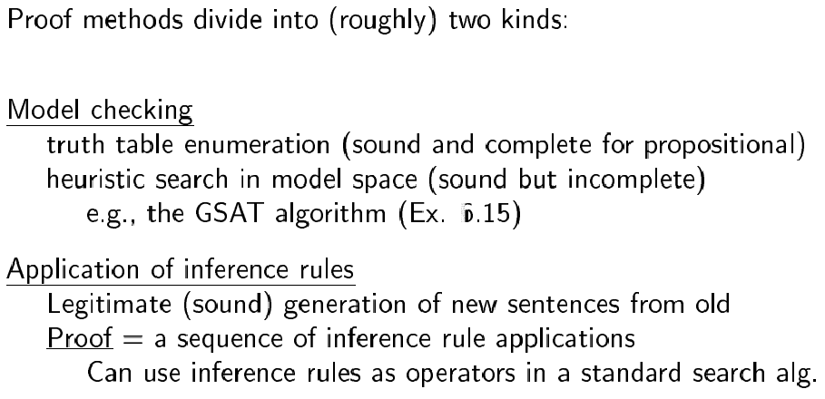
Proof methods

Slide 26
basic manipulation rules
¬(¬A) = A Double negation
¬(A ^ B) = (¬A) V (¬B) Negated “and”
¬(A V B) = (¬A) ^ (¬B) Negated “or”
A ^ (B V C) = (A ^ B) V (A ^ C) Distributivity of ^ on V
A V (B ^ C) = (A V B) ^ (A V C) Distributivity of V on ^
A => B = (¬A) V B by definition
¬(A => B) = A ^ (¬B) using negated or
A ⬄ B = (A => B) ^ (B => A) by definition
¬(A ⬄ B) = (A ^ (¬B))V(B ^ (¬A)) using negated and & or
…

Slide 27
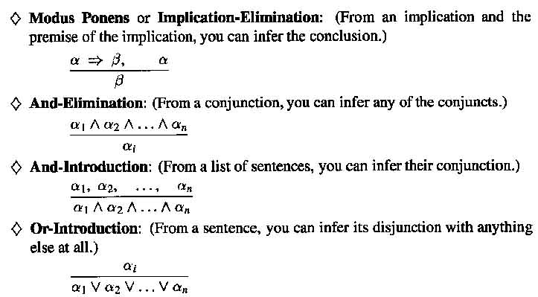
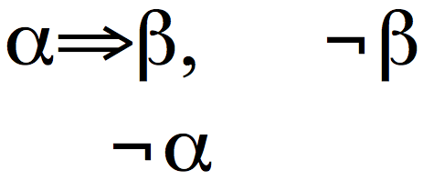
Inference Rules
Modus Tollens:z

Slide 28
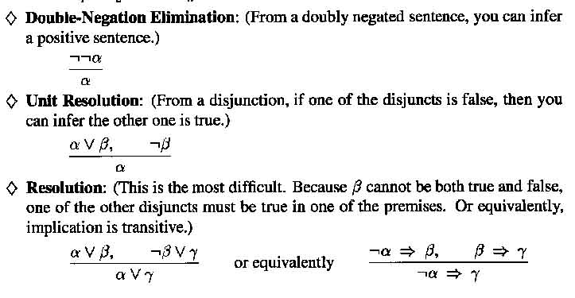
Inference Rules

Slide 29
Syntax of FOL: Basic Elements
First-order logic
Constants KingJohn, 2, Crown,...
Predicates Brother, >,...
Functions Sqrt, LeftLeg, +, ...
Variables x, y, a, b,...
Connectives ¬, ⇒, ∧, ∨, ⇔
Equality =
Quantifiers ∀, ∃
Notes:
In propositional logic had one kind of symbol, here have four, each with its own role
Constants in language are simplest way of talking about objects in domain, but can also use functions and variables

Slide 30
Example Domain: Arithmetic on Natural Numbers
Objects
Non-negative numbers (0, 1, …)
Relations
NatNum, =, <, >, …
Functions
Successor, +, -, x, integer division, remainder, exponentiation,…
E.g., >(+(5, 20211), -(5111,777)) ∧ =(5,+(3,2))
Notes:
What are the objects, relations and functions in this domain?

Slide 31
Convert from English to FOL
Circle True or False. For sentences in English make your judgment of the meaning of the sentence, i.e., you may want to translate it in FOL to conclude.
1. [True/False] "Bert and Ernie are brothers" is equivalent to "Bert is a brother and Ernie is a brother”
2. [True/False] “ p and q are not both true” is equivalent to “ p and q are both not true”
3. [True/False] “Neither p nor q” is equivalent to “both p and q are false”
4. [True/False] “Not all A’s are B’s” is equivalent to “∃x (A(x) ∧ ¬B(x) ) ”
5. [True/False] "MS students and PhD students are welcome to apply." is equivalent to “∀x [(M(x)∧P(x)) ⇒ Apply(x)]”
False
False
True
True
False

Slide 32
Convert from English to FOL
Questions 6 to 9: Attract is a relation from x to y, i.e., A(x,y) says that “x attracts y” or equivalently that “y is attracted by x”.
6. [True/False] “Everything attracts something”, where “something” means “something or other”, is equivalent to “∀x ∃y A(x, y) ”
7. [True/False] “Something is attracted by everything”, where “something” means “something in particular”, is equivalent to “∃y ∃x A( x, y) ”
8. [True/False] “Everything is attracted by something” ”, where “something” means “something or other”, is equivalent to “∃x ∀y A(x, y) ”
9. [True/False] “Something attracts everything”, where “something” means “something in particular”, is equivalent to “∃x ∃y A(x, y) ”
True
False
False
False

Slide 33
What you should know
What is entailment and inference? How do they differ?
What are examples of sound or complete inference techniques?
What does satisfiable or valid mean?
What is propositional logic? Basic manipulation rules? Inference rules? What are some of its limitations?
What is first order logic?

Slide 34
Want More?
Check out some of these exercises in the book:
7.1, 7.4-8, 10
Chap 8: 8.1-3, 8.6, 8.9-10, 8.14,17, 8.28

