Slide 1
CSCI561 Fall 2017 Week 9 Discussion
Prof Sheila Tejada stejada@usc.edu
Prof Wei-min Shen shen@isi.edu
Prof Ning Wang nwang@ict.usc.edu

Slide 2
Planning
High
Banana
Monkey
Box
The monkey-and-bananas problem is faced by a monkey in a laboratory with some bananas hanging out of reach from the ceiling.
Low
A
B
C
A box is available that will enable the monkey to reach the bananas if he climbs on it.
Initially, the monkey is at A, the bananas at B, and the box at C.
The monkey and box have height Low, but if the monkey climbs onto the box he will have height High, the same as the bananas.
[4%] Write down the initial state description.
At(Monkey,A) ∧ At(Bananas,B) ∧ At(Box,C) ∧
Height(Monkey,Low) ∧ Height(Box,Low) ∧ Height(Bananas,High) ∧
Pushable(Box) ∧ Climbable(Box)

Slide 3
Planning
The actions available to the monkey include: Go from one place to another, Push an object from one place to another, ClimbUp onto or ClimbDown from an object, and Grasp or Ungrasp an object.
The result of a Grasp is that the monkey holds the object if the monkey and object are in the same place at the same height.
Write the six action schemas with preconditions and effects
Action(ACTION: Go(x,y),
PRECOND: At(Monkey,x),
EFFECT: At(Monkey,y) ∧¬(At(Monkey,x)))
Action(ACTION: Push(b,x,y),
PRECOND: At(Monkey,x) ∧ Pushable(b),
EFFECT: At(b,y) ∧ At(Monkey,y) ∧¬At(b,x) ∧¬At(Monkey,x))
Action(ACTION: ClimbUp(b),
PRECOND: At(Monkey,x) ∧At(b,x) ∧ Climbable(b),
EFFECT: On(Monkey,b) ∧¬Height(Monkey,Low) ∧ Height(Monkey,High))

Slide 4
Planning
The actions available to the monkey include: Go from one place to another, Push an object from one place to another, ClimbUp onto or ClimbDown from an object, and Grasp or Ungrasp an object.
The result of a Grasp is that the monkey holds the object if the monkey and object are in the same place at the same height.
Write the six action schemas with preconditions and effects
Action(ACTION: Grasp(o),
PRECOND: Height(Monkey,h) ∧Height(o,h) ∧At(Monkey,x) ∧ At(o,x),
EFFECT: Have(Monkey,o))
Action(ACTION: ClimbDown(b),
PRECOND: On(Monkey,b) ∧ Height(Monkey,High),
EFFECT: ¬On(Monkey,b) ∧¬Height(Monkey,High) ∧ Height(Monkey,Low)
Action(ACTION: UnGrasp(o),
PRECOND: Have(Monkey,o),
EFFECT: ¬Have(Monkey,o))

Slide 5
Planning
What is the plan to achieve the goal Have(Monkey, Banana)?
Action(ACTION:Go(x,y),
PRECOND: At(Monkey,x),
EFFECT: At(Monkey,y) ∧¬(At(Monkey,x)))
Action(ACTION:Push(b,x,y),
PRECOND: At(Monkey,x) ∧ Pushable(b),
EFFECT: At(b,y) ∧ At(Monkey,y) ∧¬At(b,x) ∧¬At(Monkey,x))
Action(ACTION:ClimbUp(b),
PRECOND:At(Monkey,x) ∧At(b,x) ∧ Climbable(b),
EFFECT: On(Monkey,b) ∧¬Height(Monkey,Low) ∧ Height(Monkey,High))
Action(ACTION:Grasp(o), PRECOND:Height(Monkey,h) ∧Height(o,h) ∧At(Monkey,x) ∧ At(b,x), EFFECT:Have(Monkey,o))
At(Monkey,A) ∧ At(Bananas,B) ∧ At(Box,C) ∧ Height(Monkey,Low) ∧ Height(Box,Low) ∧ Height(Bananas,High) ∧ Pushable(Box) ∧ Climbable(Box)
Start
Go(A,C)
At(Monkey,A)
Push(Box,C,B)
At(Monkey,C) ∧ Pushable(Box)
ClimbUp(Box)
At(Monkey,B) ∧At(Box,B) ∧ Climbable(Box)
Grasp(Banana)
Height(Monkey,High) ∧ Height(Bananas,High) ∧ At(Monkey,B) ∧ At(Bananas,B)
Finish
Have(Monkey, Bananas)

Slide 6
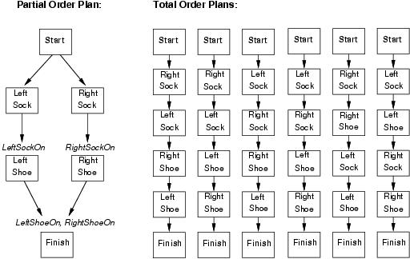
Partial and Total Order Plans
6

Slide 7
Partial Order Planning: Shoe Initial and Goal States/Plans
Initial State
Actions={Start, Finish}
Orderings={Start<Finish}
Links={}
Open={RightShoeOn,LeftShoeOn}
Goal state (plan found)
Actions={Start,Finish,RightSock,RightShoe,LeftSock,LeftShoe}
Orderings={RightSock<RightShoe, LeftSock<LeftShoe}
Also ones to ensure every action is after Start and before Finish
Links={RightSock-RightSockOn->RightShoe, LeftSock-LeftSockOn->LeftShoe, RightShoe-RightShoeOn->Finish, LeftShoe-LeftShoeOn->Finish}
Open={}

Slide 8
Flat tire problem (Fig 10.13 page 391)
Start
Initial Condition
At(Spare,Trunk), At(Flat,Axle)
Only one open precondition
Only 1 applicable action
At(Spare,Ground), ¬At(Flat,Axle)
PutOn(Spare,Axle)
At(Spare,Axle)
Finish

Slide 9
Flat tire problem (Fig 10.13 page 391)
Pick up At(Spare,Ground)
Choose only applicable action Remove(Spare,Trunk)
Add causal link between Remove(Spare,Trunk) and PutOn(Spare,Axle)

Slide 10
Flat tire problem (Fig 10.13 page 391)
Pick up ¬At(Flat,Axle)
There are 2 applicable actions: LeaveOvernight and Remove(Flat,Axle)
Choose LeaveOvernight
LeaveOvernight has effect ¬At(Spare,Ground), which conflicts with the causal link
We remove the conflict by forcing LeaveOvernight to occur before Remove(Spare,Trunk)
Conflicts with preconditions of Remove(Spare,Trunk)
The only way to resolve the conflict is to undo LeaveOvernight use the action Remove(Flat,Axle)

Slide 11
Flat tire problem (Fig 10.13 page 391)
This time, we choose Remove(Flat,Axle)
Pick up At(Spare,Trunk) and choose Start to achieve it
Pick up At(Flat,Axle) and choose Start to achieve it.
We now have a complete consistent partially ordered plan

Slide 12
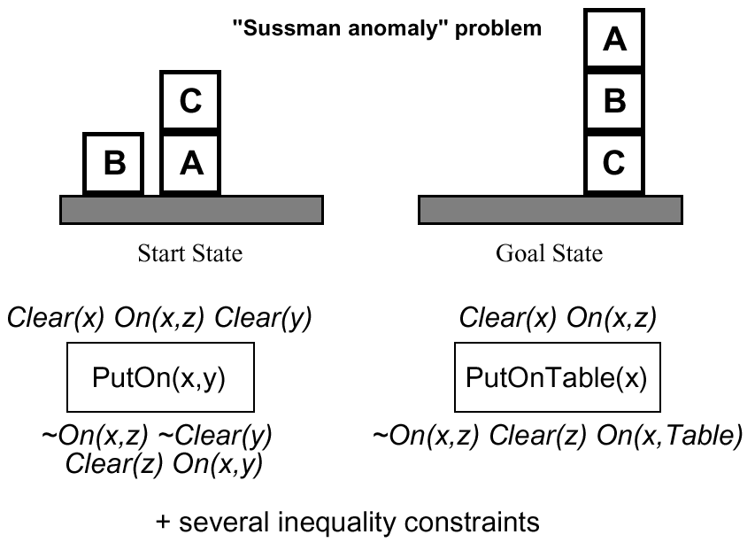
Example: block world

Slide 13
What you should know
What is Unification? How is it different than pattern matching? When is to used? What is the algorithm? Why is it important for Generalized Modus Ponens?
What is Forward Chaining? What is Backward Chaining? What is the differences between them?
What type of reasoning does Prolog use? What are the advantages and disadvantages?
What is planning? Situation calculus? What is the difference between fluents and atemporals?
What is the difference between total order planning and partial order planning?

