Slide 1
What is the goal of any scientific research?
Discover new facts.
Based on existing facts.
The scientific method is a body of techniques for investigating phenomena, acquiring new knowledge by correcting or integrating previous knowledge. -Wikipedia

Slide 2
Big Data: The Future of Bio Curation
A study of the paper on urgent need for bio-curation
Anurag Mantripragada
mantripr@usc.edu
Notes:
Slides can vary as per your presentation, but header and footer should be consistent

Slide 3
What is Biomedical Research
Utilizing biotechnology techniques, biomedical researchers study biological processes and diseases with the ultimate goal of developing effective treatments and cures.
-New Jersey Association for Biomedical Research

Slide 4
Why should we care about biomedical research?
Biomedical research provides:
Information about disease trends and risk factors.
Outcomes of treatment
Patterns of care and
Health care costs and use.

Slide 5
Biomedical Research:
Significant part of research lifecycle : Literature Review
Also true for any kind of research.

Slide 6
Data Explosion in Bio Research
Biological data from research is growing as fast as any other kind of data.
Exponential growth in data should ideally lead to exponential growth in knowledge.
Quick access to accurate data accelerates biomedical research.

Slide 7
Background
Efforts to consolidate information from various sources have been very slow

Slide 8
Bio Curators:
Biologists who:
Extract information from published literature
Develop structured vocabularies to tag data and
Make the information available online.

Slide 9
Summary of the paper: Three action items
Information exchange between authors, journals and curators.
Suppose you read a paper and see a gene name CDKN2A
It has ten literature-based synonyms. One of those, p14, is also a synonym for five other genes: CDK2AP2, CTNNBL1, RPP14, S100A9 and SUB1

Slide 10
Summary of the paper: Three action items
Information exchange between authors, journals and curators.
Results might include gene-expression patterns, mutant phenotypes etc.
What about authors inferences?
How information is presented in the literature greatly affects how fast biocurators can identify and curate it.
The vast majority of the peer-reviewed literature does not yet have a reporting-structure standard

Slide 11
Summary of the paper: Three action items
Information exchange between authors, journals and curators.
Who is responsible ?
Authors?
Journals?
Each publication must have a reference table at the end with all the Database IDs and where the database is.
Both!

Slide 12
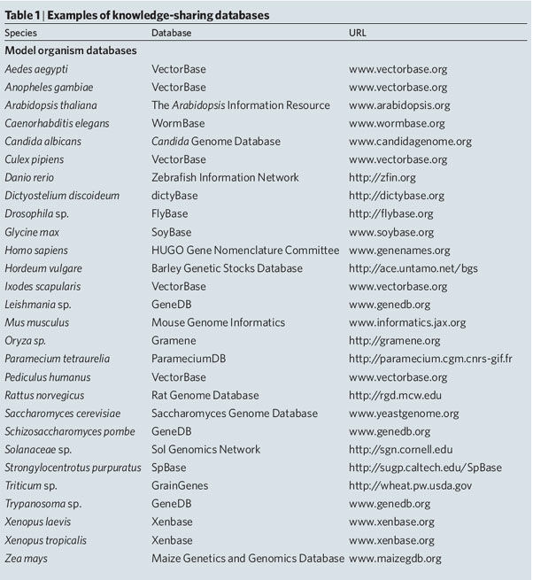
Summary of the paper: Three action items
Information exchange between authors, journals and curators.

Slide 13
Summary of the paper: Three action items
2. in the next five years, curators, researchers and university administrations develop an accepted recognition structure to facilitate community-based curation efforts.
Researchers do not roll up their sleeves and contribute to curation efforts so there is no incentives.

Slide 14
Summary of the paper: Three action items
2. in the next five years, curators, researchers and university administrations develop an accepted recognition structure to facilitate community-based curation efforts.
Incentives the researchers to include:
New information or insight for their research interests.
Improvement in academic reputation or impact.
Career advancement and better funding chances.
Academic departments and funding agencies should consider community annotation as a productive contribution to the scientific research corpus and a natural extension of the publication process.

Slide 15
Research
Annotate
Properly upload artifacts in public database.
Publish

Slide 16
Summary of the paper: Three action items
3. The whole community must promote scientific curation as a professional career option.
Schools should offer formal education in Biocuration.
It has become an interdisciplinary field.

Slide 17
Then….and Now
The success of the 1000 genomes project
The 1000 Genomes Project ran between 2008 and 2015.
Created the largest public catalogue of human variation and genotype data.

Slide 18
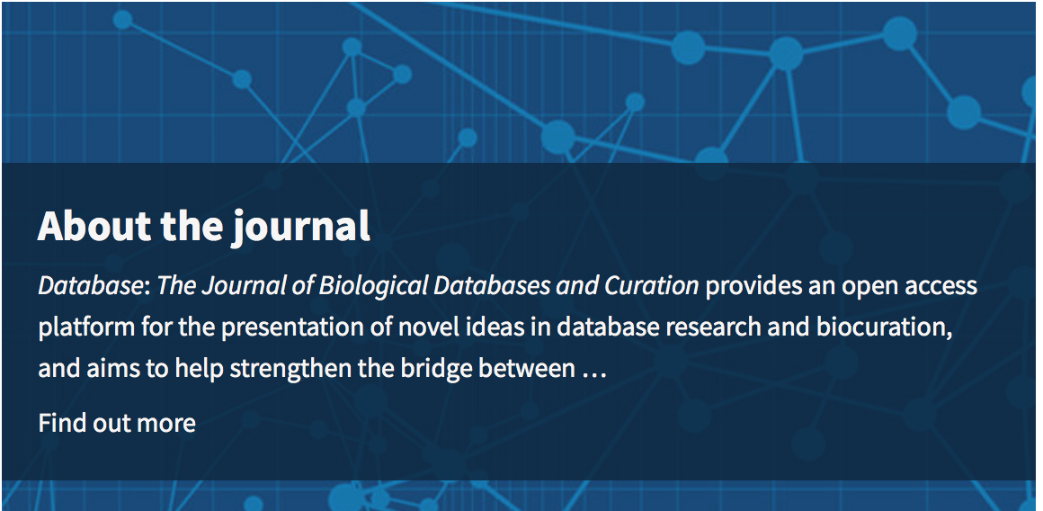
Then….and Now
The DATABASE journal

Slide 19
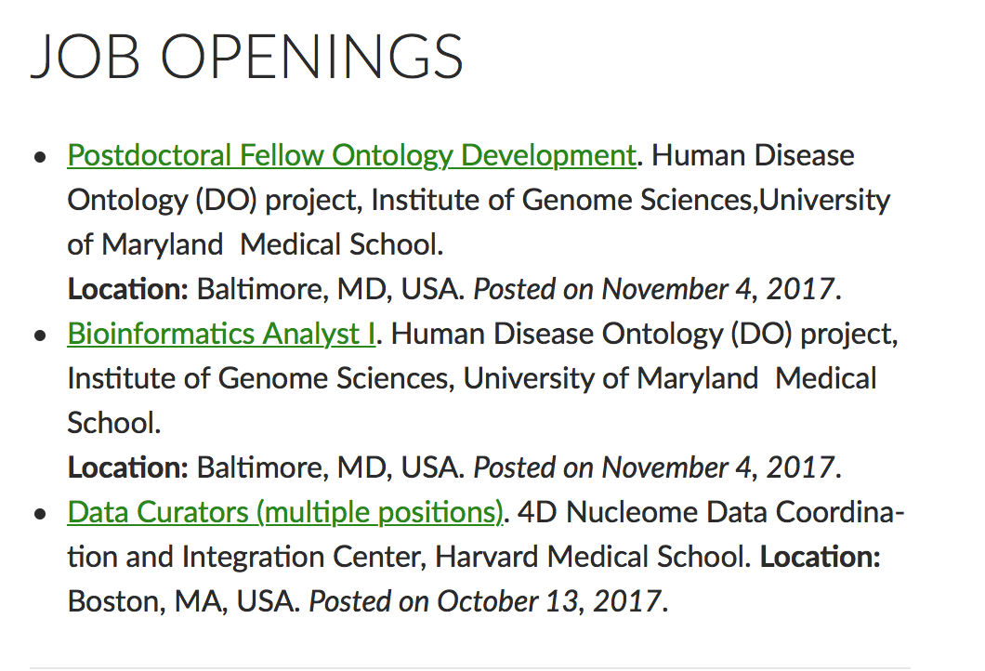
Then….and Now
Bio Curation as a career.

Slide 20
Conclusion
The good:
Excellent paper indicating the need for there pressing issues at the time.
Formed a basis for the functions of a bio curator.
Not so good:
Paper was very abstract.

Slide 21
THANK YOU

