Slide 1
Standard for ARPA Internet text messages
Teague Ashcraft

Slide 2
Background
ARPA
Authorized in 1958
Founded to maintain a technological edge over competing superpowers
Predecessor to DARPA
Notes:
DARPA – Founding was authorized by President Eisenhower in 1958
– Acronym stands for Defense Advanced Research Projects Agency
– Tumultuous first decade, the agency churned through a number of directors until taken over by Jack Ruina, a scientist who managed to stabilize the agency’s funding as well as whose leadership led to the creation of the role of Information Processing Techniques Offices, the ARPA body responsible for the creation of the ARPANET
– Many of ARPA’s ensuing projects would comprise high-risk, high-gain, “out-there” research

Slide 3
ARPANET
Previously, end-to-end communication required dedicated lines
Between 1966 and 1968, significant headway in development of network
Early packet switching network
First network to implement protocol suite TCP/IP
Notes:
For example, funding specifically earmarked for the network increased by $1 million dollars The concept of packet switching was introduced the network
Work to develop the network was contracted out
Packet switching refers to the idea of grouping transmitted data into packets, which are just payloads + headers
Data in the header is used by the network to route the packet to its destination address
For those of us rusty on our Networks knowledge, TCP/IP are quite literally the protocols that form the background of the modern internet
Specifically, TCP/IP specify the rules of data transfer, such as packetization, addressing, transmission, routing, and receiving

Slide 4
ARPANET ~ 1977
Many informal standards for mail
A strong need to codify said informal standards as WELL AS future proof the network for imminent features
Drumroll…RFC #822
Structure and content of TCP/IP messages!!!
Notes:
This specification took the course of a year and involved over 20 individuals across the country
describes the structure and content of TCP/IP e-mail messages

Slide 5
#733 Formal Definition
Structured Fields
Lexical-Analyzers
Meta-Notation
Message Formatting
Notes:
Bottom level describes meta notation (OR the rules about notation) used herein
FOR EXAMPLE a semi-colon some distance to the right indicates a comment
Second level describes the underlying lexical analyzers that break down a message into tokens for interpretation by
higher-level parsers
FOR EXAMPLE an ALPHA (any ASCII alphabetic character) can take a tokenized value between 65 and 90
Third is a specification for messages such that individual, unique fields are permitted
Lastly, the contents of several structured fields are defined
FOR EXAMPLE a date field exists that specifies values for the original send date and the “resent” date

Slide 6
Scope
Data portion of a message
Notes:
In this paper, messages are thought of as an envelope and its contents
Changes are only specified for the format and some semantic rules of the contents
Each message begins with a set of headers that describe the message and its contents. An empty line marks the end of the headers, and then the message body follows.

Slide 7
More on Messages
<header name>: <header value>
Very simple!
Special syntax allows multi-line headers to be “folded” into a single line
To: person1@domain1.org, person2@domain2.com, person3@domain3.net, person4@domain4.edu

Slide 8
Meta Notation
Rule1/Rule2
[RULE]
NRULE
Notes:
From right to left
ALTERNATIVES: Elements separated by a slash are alternates. So, what that means is either value that represents rule1 or rule 2 is accepted
OPTIONAL: Elements enclosed in brackets means the rule is optional
SPECIFIC REPETITION: Elements preceded by a number means there must be exactly n occurrences

Slide 9
Lexical Analysis
Definition: Converting a sequence of chars (messages) into meaningful tokens
Analyze the various fields that comprise the header and body
These tokens are pairs, each with an associated value

Slide 10
Lexical Analyzers
Special character
Trojan.horse@usc.edu
atom
Notes:
The lexical analyzers main role is to provide an interpretation of the text in the body of a field as a sequence of lexical symbols
Taking the address field as an example, the above is analyzed into the above symbols and types

Slide 11
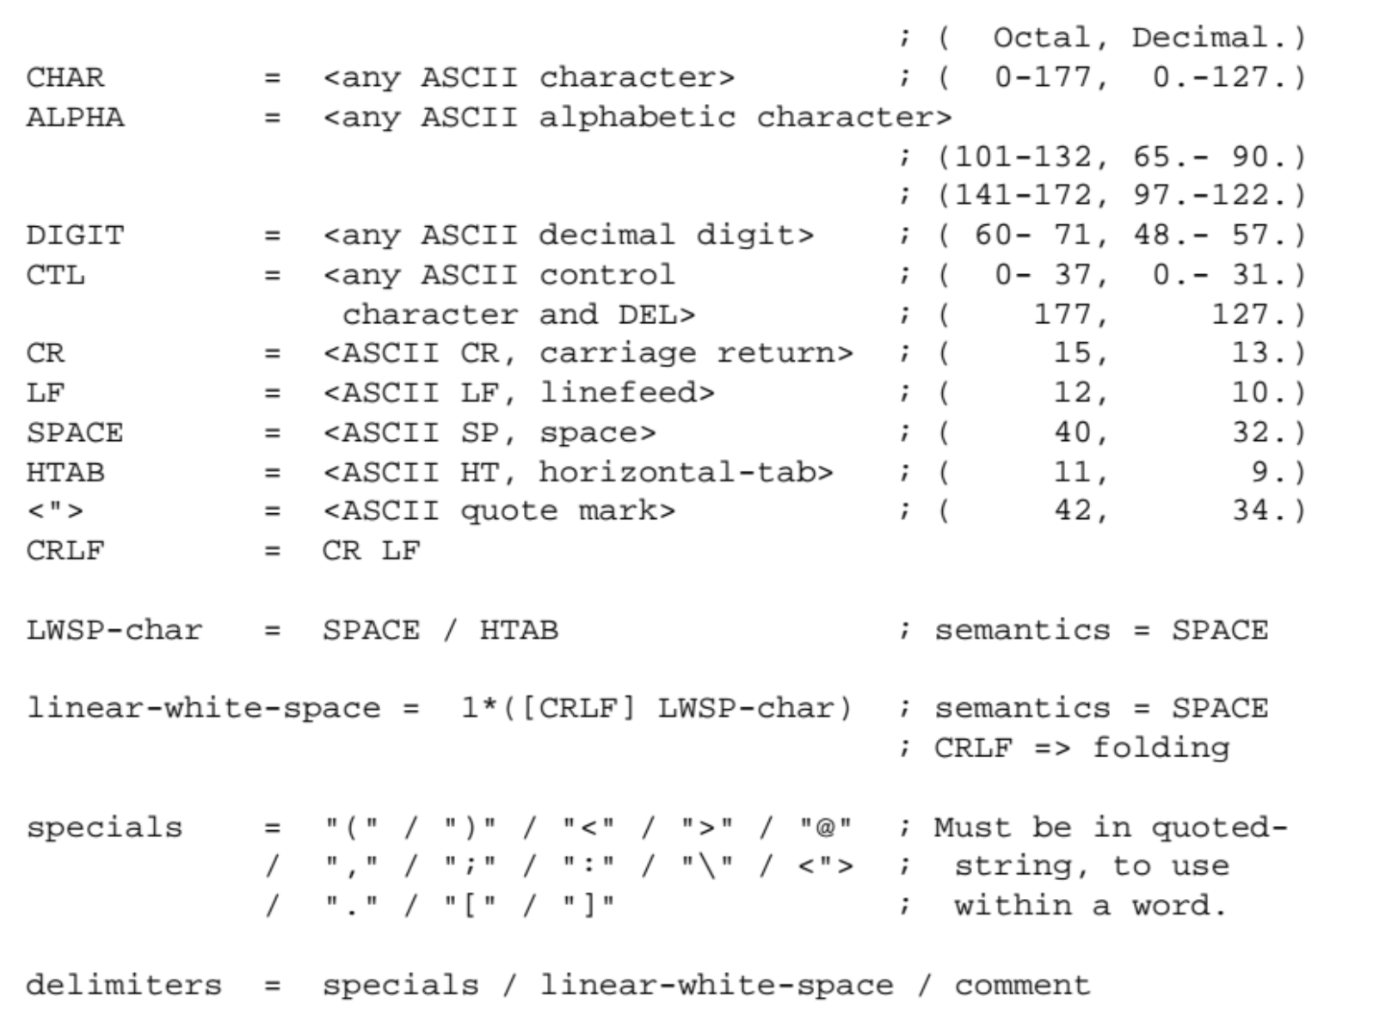
Lexical Tokens
Notes:
These rule are used to define the lexical analyzer

Slide 12
Network-Specific Transformations
From Network A
Conformance with Standard
To Network B
Remove Network-A idiosyncrasies
Impose Network-B idiosyncrasies
Notes:
Heterogeneous networks can force data to conform to its local conventions.
When crossing network boundaries two modules must be observed. The first is such that any network-specific transformations necessary for migration are adopted. The second is such that any network-specific transformations are removed

Slide 13
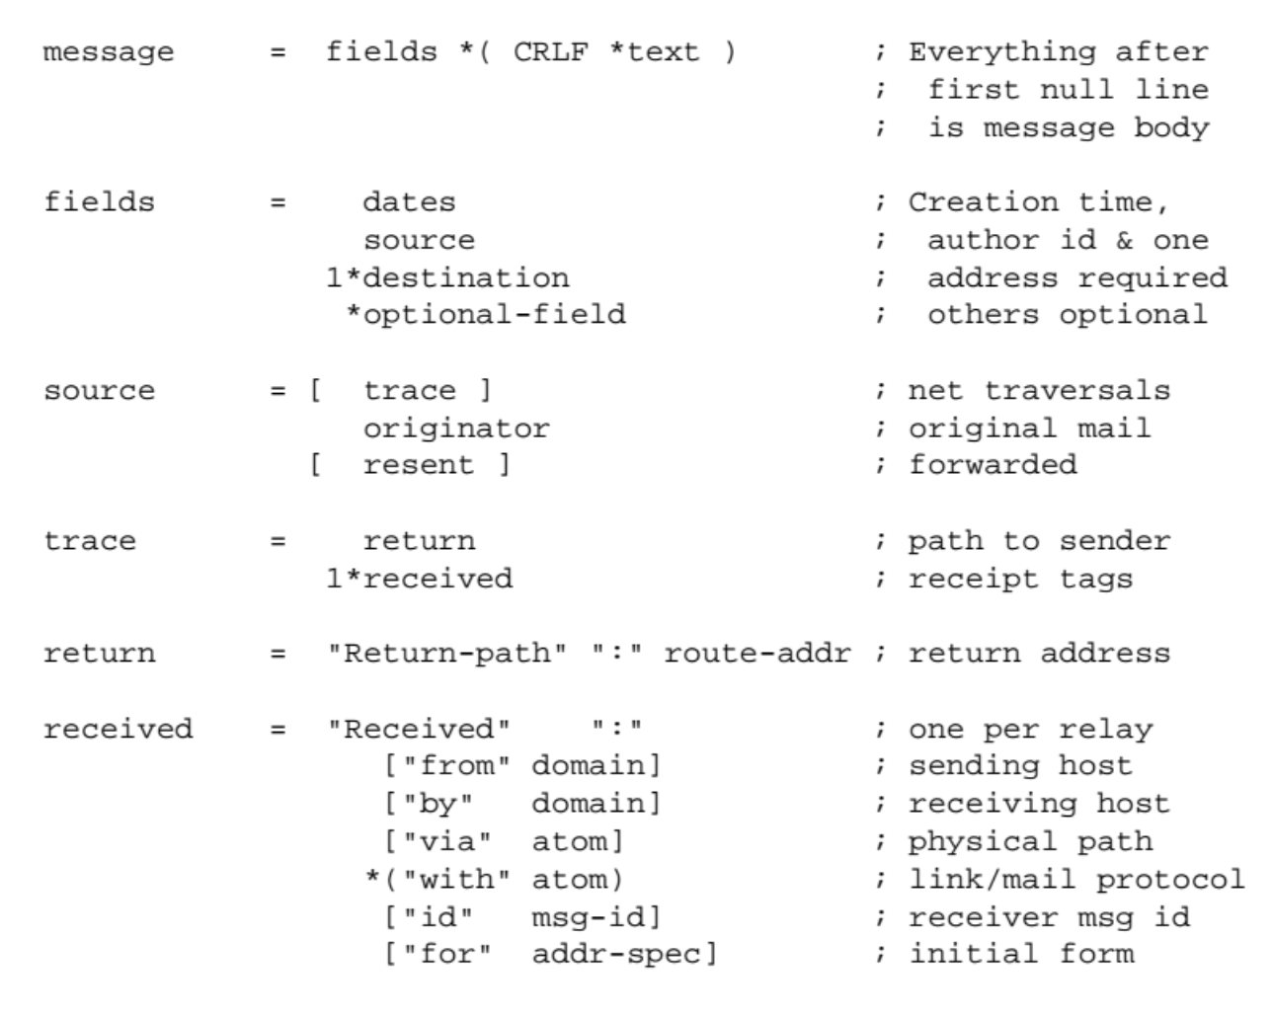
Message Formatting
Notes:
The above is an example of correct syntax for a few of the bodies of various fields, each is considered a single, long string

Slide 14
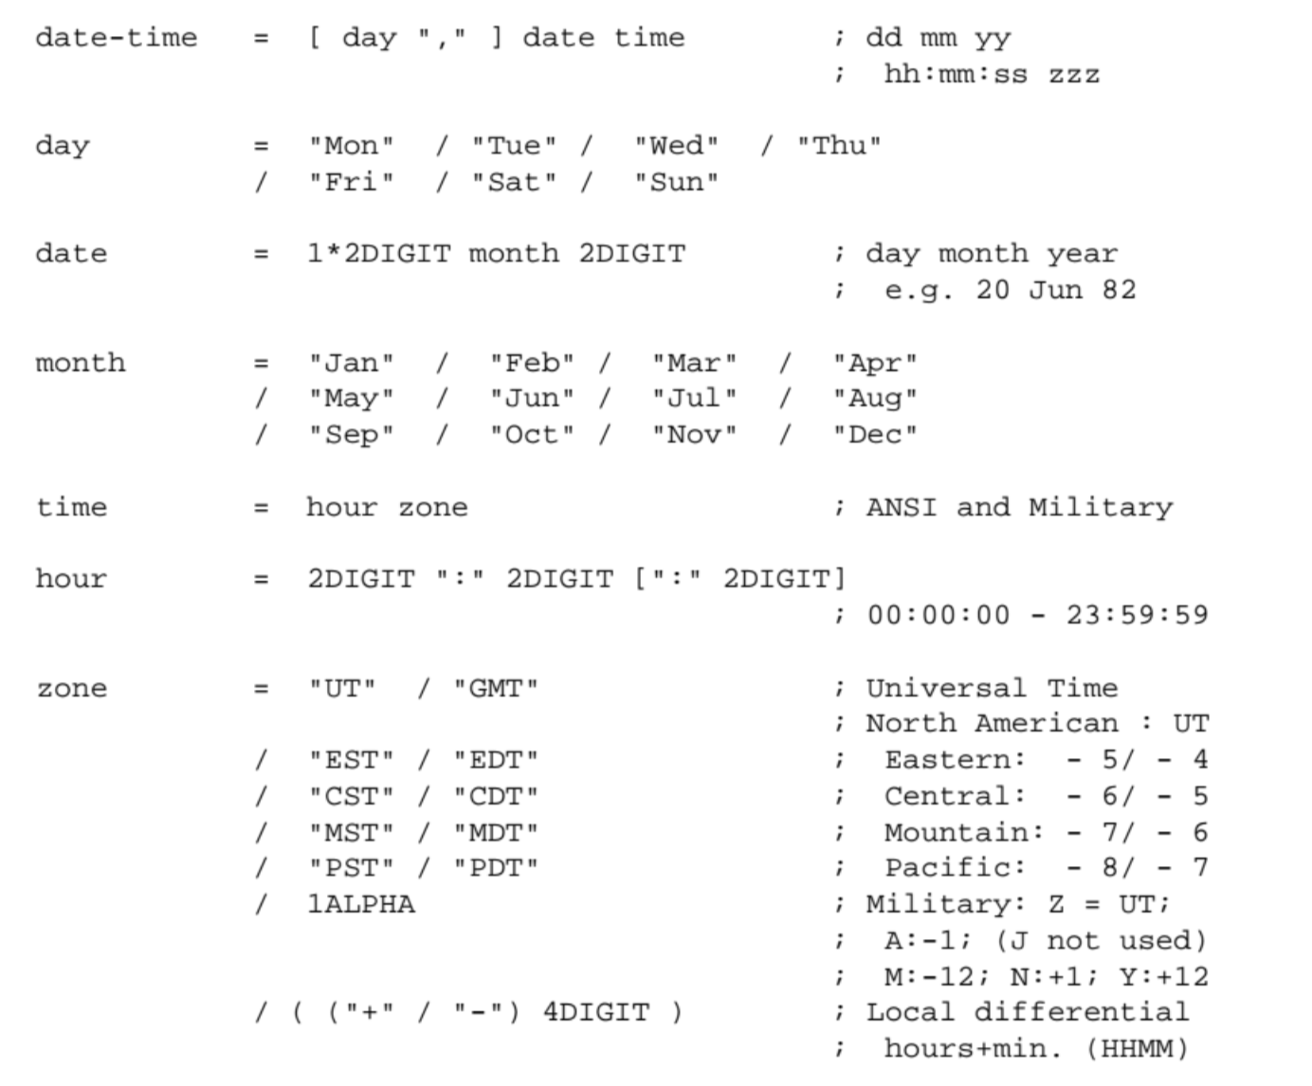
Structured Fields

Slide 15
Relevance
Pros
Great for intra-org communication
Great for well-structured inter-org communication
Cons
Document Tone
Document Apperance
Notes:
As we’ve learned from TIKA, the issue of file plurality is quite a big one. These standards were hoping to reduce the plurality of formats for messaging across networks
Its use of simple ASCII text makes it easy to create, process and read e-mail messages, which has contributed to the success of e-mail as a worldwide communication method.
Reliance on ASCII means other media types cannot be represented, THEREFORE, document appearance is restricted

Slide 16
Contributors
David Crocker
Ken Harenstein
20 unnamed individuals

