Slide 1
MIME – Media Types
Multipurpose Internet Mail Extension – Media Types
Vikas Hanumegowda
https://tools.ietf.org/html/rfc2046
Notes:
Slides can vary as per your presentation, but header and footer should be consistent

Slide 2
Abstract
Predecessor to RFC 2046 was RFC 822 which specified only US-ASCII content in headers and message body.
MIME defined to allow for:
non-US-ASCII message content
Non-textual message bodies
Multi-part message bodies
Non-US-ASCII header text information

Slide 3
Contents
Introduction
Top-Level Media Types
Discrete Media Types and their sub-types
Composite Media Types and their sub-types
Experimental Media Type Values
Security Considerations
Summary

Slide 4
Abstract (Contd.)
MIME is a set of Request For Comments (RFCs):
RFC 2045 – specifies various headers used to describe MIME messages
RFC 2046 – describes about the Media Types and the corresponding subtypes
RFC 2047 – describes extensions to RFC 822 to allow non-US-ASCII text in email header fields
RFC 2048 – specifies process of new registrations for MIME-related facilities
RFC 2049 – MIME conformance; Illustrative examples; Acknowledgements and Bibliography
All these documents are revisions of previous RFCs.

Slide 5
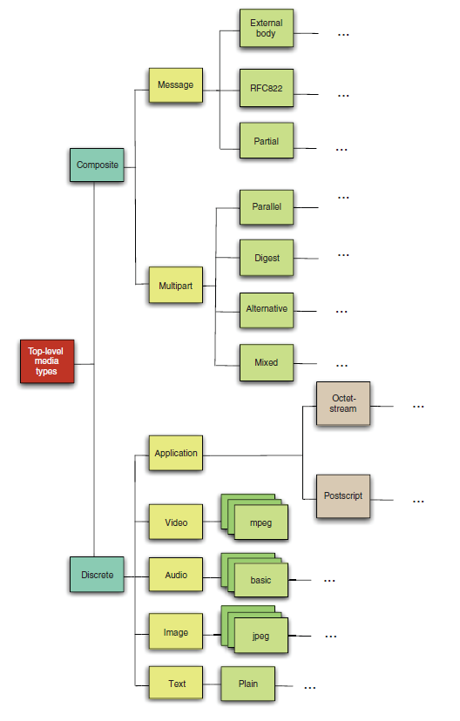
Introduction
Content-Type field in the header.
Media Type – Subtype
Parameters – modifiers of subtype
Registration for any other specific detail requires a process involving IANA which is given in RFC 2048.

Slide 6
Top-level Media Types
Name
Parameters
How user agents should handle subtypes
Restriction on content-transfer-encodings
Top-level Media Types – [subtypes]:
Discreet Media Types
text – plain, enriched
image – jpeg
audio – basic
video – mpeg
application – octet-stream
Composite Media Types
Multipart – mixed, alternative, parallel, digest
Message – rfc822, partial, external-body

Slide 7
Discrete Media Type Values
Text Media Type
Parameters: charset
Assumed to be US-ASCII if not specified
Subtype: text/plain
Line break delineation
Stacking of several characters at the same position
Facilitate for different writing directions.
Rich text
Mostly readable
Distinction from unreadable data like images, audio, etc.
Unrecognized subtypes are assumed to be “application/octet-stream”

Slide 8
Discrete Media Type Values
2. Image Media Type
Initial Subtype: jpeg
3. Audio Media Type
Initial Subtype: basic
Video Media Type
Initial Subtype: mpeg
More subtypes exist and even more are expected to be added via IANA registrations.

Slide 9
Discrete Media Type Values (Contd.)
Application Media Type
Expected usage:
File transfer
Spreadsheets
Mail-based Scheduling
Subtypes : octet-stream and PostScript
Subtype PostScript has many security problems and usage of interpreters is less encouraged than sending media to printers for last resort purposes.
Unrecognized subtypes again are taken to be “application/octet-stream”.

Slide 10
Composite Media Type Values
Handled by a MIME processor
Multipart Media Type: Body contains one or more parts
Boundary delimiter line – closing boundary delimiter line
Default content-type header value “text/plain; charset=US-ASCII”.
Other content types: “message/rfc822”, “image/jpeg”
Boundary delimiters and header fields are always represented as 7bit US-ASCII.
Body parts are encoded part-by-part

Slide 11
Multipart Media Type
Boundary Delimiter Line (BDL)
Specified using “boundary” parameter is a required parameter.
BDL: - - <“boundary” parameter value> CRLF CRLF Example:
Content-Type: multipart/mixed; boundary=gc0p4Jq0M2Yt08j34c0p
Content-Type: multipart/mixed; boundary=gc0pJq0M:08jU534c0p
Content-Type: multipart/mixed; boundary="gc0pJq0M:08jU534c0p"
Closing boundary delimiter line –
BDL: - - <“boundary” parameter value> - - CRLF CRLF

Slide 12
Multipart Media Type (Contd.)
Nested Messages and Multiparts
Outer and inner boundary markers to be handled
Subtypes: Mixed, Alternative, Digest, Parallel
Unrecognized subtypes at least treated as “multipart/mixed”

Slide 13
Message Media Type
Message within another message.
Subtypes:
RFC822 subtype – parameters: Indicates encapsulated message
Partial subtype – fragmentation and reassembly
Fragments have ID and the number of fragments to ensure successful transmission
External-Body Subtype – data only referenced in the message body

Slide 14
Experimental Media Type Values
Media type value begins with “X-”
Used between parties with mutual agreement
Older versions had “X-BE2” instead of “X-”
Use of these are discouraged and implementers should invent a subtype of an existing Media Type, say, Application.

Slide 15
Security Considerations
Media types such as “application/postscript” and “message/external-body” where actions can be performed remotely and inconspicuously should be taken into consideration in Metadata before the user agents come into an agreement.

Slide 16
Summary
The hierarchical structuring of media types and subtypes; and further specification within subtypes using parameters helps transmission and detection of data by consenting user agents.
The study of the media types helps us understand what’s being exchanged so that the study and detection becomes easier.
Backtracking of malicious contents including acts of terror; general studies, etc. are more organized.
This RFC is a perfect predecessor for the course Content Detection and Analysis for Big Data.

Slide 17
THANK YOU

