Slide 1
Automatically Organizing Digital Photographs Using Time and Content
M. Cooper, J. Foote, A. Girgensohn
Hamsa Shwetha Venkataram
CSCI 599 : Content Detection and Analysis for Big Data
Notes:
Slides can vary as per your presentation, but header and footer should be consistent

Slide 2
What to expect in next 20 minutes ?
The Problem
Motivation
Related Work
The Solution
Results and Conclusions
The Analysis
Notes:
Start with QA : You took a vacation , and
When did you last organize your photos into physical albums (print) ? 5 years ago , 10 years ago or probably 20 ? (Unless we have a DSLR)
When did you buy your first digital camera/camcorder ?

Slide 3
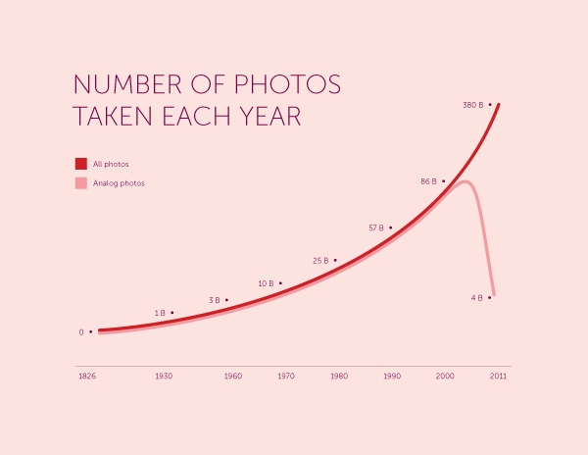
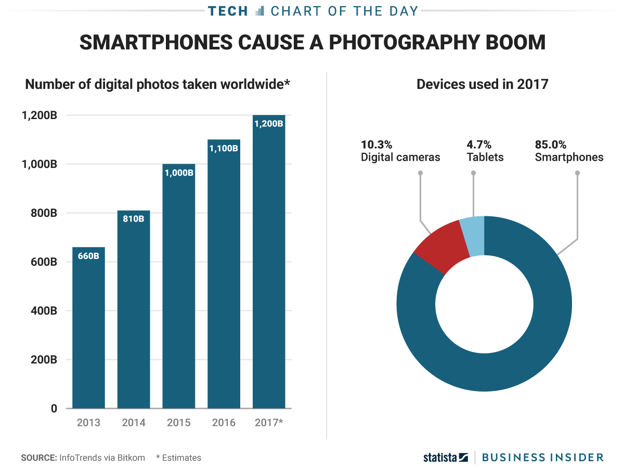
The Problem
Notes:
Trends of how digital photographs increased, and analog pictures plummeted
There was a paradigm shift in how pictures were taken, though not overnight, it was a major change
How it is not decreasing !

Slide 4
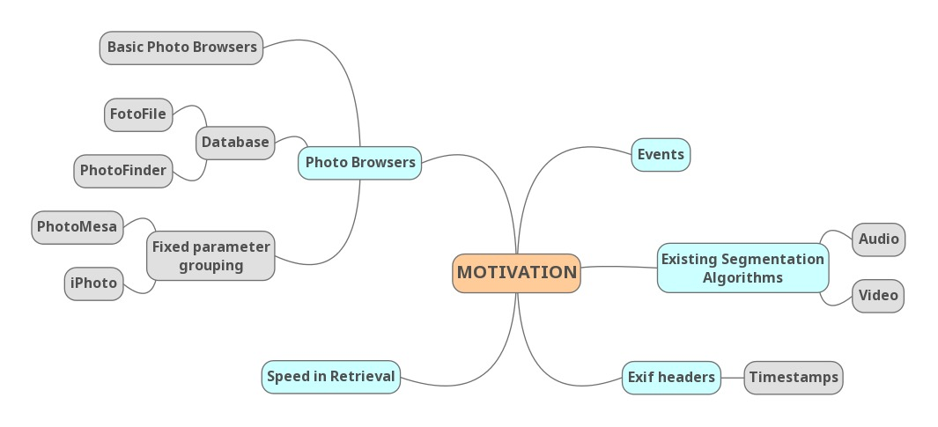
Motivation
Notes:
Photo Browsers
2. Speed in retrieval -
For example, for one task category, one of our browsers enabled a 33% improvement in speed of finding given images compared to the commercial browser. Similarly, users were able to complete 29% more tasks when using this same browser.
3. Audio Segmentation

Slide 5
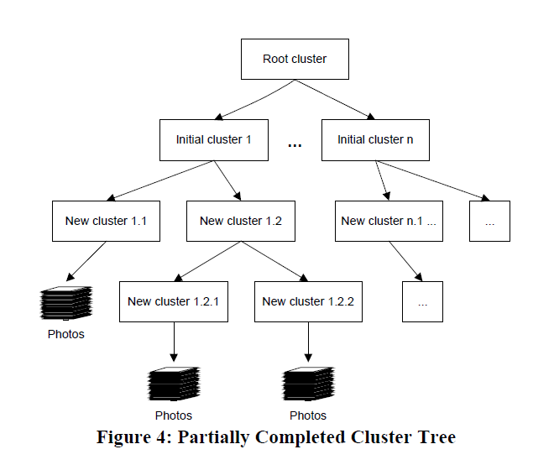
Related Work Adaptive Thresholds
Time Cluster Engine [2]
Time-Gap Detection [5]
Detect noticeable gaps in creation time
Compute local average of temporally nearby gaps
If Gap > Local Gap Average
then
Mark change of event
Notes:
Time Cluster Engine
Dividing collection of photos into number of clusters
While creating initial clusters, a constant time difference is considered – anywhere between 1 hour to 24 hours – this is coarse
These clusters are further split into new clusters by checking the intra-cluster arrival rates
As we further split, we may find pairs of pictures which are outside the normal range – then they are moved to new clusters
Time Gap Detection –
Like our intra cluster rates for splitting into clusters, here we consider gaps between the pairs – and decide when a new cluster is going to begin
When temporally close pictures are found , compute a local average
Any gap that is greater than currently split group , will mark that it’s a different event – and hence a different cluster
These gaps are dynamic, and adaptive – they take shape as we go on grouping nearby pictures

Slide 6
Related Work Segmentation Approaches
Event Segmentation Algorithm [6]
Observations
Popular method is to sort by time and organize by events
Parameters used
Creation date-time
Date/Time Clustering Algorithm
Color content ( understanding of the images)
Block-based histogram correlation
Scale-space Media Segmentation [7]
Scale-space techniques to find large jumps in the video
Create hierarchical segmentation of video (i.e., table of contents)
Notes:
The paper makes an interesting observation that – the popular method employed by users – is to sort by time and organize by events
So they use this idea to build two algorithms – one of which forms a basis for the current paper
Date/Time clustering algorithm – uses K Means algorithm – FILL HERE
By understanding the color content , we can detect change in events
One notable exception is Titanic – first half is warm and bright, second half is dark and blue tone
Scale Space media segmentation
The paper talks about video segmentation and detect change in scene
But the major takeaway is Scale Space technique – importance of scale in any physical observations – time can seconds to tens of minutes
Fine to coarser scales

Slide 7
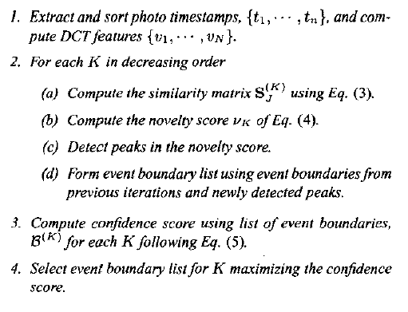
The Solution Algorithm – Hierarchical Photo Clustering
Pre-processing
Distance matrix embedding
Photo Clustering
Selecting a “best” scale
Notes:
Our approach is multi –resolution or multi scale approach
We build number of event boundaries, and determine the best scale to display to the user

Slide 8



The Solution Algorithm – Hierarchical Photo Clustering
Pre-processing for :
Temporal
Exif headers are processed
If creation time not available, rely upon modification time
Photos in collection are ordered in time
b. Content Analysis
Each photo transformed to Ohta Colorspace
Compute DCT of each channel, and concatenate DCT co-efficients to form time-ordered feature vectors
Distance Matrix Embedding
Temporal similarity matrix
Image similarity matrix
Joint temporal event matrix
Notes:
Observations
As K decreases
Content similarity is more prominent
Finer dissimilarities between groups of timestamps are apparent
DCT – helps to separate the image into parts of differing importance ( w.r.t image’s visual quality )

Slide 9
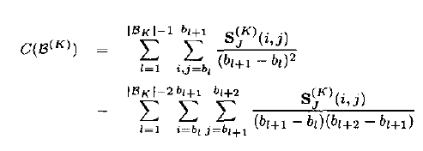

The Solution Algorithm – Hierarchical Photo Clustering
Photo Clustering
Requires detection of event boundaries
Compute Novelty Score for different K values
Ground-truth novelty scores are superimposed on computed novelty scores
Selecting a “best” scale
Computation results in lists of event boundaries for different scales
Determine goodness of scales using Confidence Measure
Notes:
Average within-class similarity - first term
Average between-class similarity – second term

Slide 10
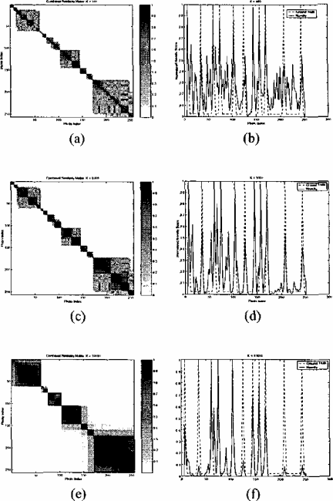
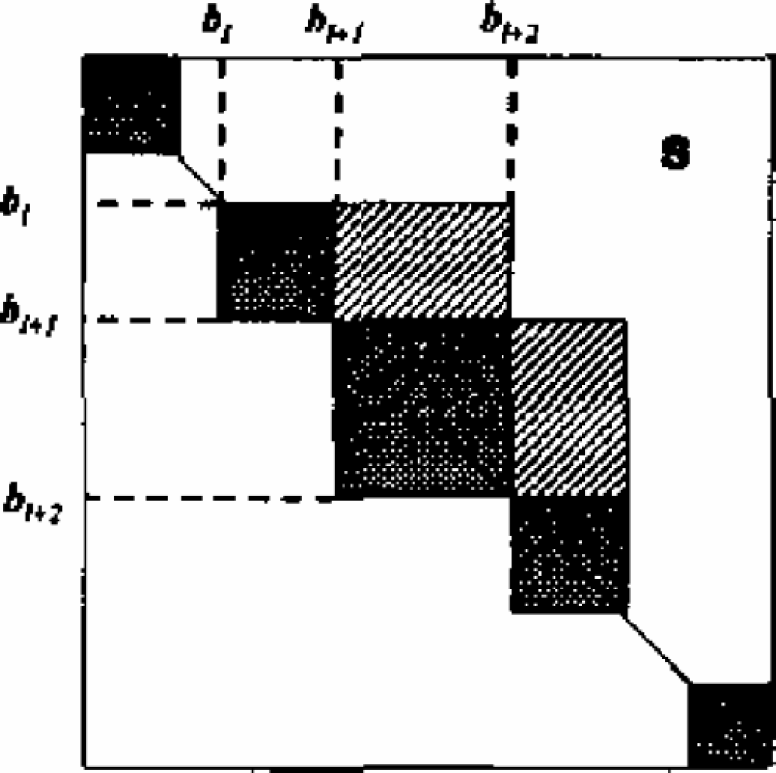
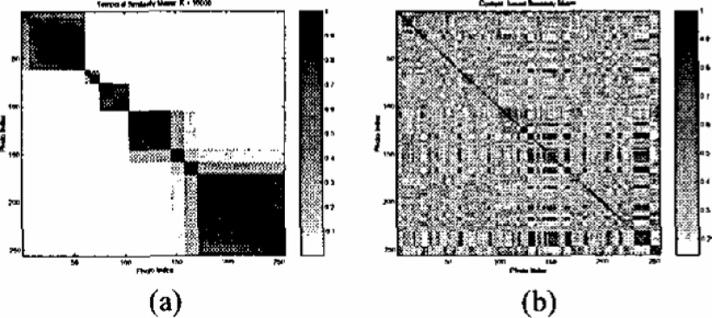
The Solution Algorithm – Hierarchical Photo Clustering

Slide 11
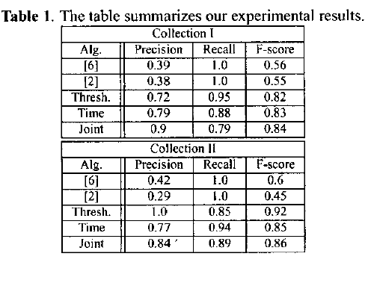
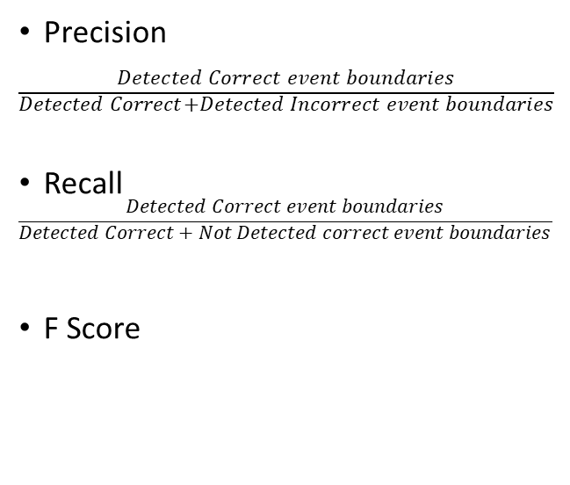
Results and Conclusions
Precision
$\frac{Detected Correct event boundaries}{\begin{aligned}Detected Correct+Detected Incorrect event boundaries \\ \end{aligned}}$
Recall
$$\frac{Detected Correct event boundaries}{\begin{aligned}Detected Correct+Not Detected correct event boundaries \\ \end{aligned}}$$
F Score
Notes:
Dataset : 5 Algorithms – on two collections of data
Data I – 1036 photos taken over 15 months
Data II – 413 photos taken over 13 months
Mistake in the paper – they compare algorithms in [2,5] with simple thresholding and joint, temporal – in diagram it is mentioned as [6]
minimal irrelevance (high precision) while ensuring that relevant information is not overlooked (high recall)

Slide 12


Slide 13
The Analysis
Pros
References and related work helped build a basis for what to expect from this paper
Flow of ideas is smooth, and easily comprehensible
Cons
The algorithmic details section has too much of jargon (had to back and forth for almost every sentence)
Paper did not offer radically new observations and insights, when compared to other references

Slide 14
Information Retrieved from ..
http://www.businessinsider.com/12-trillion-photos-to-be-taken-in-2017-thanks-to-smartphones-chart-2017-8
https://petapixel.com/2011/09/16/film-photography-peaked-in-2000-with-85-billion-photos-taken-then-plummeted/
http://cdn.collider.com/wp-content/uploads/2016/12/end-is-near-simpsons.png
https://pdfs.semanticscholar.org/ba99/ccd78ad265b197162183d62a821789309c6a.pdf
http://www.schnarff.com/file-formats/exif/Exif2-1.PDF
https://link.springer.com/content/pdf/10.1007/978-1-84628-799-2_3.pdf
Paper References -
[1] Digital Still Camera Image File Format Standard
[2] Time as the essence for Photo Browsing Through Personal Digital Libraries
[3] Automatic Audio Segmentation using a Measure of Audio Novelty
[4] Scene Boundary Detection Via Video Self-Similarity Analysis
[5] Photo-TOC: Automatic Clustering for Browsing Personal Photographs
[6] Automatic Image Event Segmentation and Quality Screening for Albuming Applications
[7] Multimedia Edges: Finding Hierarchy in all Dimensions
[8] Color Information for Region Segmentation

Slide 15
THANK YOU !

