Slide 1
Content based file type detection algorithms.
Kavya Vishwanath B
Byte frequency analysis (BFA)
Byte frequency cross-correlation
File header/trailer (FHT)
Authors
M.H. Heydari
M. McDaniel
http://ieeexplore.ieee.org/document/1174905/
Notes:
Slides can vary as per your presentation, but header and footer should be consistent

Slide 2
Why do we need to find File-type?
Forensic analyses of computer hard drives.
Virus protection software
Intrusion detection systems
Firewalls and web browsers

Slide 3
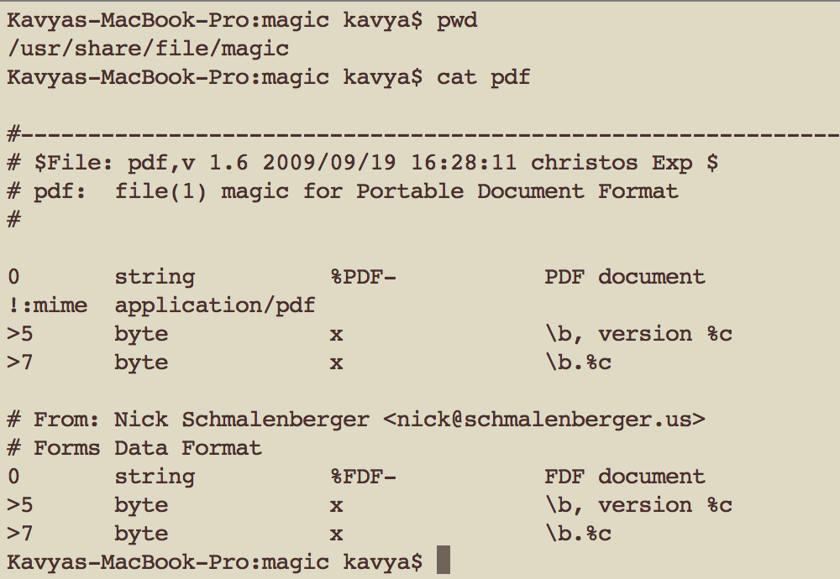
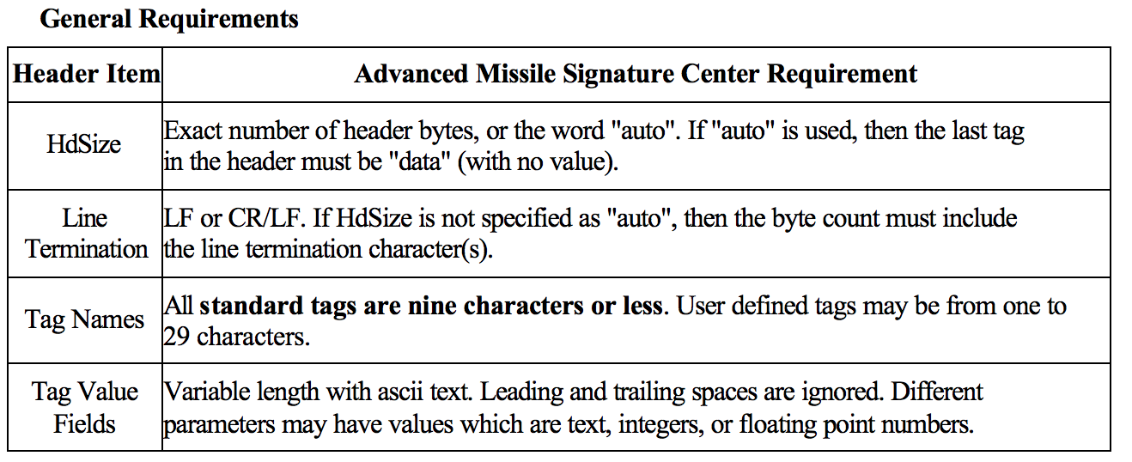
Methods for file type detection
Type | Example | Problems
File extensions based (Content Independent) | readme.txt, image.jpg, content.pdf | Unreliable
Magic Numbers (Content Dependent) | /etc/magic in UNIX /usr/share/file/magic/ in OS-X | Time consuming while defining rules Once defined rule cannot be changed Can be spoofed
Standard File Formats (SAF) (Content Dependent) | Advanced Missile Signature Center | Limited usage Cannot be transferred over internet

Slide 4

Design Goals :
Accuracy
Automatic generation of Fingerprint
Small Fingerprint
Speed
Flexible (trade off between accuracy and speed)
Independent from file size

Slide 5

Byte frequency analysis (BFA)
Input File
Find Byte Frequency
Normalize by the maximum frequency
Add to fingerprint by taking average
1x256 matrix
Normalized matrix
Stream of Bytes
A | D | T | S
A | D | T | S
D | A | T | A | S
1 | 0.5 | 0.5 | 0.5
2 | 1 | 1 | 1
Normalization is required to prevent very large file from skewing the file type fingerprint.
NFPS – New fingerprint score
OFPS – Old fingerprint score
NFS – Number of files

Slide 6
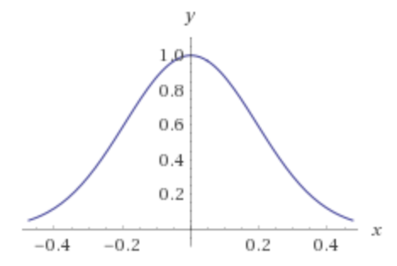
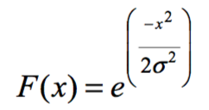
Byte frequency analysis (BFA) Contd
Correlation Strength (used to check input file)
If a byte value always occurs with a regular frequency for a given file type, then this is an important feature of the file type. Example : ASCII chars in txt file
Correlation Strength is dependent on difference in frequency score between input file and fingerprint, if it is less Correlation strength increases toward 1 else it falls towards 0. This is given by :
x is the difference in frequency between input file and fingerprint,
experiments show σ = 0.0375 is the optimal σ value

Slide 7
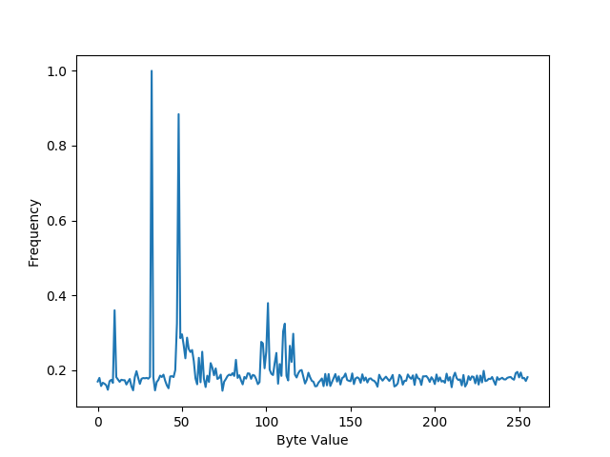
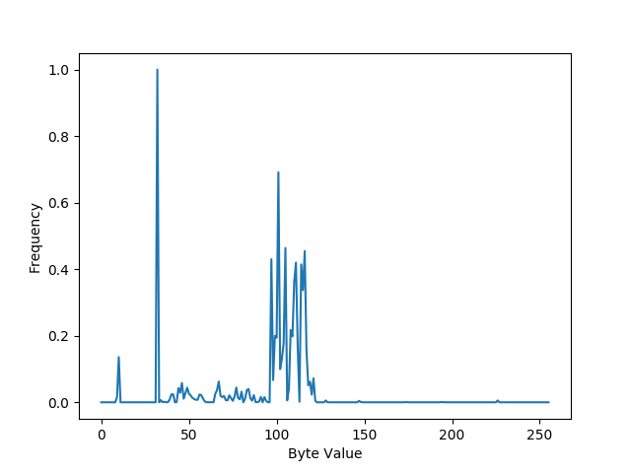
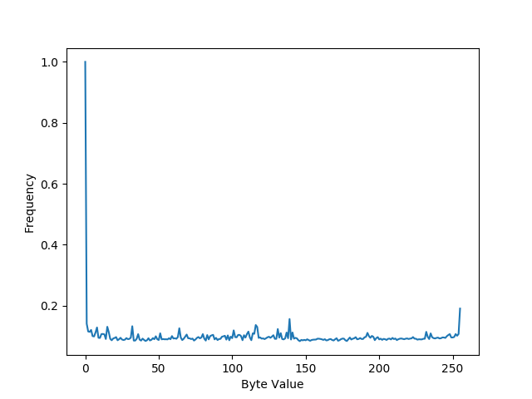
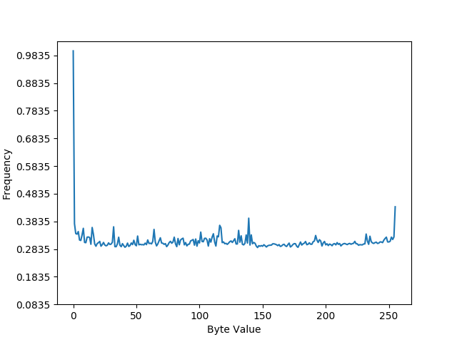
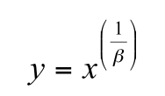
Findings
txt file
pdf file
exe file
exe file after companding
Companding Function used : with β = 1.5

Slide 8
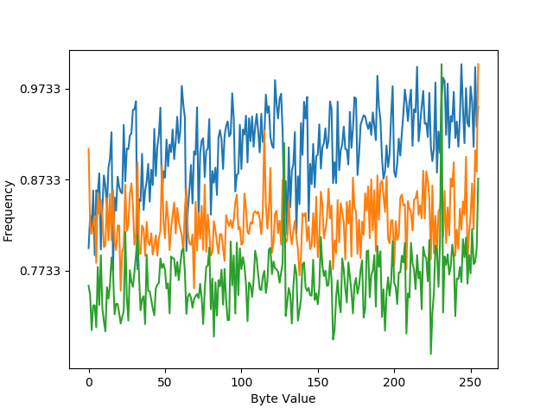
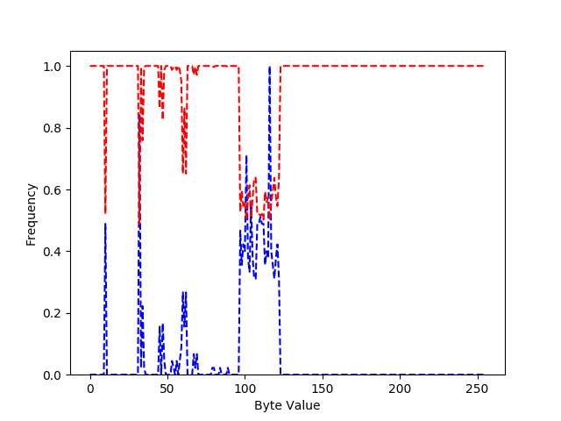
Pros and Cons of BFA
BFA for zip files
BFA for html file
-- correlation strength
-- Frequency difference
Pros :
Accuracy is only 27.50%. Better than pure guess!
Unknown file takes on average of 0.010 seconds to compare to 25 fingerprints and identify the closest match
Cons :
Files like zip, tar have irregular frequency patterns
Correlation between bytes not captured
Corresponds to ‘<‘ and ‘>’

Slide 9
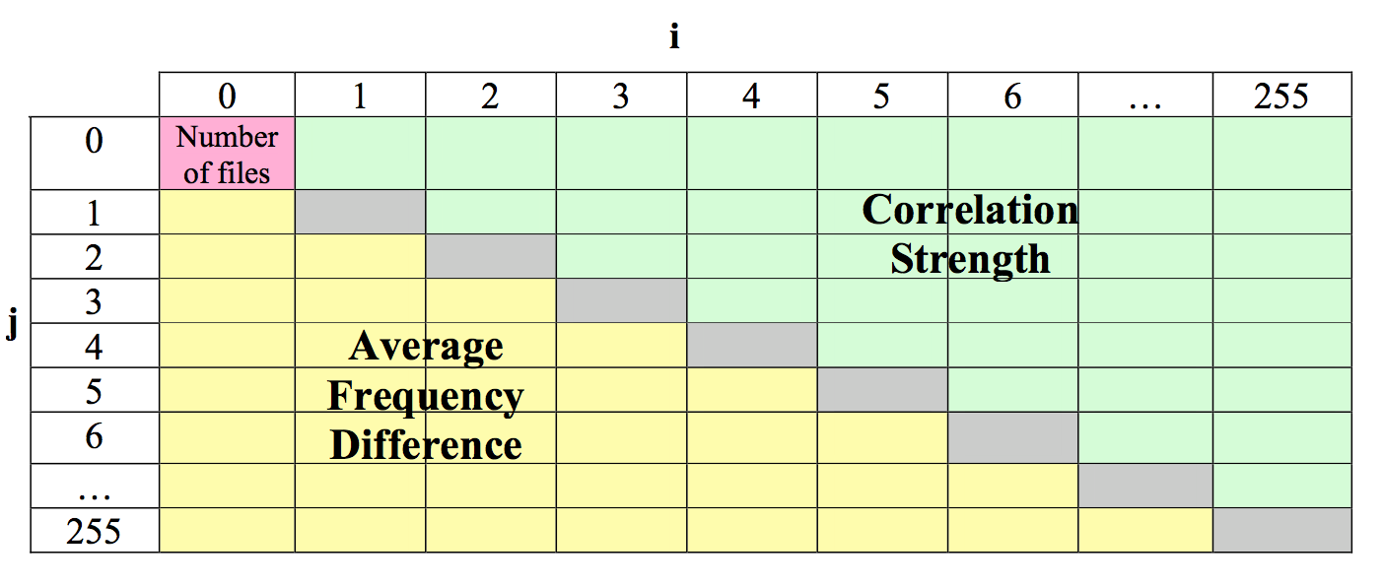
Byte frequency cross-correlation
1. Known input File
4. Update Fingerprint by taking average frequency difference and correlation strength
3. For each byte pair find frequency difference and correlation strength(similar to BFA function) 256x256 array
2. Calculate Byte Frequency and normalize using max value - similar to BFA

Slide 10
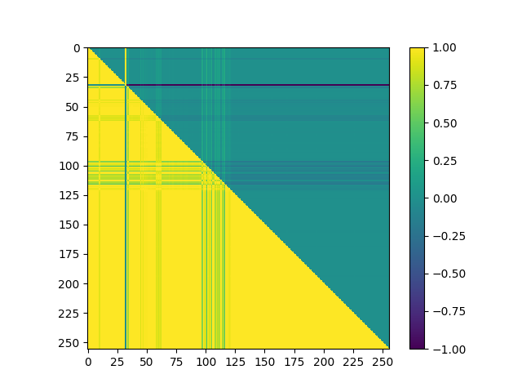
Byte frequency cross-correlation Contd
Strong correlation at (60,62) which corresponds to ‘<‘ and ‘>’
Bytes in range 125-250 have frequency difference of 0, which implies these bytes never occurred in the files
Byte Frequency cross correlation for HTML file

Slide 11
Pros and Cons of BFC
Pros
Accuracy is 45.83%better than BFA
Cons
An Unknown file takes 1.19 seconds to compare to 25 fingerprints and find closest match
Not accurate enough for practical purpose
Slowest compared to other 2 algorithms

Slide 12
File header/trailer (FHT)
Input file Byte Stream
Known Input file
Get Header and Trailer Matrix
header[H][256], trailer[T][256]
calculate fingerprint
Update fingerprint by taking average of correlations strength like in BFA and BFC
header[i][j] set to 1 if at position i byte j is found similarly for trailer

Slide 13

File header/trailer (FHT) Contd
To find if the input file belongs to given fingerprint, Header and Trailer scores are used which is given by the following equation where C is the correlation strength for the byte value extracted from the input file for the position and G is the highest correlation strength from the fingerprint for the same position. Input file is classified based on the max of header and trailer scores.

Slide 14
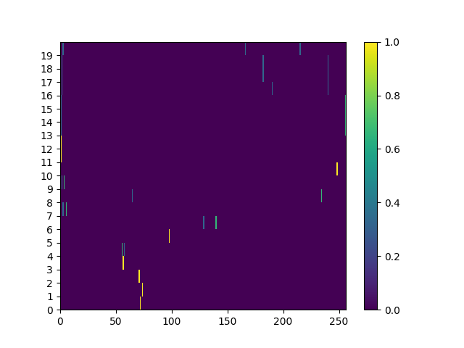
FHT experiments
Strong correlation at positions 0,1,2,3 which corresponds to byte values of ASCII characters G,I,F,8
If an unknown file has different bytes in these positions, it is a very strong indicator that it is not a GIF file
If the unknown file has a differing byte value at position 14, which shows a very low correlation strength, this offers no real information about whether the unknown file is a GIF file
FHT run on GIF file

Slide 15
Pros
File header/trailer (FHT) Contd
Accuracy is 95.83% (for combined OLE Doc fingerprint)
Faster compared to BFC but slower than BFA by 0.005 seconds
Identifies exe files with 100% accuracy
Experiments proved header size of 5 would be a good measure to classify exe files, this would generate a fingerprint of only 53 Bytes.
Cons
Not all files have characteristic headers and trailers
Finding the right header and trailer length

Slide 16
Future Work
Hybrid approach using combination of all 3 algorithms to classify files
Improvements in computing score for BFA and BFC
Sophisticated curve matching algorithms to be tested

Slide 17
Current methods
PCA and Neural networks with Multi Layer Perceptron, accuracy of 98.3% on 6 file types - 2008
Statistical learning using n-grams trained on SVMs, KNNs and COTS methods. Average accuracy even on damaged files was >90% for SVMs. - 2011
Tika - Mime Magic Detection(Freedesktop MIME-info), Container Aware Detection (.ppt, .doc)

Slide 18
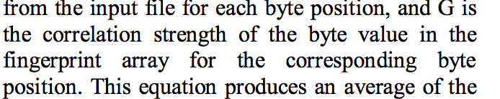
Pros and Cons of Paper
Pros
Approaches in this paper are basis for many statistical models developed
The experimental set ups were very clear
Cons
Few references were incorrect
Matrix representation was ambiguous for BFC
Few points were not consistent with the actual thesis

Slide 19
Many OS today hide file extensions for security reasons
Type codes were used in classic MacOS
in a manner similar to file extensions
File command internally uses magic numbers to identify file types
Questions? THANK YOU
In the original FAT filesystem, file names were limited to an 8-character identifier and a 3-character extension, known as an 8.3 filename
There are 51,537 registered file types

