Slide 1
FILE TYPE DETECTION
A New Approach to Content-based File Type Detection
Mehdi Chehel Amirani
Mohsen Toorani
Ali A. Beheshti
- Koustav Mukherjee
Notes:
Slides can vary as per your presentation, but header and footer should be consistent

Slide 2
Why do we care to detect file types ?
Proper functioning of Operating Systems
Prevent vulnerability in security and intrusion detection systems
File Forensics
Scientific Data Processing
Used in applications and systems like:
Anti Virus
File type classifiers

Slide 3
Methods of Detecting File Types
Extension Based
Fastest and easiest way to classify files
However, can be easily spoofed by a simple file renaming
Magic Bytes Based
Predefined signatures in header or trailer of binary files
Not an enforced or regulated aspect of the file types
Can be spoofed by altering, defeats the true purpose of file type detection

Slide 4
File Types cont. (Related Work + Background)
Content Based (Statistical Modeling)
Byte Frequency Analysis (27.5 %)
BFD: Count the frequency of each byte in the File (1 File represented using 256 features)
Each file BFD is averaged across many samples of same type – File-print / Fingerprint
Based on correlation strength between a file and its BFD
Byte Frequency Cross Correlation (45.83 %)
Average difference of frequency between byte pairs
Cross-correlation array captures the information and can be compared to new files
File Header Trailer (95.85%)
Patterns of bytes that appear at fixed location at beginning and end of file
Create H and T Matrices and use it for classification

Slide 5
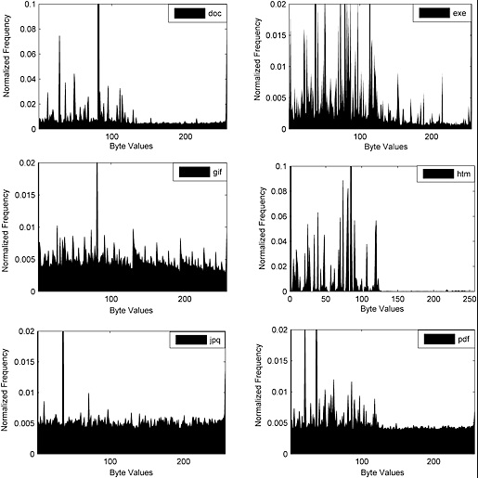
Why Normalize Frequency ?

Slide 6
PCA + Neural Networks => File Type Detection
Computing BFD and Normalizing
Feature Extraction and Selection
Principle Component Analysis
Unsupervised Auto-associative Neural Networks
Classification of File Types
Supervised 3 layered MLP for File Type classification
Accuracy: 98.33% (Reason, we should care)

Slide 7
Feature Selection & Extraction
If we consider each file is a data point, after BFD we would require 256 dimensions or features for representing it. Compare it to a point in cartesian coordinates - Just requires 2 features / dimensions (x, y)
Feature extraction – Linear / Non-Linear combination of original features to create a smaller set of features
Feature selection – Chooses a subset of original features
Reduce number of effective features to represent the data set, while retaining most of intrinsic information content of the data

Slide 8
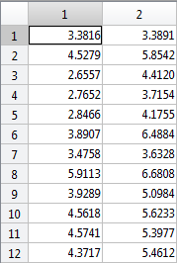
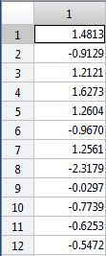

Principle Component Analysis
Performs orthogonal transformation of coordinate
PCA transforms $X=\left\{ x_{n}∈R^{d} \right| n=1…N \}$ to $Z=\left\{ z_{n}∈R^{k} \right| n=1…N \}$, where $k<d$
Image on right reduces a 2D data to 1D data, similarly post BFD this algorithm reduces a 256D feature space to a 60D feature space using PCA

Slide 9
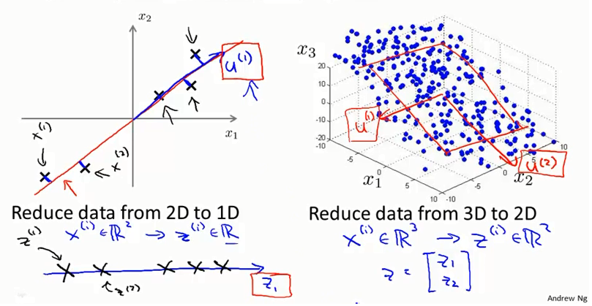
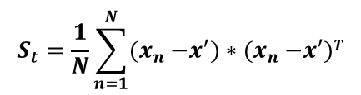

$$S_{t}=\frac{1}{N}\sum_{n=1}^{N}{{(x}_{n} −x^{′})∗{(x}_{n} −x′)T}$$
$S_{t}φ= φ∇$

Slide 10
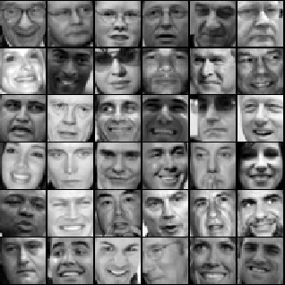
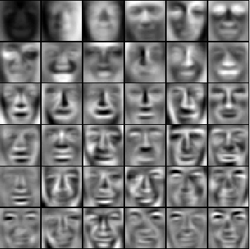
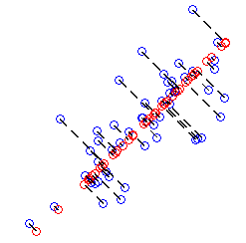
2D to 1D
5000 * 1024
5000 * 100

Slide 11
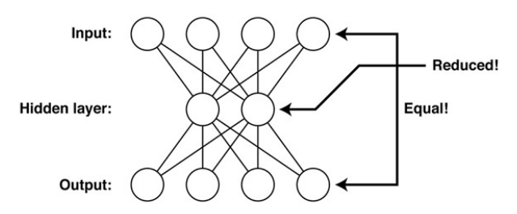
Auto-associative Neural Network
Used for reducing the feature space further, down from 60 to 15
Base Model that uses a linear transformation functions

Slide 12
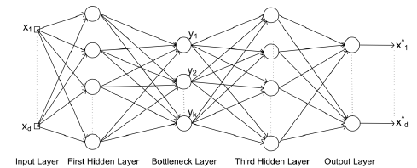
Auto-associative Neural Network cont.
However, this algorithm leverages a modified version of Cybenko’s network (Non-linear function in second layer and linear function in the third layer) to achieve a better compression
Algorithm uses a 5 layer MLP
Dimensionality Reduction from d to k
This layer approximates the input
Cybenko’s Network
Non-linear transformation function
Linear transformation function

Slide 13
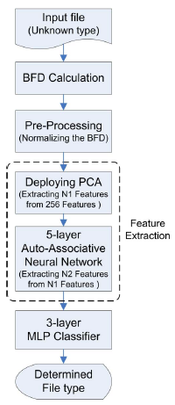
File Type Classification Algorithm
After feature extraction the algorithm leverages a 3 layered supervised MLP Neural Network for file type classification
PCA is fast but poor when compared to non-linear mapping methods
Why not use PCA just once for reducing from 256 to 16 ?
Why not perform extraction and classification using 1 MLP ?

Slide 14
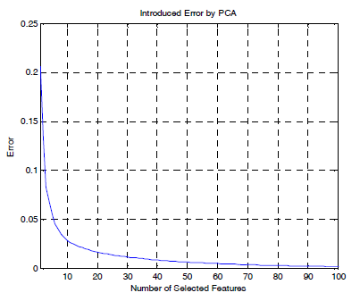
Test Setup
6 file types were used (.doc, .pdf, .exe, .jpg, .html and .gif)
Used different languages and file sizes to ensure randomization
120 files from each file type
90 files from each file type for training and 30 for testing
Chose the value of N1 = 60 and N2 = 15, by trial and error. Figured an optimal value that reduces errors.

Slide 15
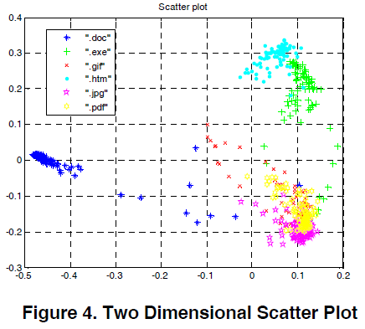
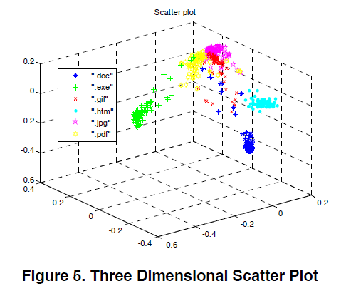
Scatter plots with N2 = 2 and N2 = 3
With N2 = 2 (Fig. on left), some overlap between (yellow & pink) + (green & blue) regions. With N2 = 3 (Fig. on Right) the overlaps have significantly been reduced. So with N2 = 15, there will be a significant improvement in accuracy.

Slide 16
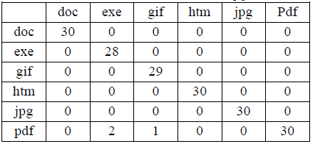
Results + Comparison with Related Work
Rows denoted actual classification by the algorithm and columns the expected result
.doc, .html, .jpg & .pdf correctly classified
Accuracy = (180 – 3) / 180 = 98.33%
Better than n-grams approach (82%) and BFA (27.5%)
Independent of File Headers

Slide 17
Pros and Cons
Pros
General: Brief, concise and to the point
General: They have considered different languages and different file sizes while testing for accuracy of the algorithm, which some of the prior works haven’t
Individual: New learning - never knew that Neural Networks can be used for dimensionality reduction, have always known it as a classification algorithm.
Cons / Opportunity for improvement
General: Talked about different languages but not charsets used for testing
General: The test set never included any file outside the types that were trained for classification. Moreover never spoke of time. HTA takes 0.015s.
General: Training 540 files of 6 types and testing 180 files is a very small number to claim a 98.33% accuracy. How N2 is affected when file type increases. How does this impact time / accuracy ?

Slide 18
Mat-lab Simulation for Demonstration + TQCs

