Slide 1
TREC - 6
Overview of Sixth Text Retrieval Conference
Ellen M. Voorhees, Donna Harman
Presented By
Arathi Mary Sunder
Notes:
Slides can vary as per your presentation, but header and footer should be consistent

Slide 2
When did Information Retrieval Begin?
Emanuel Goldberg
1920- 1930’s
Gerard Salton
1960’s
TREC
1990’s
Univac
1940-1950’s
Inverse Document Frequency
1970’s

Slide 3
TREC (Text REtrieval Conference)
Started in 1992 by DARPA in close collaboration with NIST (National Institute of Standards and Technology)
Responsible for sponsoring the first large-scale evaluations of retrieval across different languages

Slide 4
Why TREC?
Provides Infrastructure
Increases Communication
Encourages Research
Provides Evaluation

Slide 5
TREC Test Collections
Topic
Documents
Relevance Assessments

Slide 6
Topics
Questions that users generally ask and require to be retrieved from the document
Topics in TREC were more like user-need statements

Slide 7
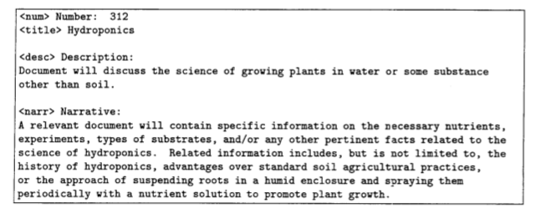
Example of a Topic as provided in TREC-6

Slide 8
Documents
Documents are given in CD-ROM’s (around 1GB each)
5 disks were provided (Disks 1-4: Training documents; Disk 5: Ad hoc task)
Documents are tagged using Standard Generalized Markup Language (SGML)

Slide 9
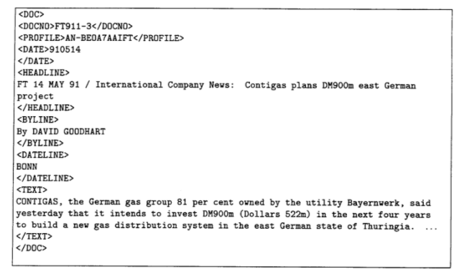
An example of a document tagged using SGML

Slide 10
Relevance Assessments
The results of each topic submitted by the participating groups needs to be assessed for relevance
The relevance assessments were tested for consistency and completeness

Slide 11
Standing Queries
A query that is issued once over a database, and then logically runs continuously over the data in the database until the query is terminated
Examples:
Amazon’s best seller’s over the last hour
Monitoring stocks or news

Slide 12
Tasks Involved in TREC

Slide 13
Routing Task
Investigates system performance using standing queries
Ad hoc Task
Searches a static set of documents using new topics
Tracks
Subtasks that focus on common sub problems in retrieval

Slide 14
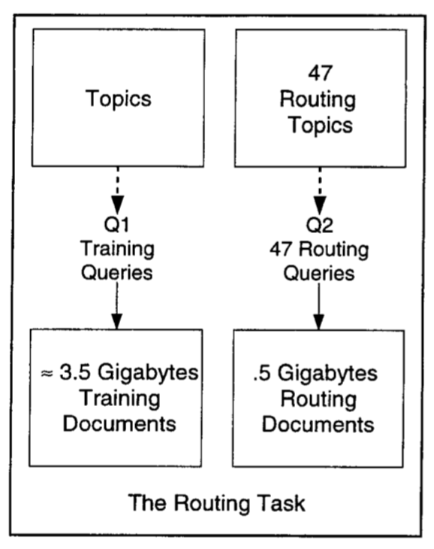
Q1 are the queries generated from the given topics
Q1 set of queries might be adjusted by the system according to the training documents
Q2 is the resulting queries after training
Q2 is then run on the test documents

Slide 15
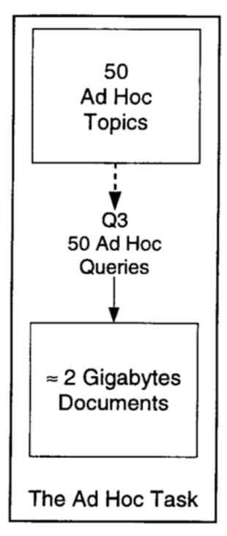
New topics are run against a static set of documents
Unlike the routing task, there is no training set provided
Two types of query construction methods are allowed
a) Automatic Methods
b) Manual Methods

Slide 16
Results of Routing Task
Results of the routing task scaled better than TREC-5
An increase of 9% was seen from the last time, though even better results were expected
Techniques used in this task were
- Iterative methods of term weighting (City University)
- Expanding queries from relevance backpropagation
- Using different term selection strategies for different parts of the
queries

Slide 17
Results of Ad hoc Task
Ad hoc task was run on different versions of a topic
- Short Version (includes only the description field)
- Title only Version
- Long Version
Results varied for automatic runs and manual runs
Example: City University used fewer documents for mining and adding expansion terms; University of Waterloo used more data fusion for title-only runs

Slide 18
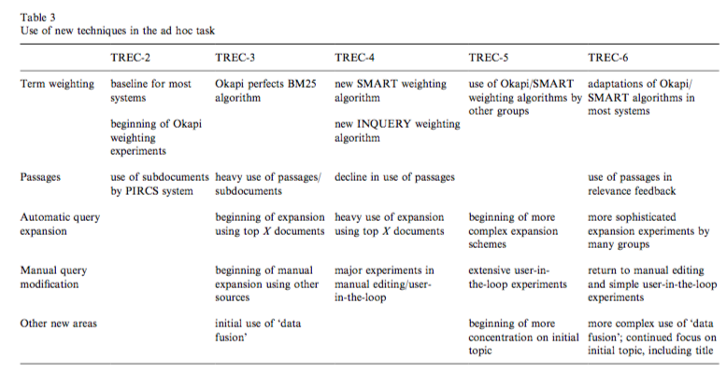

Slide 19
Results of Tracks used in TREC-6
Chinese Track
Cross Language Track
Filtering Track
High Precision Track
Spoken Document Retrieval Track
Very Large Corpus Track

Slide 20
Conclusion
TREC provided a platform for exchange of ideas
Large scale testing helped the participants identify where their system were failing and in turn find a fix
Allowed for generation of innovative ideas
Use of tracks helped solve sub problems of particular focus

Slide 21
Pros
Cons
Pros
Elaborated the proceedings of TREC
Sub problems that each track tackled was explained clearly
Cons
Strategies used by participants was not discussed

Slide 22
THANK YOU

