Slide 1
The Roma Personal Metadata Service Edward Swierk, Emre Kiciman, Nathan C. Williams, Takashi Fukushima, Hideki Yoshida, Vince Laviano And Mary Baker
Vaishnavi Kishore Kumar
USC ID: 8786316343

Slide 2
Introduction
Use of heterogeneous digital devices and a variety of data repositories
Switch among multiple devices
May not remember
On which device a file is present
Which device has latest copy
File name itself
All related documents

Slide 3
Why should we care
Tries to solve one of the common problems faced by all of us while handling multiple heterogeneous devices
Related to what we study
We have just learnt about metadata in class

Slide 4
Required Functionalities of Roma
Make metadata available to the user – file location
Version numbers to help synchronize ﬁles
Keywords for searching
Track ﬁles stored outside the user’s control
Track ﬁles stored on disconnected media

Slide 5
How is it implemented?
Maintain centralized metadata
Always accessible to user
Metadata records contain UID, version, location, keywords etc
Instances of a file have same UID
Group logically similar files

Slide 6
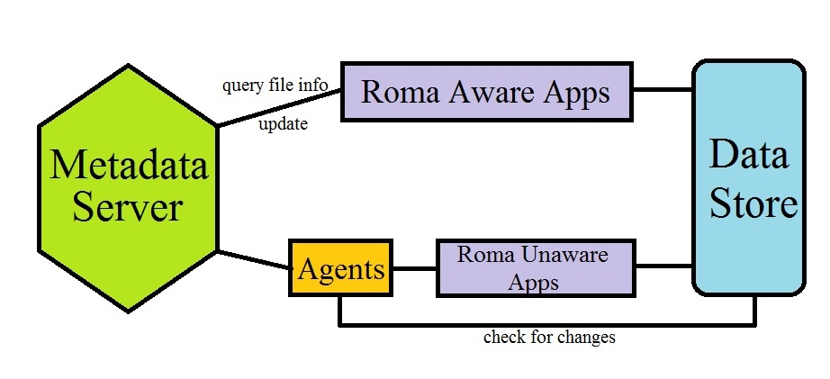
Architecture

Slide 7
Metadata Server
Maintains metadata records – info about all copies of all user’s data
Centralized
Advantages
Avoid write conflicts
Easy for apps to search
Separate from data stores
Advantages
Easy to integrate from heterogeneous devices

Slide 8
Metadata Server
User’s namespace
Gives apps knowledge about data in unavailable stores
Implemented by the authors in Java
Records are maintained in XML-based format

Slide 9
Data Stores
Stores user’s data accessed by apps
Can be any data storage
traditional ﬁle
web servers
laptops, personal digital assistants, cell phones, wristwatches
offline storage like CDs

Slide 10
Data Stores
Need no connectivity with metadata server
Need not be Roma aware
Implemented by the authors
Limited to those accessible via URI
HTTP, FTP, file system

Slide 11
Applications
The applications that operate on data in data stores
Can be text editors, personal information managers, web-based applications
Can be of two types
Roma Aware
Must use metadata
Report changes to metadata server

Slide 12
Applications
Roma Unaware
Any traditional application
Must be connected to metadata server during use
Implemented by authors
Three types of Roma Aware apps
Web based metadata browser
Command line tools – ls, locate, get, import
PDA app for browsing metadata

Slide 13
Agents
Act on behalf of users and Roma Unaware apps
Three types based on interaction with metadata
Read-only
Write-only
Read/write
Needs access to both metadata server and data store
Authors implemented only write-only agent

Slide 14
Design Issues
Write conflicts
Users know which version is right
Metadata availability
Future (today’s) networks make PANs a reality
Cache metadata subsets into multiple servers

Slide 15
Design Issues
Amount of storage needed
Absolute size of memory - around 1MB
metadata size : data size - 1:25
Making apps Roma Aware
Add extensions
Add Roma aware layer
Use agents
Identifying file instances – URI to files is M-to-N

Slide 16
Related Work
Distributed File System–can use all these along with Roma
Coda
Works for no/weak network by caching data
OceanStore
Set of untrusted servers for fee
Bayou
Peer to peer distributed system

Slide 17
Related Work
SyncML
XML-based synchronization protocol for resource constrained system
Presto
Similar to Roma, but no tracking and sync
Dataheap
Centralized metadata server + transformation from native format to user’s current device

Slide 18
Conclusions
System which provides personal mobility and version tracking via centralized metadata repository
Pros
Very good explanation with example
Good innovation analyzing future tech improvements
Cons
Depend on apps to detect and handle confusions with URI
Related Work just before conclusions

Slide 19
Thank You

