Slide 1
CLOUD COMPUTING · PROJECT REVIEW
Container Resource Optimization in Cloud Computing
ML-driven workload prediction, priority scheduling and dynamic resource allocation
Priyanshi Kapoor – 24BIT0206
Pavni Arora – 24BIT0219
Notes:
Introduce the project: a generalized system that takes any raw CSV workload dataset, predicts CPU and memory usage, schedules by priority, allocates resources, and surfaces everything on a dashboard backed by AWS S3.

Slide 2
Problem & Goal
Goal
1
Any CSV workload dataset
Not hardcoded for one dataset
Build a generalized system that accepts a raw CSV workload dataset, automatically detects relevant columns, preprocesses the data, predicts future CPU and memory usage using ML, assigns workload priorities, performs dynamic resource allocation, and displays results on a web dashboard.
2
Predict CPU & memory
Random Forest regression
3
Prioritize & allocate
Based on cluster capacity
4
Dashboard + cloud storage
React UI, AWS S3
Container Resource Optimization in Cloud Computing
Notes:
State the goal: a generalized system, not hardcoded for one dataset. Walk through the four capabilities on the right.

Slide 3
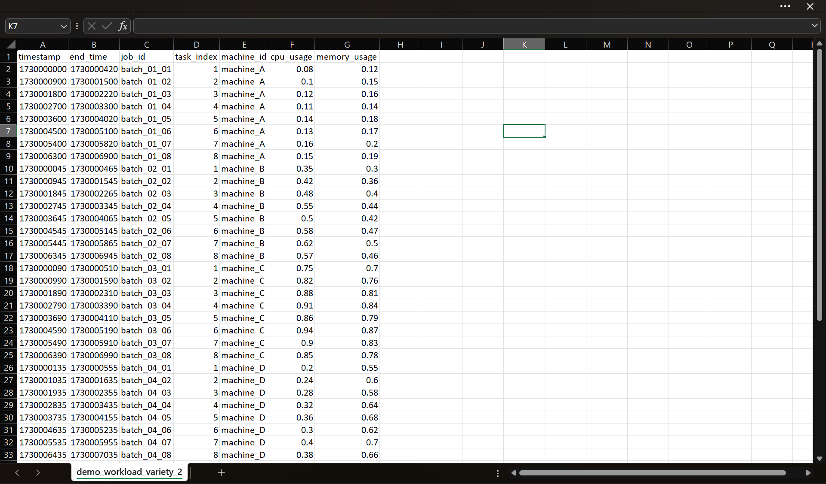
Link of Sample Dataset
Google Cluster Data Trace: https://github.com/google/cluster-data
Container Resource Optimization in Cloud Computing
Notes:
Everything produced by the pipeline is stored in one S3 bucket, organised into four folders via Boto3.

Slide 4
Data Preparation & Feature Generation
1
Detect columns
Automatically identifies relevant workload columns; no dataset-specific hardcoding
200,240
2
Clean & normalize
Prepares raw CSV values for modelling
ML-ready rows from the main dataset
3
Generate features
Previous 3 CPU and memory values, current CPU and memory, time gap
4
Create targets
Next CPU usage and next memory usage
Container Resource Optimization in Cloud Computing
Notes:
Emphasise that nothing is tied to one dataset: columns are detected automatically, then the data is cleaned, normalized and turned into ML-ready rows.

Slide 5
End-to-End Pipeline
1
Raw CSV
2
Automatic Column Detection
3
Cleaning & Normalization
4
Feature Generation
5
ML Training
6
CPU / Memory Prediction
7
Priority Assignment
8
Time Aware, Dynamic Resource Allocation
9
FastAPI Backend
10
React Dashboard
11
AWS S3 Storage
Data & ML
Scheduling
Serving & cloud
Container Resource Optimization in Cloud Computing
Notes:
Eleven stages from raw CSV to cloud storage. Blue = data and ML, teal = scheduling, navy = serving and cloud.

Slide 6
System Architecture
Data & ML
Scheduler
Backend
Frontend
Cloud
Column detection
Cleaning & features
Random Forest: CPU, memory
Priority from predicted CPU + memory
Dynamic allocator
Cluster-capacity aware
FastAPI
Metrics, predictions, allocations, upload
Background jobs + status
React + Vite
Axios API calls
Recharts charts
AWS S3 via Boto3
processed/ predictions/
allocations/ models/
Python
Pandas
Scikit-learn
FastAPI
React
Vite
Axios
Recharts
AWS S3
Boto3
Git/GitHub
Container Resource Optimization in Cloud Computing
Notes:
Five layers. Data/ML feeds the scheduler; the FastAPI backend exposes it; React consumes it; S3 stores artifacts.

Slide 7
Machine Learning Pipeline
Inputs: 9 features
Random Forest Regression
Targets: 2 outputs
Previous 3 CPU values
Previous 3 memory values
Current CPU
Current memory
Time gap
Two models: CPU and memory
Python · Pandas · Scikit-learn
Saved as .pkl files
Next CPU usage
Next memory usage
Chronological split
80% Training (Early timeline)
20% Testing
(Later timeline)
Container Resource Optimization in Cloud Computing
Notes:
Nine input features, two Random Forest regressors, two targets. Split is chronological, so no future data leaks into training.

Slide 8
Why Random Forest Regression?
Our problem is a supervised regression problem where we need to predict continuous values — the next CPU usage and next memory usage.
Our input consists of multiple tabular features such as the previous three CPU values, previous three memory values, current CPU and memory usage, and the time gap. Random Forest is well suited for this type of tabular data because it can capture nonlinear relationships between these features and the resource usage without requiring us to assume a specific mathematical relationship.
It is also relatively robust to noise and provides a strong baseline model.
Since we needed two continuous predictions, we trained two Random Forest Regressors — one for CPU and one for memory.
We chose it as our initial model rather than claiming it is universally the best model. Comparing it with other regression or time-series models and tuning it further is part of our future scope.
Container Resource Optimization in Cloud Computing
Notes:
Everything produced by the pipeline is stored in one S3 bucket, organised into four folders via Boto3.

Slide 9
Priority Scheduler & Dynamic Allocator
Predicted CPU + Memory
Priority Assignment
Dynamic Resource Allocator
Time Aware Allocation
Allocation Status
Priority levels
Allocation status
LOW
Calculated from predicted CPU + predicted memory
FULL
Request fully granted
MEDIUM
PARTIAL
Part of the request granted
HIGH
NOT_ALLOCATED
No capacity assigned
CRITICAL
Container Resource Optimization in Cloud Computing
Notes:
Priority comes from predicted CPU + predicted memory. The allocator then grants resources by priority within available cluster capacity.

Slide 10
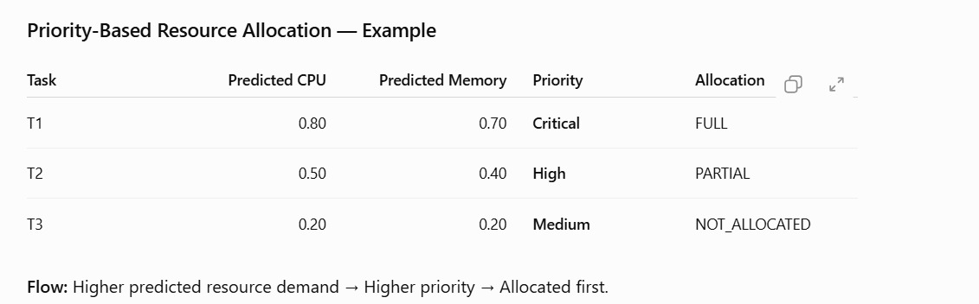
Example:
Container Resource Optimization in Cloud Computing
Notes:
Everything produced by the pipeline is stored in one S3 bucket, organised into four folders via Boto3.

Slide 11
FastAPI Backend
Metrics endpoint
1
Background optimization job
Upload CSV
Predictions endpoint
2
Start optimization (background job)
Allocations endpoint
3
Poll job status via API
CSV upload / optimization endpoints
Fetch results
4
Container Resource Optimization in Cloud Computing
Notes:
The backend exposes four groups of endpoints. Optimization runs as a background job so the UI stays responsive and polls a status endpoint.

Slide 12
React Dashboard & Demo Flow
1
Upload CSV
2
Run Optimization
3
Monitor Status
4
View Metrics & Predictions
5
Review Allocations & Tasks
Dashboard panels
CSV Upload
Run Optimization Button
Optimization Status
Metrics
Predictions
Resource Allocation
Task Status
Recharts Charts
React + Vite · Axios · Recharts
Container Resource Optimization in Cloud Computing
Notes:
Walk the demo left to right: upload, run, watch status, then explore metrics, predictions, allocations and task status.

Slide 13
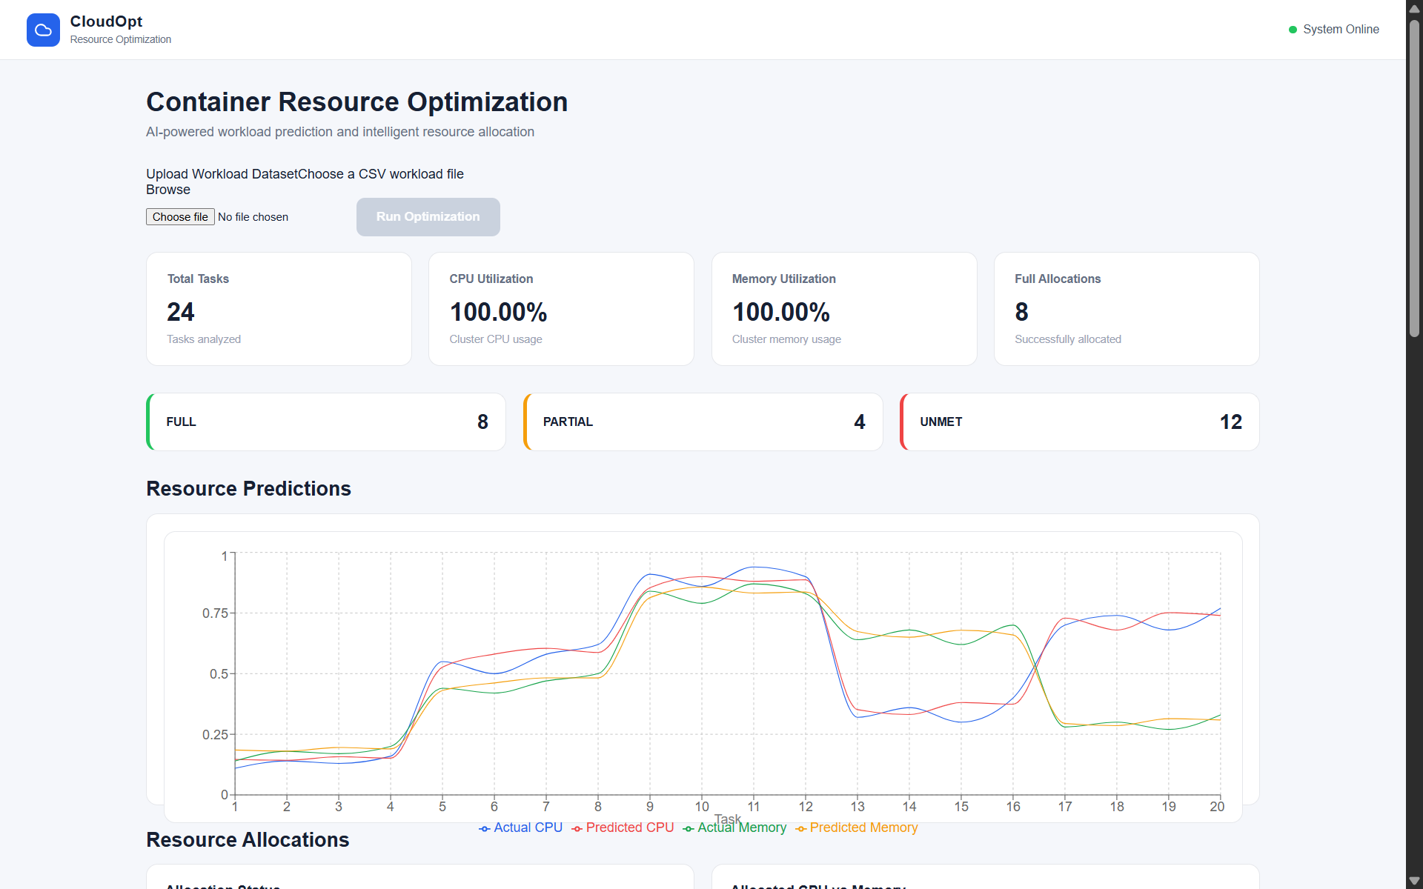
Screenshots
Container Resource Optimization in Cloud Computing
Notes:
Everything produced by the pipeline is stored in one S3 bucket, organised into four folders via Boto3.

Slide 14
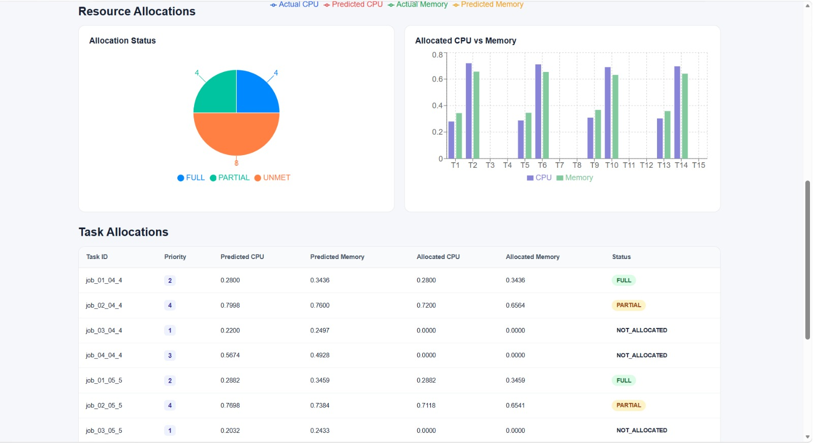
Screenshots
Container Resource Optimization in Cloud Computing
Notes:
Everything produced by the pipeline is stored in one S3 bucket, organised into four folders via Boto3.

Slide 15
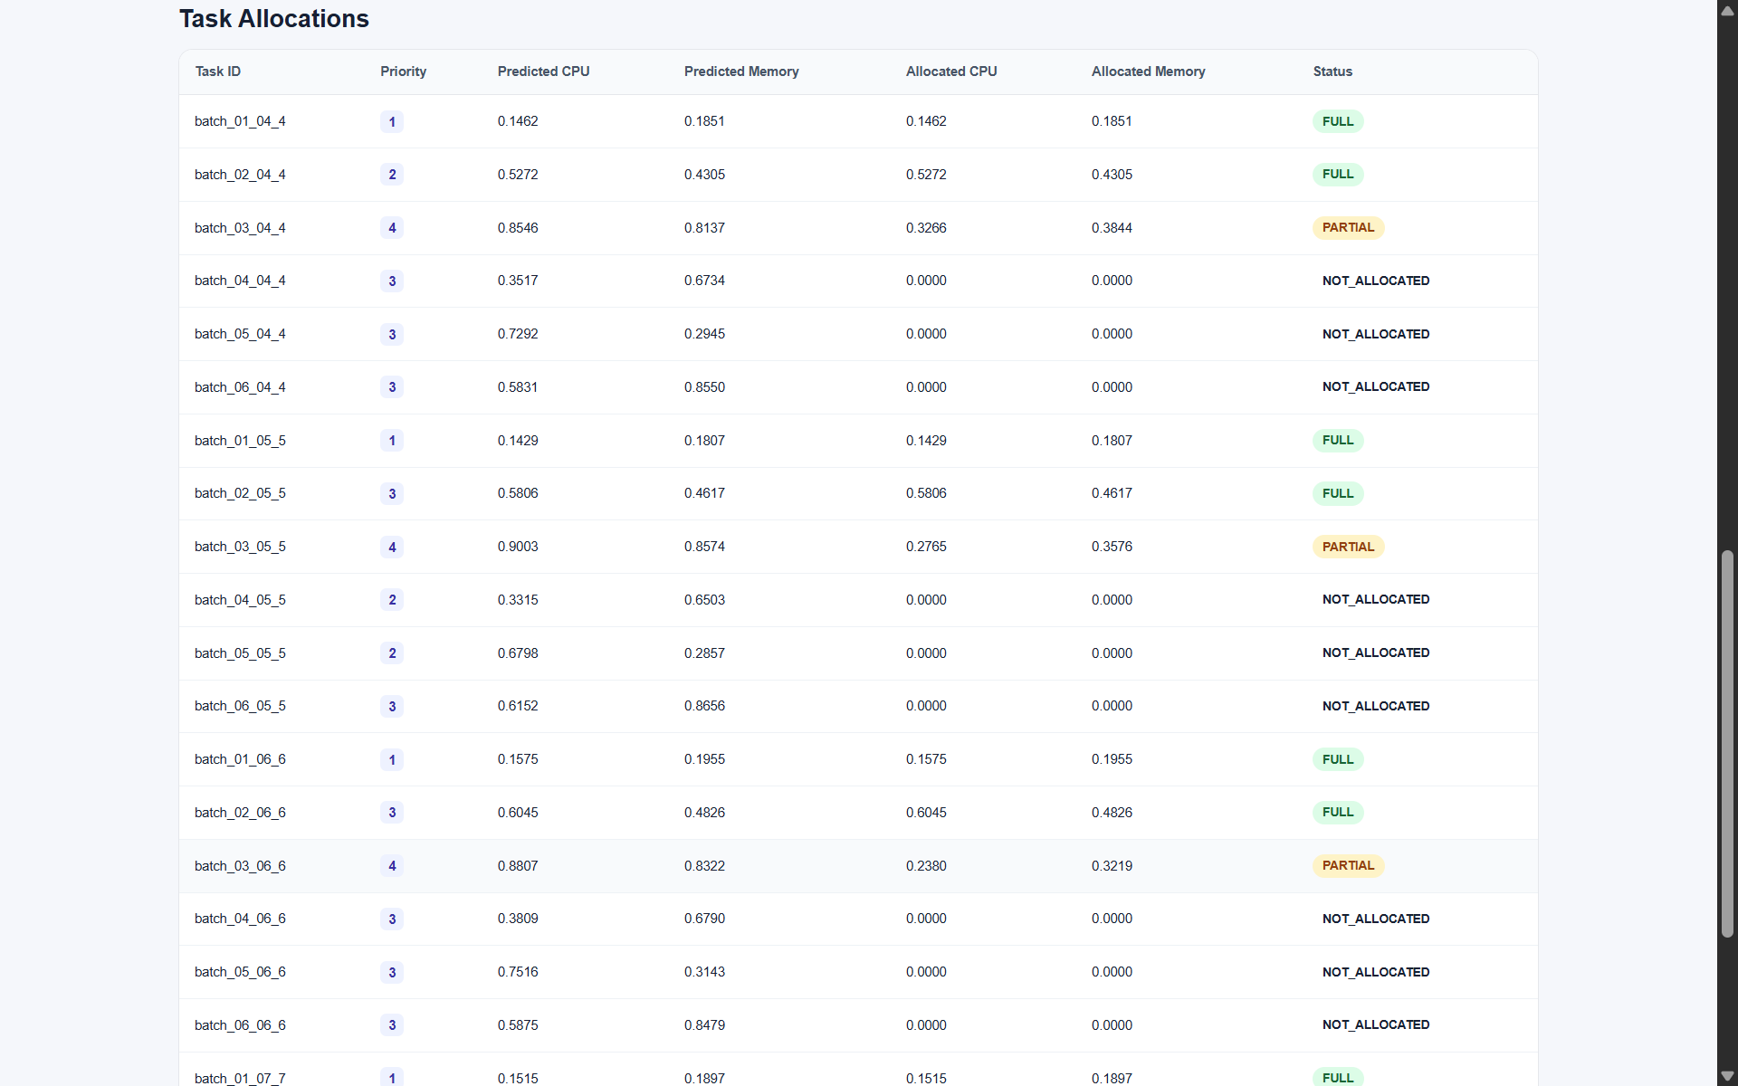
Screenshots
Container Resource Optimization in Cloud Computing
Notes:
Everything produced by the pipeline is stored in one S3 bucket, organised into four folders via Boto3.

Slide 16
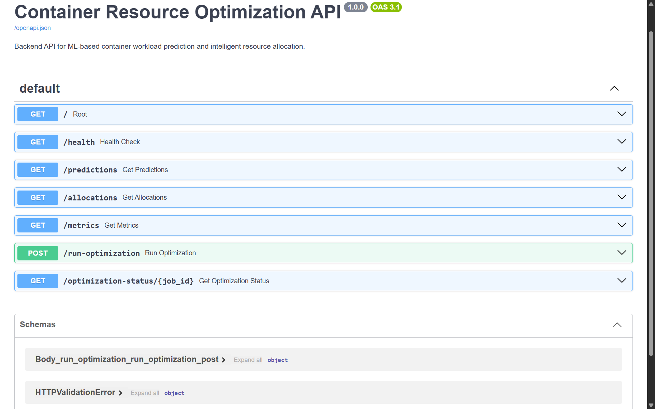
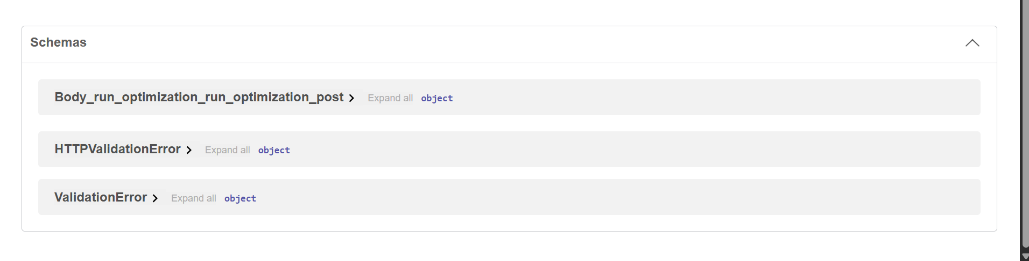
Screenshots
Container Resource Optimization in Cloud Computing
Notes:
Everything produced by the pipeline is stored in one S3 bucket, organised into four folders via Boto3.

Slide 17
AWS S3 Cloud Storage
processed/
AWS S3
Processed dataset
FastAPI backend
+ Boto3
Bucket
predictions/
container-resource-optimization
CPU & memory predictions
allocations/
Region
Resource allocation results
ap-southeast-2 (Sydney)
models/
Trained CPU & memory models
Container Resource Optimization in Cloud Computing
Notes:
Everything produced by the pipeline is stored in one S3 bucket, organised into four folders via Boto3.

Slide 18
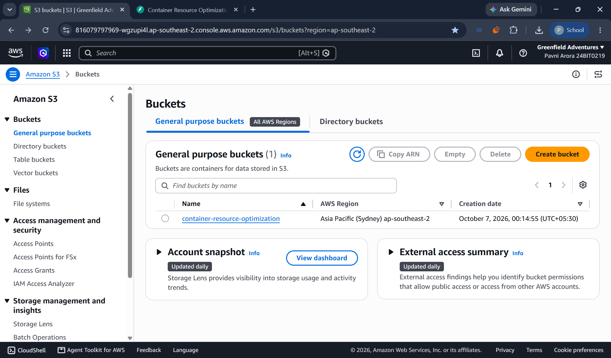
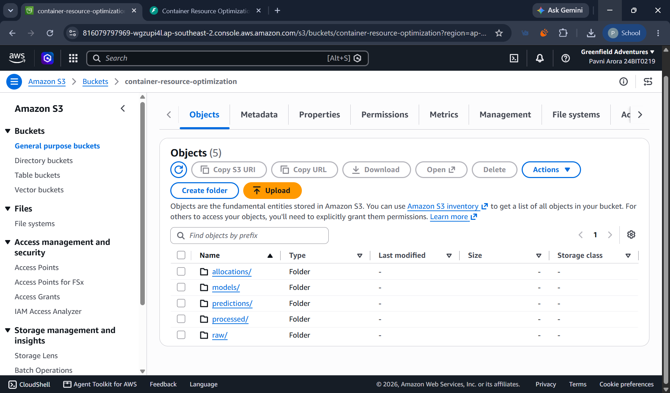
Screenshot of AWS
Container Resource Optimization in Cloud Computing
Notes:
Everything produced by the pipeline is stored in one S3 bucket, organised into four folders via Boto3.

Slide 19
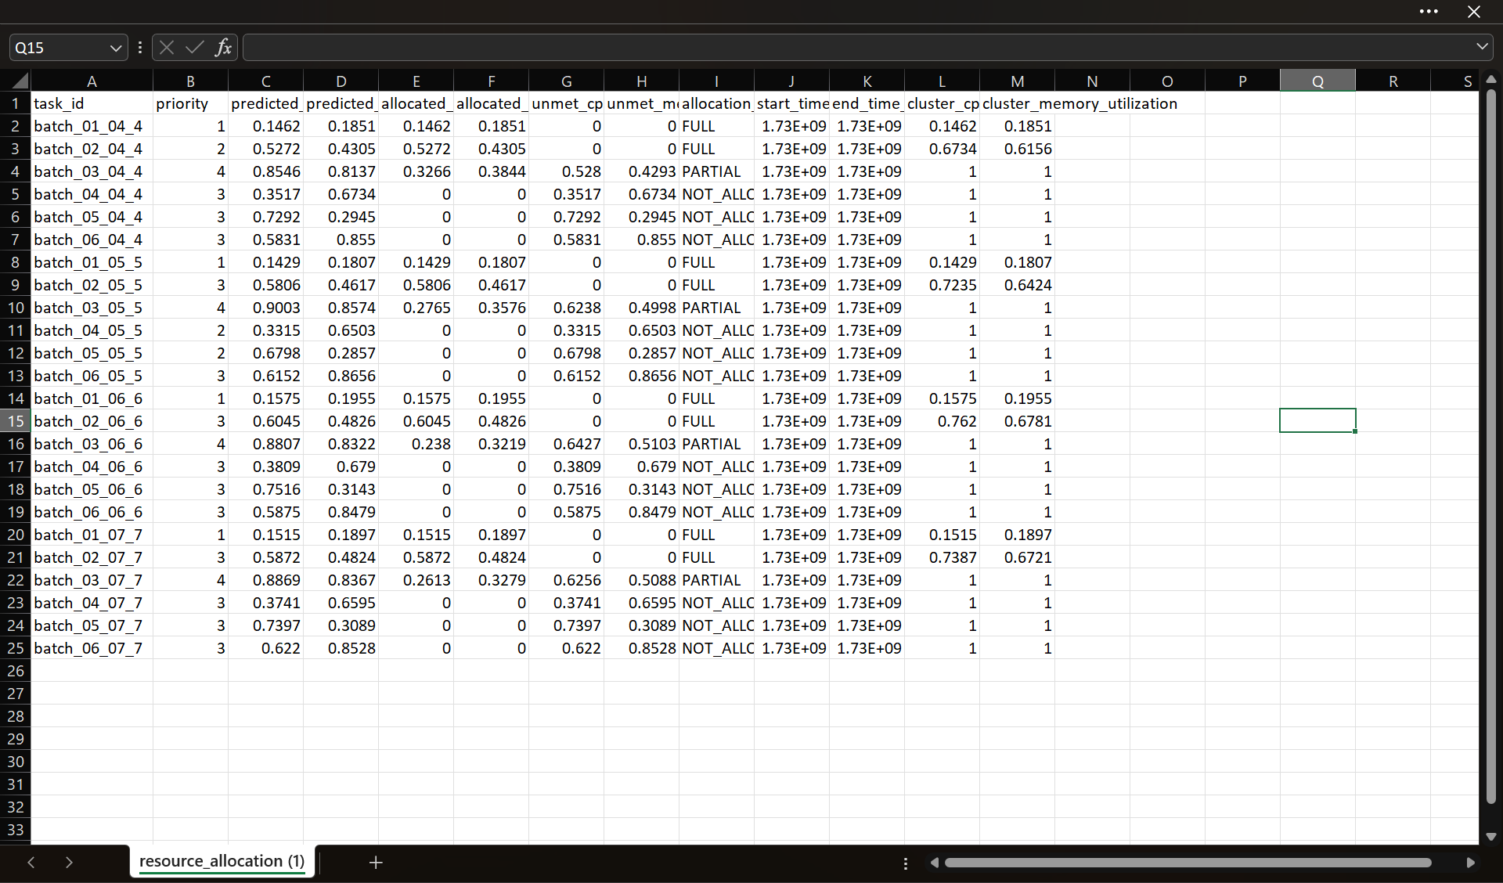
Screenshot of AWS
Container Resource Optimization in Cloud Computing
Notes:
Everything produced by the pipeline is stored in one S3 bucket, organised into four folders via Boto3.

Slide 20
Results: Random Forest Performance
200,240
2
80 / 20
ML-ready rows
Random Forest models
Chronological train / test
Target | MAE | RMSE | R²
CPU | 0.0158 | 0.0293 | 0.1055
Memory | 0.0198 | 0.0352 | 0.2143
Pipeline verified end to end: prediction, scheduling, allocation and cloud storage.
Container Resource Optimization in Cloud Computing
Notes:
Large dataset (about 200,240 rows). Errors are small in absolute terms; R-squared is modest, which we discuss on the limitations slide.

Slide 21
Results: Error Metrics & R²
Low absolute errors, but R² of 0.11 (CPU) and 0.21 (memory) means limited explained variance.
Container Resource Optimization in Cloud Computing
Notes:
Left: MAE and RMSE for both targets. Right: R-squared. Memory prediction scores somewhat better than CPU on every metric.

Slide 22
Conclusion
1
Generalized
2
Predicts
Works from any raw CSV workload dataset using automatic column detection
Random Forest models forecast next CPU and memory usage
3
Schedules & allocates
4
End to end
Priority-based, time-aware allocation with resource release and reuse
FastAPI backend, React dashboard and results stored in AWS S3
Notes:
Wrap up: the complete pipeline demonstrably performs prediction, scheduling, allocation and cloud storage on a generalized CSV input.

Slide 23
Limitations & Future Scope
Limitations
Future scope (proposed)
R² is 0.1055 (CPU) and 0.2143 (memory): limited explained variance
Random Forest is the only model family used
Results reported on the main dataset (about 200,240 rows)
Tune models and enrich features to raise R²
Compare other regression and time-series models
Validate on more CSV workload datasets
Refine scheduling and allocation policies
Container Resource Optimization in Cloud Computing
Notes:
Be upfront about the modest R-squared. Future directions are proposed next steps, not completed work.

Slide 24
Thank You
Container Resource Optimization in Cloud Computing
Notes:
Everything produced by the pipeline is stored in one S3 bucket, organised into four folders via Boto3.

