Slide 1

HireSmart
Skill-Based Recruitment Portal
A Data-Driven Solution to Automate Candidate Screening
Pavitra Patel • Nidhi Sabva • Drashti Sabva
Guide: Ms. Hema Patel | CHARUSAT University | April 2026

Slide 2
Agenda
01
Project Profile & Overview
06
UML Diagrams
02
Introduction to Tools
07
System Design & Data Dictionary
03
System Study – Existing & Proposed
08
System Testing
04
Feasibility Study
09
Future Enhancements
05
System Analysis & Modules
10
References

Slide 3
Project Profile
Overview of HireSmart

Slide 4
Project Profile
Project Name
HireSmart
Type
Data-Driven Recruitment Portal
Front End
HTML, CSS
Back End
Django (Python)
Database
SQLite
Tools
Visual Studio Code
Team Size
3 Students

Slide 5
What is HireSmart?
AI-powered skill-based recruitment portal
The system automatically compares resumes with jobs and finds the best match.
Students provide skills, experience, and resumes
System calculates a Match Score against specific job requirements
Streamlines hiring from OTP registration to final acceptance
Three roles: Student, HR, Admin
Reduces manual work and human error in recruitment

Slide 6
Introduction to Tools
Technologies powering HireSmart

Slide 7
Frontend: HTML & CSS
HTML
CSS
Standard markup language for web pages
Created Login, Signup, Dashboard, Job pages
Designed forms for resume & job applications
Structured text, buttons, and input fields
Controls visual appearance & layout
Made website attractive and modern
Designed dashboards, buttons, forms
Added responsiveness & better UX

Slide 8
Backend & Database
Django (Python)
SQLite & VS Code
Powerful Python web framework
Managed user authentication with OTP
Handled resume and job data storage
Implemented job application system
Controlled AI job matching logic
SQLite: lightweight embedded database
Stored student, HR, job, and application data
VS Code: lightweight, powerful code editor
Extensions for Django & Python
Fast debugging and auto-suggestions

Slide 9
System Study
Existing System vs. HireSmart

Slide 10
Existing System – Problems
Checking resumes by hand takes too much time.
HR professionals review each resume individually
High chances of human error and missed candidates
No intelligent skill-to-job matching system
Students apply without knowing if skills match
No automated filtering of candidates
No proper communication system between HR and students
Difficult to manage large data

Slide 11
Proposed System – HireSmart Features
HireSmart is a web-based job portal using AI
Match percentage shows suitability
Students create resumes and apply for jobs easily
HR posts vacancies and views ranked applicants
Match percentage helps HR shortlist best candidates
Messaging system between HR and students
Fast, efficient, and error-free hiring workflow

Slide 12
Scope of Proposed System
Provides an online platform for students and HR
Automates the recruitment process
Uses AI to match resumes with job requirements
Helps students find suitable jobs easily
Helps HR shortlist best candidates quickly
Supports resume creation and management
Enables communication between HR and students
Reduces time and effort in the hiring process

Slide 13
Aim & Objectives
Aim: Build an intelligent job portal connecting students & HR using AI
Automate the recruitment process end-to-end
To match resumes with job requirements using AI
Help students find suitable jobs based on their skills
Provide a user-friendly and interactive platform
Improve communication between HR and students
To help HR shortlist the best candidates quickly

Slide 14
Feasibility Study
Operational • Technical • Economic

Slide 15
Feasibility Study at a Glance
⚙
💻
₹
Operational
Technical
Economic
Easy registration & OTP login
Simple resume interface
Quick job search & apply
Instant match percentage
Easy system for both students and HR
HTML/CSS web interface
Django backend
AI matching engine
Admin panel via Django
Browser accessible – no install
Free tools (VS Code, Django, SQLite)
No paid licenses needed
Low maintenance cost
Reduces manual hiring costs
Free access for students & HR

Slide 16
System Analysis
Modules & Requirements

Slide 17
Student Module – Requirements
Functional
Non-Functional
Register via email & OTP
Secure login / logout
Create & update resume
Add skills, education, experience
Browse & apply for jobs
View match percentage
Read messages from HR
Easy-to-use interface
Fast response on job apply
Secure user data handling
User-friendly navigation

Slide 18
HR Module – Requirements
Functional
Non-Functional
Secure HR login
Post new job vacancies
Define skills & experience needed
View applicants per job
Check match percentage
Approve or reject applications
Message selected candidates
Handle multiple applicants efficiently
Quick loading of applicant data
Secure HR access control
Intuitive dashboard design

Slide 19
Admin & AI Matching Modules
Admin Module
AI Matching Module
Secure admin login
Manage student & HR accounts
Monitor system activity
Manage job postings
Ensure data integrity & security
Compare resume and job
Check skills and experience
Find how much they match
Generates final match score (%)
Helps find best candidates

Slide 20
UML Diagrams
Use Case • Activity • Class Diagrams

Slide 21
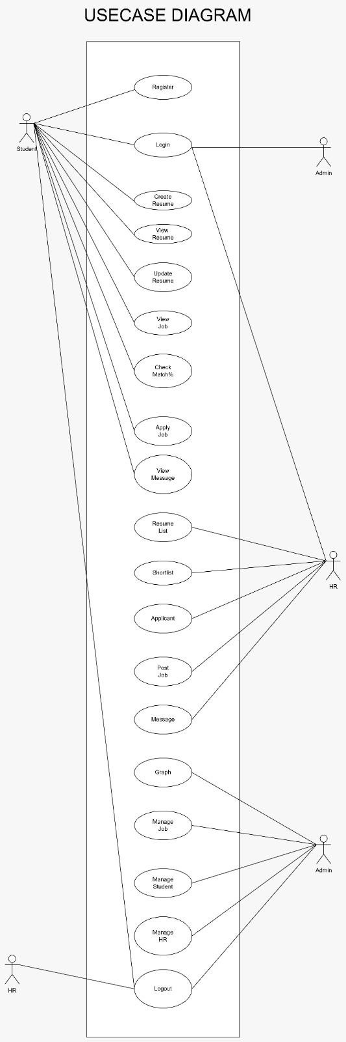
Use case Diagram – Key Flows

Slide 22
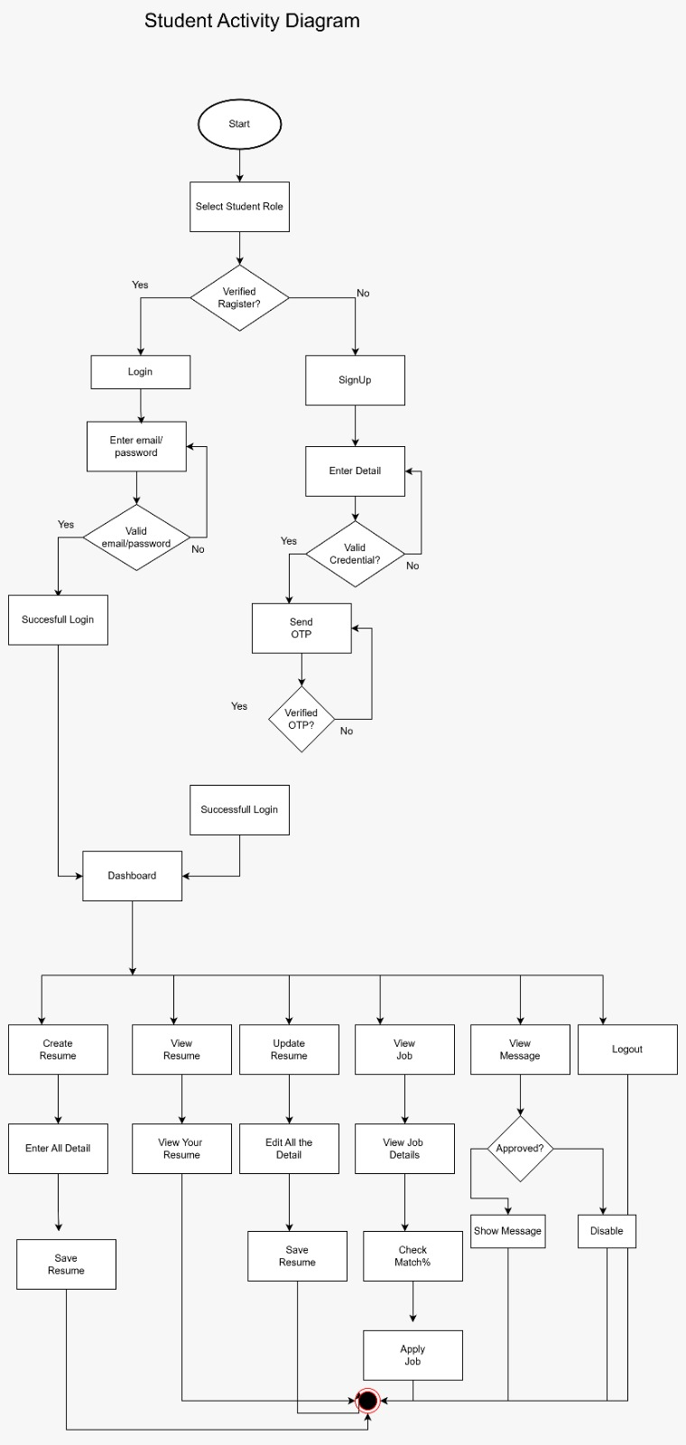
Use Case Diagram – Overview
Student
HR
Admin
Activity Diagram – Key Flows
(Student)

Slide 23
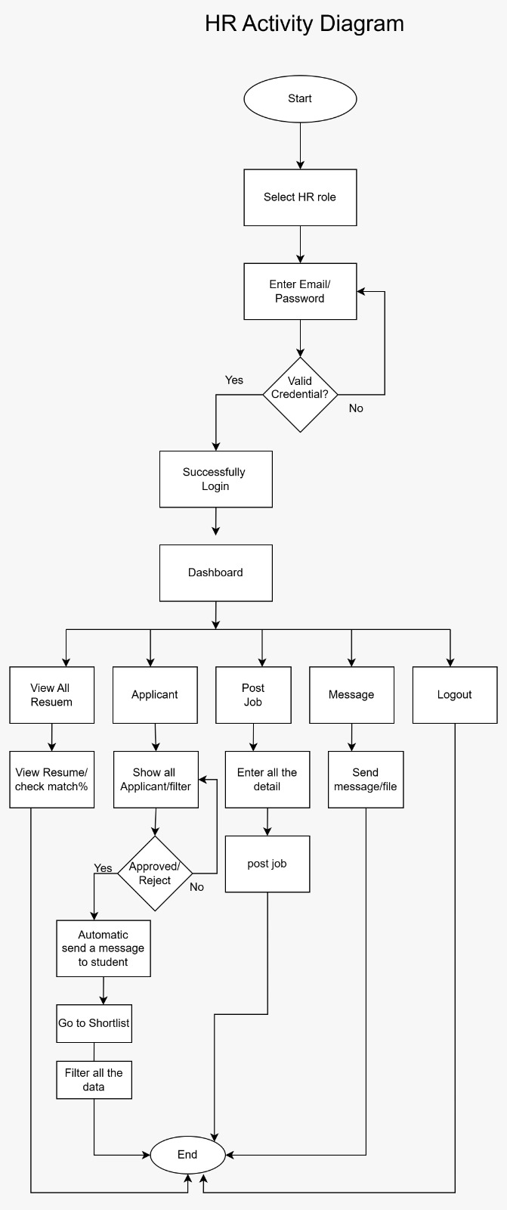
Activity Diagram – Key Flows
(HR)

Slide 24
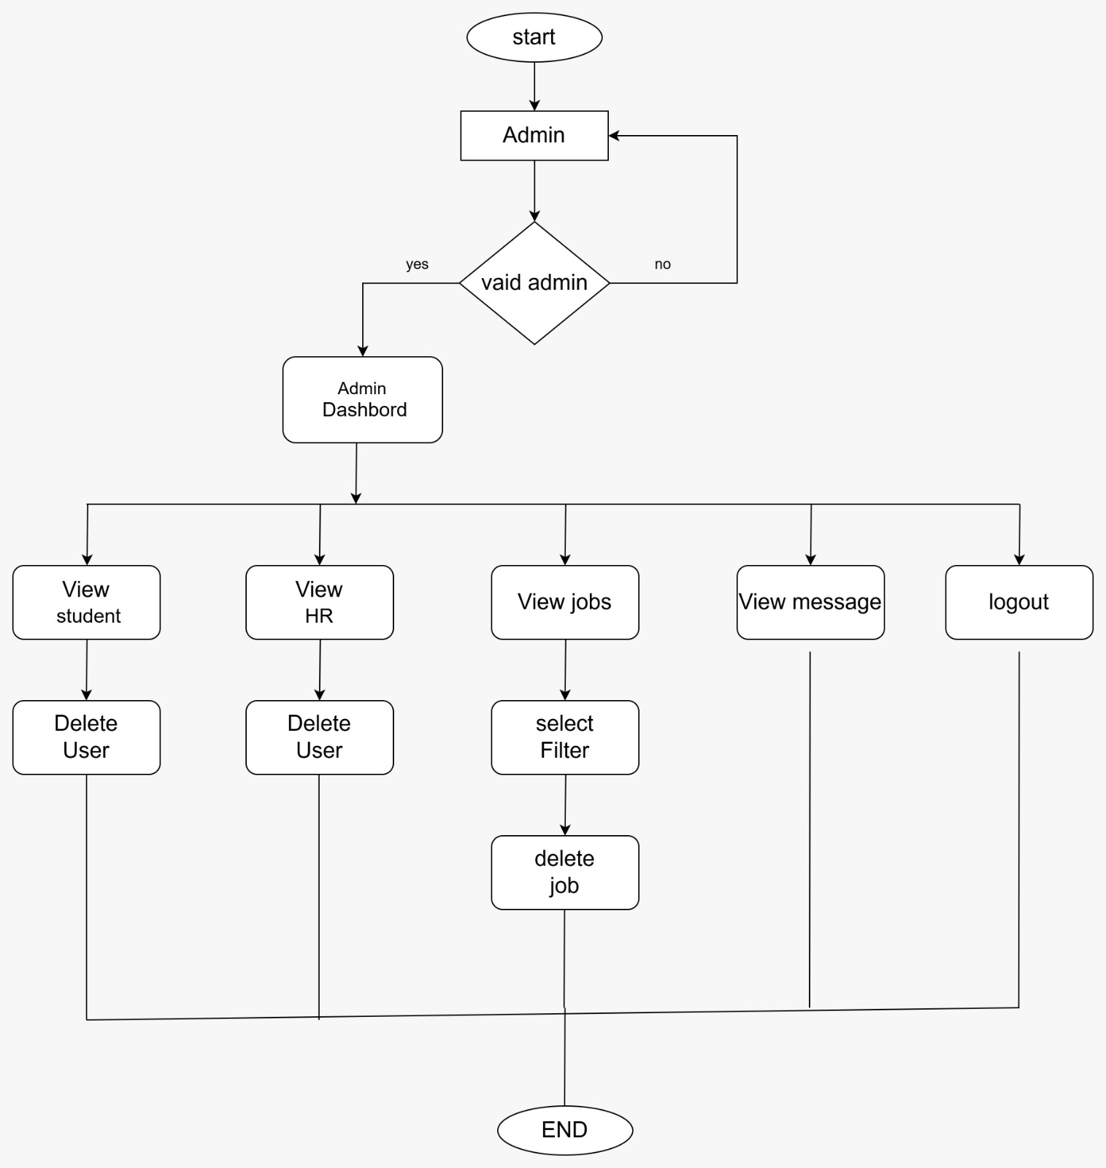
Activity Diagram – Key Flows
(Admin)

Slide 25
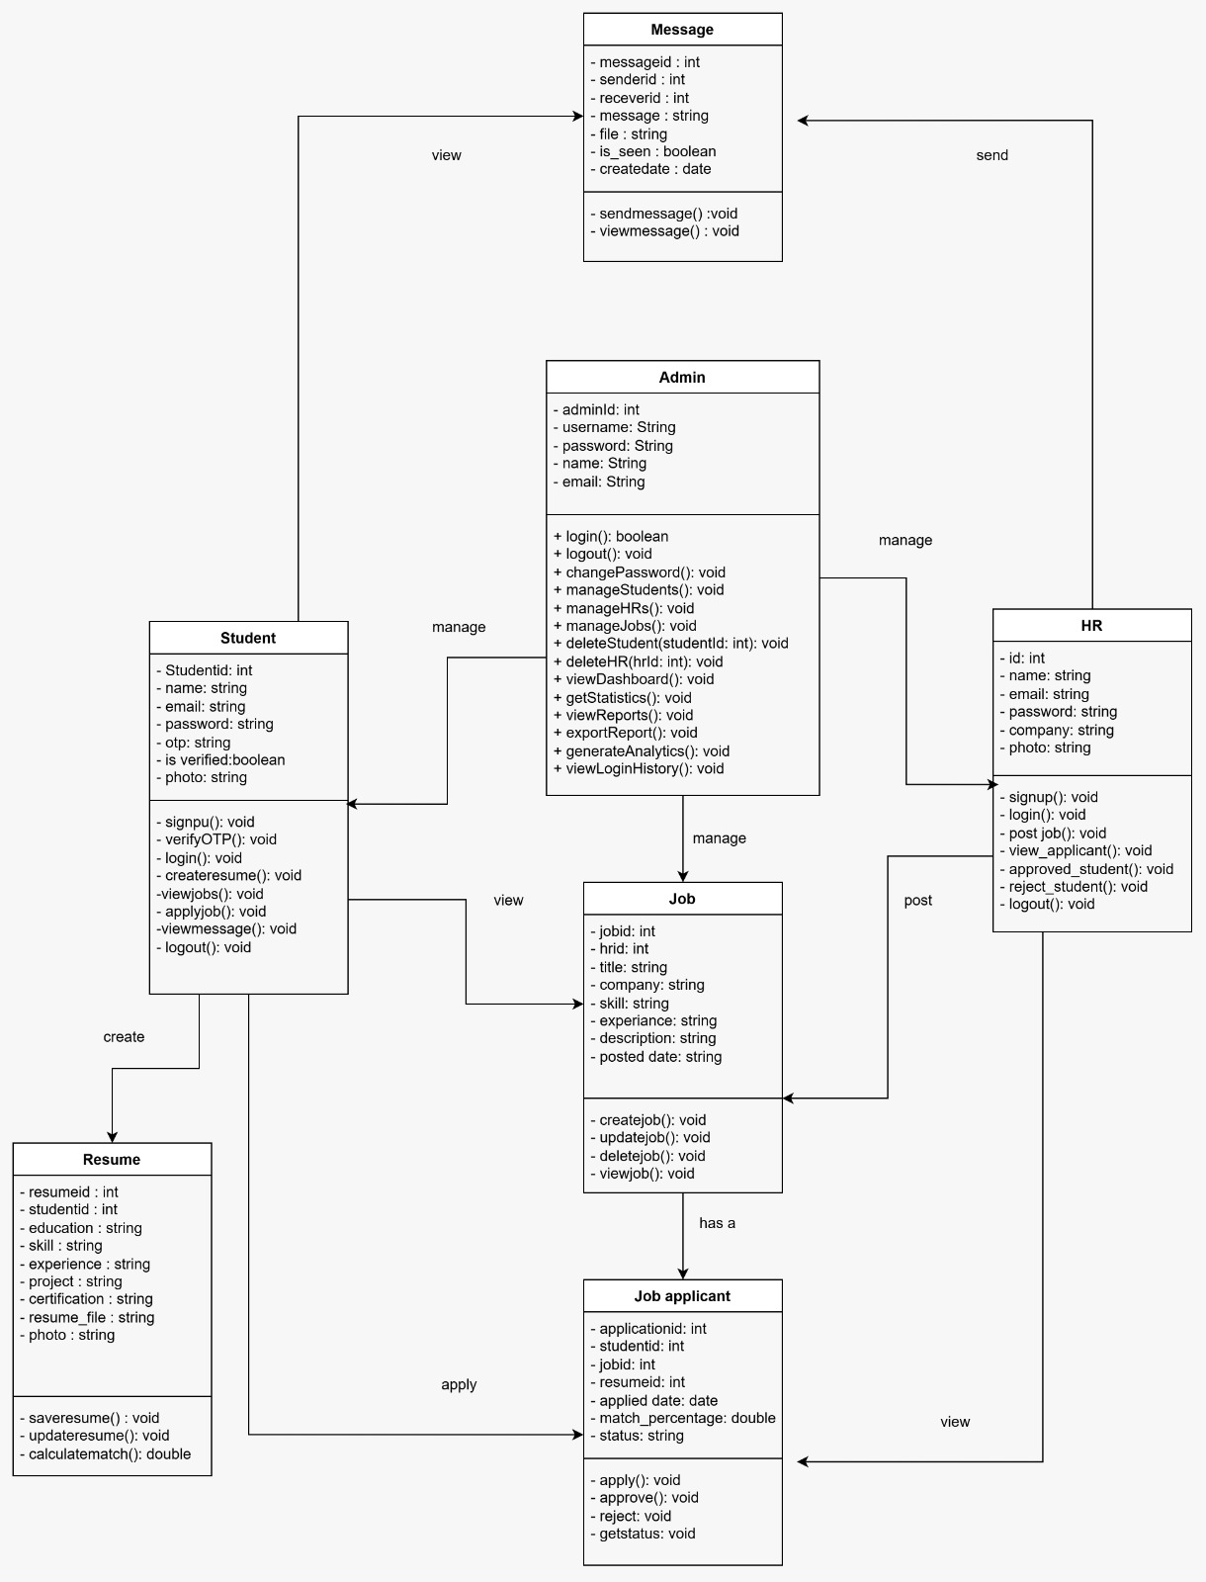
Class Diagram – Key Flows

Slide 26
System Design
Data Dictionary & Screen Layouts

Slide 27
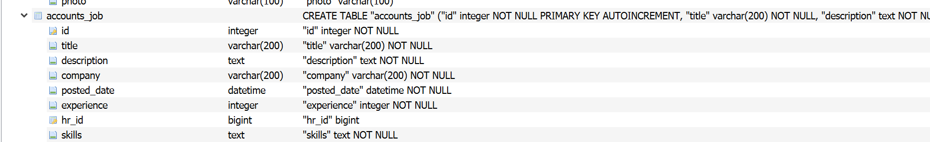
Data Dictionary – Database Tables
accounts_hr
accounts_job

Slide 28
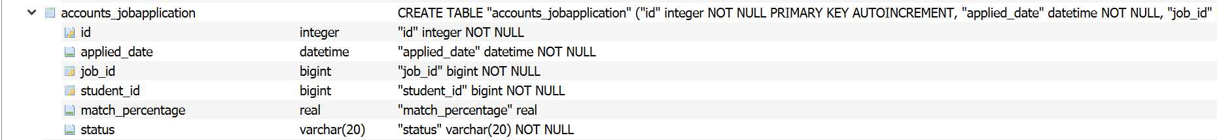
Data Dictionary – Database Tables
accounts_jobapplication
accounts_loginhistory

Slide 29
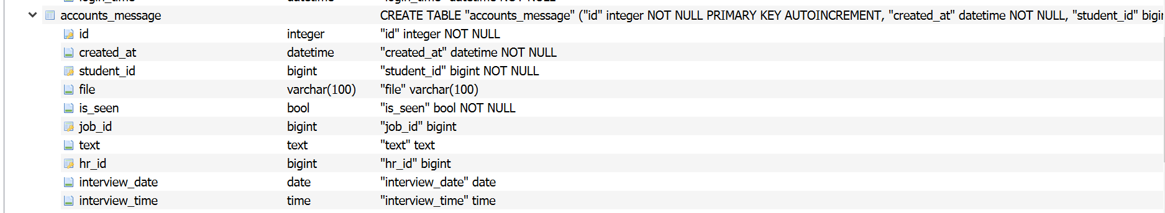
Data Dictionary – Database Tables
accounts_message
accounts_rating

Slide 30
Data Dictionary – Database Tables
accounts_message
accounts_rating

Slide 31
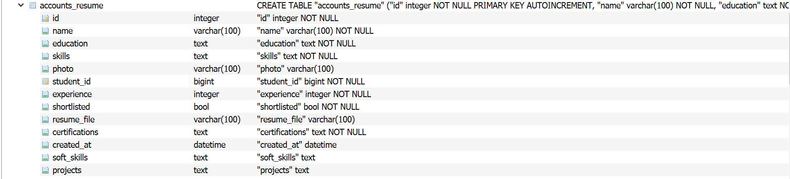
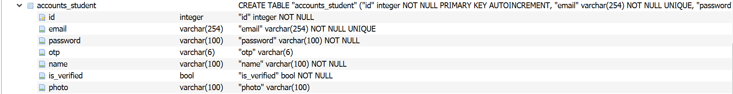
Data Dictionary – Database Tables
accounts_resume
accounts_student

Slide 32
Data Dictionary – Database Tables
auth_group
auth_group_permission

Slide 33
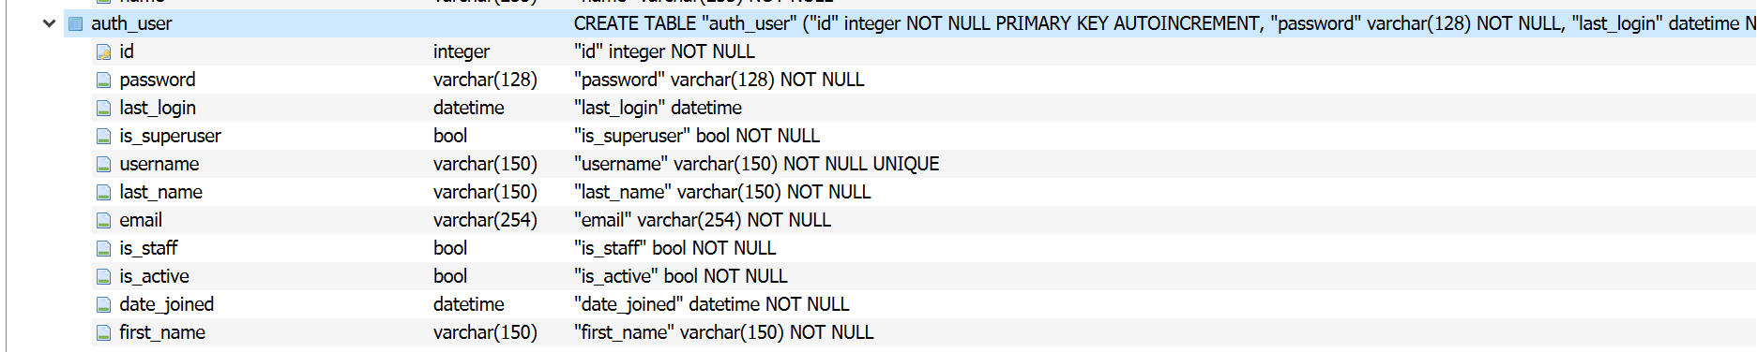
Data Dictionary – Database Tables
auth_permission
auth_user

Slide 34
Data Dictionary – Database Tables
auth_user_groups
auth_user_permission

Slide 35
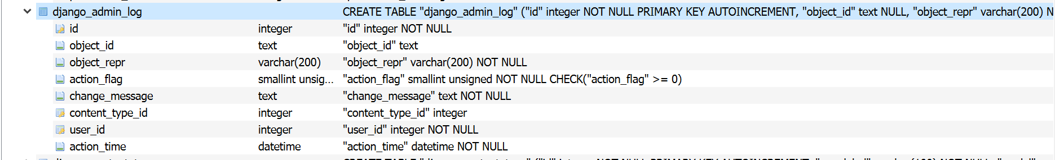
Data Dictionary – Database Tables
django_admin_log
django_content_type

Slide 36
Data Dictionary – Database Tables
django_migration
django_session

Slide 37
Data Dictionary – Database Tables
sqlite_sequence

Slide 38
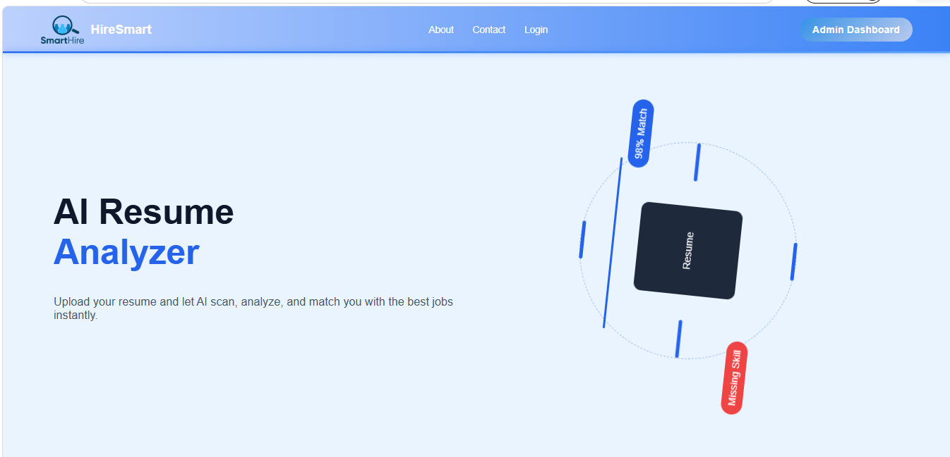
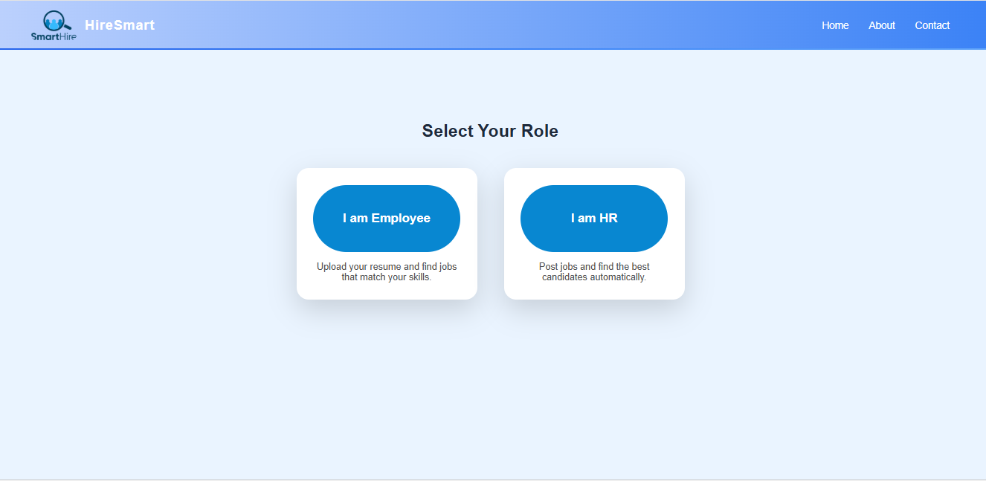
Screen Layout
Home page
Select your role

Slide 39
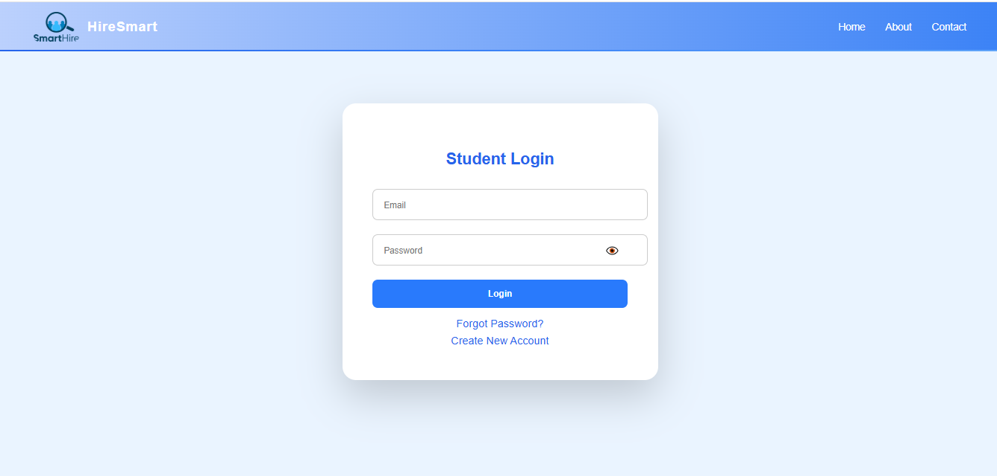
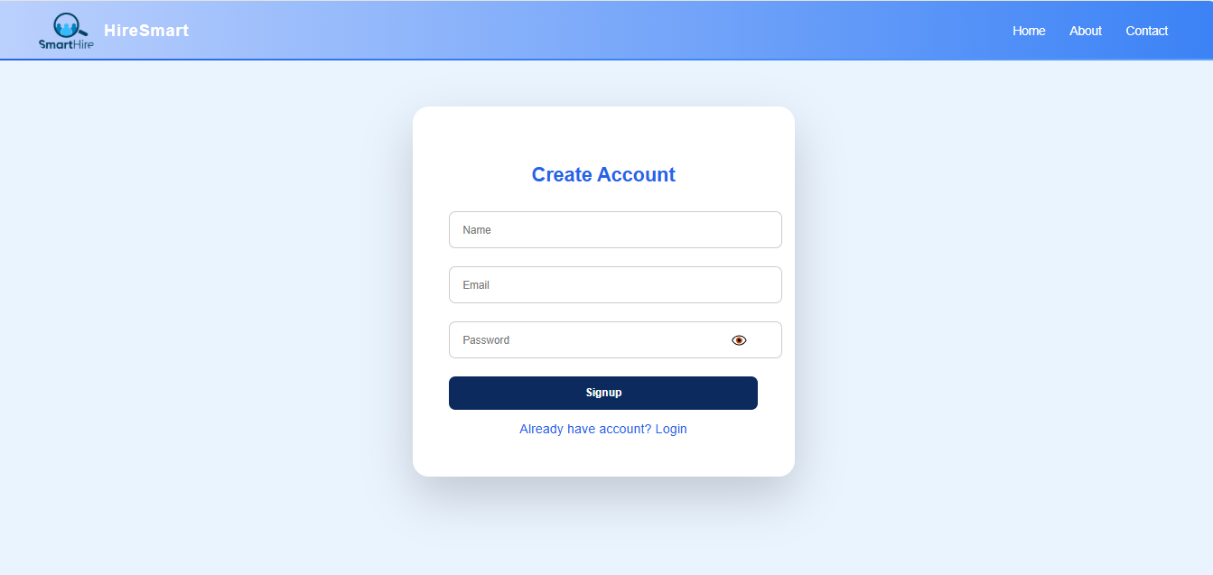
Screen Layout
Student Login
Create new account

Slide 40
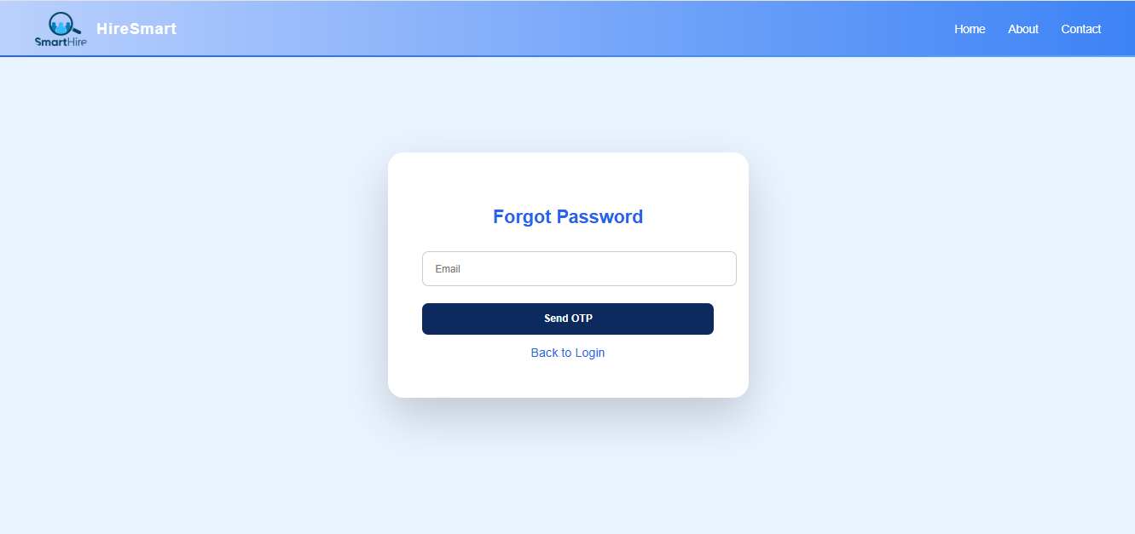
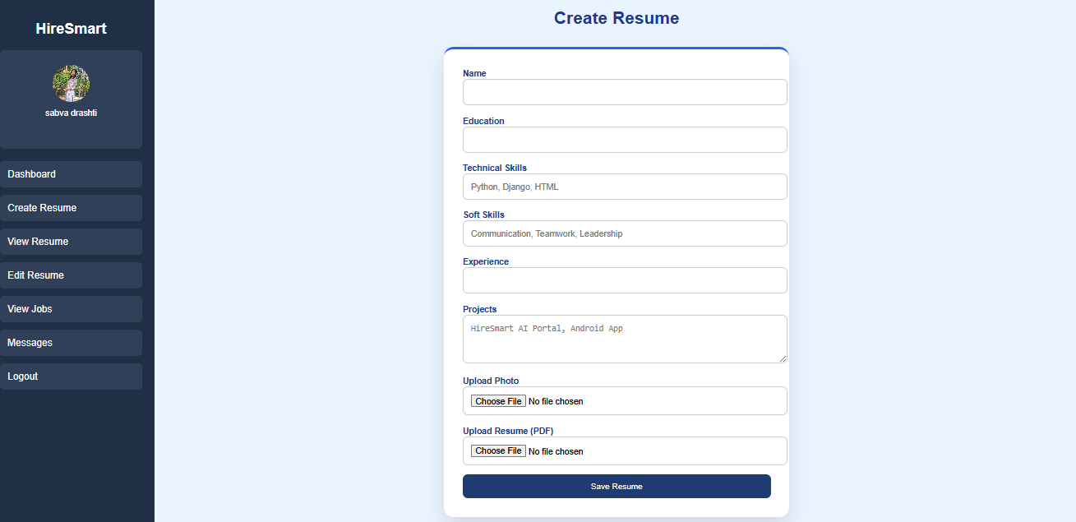
Screen Layout
Forgot Password
Create resume

Slide 41
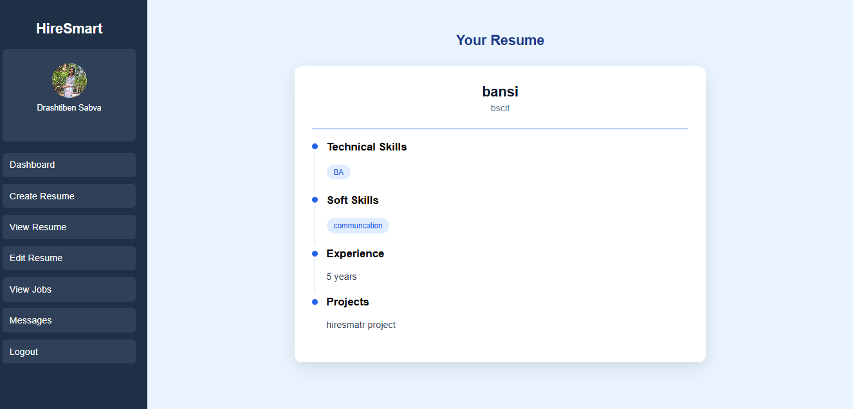
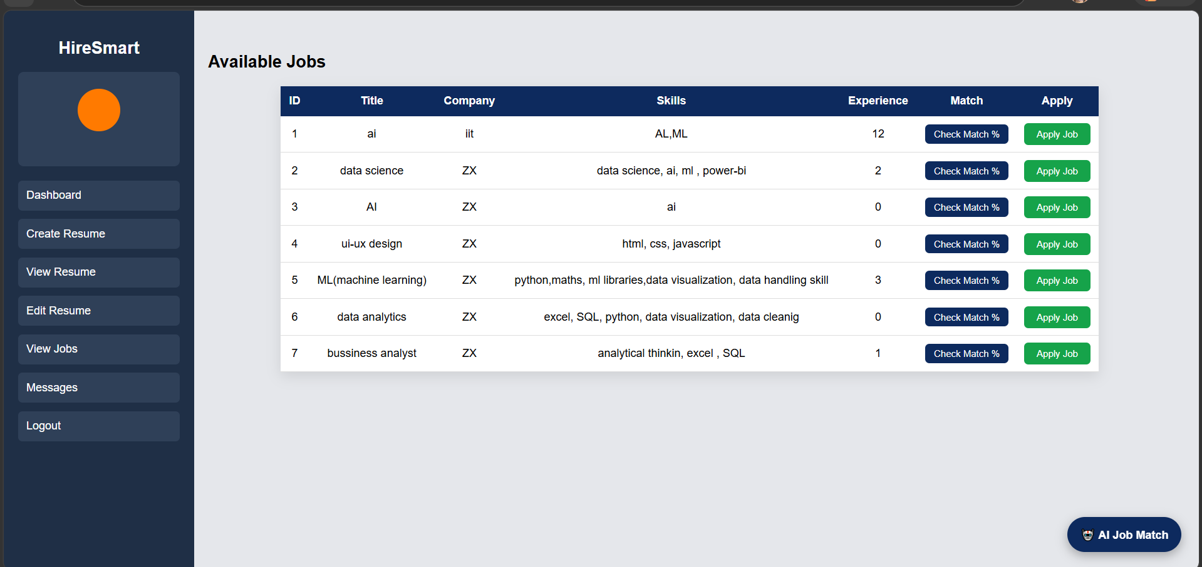
Screen Layout
View resume
View job

Slide 42
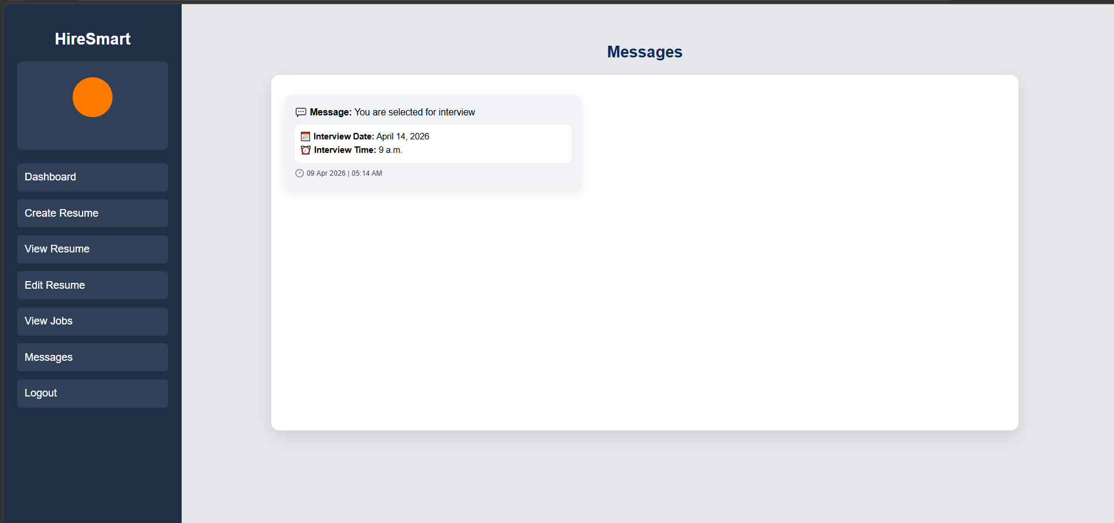
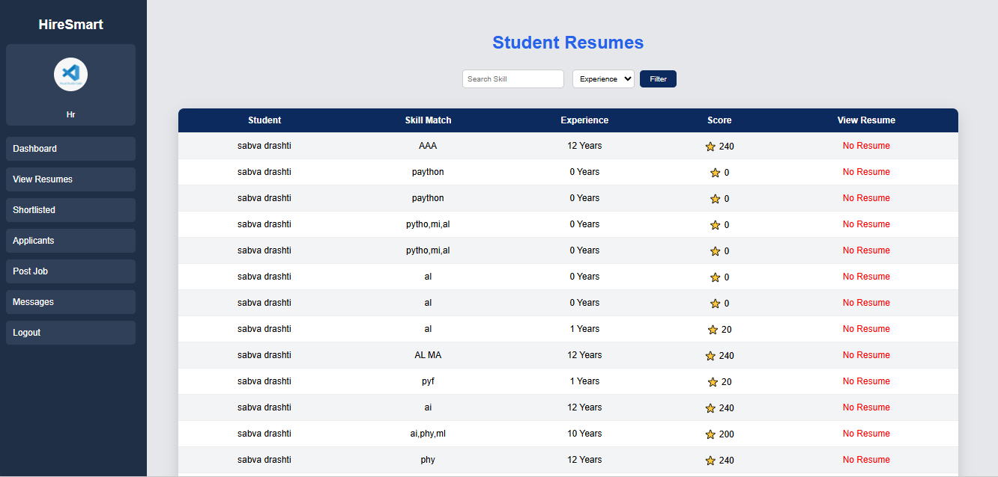
Screen Layout
Message
Student resume

Slide 43
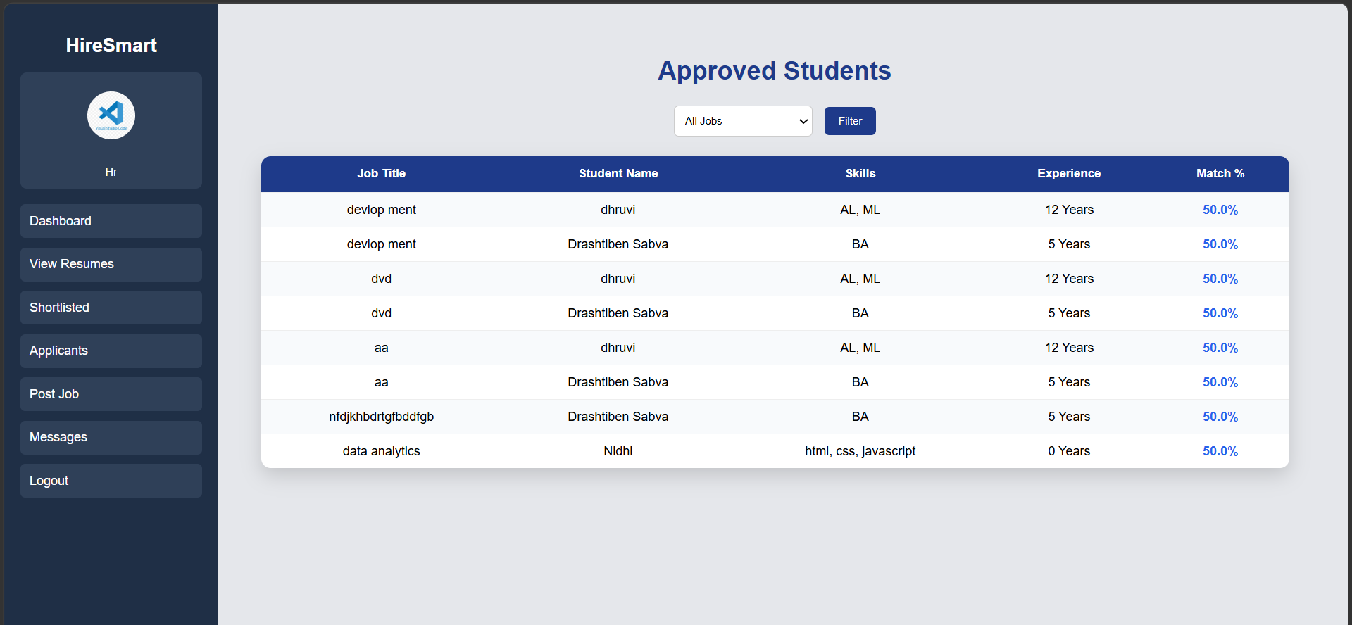
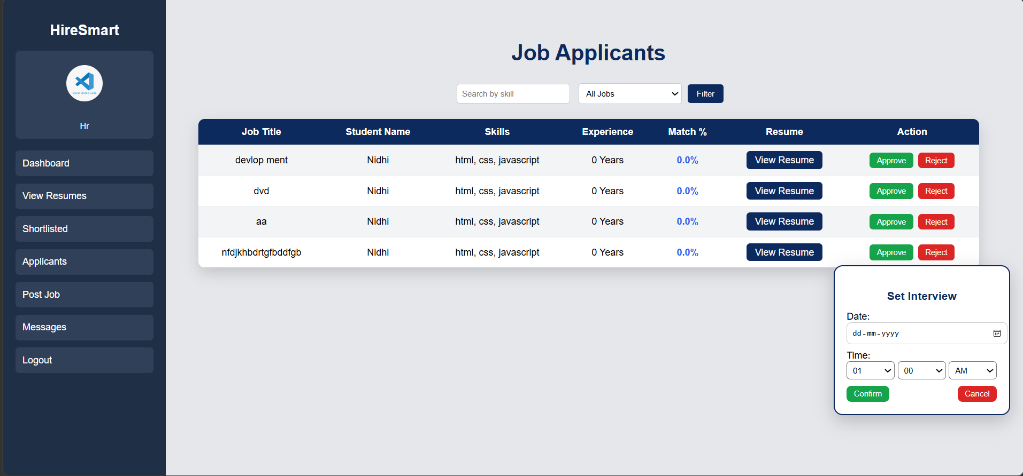
Screen Layout
Shortlist
Applicant

Slide 44
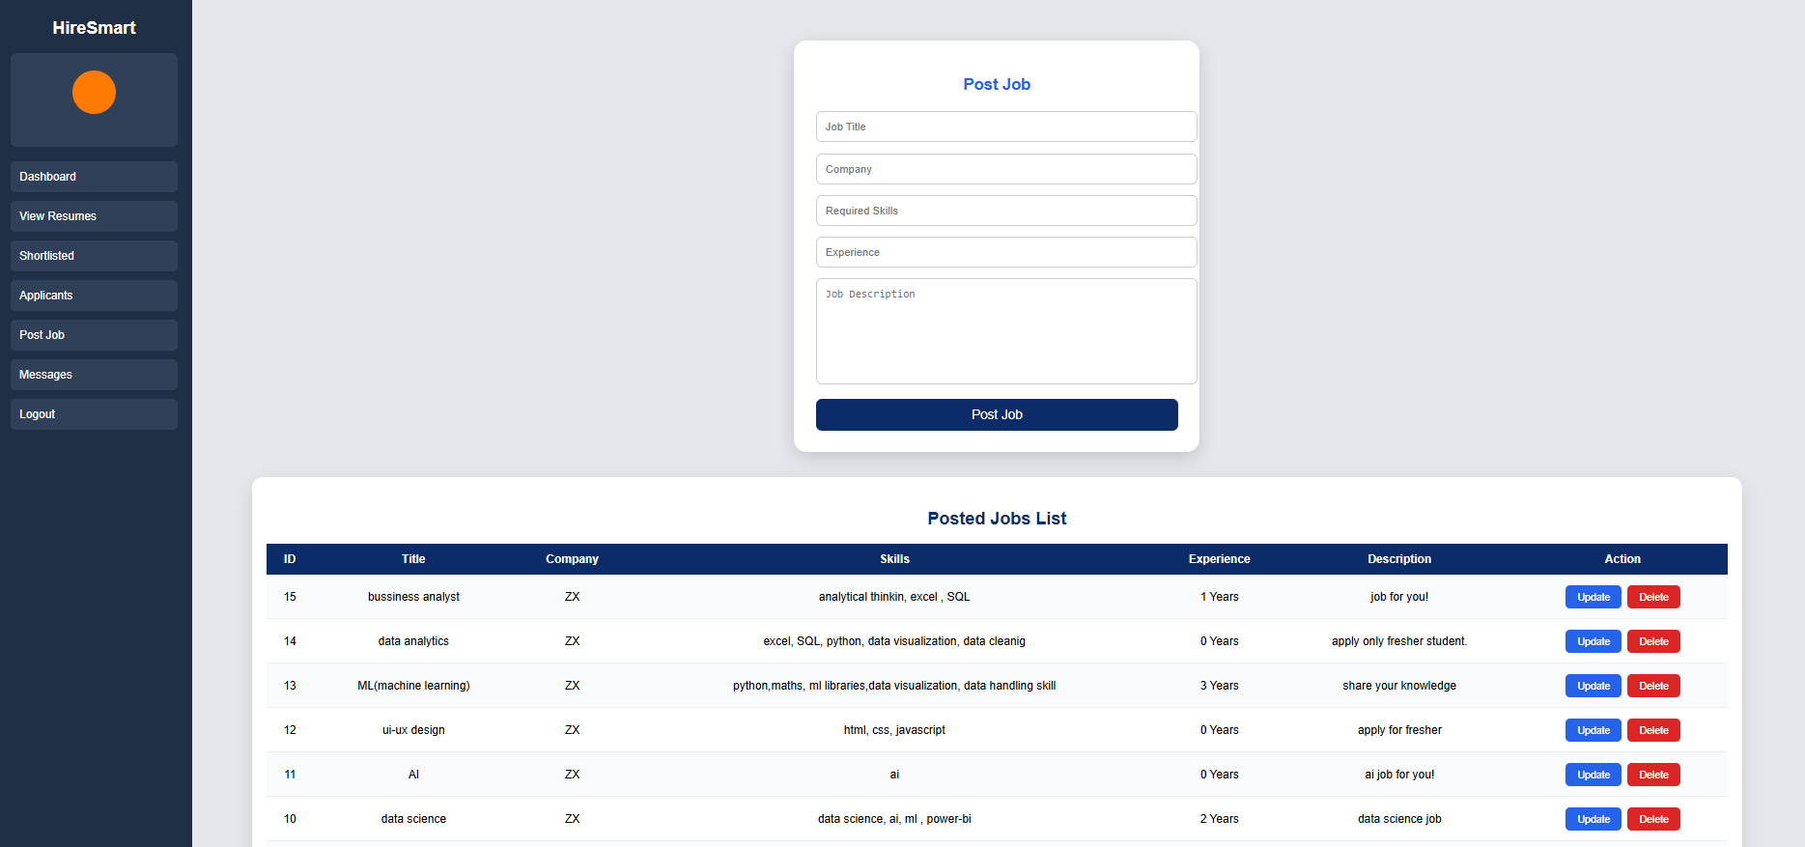
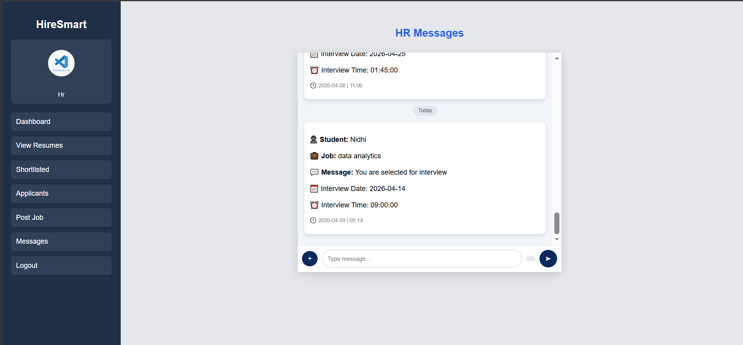
Screen Layout
Post job
Message

Slide 45
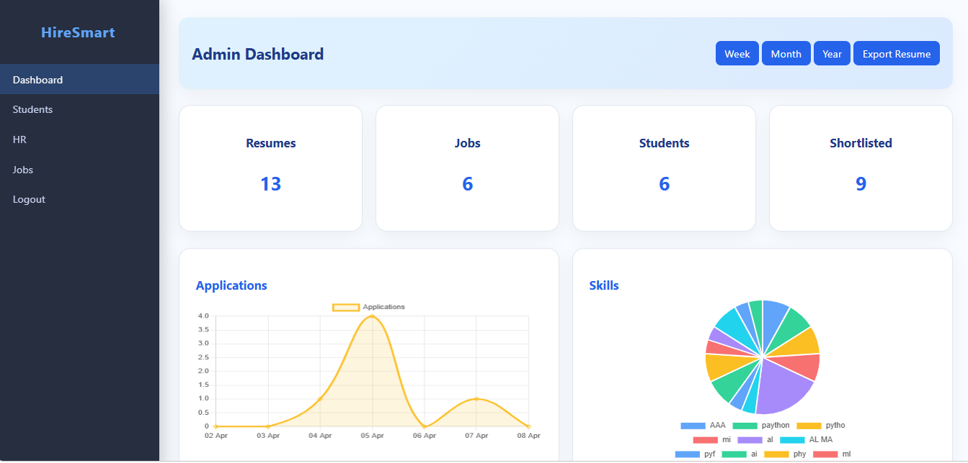
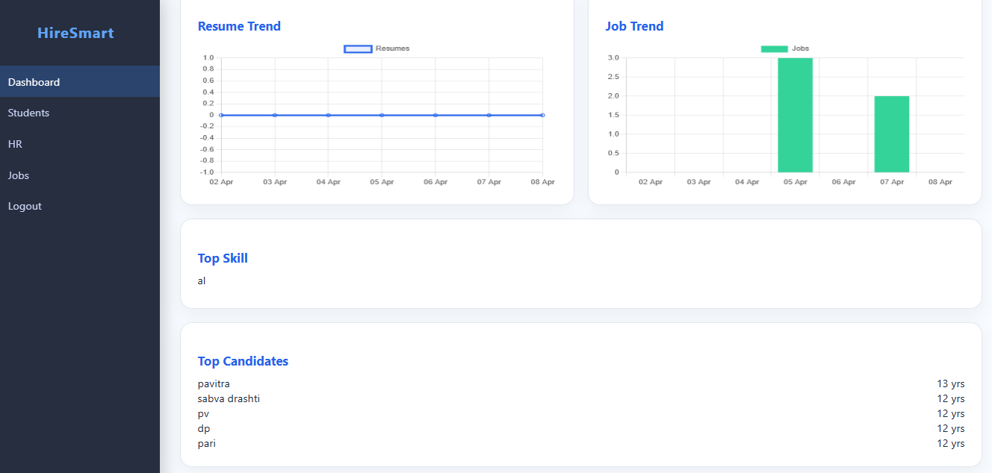
Screen Layout
Dashboard
Dashboard

Slide 46
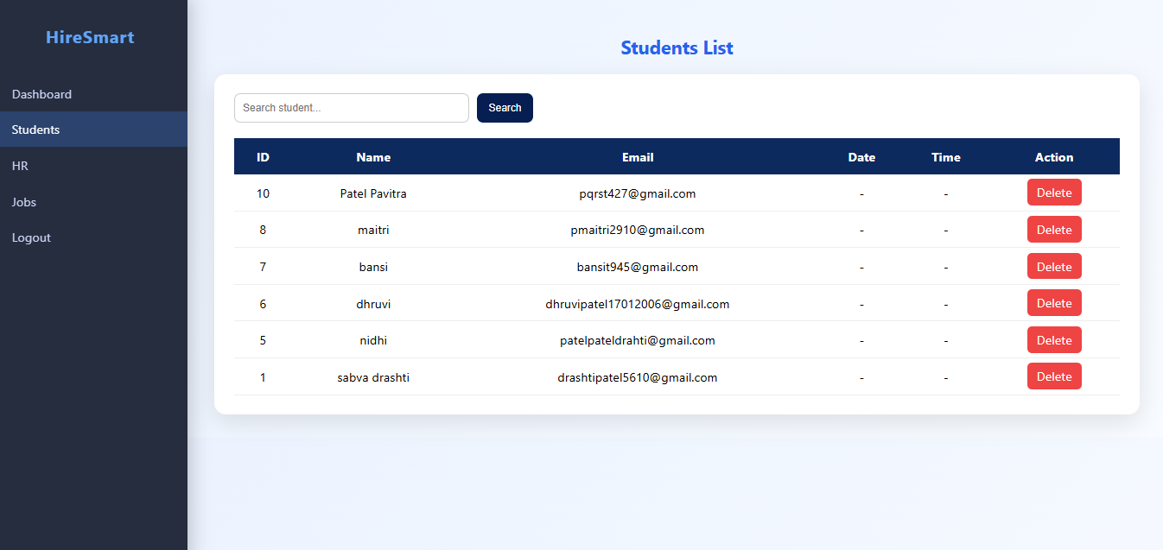
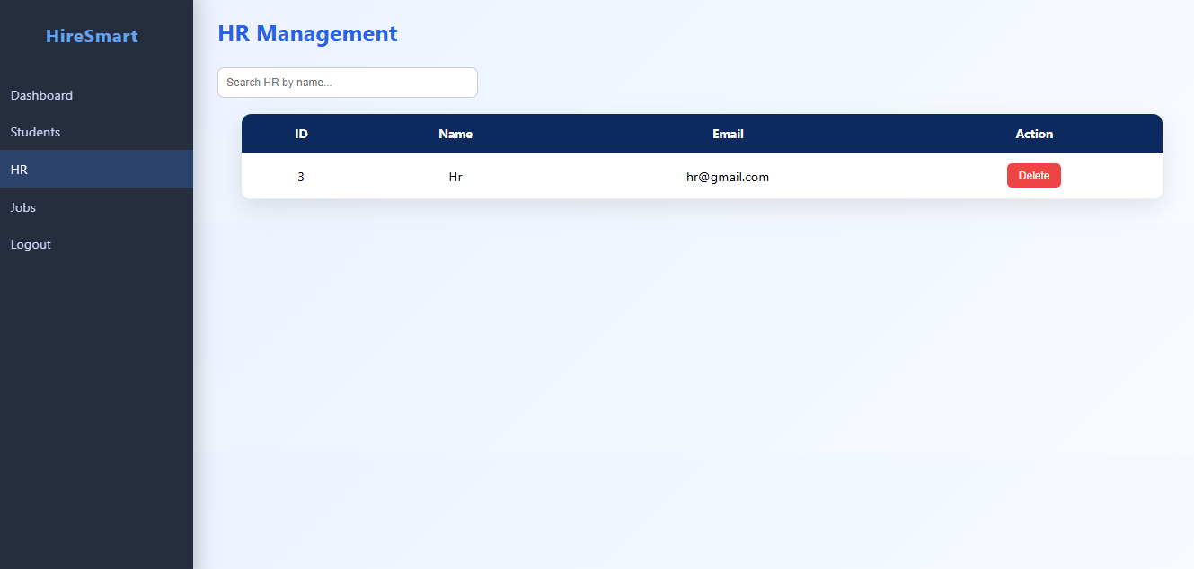
Screen Layout
Student
HR

Slide 47
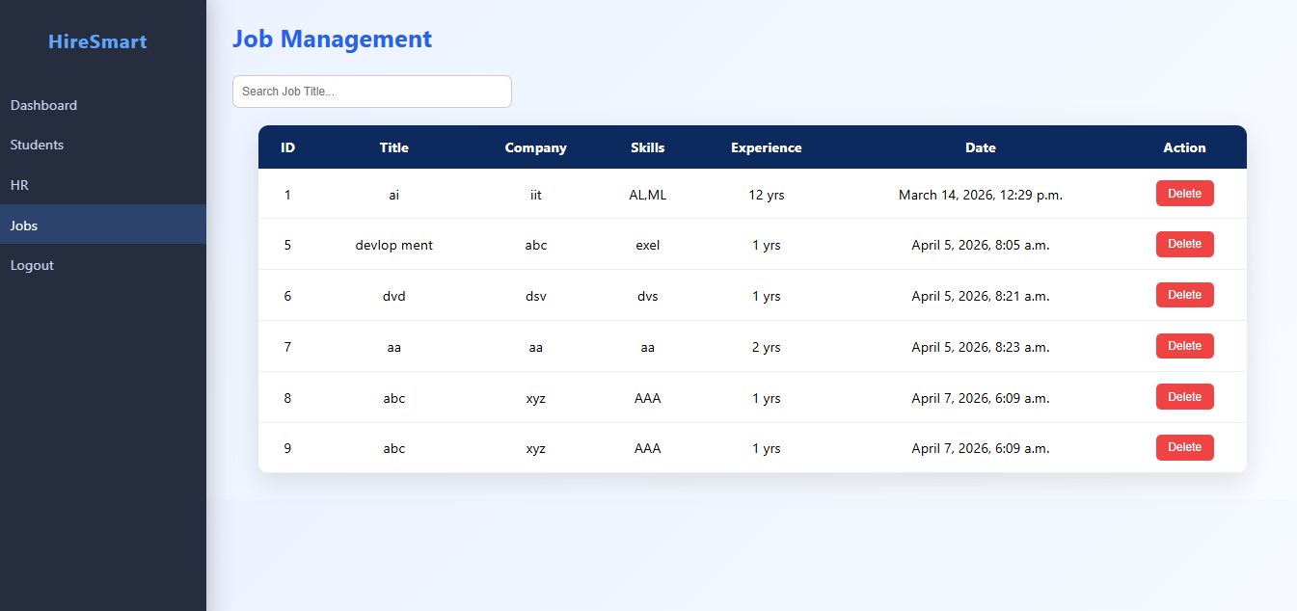
Screen Layout
Jobs

Slide 48
Thank you

