Slide 1
CSE 3522 · DATABASE MANAGEMENT SYSTEMS LABORATORY
PawHome
A pet adoption and boarding management system — built so the database, not the code, holds the rules
Team
Institution
Mir Mukararam Hossain · Nowshin Islam Tonni
United International University
Notes:
Open by naming the system in one line: PawHome manages the whole life of an animal in a shelter's care, not just the adoption. Then state the thesis of the talk — we pushed as much correctness as possible into the database itself, and the interesting part of the project was finding exactly where that stops being possible.

Slide 2
One animal, its whole life in the shelter’s care
A pet is registered, listed publicly, applied for and adopted — and then, as an owned pet, comes back for boarding or a daycare subscription, each with its own rooms, capacity limits, daily care record and bill. Three roles use it: adopter, shelter staff, administrator.
32
69
151
149
base tables
foreign keys
REST endpoints
hand-written queries
290 columns, 4 views
39 CHECK constraints
47 screens, 3 roles
plus 19 migrations
Spring Boot 3.4.1 · Java 17 · React 19 · MySQL 8.4 in Docker · Flyway-owned schema, Hibernate on ddl-auto: validate
Every number here was read from the running database or counted from the source — none estimated.
Notes:
If asked: 290 is base-table columns; the four views define a further 61 on top of those. 149 is the hand-written SQL and JPQL — Hibernate generates a further 90 single-row writes that never appear in the source.

Slide 3
Why we built it
A notebook cannot join
The hard problems are database problems
One pet, several relationships
Small shelters keep records on paper or a spreadsheet. That works for a list of names and fails where it matters — when an animal has a history. Which shots are due, who fed the dog in room 3, whether this family already has an application open elsewhere, how many nights a stay actually ran. Every one of those is a join.
We wanted the difficulty to live in the data, not the interface. A pet must not be double-booked however fast two staff click. A cat room must not take a dog. Approving one application must close every rival in one statement. A bill, once issued, must not change.
The same animal is shelter stock, then an adopted pet owned by a person, then a paying guest in boarding. Two tables duplicate the animal; one table must express in constraints that an owned pet cannot be listed as available. We chose one table and paid for it in CHECKs.
The third point is the modelling decision that made the project worth doing — ck_pets_owner_when_placed is the constraint that enforces it.
Notes:
Land the third point hardest. A pet with an owner cannot be AVAILABLE, and the database refuses the row rather than trusting the service to check.

Slide 4
Key features, by role
Adopter
Staff — one shelter
Administrator
Browse and filter the public catalogue
Matching quiz → trait-scored recommendations
Eligibility quiz, then apply; withdraw while pending
Own pets: edit, add photos, keep vaccinations
Request boarding; follow the stay’s timeline
Daycare subscription; see the pet is on site now
Read their own billing slips
Rooms with species limits and live occupancy
Register pets, photos, traits, cover photo
Review applications; approve closes all rivals
Accept boarding — five capacity checks
Assign and change rooms mid-stay
Check in / out; charges added during the stay
Care tasks, care log, vaccinations
Daycare arrivals board and attendance history
Shelters, and any shelter’s rooms
Users: approve, invite, activate, reassign
Quiz bank: questions, options, trait weights
Analytics — revenue, nights, subscriptions
Recent activity from the audit log
Network-wide billing and reports
Three scheduled jobs run with nobody watching: monthly daycare billing, vaccination reminders, care-task announcements.
Notes:
Do not read the lists. Pick one item per column and say what is behind it: approving an application is one UPDATE that closes every rival; accepting a stay runs five checks under a lock; the analytics tiles all come out of one view.

Slide 5
Database design approach
Put every rule the database can enforce into the database, and accept the cost. A rule in a Java service can be broken by a second service, a script, or a late-night manual UPDATE. A constraint cannot.
3NF, with two departures
Where a CHECK stops
Flyway owns the schema
Surrogate keys, natural keys as UNIQUE, junction tables for many-to-many. Prices are copied on purpose — a shelter raising its rate must not reprice a booked stay or reissue an old bill differently. Four generated columns, two of them only so a partial unique index is possible.
39 CHECKs carry every rule that fits in one row: a stay ends after it starts, a quantity is positive, staff have a shelter and others do not. A CHECK sees one row — so “this room is not full” cannot be one, and becomes a transaction holding a lock.
19 migrations run in order on every boot; Hibernate runs ddl-auto: validate and refuses to start if the entities disagree. A migration that has run is never edited. ENUM values are only ever appended — MySQL stores the index, not the text.
Notes:
The ddl-auto: validate point is worth stressing — the code can never silently change the schema, which is the opposite of the usual Hibernate default.

Slide 6
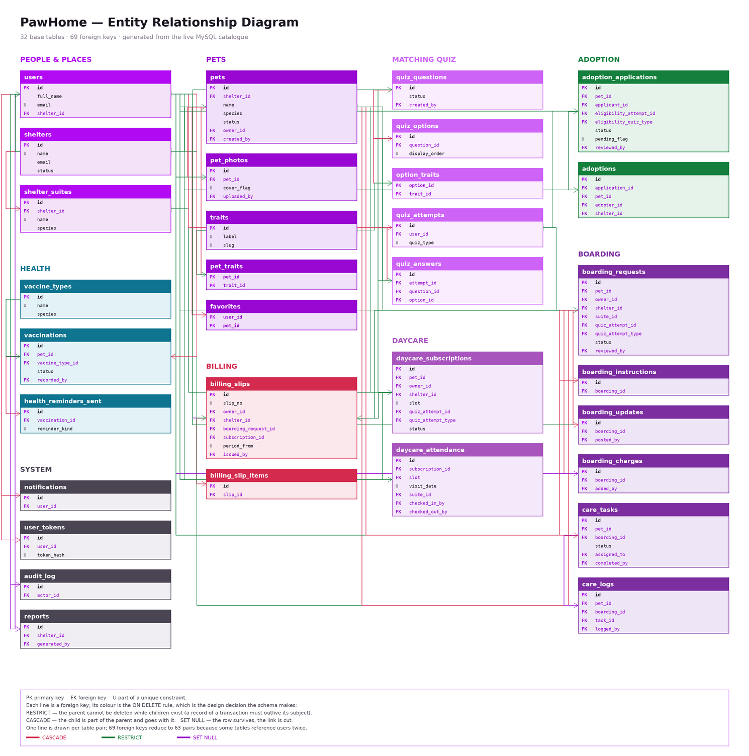
The ERD
32 entities, 69 foreign keys, grouped by subject area. Generated straight from information_schema, so nothing in it was transcribed by hand and it cannot drift from the schema the application actually runs on.
Line colour is the ON DELETE rule, not the relationship — that rule is where the design decisions live.
RESTRICT — 42
a record that must outlive its subject
CASCADE — 21
part of the parent, goes with it
SET NULL — 6
the row survives, the link is cut
Full-size ERD and physical schema: pawhome-diagrams.drawio
Notes:
If asked why 63 lines and not 69: several tables reference users more than once — an applicant and a reviewer, a check-in and a check-out staff member — so one line is drawn per table pair.

Slide 7
Every foreign key answers one question
If the parent goes, what happens to this row? The clearest case is pets, which uses both answers.
CASCADE — describes the pet
RESTRICT — a transaction involving it
pet_photos · pet_traits · favorites · vaccinations · care_logs · care_tasks
A photograph of a dog means nothing once the dog’s row is gone. Cascades chain: deleting a pet takes its vaccinations, and each takes its reminder rows.
adoption_applications · adoptions · boarding_requests · daycare_subscriptions
An adoption is an agreement between two parties. It cannot vanish because the pet record was tidied away — so the pet simply cannot be deleted.
None of this cascading is in Java. There is no CascadeType, no orphanRemoval and no @JoinColumn anywhere — foreign keys are mapped as plain Long columns, so JPA has no object graph and could not cascade if asked. All 21 cascades are ON DELETE clauses in the migrations.
Notes:
Linger here. Same parent, opposite answers, decided entirely by what the child row means. The last paragraph usually gets a question: the database performs every cascade, and we verified it by running the deletes and counting what was left.

Slide 8
Views — 4, all four read by application code
We use a view when a definition must live in exactly one place. The trigger was real drift: what “vaccinated” means had been hand-written in three separate queries, and they had already begun to disagree.
View | The definition it owns | Why a view and not a query
v_pet_listing | The public catalogue row: cover photo, gallery, trait labels, open applications, and what counts as vaccinated | Five screens must agree on “vaccinated”. A comment promising they do was a promise no compiler checked.
v_adopter_traits | The weighted trait profile a quiz attempt produces | Read by the recommendation query and the quiz service — one scoring rule, three call sites.
v_shelter_revenue | Billing by shelter and month, boarding and daycare kept apart | units means nights on a boarding slip and months on a subscription. One summed column would add nights to months.
v_daycare_day | One attendance row with every name attached — eight tables joined | The live board and the history screen cannot disagree about what a visit is.
A view is a correctness tool, not a performance tool — we chose one definition of “vaccinated” over a faster query, knowingly.
Notes:
The honest framing: we did not add views to make anything faster. We added them because the same definition was being retyped. Reading the catalogue through the view is measurably slower than hand-writing it, and we accepted that trade on purpose.

Slide 9
Transactions — 162 @Transactional, 6 pessimistic locks
A transaction does exactly two jobs here: making several writes land all or none, and — with SELECT … FOR UPDATE — enforcing the cross-row rules MySQL cannot state as constraints.
All or none
Locks — rules a CHECK cannot see
Approve an application — close every rival, mark the pet adopted, notify, write the audit row
Check out of boarding — compute nights stayed, copy charges onto a slip, issue it, free the room
Monthly billing job — retire ended subscriptions, then bill the live ones
The audit row has no @Transactional of its own: it joins the caller’s, so it can never record a decision that rolled back
lockOverlappingForPet — one animal, no two overlapping stays
lockOverlappingForSuite — no room filled past capacity
lockById on shelters — the building’s capacity, held while deciding
lockPetSlot, lockSlotAtShelter, lockPetSubscriptionsOver — daycare bands
Under REPEATABLE READ an unlocked read is a consistent but stale snapshot — still wrong when you write based on it
Accepting a boarding request runs five capacity and eligibility checks inside one transaction before anything is written.
Notes:
The one-line version: a CHECK sees one row, so every rule about OTHER rows had to become a lock plus a transaction. That boundary is the most useful thing the project taught us.

Slide 10
Indexes — 124 total, 41 composite, 19 unique beyond the keys
Each one exists for a named query. Column order is part of the design: a composite index is only useful left to right, so it is a statement about which filter comes first.
Index | Serves | Why these columns, in this order
idx_pets_browse (status, species, size) | The public catalogue | Status first, because every catalogue query filters on it; species and size are the filters the page offers next.
idx_boarding_overlap (pet_id, start_date, end_date) | The double-booking lock | Keeps the lock window short. Without it the overlap check is a table scan holding row locks — a correctness feature turned into a throughput problem.
idx_attendance_suite_band (suite_id, visit_date, slot, checked_out_at) | Daycare room occupancy | Answers “who is in this room, on this date, in this band, still here” in one lookup.
uq_pet_cover (pet_id, cover_flag) | One cover photo per pet | MySQL has no filtered index, so cover_flag is a generated column, IF(is_cover,1,NULL) — NULLs do not collide, so the unique index permits many non-covers and exactly one cover.
uq_one_open_app (applicant_id, pet_id, pending_flag) | One open application per pet | The same trick: pending_flag is NULL unless the row is PENDING, so a person may re-apply after a rejection but never have two open at once.
The last two are constraints, not optimisations — an index enforcing a business rule MySQL has no other way to state.
Notes:
The generated-column trick is the thing examiners ask about. Postgres has partial indexes; MySQL does not, so you make a column that is NULL exactly when you want the row exempt, and index that.

Slide 11
Benchmarking — how we compare
Two kinds of product exist in this domain. Petfinder is a listing aggregator — an adopter applies to the shelter, not through it. Shelterluv is a full management platform used by 2,500+ shelters and rescues. Comparing against both is what told us where a student project could sit honestly.
Capability | Petfinder | Shelterluv | PawHome
Public adoptable-pet catalogue | Yes | Yes | Yes
Adopter accounts and favourites | Yes | Partly | Yes
Applications handled in-system | No — passed on | Yes | Yes — review, decline reasons, rival closure
Trait-scored matching quiz | No | No | Yes — unique to PawHome
Medical / vaccination records | No | Yes | Yes — with due-date reminders
Boarding with rooms and capacity | No | No | Yes — unique to PawHome
Daycare subscriptions and attendance | No | No | Yes — unique to PawHome
Daily care tasks and logs | No | Yes | Yes
Billing and itemised slips | No | Yes — donations | Yes
Foster management | No | Yes | No
Donations, microchip, field services | No | Yes | No
Multi-shelter administration | Aggregates listings | Yes | Yes
Three rows appear in neither product: boarding and daycare as capacity-constrained services with rooms and per-stay billing, and matching on temperament rather than breed and distance.
Notes:
Be straight about scope: Shelterluv is far larger than a semester project and we are not claiming to beat it. The claim is narrower and defensible — the three purple rows are things neither product models at all. If asked where we are weaker, point at foster placements, donations and the microchip registry, all named on the next slide.

Slide 12
Limitations
Found by auditing the system against itself — a mechanical cross-reference of all 151 endpoints against every front-end call. It found no broken call, no role mismatch and no ungated private endpoint. It did find these.
Functional gaps
Design limits we accepted
Operational
No admin screen for daycare subscriptions — the endpoint exists and returns data
Quiz questions cannot be reordered after creation
Owners see the stay timeline but not the staff care log
14 repository methods compile and are called by nothing
Cross-row rules are only as strong as going through the service — a direct UPDATE could still double-book
Room fitting uses Hall’s condition: a correct feasibility test, not an optimal arrangement
Reading the catalogue through a view costs more than the hand-written query
The audit log records seven kinds of decision, not every change
Single database, no replication, no automated backup
Photos live on the app server’s filesystem — files and rows can drift apart
No sustained load test was run
One SMTP account — if it is down, verification stalls
We went looking for these. A project that claims no limitations has not been checked.
Notes:
The audit is in the repository as docs/ROLE_AUDIT.md. Offer it if the examiner wants evidence.

Slide 13
Future work
Database
Features
Engineering
A narrower listing view, or a summary table refreshed on write, to remove the catalogue’s view cost
Partition daycare_attendance and boarding_updates by date — both grow without bound
Full-text index on pet name and description; search is a LIKE today
An optimistic-locking version column — the pessimistic locks protect bookings, not concurrent edits
Foster placements — the nearest real gap, and a natural extension of the boarding model
Online payment; the slip already carries everything a payment would reference
Microchip registration, so a found animal traces back to its adoption
A mobile client — check-in and care logging happen away from a desk
Automated tests around the capacity and locking rules specifically — where a regression would be easy to introduce and hard to notice
Backups with a tested restore, and a read replica so reporting cannot slow the operational path
Object storage for photographs, with the database as the only index
Notes:
If time is short, name only foster placements and the capacity tests. Both follow directly from what is already built.

Slide 14
How much of a system’s correctness
can live in the database?
Most of it — but not all, and the boundary is sharp. 39 CHECKs and 69 foreign keys carry every rule that fits inside one row or one relationship. The rules that span rows cannot be stated declaratively in MySQL at all, and became transactions holding locks.
Learning to tell those two categories apart was the most useful thing this project taught us.
Every number in this deck was read from the running database or counted from the source — none estimated.
Thank you — questions?
Notes:
Close on the question, not on a summary of features. If the examiner wants one concrete thing, offer the ON DELETE policy: 69 foreign keys, three different answers, each decided by what the child row means.

