Slide 1
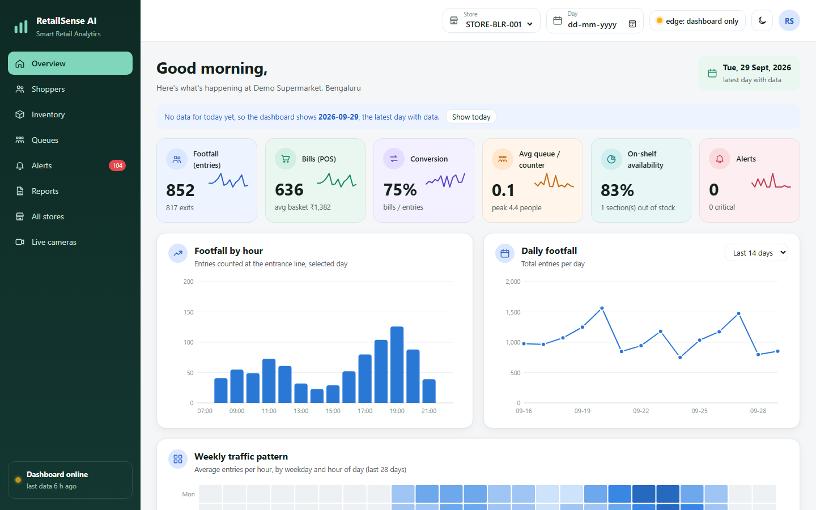
SMART INDIA HACKATHON 2025
नज़र – RetailSense AI
Edge-AI Retail Intelligence Platform: Shopper Analytics, Shelf Monitoring & Queue Prediction on In-Store Cameras
Problem Statement ID
[Enter PS ID]
Problem Statement Title
AI-powered retail intelligence with on-device (edge) AI
Theme
[Enter Theme]
PS Category
Software
Team ID
[Enter Team ID]
Team Name
[Enter Team Name]
Working prototype: live store dashboard
Notes:
Title slide. Apni team ki details (PS ID, Theme, Team ID, Team Name) laal brackets wali jagah par bharna. Ek line mein bolna: RetailSense AI store ke CCTV ko smart banata hai - bheed, khaali shelf aur billing queue ko store ke andar hi AI se samajhta hai, bina internet ke.

Slide 2



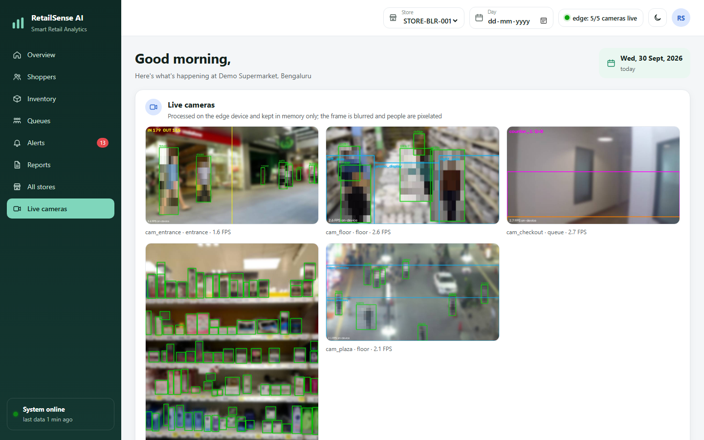
[Team Name]
नज़र – RetailSense AI
SMART INDIA
HACKATHON 2025
Edge-AI Retail Intelligence for Indian Stores
Understanding the Problem
Our Unique Solutions
Empty shelves go unnoticed: about 8% of items are out of stock at any time and shoppers buy elsewhere.
Long billing queues: managers see the rush too late; shoppers leave the line.
No shopper insights: stores don't know footfall, peak hours or which displays work.
Cloud CCTV analytics is costly: needs fast internet and sends video outside (privacy risk).
Weak internet in Tier-2/3 towns: cloud tools stop working during outages.
Works on existing CCTV: uses the store's own RTSP cameras.
Runs on a ₹35k mini PC: no GPU, 3 cameras on one CPU (measured).
Privacy by design: no faces or photos stored, only anonymous counts.
Predicts, not just reports: queue forecast from entrance footfall.
"Mark as Full" calibration: compares a shelf with its own full photo.
Offline-first: stores data locally, syncs to HQ when online.
POS / ERP ready: bills via CSV/API, auto refill orders.
Our Solution
Footfall Counting: counts people entering and leaving with a virtual line.
Heatmaps & Dwell Time: shows where shoppers walk and how long they stay.
Shelf Monitoring: finds empty slots and low stock from shelf cameras.
Queue Intelligence: measures waiting time and predicts queues 15 min ahead.
Smart Alerts: tells staff to refill a shelf or open a counter.
Edge AI: all AI runs inside the store, works without internet.
Dashboard & Reports: daily/weekly footfall, conversion, availability.
USPs
Real-time footfall, dwell & heatmap
Empty-shelf alerts in minutes
15-min queue forecast + counter advice
100% on-device, privacy-first
Prototype (working today)
5 live cameras processed on a laptop CPU
Shelf model mAP50 0.93 on unseen images
Dashboard, alerts, reports, 33 tests pass
WORKING PROTOTYPE IS READY – TESTED ON REAL PUBLIC VIDEOS & BENCHMARK DATASETS
Notes:
Problem: store mein khaali shelf, lambi billing line aur customer ka data nahi hota. Cloud CCTV mehnga hai aur internet chahiye. Solution: store ke purane CCTV + ek chhota PC. AI andar hi chalta hai: log ginta hai, heatmap banata hai, khaali shelf pakadta hai, queue ka 15 minute pehle anumaan lagata hai, aur staff ko alert bhejta hai. Chehre ya photo save nahi hote.

Slide 3















[Team Name]
Technical Approach
SMART INDIA
HACKATHON 2025
Methodology
User Interface (store dashboard)
Implementation Flow
Capture: read CCTV streams (RTSP) at 3–10 FPS on the in-store edge box.
Detect: YOLO11 finds people and shelf products (trained on SKU-110K, 11,743 shelf photos).
Track: ByteTrack gives each shopper an anonymous ID (no face data).
Analyse: line counting, zone dwell, heatmap, queue length, empty-slot detection.
Predict: LightGBM forecasts the queue 15 min ahead; Erlang-C suggests counters.
Act: alerts + dashboard; data kept in SQLite (offline) and synced to HQ.
Entrance cam
Floor cam
Checkout cam
Shelf cam
Frame sampler (3–10 FPS)
Edge AI: YOLO11 detect + ByteTrack
Footfall, dwell, heatmap
Queue + 15-min forecast
Shelf empty slots
Live Cameras (edge AI output, privacy-blurred)
Issue found?
Yes
Alert staff
Tech Stack
No / log
Local DB (SQLite, offline)
Python
PyTorch
YOLO11
OpenCV
ONNX
LightGBM / sklearn
Dashboard & reports
FastAPI
SQLite
Docker
JS Dashboard
Colab T4 GPU
Pandas
HQ sync (optional)
Notes:
Kaise kaam karta hai: camera se frame lete hain (3-10 per second), YOLO11 log aur products dhoondhta hai, ByteTrack har insaan ko ek anonymous number deta hai. Phir counting, heatmap, queue aur khaali shelf nikalte hain. Koi problem mile to staff ko alert. Sab data store ke andar SQLite mein, internet aane par HQ ko sirf numbers jaate hain. Shelf model Google Colab T4 GPU par train kiya.

Slide 4
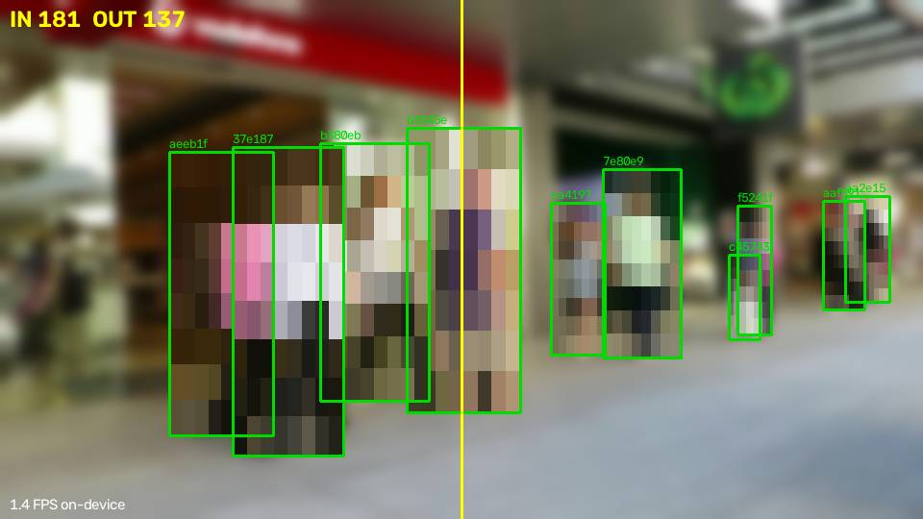
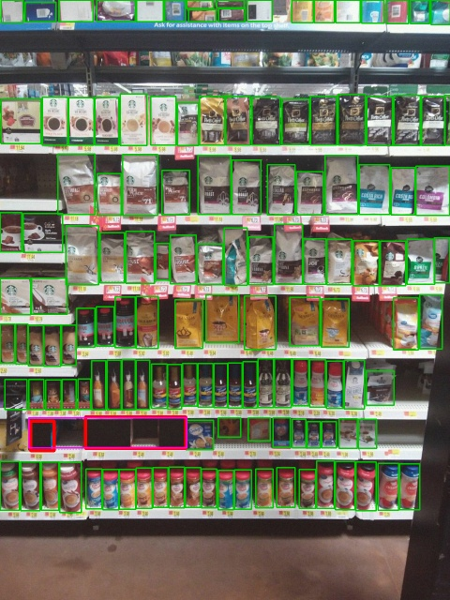

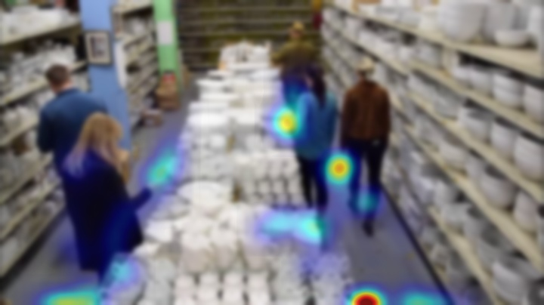
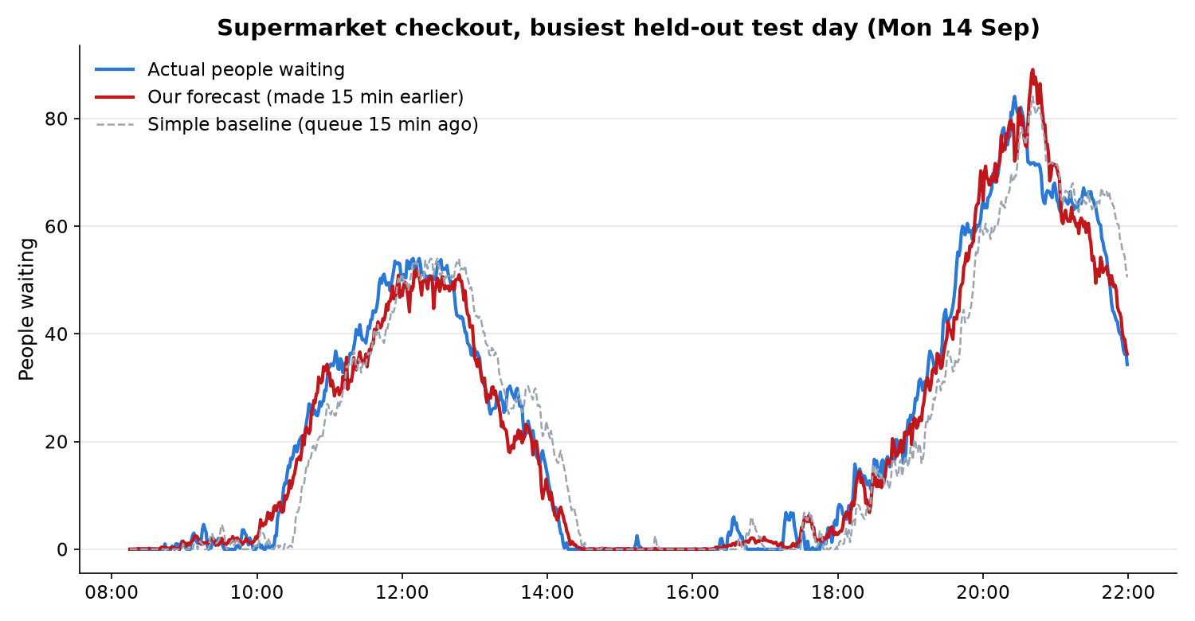
[Team Name]
Prototype Output & Results
SMART INDIA
HACKATHON 2025
Key Results (unseen test data)
0.93
mAP50 of our shelf detector on 2,936 unseen shelf photos
89%
product count accuracy per shelf photo
1. Footfall counting: live IN / OUT, people pixelated (MOT17 mall video)
2. Shelf monitoring: products (green), empty slots (red)
83%
empty-slot alerts at the right place (fixed camera)
27%
lower queue forecast error than the simple baseline
64%
footfall count accuracy on crowded street videos with human ground truth
3 cams
run together on one laptop CPU, no GPU
3. Shopper heatmap: where people walk and stop
4. Queue forecast on a festival rush day: error 2.8 vs 4.7 people for the baseline
Notes:
Yeh sab asli output hain, fake nahi. Shelf model ko 2936 aisi photos par test kiya jo training mein nahi thi: mAP50 0.93. Footfall ko MOT17 benchmark par insaano ke label se match kiya: bheed wali sadak par 64% (store darwaze par isse behtar hoga). Queue forecast simulated data par hai - asli store ke 2-4 hafte ke data se dobara train hoga.

Slide 5



[Team Name]
Impact and Benefits
SMART INDIA
HACKATHON 2025
Impact on Store Operations
Benefits for Shoppers & Chains
Fewer empty shelves: staff get refill alerts before shoppers notice.
Shorter queues: open a counter 15 minutes before the rush.
Better staffing: plan shifts from real footfall and peak hours.
Smarter layout: heatmaps show which aisles and promos work.
No manual counting: daily and weekly reports are automatic.
Products available: shoppers find what they came for.
Less waiting: faster billing, better experience.
Privacy respected: no faces, no photos, only numbers.
Works offline: reliable in Tier-2/3 towns with weak internet.
Multi-store view: HQ sees all stores on one screen.
Economic and Strategic Gains
Recover lost sales: stock-outs cost retailers about 4% of sales (global GMA study); faster refills win this back.
Low cost: runs on existing CCTV + a ₹35–50k mini PC; no cloud video bills.
Huge data saving: 1.2 MB/day per camera instead of 12.6 GB of video (99.99% less).
Big market: India has ~13 million kirana stores and a US$ 1 trillion+ retail market.
Future ready: fits DPDP Act 2023 (privacy) and scales from one shop to a national chain.
Notes:
Store ko fayda: khaali shelf jaldi bharna, rush se pehle counter kholna, staff sahi time par. Paisa: stock-out se lagbhag 4% sales jaati hai (GMA global study) - hum wapas laate hain. Kharcha kam: purane CCTV + ek chhota PC. Chart ke numbers humare apne prototype ke measurement hain, andaze nahi.

Slide 6


[Team Name]
Feasibility and Viability
SMART INDIA
HACKATHON 2025
Analysis of the Feasibility of the Idea
Proven AI: YOLO + ByteTrack are industry standard; our models are trained and tested.
Hardware ready: runs on a CPU mini PC; Jetson / OpenVINO for more cameras.
Uses existing cameras: RTSP from Hikvision / CP Plus / Dahua NVRs.
Open datasets: SKU-110K, COCO, MOT17: no private data needed to start.
Reliable offline: local database, auto camera reconnect, sync later.
Easy install: one Docker command + zone-drawing helper tool.
WHAT IFs....?
Strategies to Overcome Challenges
01
Internet goes down?
02
A camera fails?
03
AI makes a mistake?
04
Shoppers worry about privacy?
05
Store has a small budget?
Low computing power: light YOLO11n, 3–10 FPS sampling, higher resolution only for the entrance camera.
Limited Indian retail data: start with open datasets, then fine-tune on store photos using free Colab GPU.
Crowded entrances: angled camera over the door, 960 px input, jitter-proof counting (tested on MOT17).
Counting bias on odd shelves: per-camera 'Mark as Full' baseline cancels the bias.
Everything runs offline in the store; data syncs to HQ later.
Other cameras keep working; the camera reconnects automatically.
Confidence limits, alert cooldown, staff can acknowledge; recalibrate with 'Mark as Full'.
No faces or photos saved; anonymous IDs reset daily; clear signage.
Existing CCTV + ₹35k PC; one box serves three cameras.
Notes:
Feasible kyun hai: models already train aur test ho chuke hain, sasta hardware, purane camera. What-if: internet gaya to offline chalega, camera kharab to baaki chalte rahenge, AI galti kare to staff acknowledge/recalibrate kar sakta hai. Chart mein humare apne sudhaar: pehla version vs fix ke baad.

Slide 7

[Team Name]
Research & References
SMART INDIA
HACKATHON 2025
Feature | Our Proposed Solution | Existing Conventional Solutions
Where AI runs | Edge: inside the store, on a small PC | Cloud servers far away
Internet need | Works offline; syncs numbers later | Needs constant, fast internet
Privacy | No faces / photos stored; anonymous counts | Video uploaded to the cloud
Cost | Existing CCTV + ₹35–50k PC | Subscription + high bandwidth bills
Shelf checking | Automatic empty-slot alerts | Manual audits / staff rounds
Billing queues | Predicts 15 min ahead, advises counters | Reacts after the queue forms
Shopper insights | Footfall, dwell, heatmap, conversion | Only CCTV recording
Research and Dataset References
SKU-110K — dense retail shelf dataset (CVPR 2019)
https://github.com/eg4000/SKU110K_CVPR19
MOT17 — people-tracking benchmark with ground truth
https://motchallenge.net/data/MOT17/
COCO — person detection dataset
https://cocodataset.org
ByteTrack — multi-object tracking (ECCV 2022)
https://arxiv.org/abs/2110.06864
Ultralytics YOLO11 — real-time detector
https://docs.ultralytics.com
Out-of-Stock Detection — Sensors 2024 (shelf voids)
https://pmc.ncbi.nlm.nih.gov/articles/PMC10819825/
Retail Out-of-Stocks — worldwide study, GMA 2002
https://www.supplychain247.com/images/pdfs/GMA_2002_Worldwide_OOS_Study.pdf
Kirana modernisation — Invest India
https://www.investindia.gov.in/team-india-blogs/modernization-kirana-stores-india
DPDP Act 2023 — India data-protection law
https://www.meity.gov.in/data-protection-framework
IBEF Retail India — Indian retail market data
https://www.ibef.org/industry/retail-india
Erlang-C queueing model — counters needed for a target wait
https://en.wikipedia.org/wiki/Erlang_(unit)
Notes:
Existing solutions cloud par chalte hain, internet aur paisa zyada lagta hai, video bahar jaata hai. Hum store ke andar chalte hain. References: datasets jin par train/test kiya (SKU-110K, COCO, MOT17), research papers (ByteTrack, out-of-stock detection) aur India ke data (Invest India, DPDP Act).

