Slide 1
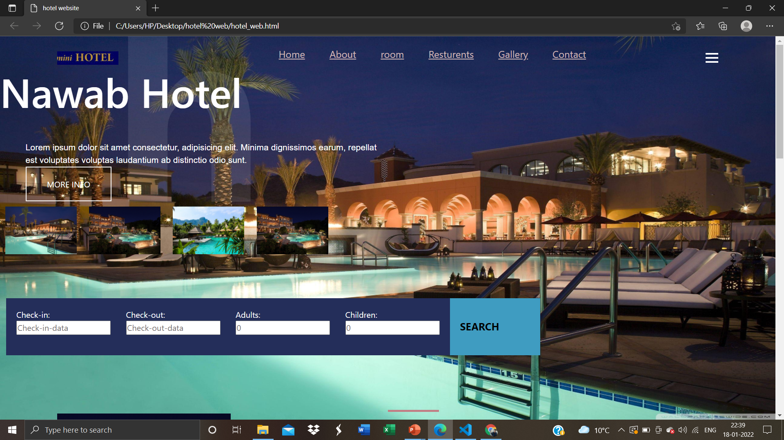
Hotel website
Web development based project
Developed by :- Akash Kashyap

Slide 2
Overview
this project is totally dynamic and responsive type . In this project our goal is to build a responsive and attractive hotel website and for good looking I added some animation and hover effects ,With using bootstrap 5 and javaScript . In this web page there is multiple pages added so whenever you click any button so you will get that page. This website totally divided in 8 sections like home ,gallery ,rooms ,food , feedback and contact, every section contains all the details, and images according to that section ,and in the last we have a footer section so in this section i added all the highlighted details about this hotel and also there is a book now button that links with contact page and in the last line of this web there is a copyright mark with hotel web name and contact number.

Slide 3
Software Requirements
IDE/Text Editor:
* Visual Studio Code Browser:
* Git Bash CLI * Safari
Front End : * Google Chrome
*HTML5 * Mozilla FireFox
*CSS3
*JavaScript
*Bootstrap5

Slide 4
Objective
Provide users with clear and precise information referring to their search criteria.
Reassure them about your hotel’s quality, value and significance.
Make it a dream and desire for them to stay at, and experience your hotel.
Allow them to easily check rates and availability so they can book their rooms promptly and effortlessly.

Slide 5
System users
Admin :Use case of admin are managed payments, manage booking , manage customers , manage hotel , manage rooms ,managed services , manage user and full hotel booking system operations .
User : Use case of system user are managed payments , manage booking , manage customers , manage hotel , manage rooms manage services .
Hotel : use case of hotel are check booking request , allot rooms , create invoice , collect payments .
Customer : Use case of customers are search hotels , book rooms, make payments .

Slide 6
Use case diagram of hotel booking system
Manage Users And Full application
Book Rooms
Admin
Manage Hotel
Search Hotels
Customer
Manage Customer
Make Payments
Login And Logout From System
Update My Profile
Change Account password
Manage Rooms
Allow Rooms
Manage Services
Collect Payments
Hotel
System User
Manage Payments
Checked Booking Request

Slide 7
Thank You
.

