Slide 1

Project-64(P64)
NATURAL LANGUAGE PROCESSING
Hotel Rating Classification
Pawan Dharam Singh
Mentor- Mr.Parth
Starting date- 26/07/2021

Slide 2
Business Objective
Extract reviews from trip advisor and ratings for different hotels and our goal is to examine how travelers are communicating their positive and negative experiences in online platforms for staying in a specific hotel and major objective is what are the attributes that travelers are considering while selecting a hotel. With this manager can understand which elements of their hotel influence more in forming a positive review or improves hotel brand image.

Slide 3
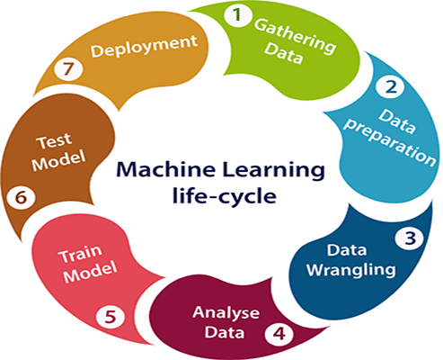
Project Flow

Slide 4

Web Scraping

Slide 5
Data Extraction
Web Scraping - Beautiful Soup
Web scraping can help us to extract any kind of data that we want.
So that we can able to retrieve, analyze and use the data the way we want.
So web scraping simplifies the process of extracting data, speeds it up by automating it and creates easy access to the scrapped data by providing it in a CSV format.
Beautiful Soup is a Python package for parsing HTML and XML documents.
It creates a parse tree for parsed pages that can be used to extract data from HTML, which is useful for web scraping. Beautiful Soup supports the HTML parser included in Python’s standard library, but it also supports a number of third-party Python parsers. One is the lxml parser.

Slide 6
Reviews extraction from TripAdvisor
Hotel – Strand Palace-London_England
TripAdvisor is the most popular website to search for best hotels.
Scrape TripAdvisor reviews provide very useful data
So using scraped reviews a customer can do sentiment analysis or create a recommendation engine to find best places or a hotel.
We are using https://www.tripadvisor.in/Hotel_Review-g186338-d193112-Reviews-Strand_Palace-London_England.html to extract reviews as this hotel has 12000+ reviews.

Slide 7
Prerequisite:- Requests , BeautifulSoup
Module needed:
bs4: Beautiful Soup(bs4) is a Python library for pulling data out of HTML and XML files.
requests: Requests allows you to send HTTP/1.1 requests extremely easily.
Use Beautiful Soup to extract href links
html = urlopen("http://kite.com")
soup = BeautifulSoup(html. read(), 'lxml')
links = []
for link in soup. find_all('a'):
links. append(link. get('href'))
print(links[:5]) print start of list.

Slide 8
Steps to extract reviews from TripAdvisor using Beautiful Soup
Step 1: Find the URL you want to scrape.
Step 5: Isolating the results:
Step 6: Saving all the reviews to CSV file
Step 4: Web Scraping Code
Step 2: Identify the structure of the sites HTML
Step 3: Install Beautiful Soup and Requests

Slide 9
EXPLORATORY DATA ANALYSIS (EDA)
Cleaning Data
Remove special characters using library re
Spell Check using library autocorrect
Expanding Contractions using library contractions
Removing Punctuations
Tokenization using library nltk
Converting Uppercase letters to Lowercase
Removing Stopwords using library nltk
Count Number of Words in single review
Number of characters in single review
Stemming
Lemmatization

Slide 10
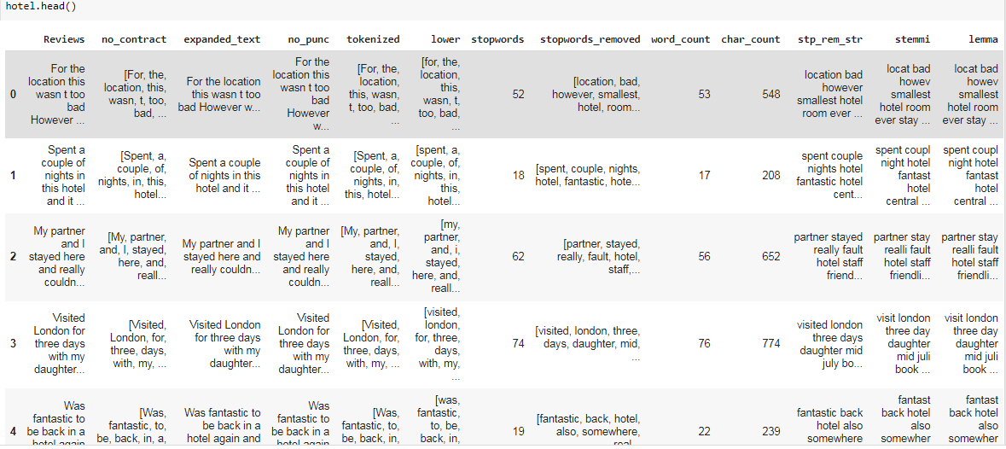
Cleaned data

Slide 11
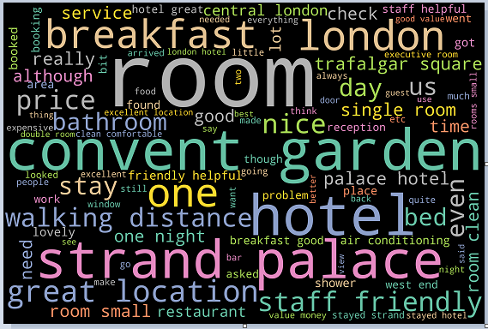
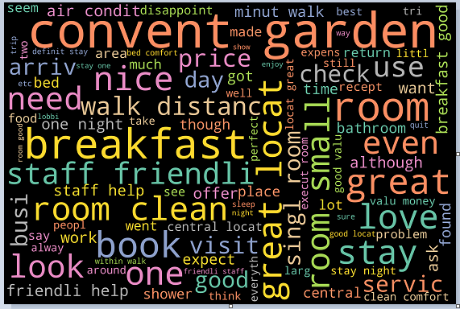
Wordcloud
There are some words which are not much useful for our classification problem.
So , we have removed those words from our dataset for getting better classification .
These the word clouds of before and after removal of such words.
Before removing unwanted words
after removing unwanted words

Slide 12
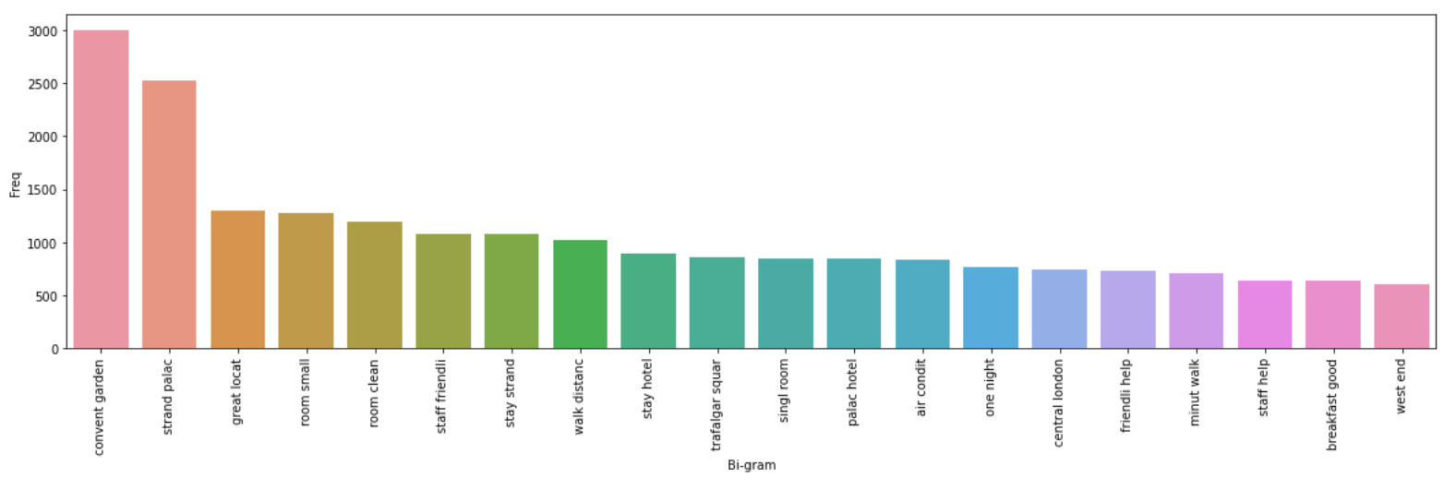
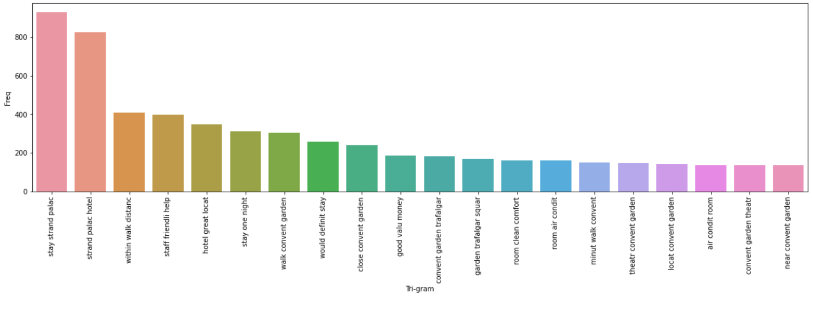
These are top 20 Bi-gram
and Tri-gram word used
in reviews.

Slide 13
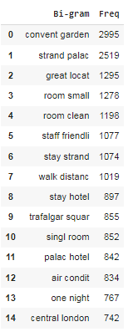
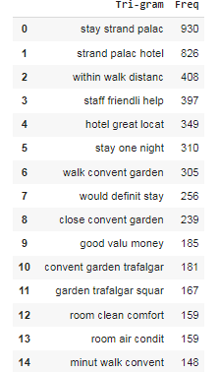
These are top 15 Bi-gram and Tri-gram word used in reviews.

Slide 14
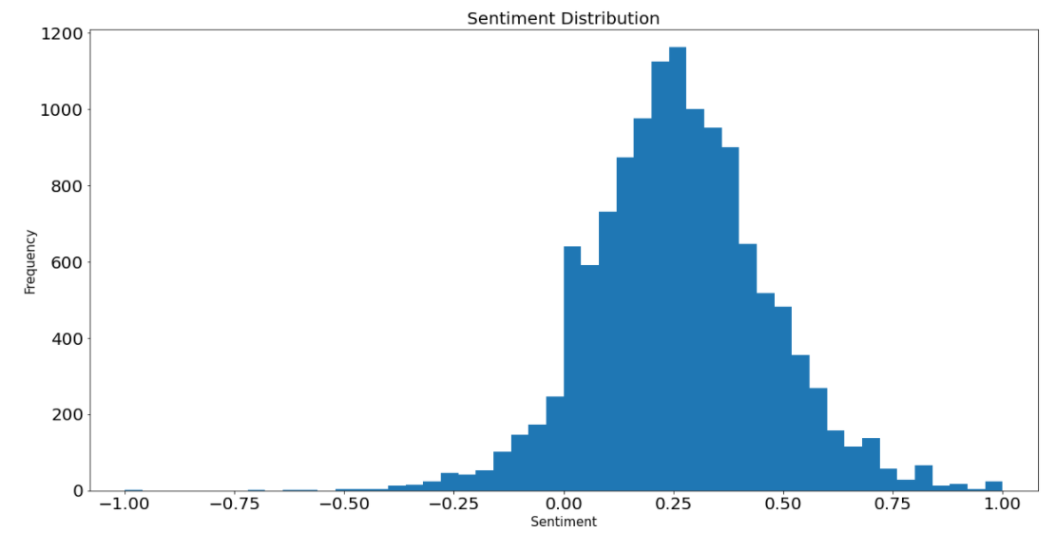
Sentiment Analysis
From graphical representation it is clear that most of the sentiments values are more than 0 i.e positive sentiments.

Slide 15
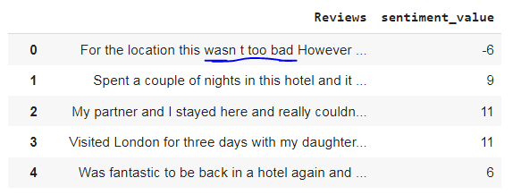
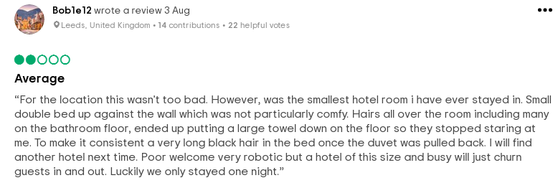
Sentiment value for 5 reviews
From sentiment analysis we got 1st review as negative
And confirm from the hotel review web side

Slide 16
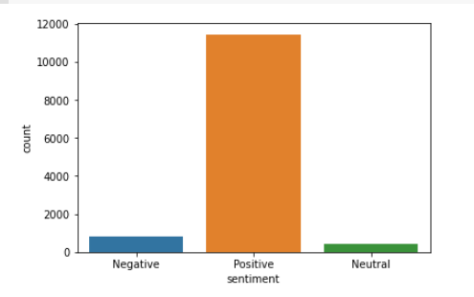
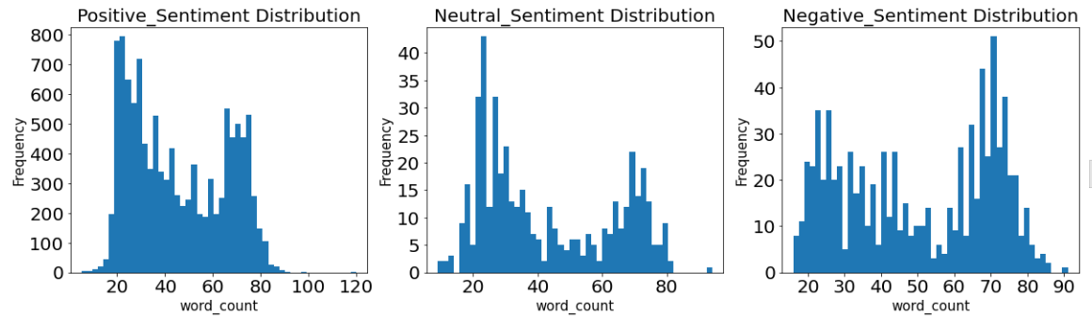
Sentiment Distribution
The reviews having sentiment value more than 0
are consider as Positive, less than 0 are consider
as Negative review and having 0 as Neutral review.
Out of 12732 reviews more than11000 reviews are of positive sentiments

Slide 17
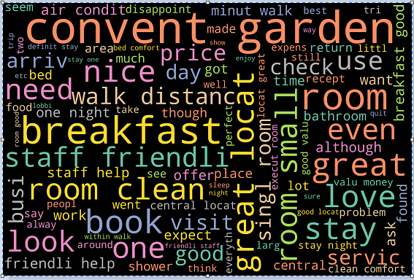
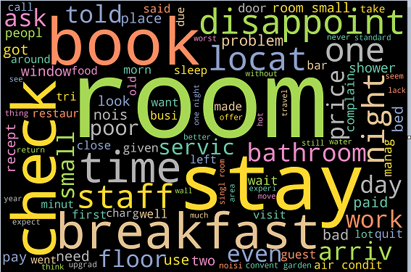
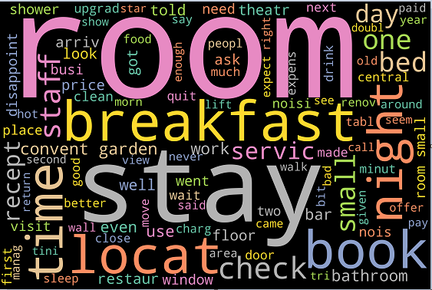
Wordcloud for positive reviews
Wordcloud for Negative reviews
Wordcloud for neutral reviews

Slide 18
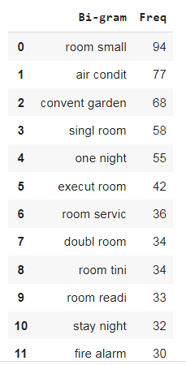
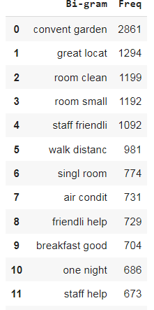
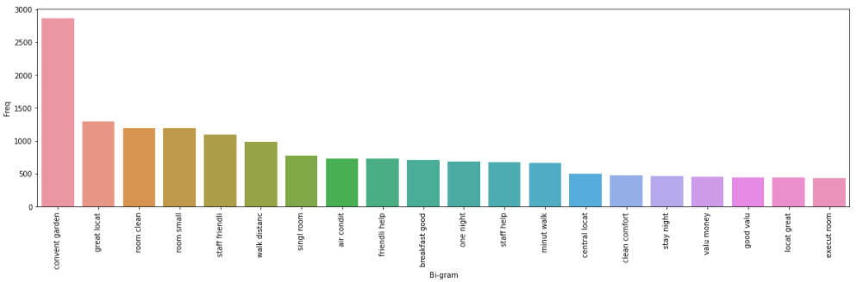
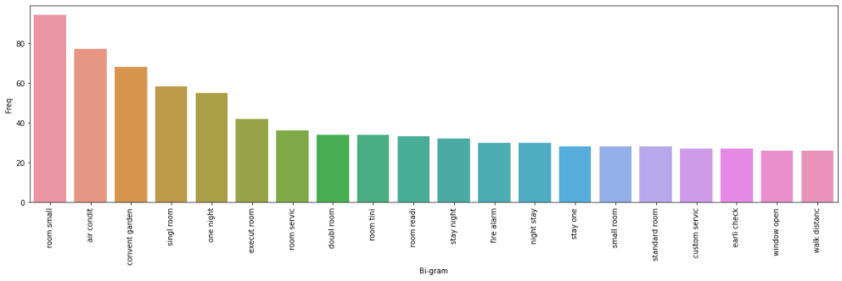
Top few Bi-Gram for Positive and Negative Reviews

Slide 19
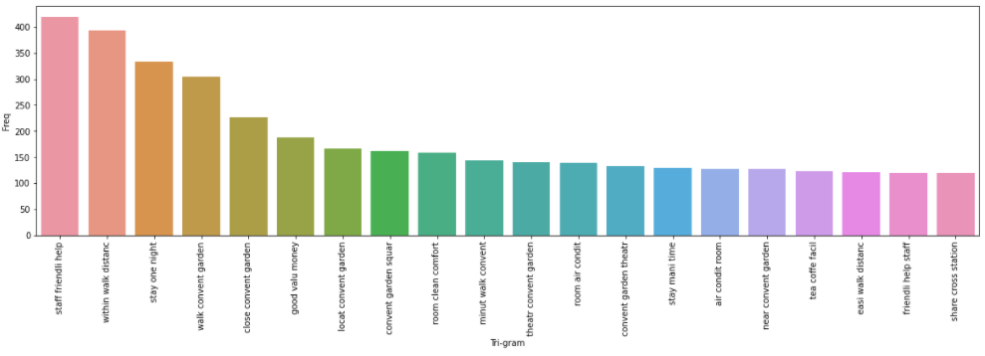
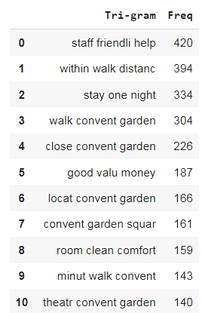
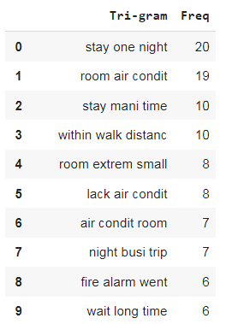
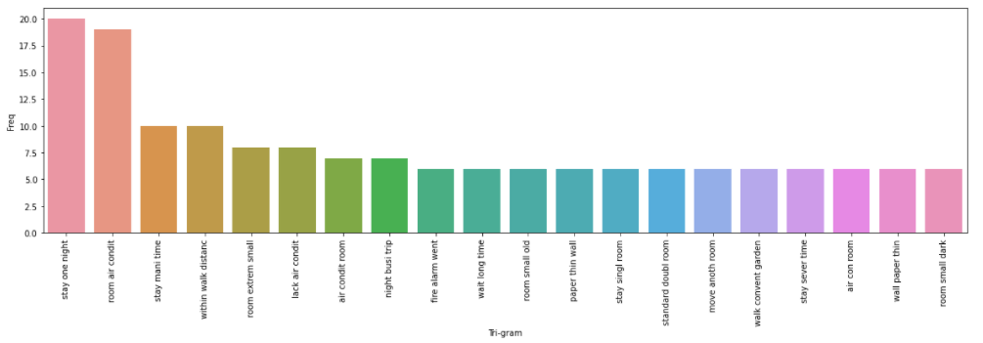
Top Few Tri-Gram for Positive and Negative Reviews

Slide 20
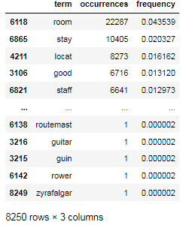
FEATURE EXTRACTION
Applied the Feature Extraction technique Count Vectorization. It is showing the words with most and least occurrences and their frequencies.
It helps us in dealing with most frequent words.

Slide 21
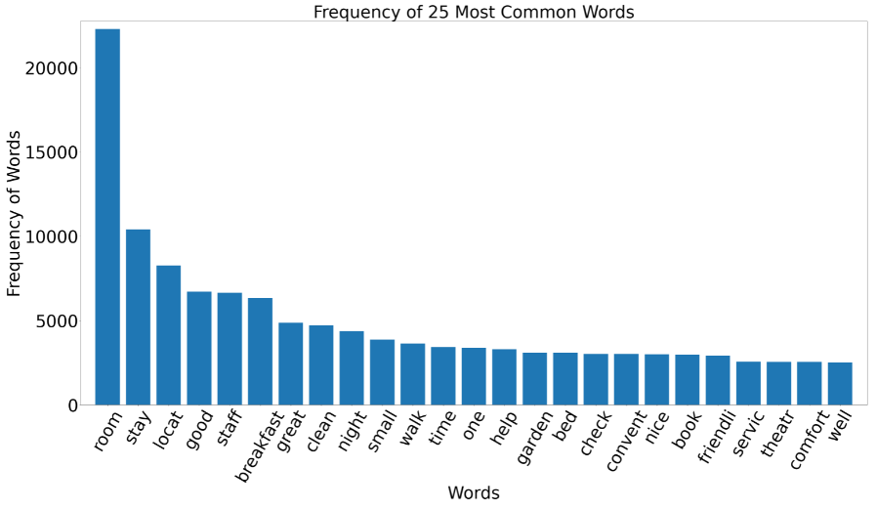
Frequency of 25 Most Common Words
These are the top 25 words in reviews and their frequency.
The word “room” is used more than 22000 times in the reviews.

Slide 22
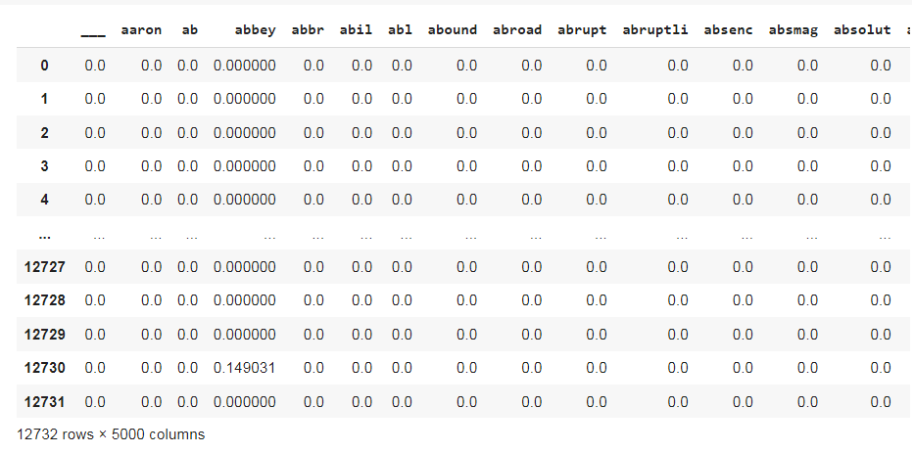
Another Feature Extraction technique TFIDF( term frequency–inverse document frequency). It is showing the weights of term's frequency (TF) and its inverse document frequency (IDF).
By TFIDF we can know how relevant a term is in a given document.
Using this TFIDF we can get better accuracy while building

Slide 23
MODEL BUILDING
After performing EDA and Feature Extraction on our dataset we have stared model building.
We have divided the data into Train and Test with 33% as Test
We used SMOTE method for balancing the minority class in our dataset.
The models we have build are
Logistic Regression Model (Basic classification model)
XGBoost
Support vector Machine (SVM) Model
Random Forest classification
Multinomial Naive Bayes
All the ML models are built with both default data and data with features to see the variation .

Slide 24
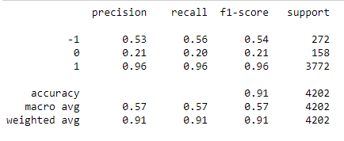
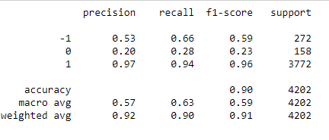
Logistic Regression Model
It is a classification algorithm. It is used to predict a binary outcome (1 / 0, Yes / No, True / False) given a set of independent variables. In simple words, it predicts the probability of occurrence of an event by fitting data to a logit function, multi_class='multinomial'
Logistic regression on BOW CountVectorizer balanced data
Accuracy of Training data = 92.10%
Accuracy of Test data = 90.57%
Logistic regression on TFIDF on balanced data
Accuracy of Training data = 98.7%
Accuracy of Test data = 89.3%

Slide 25
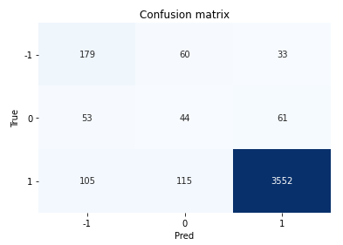
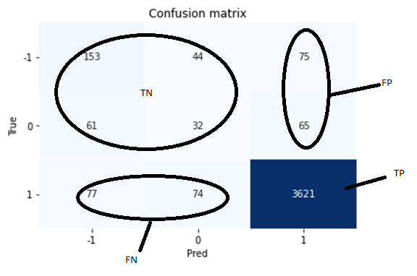
These are the Confusion matrix
Logistic regression on BOW CountVectorizer balanced data
Logistic regression on TFIDF on balanced data

Slide 26
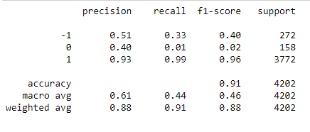
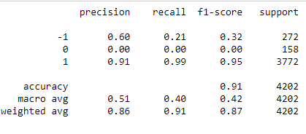
Random Forest classification
It is a supervised classification algorithm. As the name suggest, this algorithm creates the forest with a number of trees. It is a kind of ensemble learning method, where a few weak models combine to form a powerful model.
Random Forest classification on BOW CountVectorizer balanced data
Accuracy of Training data = 99.0%
Accuracy of Test data = 90.79%
Random Forest classification on TFIDF on balanced data
Accuracy of Training data = 100%
Accuracy of Test data = 90.5%

Slide 27
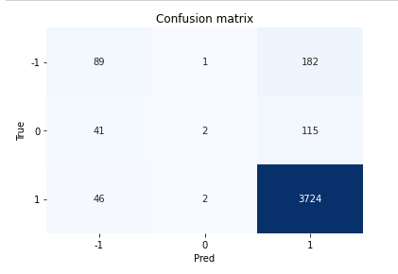
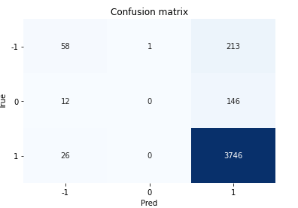
These are the Confusion matrix
Random Forest classification on
TFIDF on balanced data
Random Forest classification on BOW
CountVectorizer balanced data

Slide 28
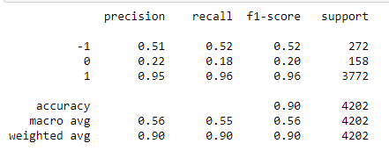
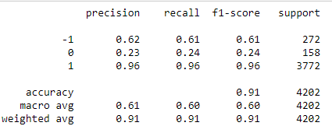
SVM classification
It is formally defined by a separating hyperplane.
SVM classification on BOW CountVectorizer balanced data
Accuracy of Training data = 92.2%
Accuracy of Test data = 90.12%
SVM classification on TFIDF on balanced data
Accuracy of Training data = 99.9%
Accuracy of Test data = 91.3%

Slide 29
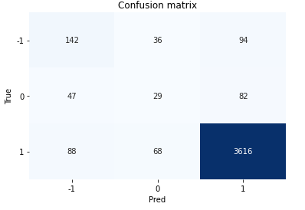
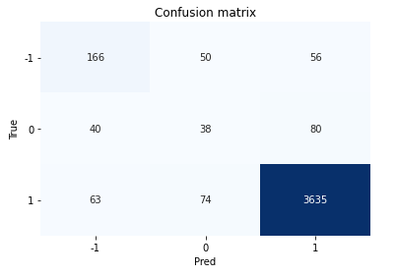
These are the Confusion matrix
SVM classification on
TFIDF on balanced data
SVM classification on BOW
CountVectorizer balanced data

Slide 30
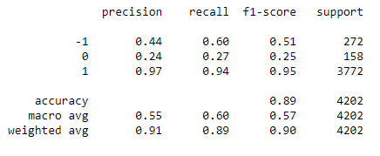
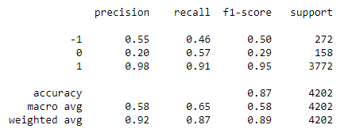
XGBoost
XGBoost classification on BOW CountVectorizer balanced data
Accuracy of Training data = 81.4%
Accuracy of Test data = 89.0%
XGBoost classification on TFIDF on balanced data
Accuracy of Training data = 93.2%
Accuracy of Test data = 87.1%

Slide 31
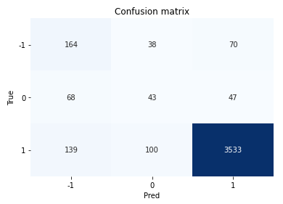
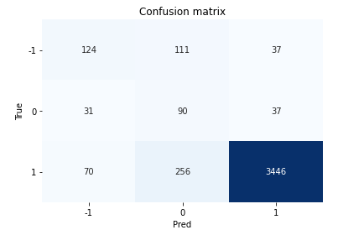
These are the Confusion matrix
XGBoost on
TFIDF on balanced data
XGBoost on BOW
CountVectorizer balanced data

Slide 32
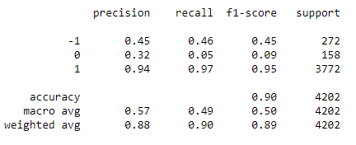
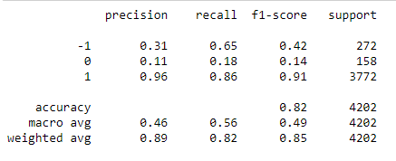
Multinomial
The multinomial Naive Bayes classifier is suitable for classification with discrete features (e.g., word counts for text classification). The multinomial distribution normally requires integer feature counts. However, in practice, fractional counts such as tf-idf may also work.
Multinomial classification on BOW CountVectorizer balanced data
Accuracy of Training data = 85.1%
Accuracy of Test data = 90%
Multinomial classification on TFIDF on balanced data
Accuracy of Training data = 92.4%
Accuracy of Test data = 82.2%

Slide 33
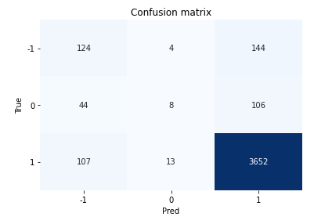
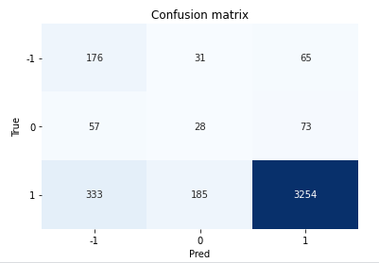
These are the Confusion matrix
Multinomial on
TFIDF on balanced data
Multinomial on BOW
CountVectorizer balanced data

Slide 34
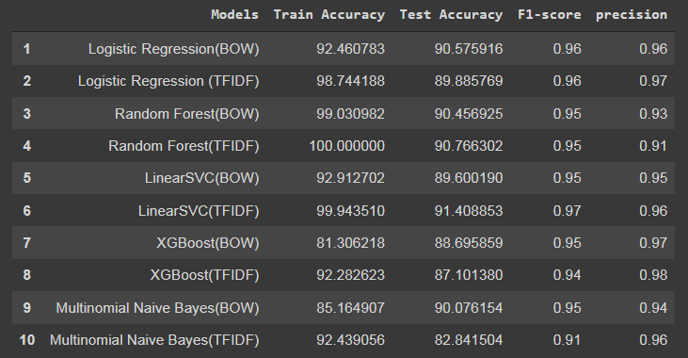
Model's Summary

Slide 35
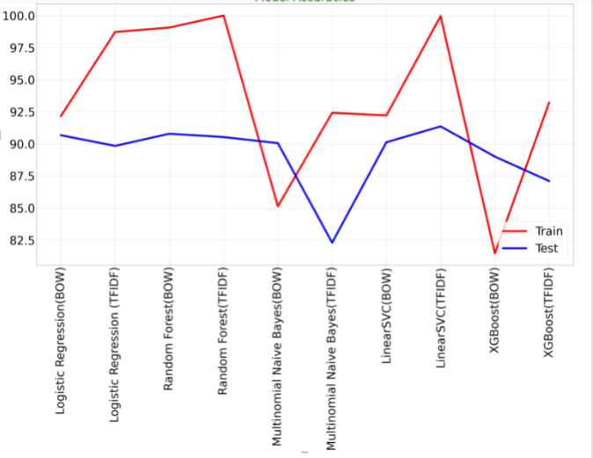
Model's Accuracy

Slide 36
MODEL DEPLOYMENT
We have taken linearSVM ML model for our final deployment
For deployment we have used streamlit method for building webpage and classifying
Streamlit is an open-source Python library that makes it easy to create and share beautiful, custom web apps for machine learning and data science
In the webpage we need to add the text we want to predict in the text box provided there and click the button predict.
Then it shows whether the entered text is Positive, Negative or Neutral sentiments.
Keywords shows by clicking kewords button and same as for word cloud

Slide 37
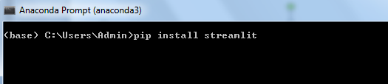

Steps (MODEL DEPLOYMENT)
Step 1. Install streamlit using (pip install streamlit) in anaconda prompt
Step 2. go do the respective folder and run that file using following command

Slide 38

Following page get display

Slide 39

Enter reviews that you want to analyze

Slide 40


Slide 41


Slide 42
CHALLENGES FACED
Review extraction from Tripadvisior.
Applied sentiment analysis on extracted data but the data was a imbalanced data,
The data received was a imbalanced data ,there are only 4% of Neutral sentiment reviews,6% of Negative sentiment reviews and 90% of Positive sentiment reviews.
OVERCOMING CHALLENGES
We have used SMOTE method for balancing the data as it creates synthetic data of minority class.
For Data extraction we used Beautiful soup library

Slide 43


