Slide 1

Coursework

Slide 2
Part 1
M1: A short summary of the dataset.
M2: Adequately join the protein sequences onto the epitopes table
Data is now: 7105 x 28

Slide 3
Part 2
Data is now: 7105 x 28 : each row represent an epitope
M3 (i): There is a column which tells you the corresponding protein sequences for each epitope. Remove the epitopes that do not have it
Data is now: 7100 x 28 : each row represent an epitope
For ii) we need to do the following:
epit_seq
start_pos
end_pos
TSeq_sequence
epit_seq_actual
“damIsCoolA”
2
11
“AdamIsCoolAndNice”
“damIsCoolA”
Keep if epit_seq =
epit_seq_actual
Data is now 7094 x 28

Slide 4
Part 3
After M3 (ii) 7094 x 28
M3 (iii)
M3 (iv)
start_pos
end_pos
TSeq_length
2
11
77
Data is now 6826 x 28
epit_seq
start_pos
end_pos
“damIsCoolA”
55
777
“damIBsCoolA”
55
777
“dJmIBsCoolA”
55
777

Slide 5
Part 4
M4
n_Positive
n_Negative
Class
2
1
1
1
7
0

Slide 6
Part 5
M5 (i) Bar plot of the new Class column
(ii) Histogram (or equivalent) of the epitope lengths
(iii)
epit_seq
“damIsCoolA”
10
“damIBsColA”
9
“aaa”
3
epit_seq
Class
Total A = 4 times
3 times in class 1 (3/4)=75%
1 times in class 0 (1/4)=25%
“cdca”
0
“efg”
1
“aaa”
1

Slide 7
Part 6
M6
AA_window
102659 rows
epit_seq
start_pos
end_pos
TSeq_sequence
“damIsCoolA”
12
15
“AdamIsCoolAndNice….”
epit_seq
start_pos
end_pos
TSeq_sequence
AA_position
“damIsCoolA”
12
15
“AdamIsCoolAndNice….”
12
“damIsCoolA”
12
15
“AdamIsCoolAndNice….”
13
“damIsCoolA”
12
15
“AdamIsCoolAndNice….”
14
“damIsCoolA”
12
15
“AdamIsCoolAndNice….”
15

Slide 8
Part 6 cont’d
M6
AA_window
epit_seq
TSeq_sequence
AA_position
New_start_pos
New_end_pos
“damIsCoolA”
“AdamIsCoolAndNice….”
12
5
19
“damIsCoolA”
“AdamIsCoolAndNice….”
13
6
20
“damIsCoolA”
“AdamIsCoolAndNice….”
14
7
21
“damIsCoolA”
“AdamIsCoolAndNice….”
15
8
22
…..5 6 7 8 9 10 11 12 13 14 15 16 17 18 19 ….

Slide 9
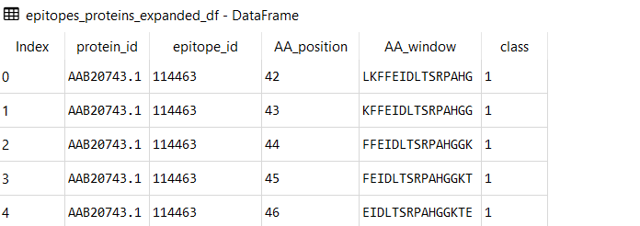
Part 6 cont’d
M6
AA_window
epit_seq
TSeq_sequence
AA_position
New_start_pos
New_end_pos
AA_window
“damIsCoolA”
“AdamIsCoolAndNice….”
12
5
17
IsCoolAndNice
102659 rows 5 columns

