Slide 1
School Database Management System
Name- Pawan Aru
Mis – 112103013
Div- Computer Div 1

Slide 2
Topics
INTRODUCTION
FEATURES
TECHNOLOGY USED
OVERVIEW
CONCLUSION

Slide 3
Introduction
The School Management System is designed to efficiently manage student and teacher information within an educational institution.
It helps to manage student records, such as roll numbers, names, contacts, and email IDs, is crucial for seamless administrative operations for students.
It is Built using the Flask framework and by SQLite database, our system offers a convenient and efficient solution for managing student information.

Slide 4
Features
Users can access a student list, displaying essential details such as roll numbers, names, contacts, and email IDs.
Teacher with their ID can login into the profile and can see their all details
We can Add a New Student to the Database:
The system offers a user-friendly interface for adding new students to the database by taking input student details, including roll numbers, names, contacts, and email IDs, through a dedicated form.
Upon submission, the information is securely stored in the SQLite database, ensuring accurate record-keeping and data integrity.
Edit an Existing Student's Information:
The Student Management System allows for seamless editing of student information.
Authorized users can easily update student records, such as roll numbers, contacts, or any other relevant details.
By accessing the "Edit User" functionality, administrators can modify specific fields, ensuring up-to-date and accurate student information.
Delete a Student from the Database:
The system enables administrators to remove student records when necessary.
By selecting a student from the list, authorized users can initiate the deletion process.
Deleting a student permanently removes their information from the database, ensuring data privacy and maintaining database cleanliness.

Slide 5
Technology Used
Flask with python:-Flask framework, a powerful and lightweight web framework written in Python and can handle HTTP requests and help in rendering dynamic HTML templates.
SQLite Database:-The project utilizes the SQLite database management system. It offers features for data storage and retrieval, ensuring efficient management of student records.
DB Browser:- DB Browser for SQLite tool used for managing and manipulating SQLite databases and help to modify database structure, executing queries, and viewing data.
HTML and CSS:- HTML and CSS are technologies used here to create web pages with structured content and visual styling.

Slide 6
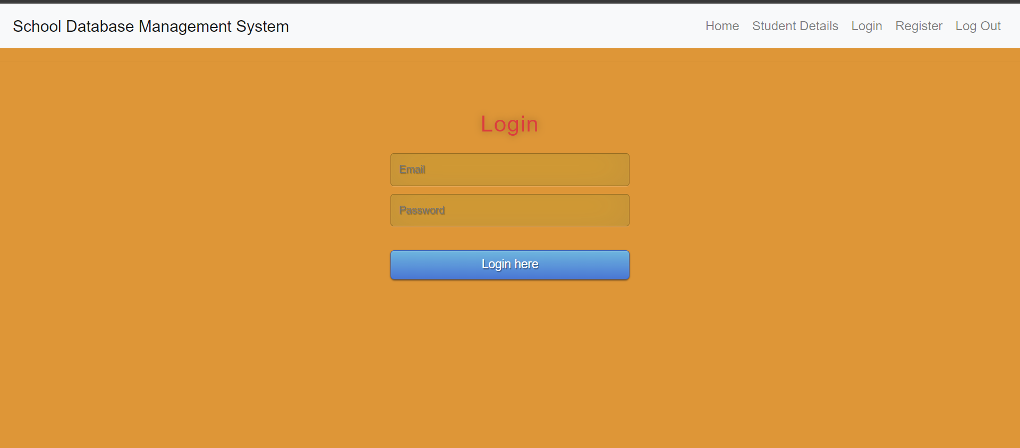
Overview
Home page
The Homepage contain navigation bar for which the user can login into their profile page and can register here.
We can also view the student details which is connected to database ,and can edit their details , which will appear in database.

Slide 7
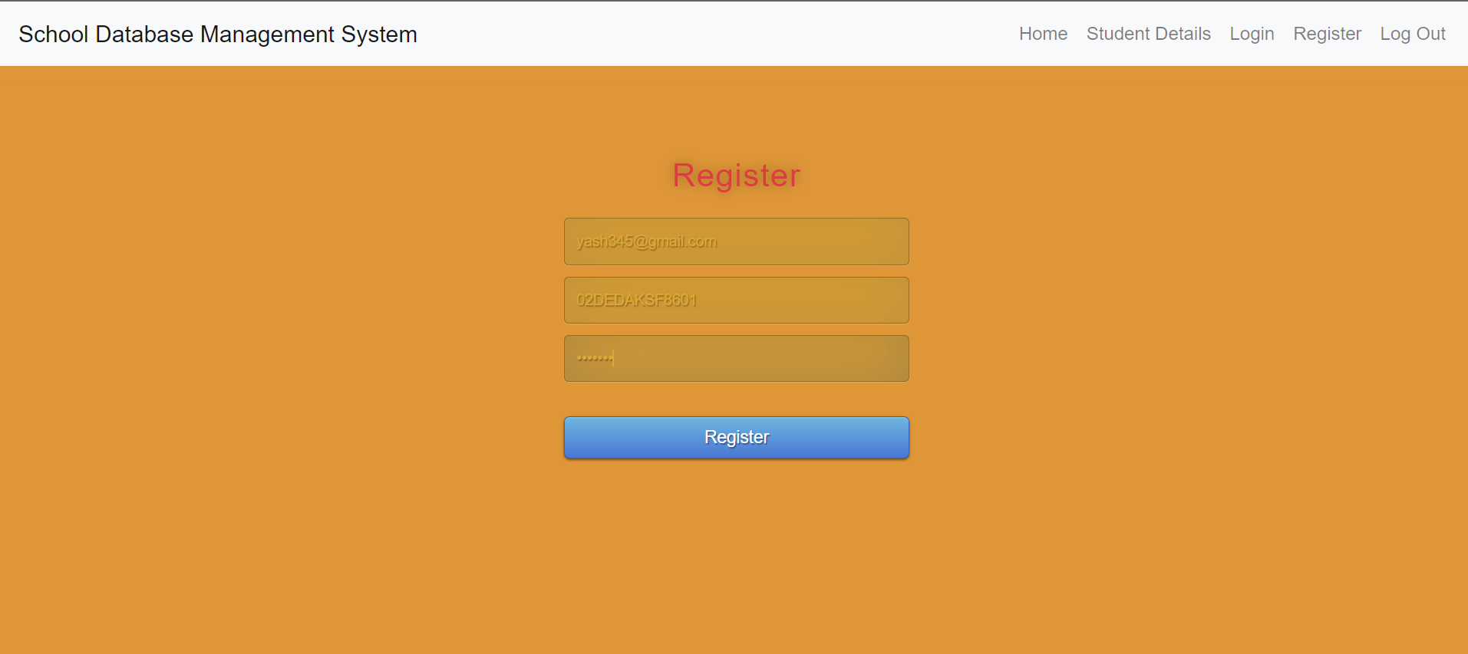
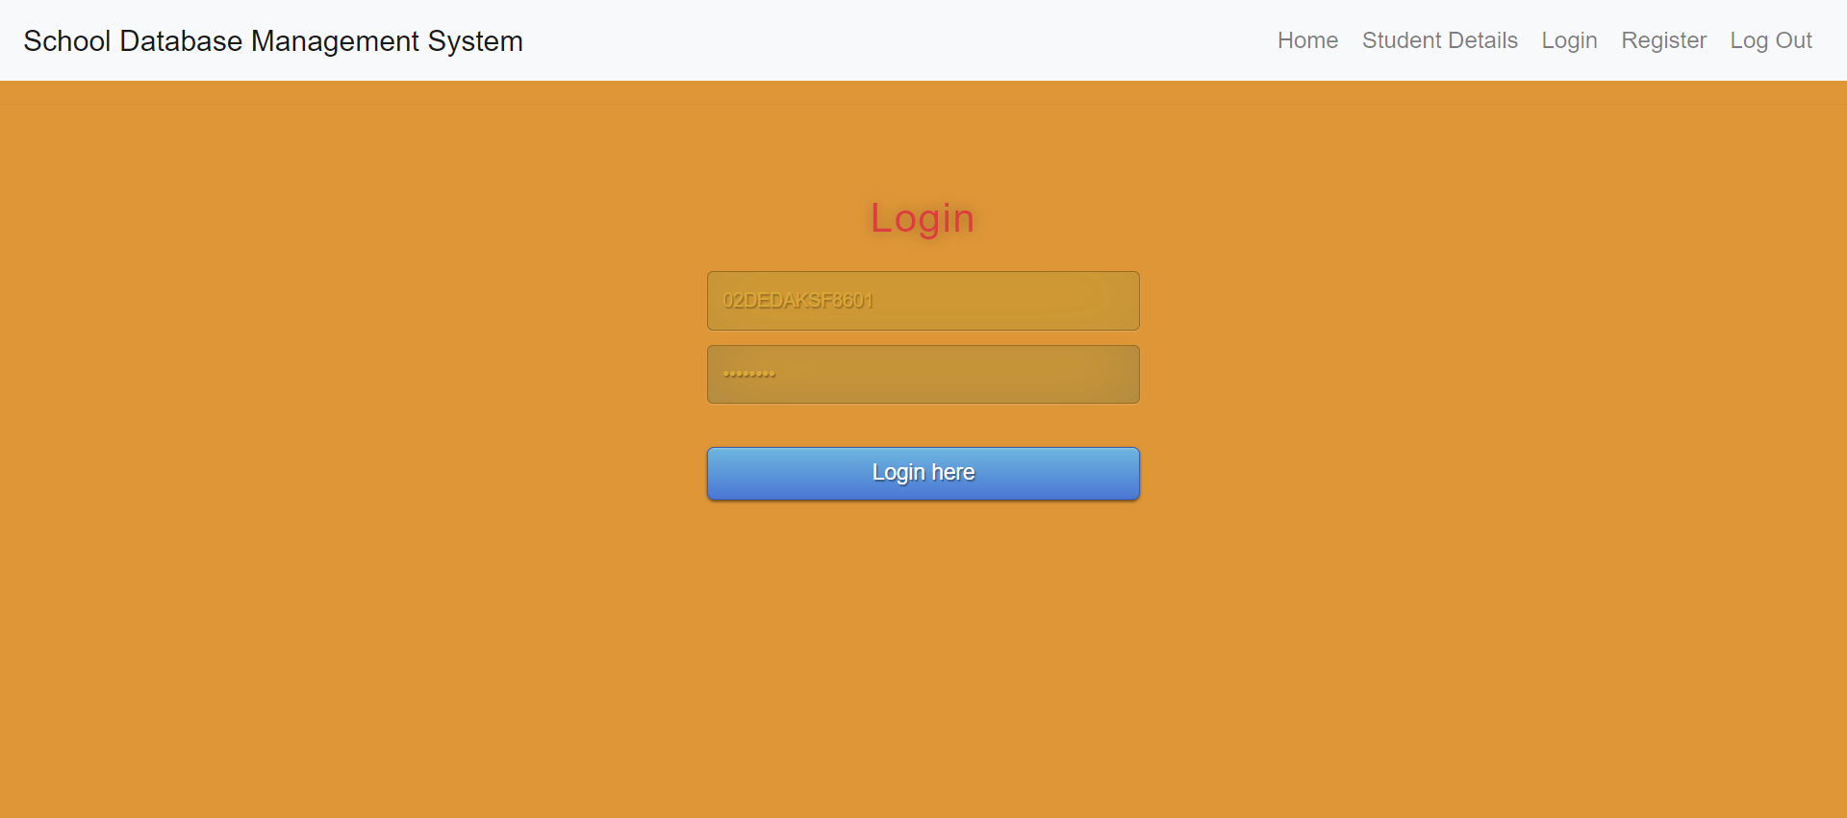
Register and login page
If the user is trying to log in without doing registration , then user is not able to login to there profile.
When user register here , it will get stored in database table ‘user’ and it will verify from the ‘payslip’ where it the user exists or not .
For login, it will also check whether the user has registered or not. If it exist then it will redirect to their profile page.

Slide 8
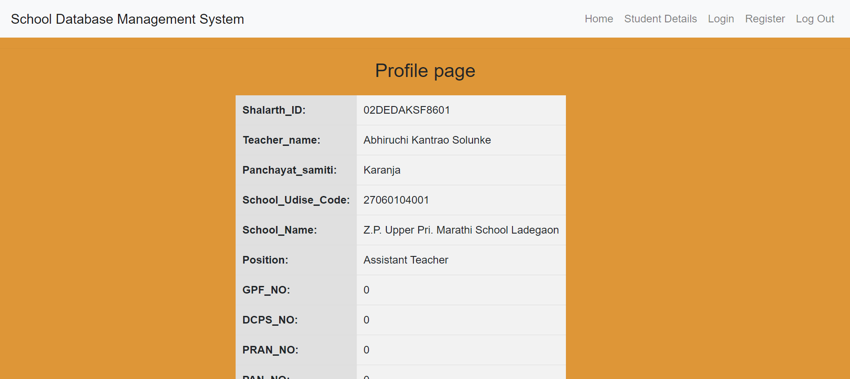
Profile page
This data get retrieved from DB Browser database with the help of SQLite when user login to the profile.

Slide 9
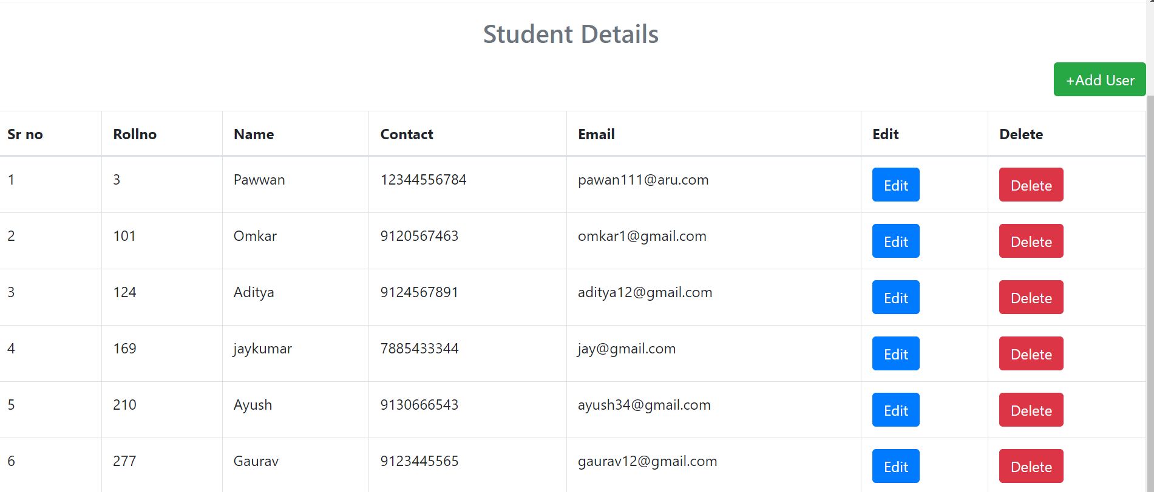
Adding a New STUDENT
We can add Student details here which will be shown in ‘Student Details’ table given in fig. We had option to add student details and then the database will get updated.

Slide 10
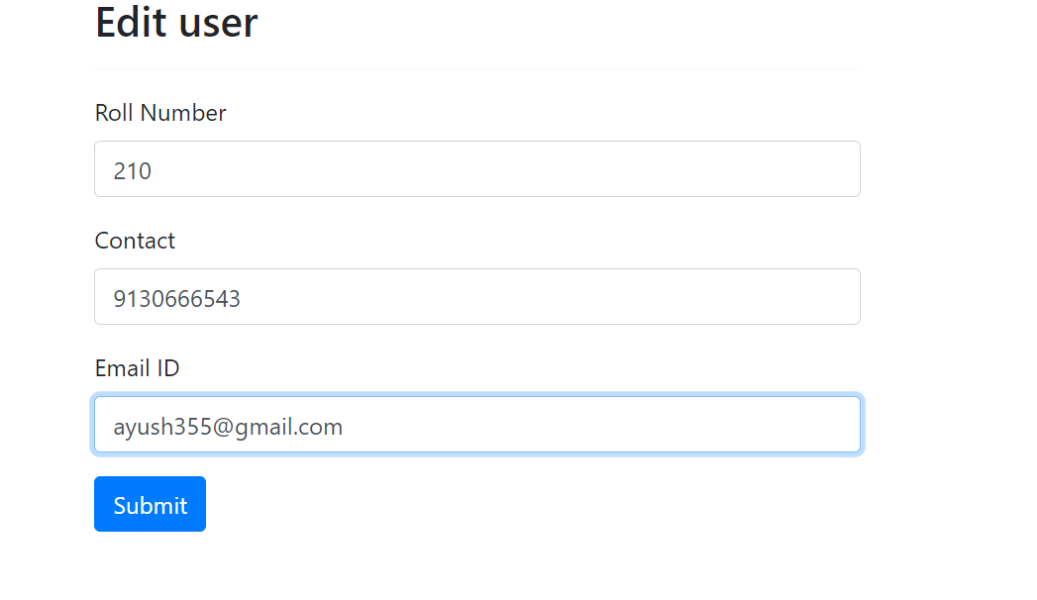
EDITING A STUDENT DATABASE
We can also edit the details of particular user by clicking on Edit button.
After we edit the data , the database will get updated will the help of SQLite and it will shown in student list.

Slide 11
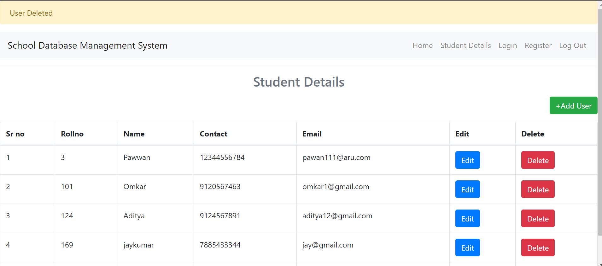
DELETING A STUDENT DATABASE
We can also the delete the details which we want to delete from the database . By clicking on the delete button , the data of the user will get delete from database and table will get updated.

Slide 12
CONCLUSION
The Student Management System is a powerful tool designed to streamline the management of student information .It offers features such as viewing a comprehensive list of all students, adding new students to the database, editing existing student information, and deleting student records.
The system is built using the Flask framework, Python programming language, SQLite database, HTML, CSS, and DB Browser.
Improved efficiency:- School management system helps to improve efficiency by enabling quick access to student and teacher information and help in record keeping in SQLite database.
Time and resource savings: By automating manual processes, the system reduces paperwork and minimizes errors.

Slide 13
THANK YOU

