Slide 1


JSPM’s
Bhivarabai Sawant Institute of Technology & Research
Accredited with NAAC and NBA
Department of Computer Engineering
Project Presentation
on
“UNIFIED CONTENT AUTHENTICITY VERIFICATION SYSTEM: DEEPFAKE DETECTION WITH CROSS-GENERATOR GENERALIZATION AND DOCUMENT TAMPER LOCALIZATION”
Presented By :
Pawan Singh Jagdish Bhandari ( )
Rahul H. Bramhankar ( )
Bhoomi Kushwah ( )
Guided By : Dr. G. M. Bhandari
Notes:
Introduce the project: a web system that checks whether an image, video or document is real, AI-generated or tampered with. Phase 1 (images) is complete; video and document analysers are designed. Team: The Perceptrons. Guide: Dr. G. M. Bhandari.

Slide 2
Introduction
Content :
Problem Statement
Introduction
Objectives
Literature Survey
System Architecture
UML Diagrams
Algorithm
Data Preprocessing and Augmentation
CLIP Encoder and Trained Head
System Requirements
Project Plan
Results
Test Cases
Applications
Conclusion
Future Enhancement
References
Notes:
Outline of the talk. The order follows the department format: problem, background, design diagrams, algorithm, results, tests, conclusion.

Slide 3
Problem Statement
To develop a web-based, explainable system that checks whether an image, a video or a document is authentic, AI-generated or tampered with, and that keeps working on generators that were not seen in training.
Notes:
One sentence: one tool, three kinds of files, a score people can understand, and it must work on new AI tools, not only the ones it was trained on.

Slide 4
Introduction
AI tools such as Stable Diffusion, Midjourney, ChatGPT and Gemini now make pictures that look like photographs.
Face-swapped videos and edited documents are also easy to make, and checking them by eye is unreliable.
Many detectors only work for the generators they were trained on and fail on new ones.
Thus one explainable screening system that works on unseen generators would be helpful.
Notes:
Why the project matters. The key difficulty is that a detector trained on one AI tool can fail on the next one.

Slide 5
Objectives
To detect AI-generated images, including images from generators that were not seen in training.
To give every result as a Trust Score (0 to 100), a verdict and a Needs Human Review band.
To explain every verdict with a heatmap and plain-language sentences.
To run on a CPU within 2.7 GB of memory and never store uploaded files.
Next phases: face-manipulated videos and tampered documents.
Notes:
Five objectives. The first four are achieved for images in Phase 1; video and documents are the next two phases.

Slide 6
Literature Survey
Sr. No. | Paper Name | Authors | Publication Year | Conclusion
01 | CNN-generated images are surprisingly easy to spot... for now | S.-Y. Wang | 2020 | A CNN trained on one GAN, with blur and JPEG augmentation, detects other GANs; weaker on other generator families.
02 | Towards Universal Fake Image Detectors that Generalize Across Generative Models | U. Ojha | 2023 | A linear classifier on frozen CLIP features transfers better to unseen generators; whole-image score only.
Notes:
Related work. The common gap: results on the training generators are good, results on new generators and on compressed files are not. Our design answers this with CLIP features, degraded training copies and tests on unseen generators.

Slide 7
Literature Survey
Sr. No. | Paper Name | Authors | Publication Year | Conclusion
03 | On the detection of synthetic images generated by diffusion models | R. Corvi | 2023 | Diffusion-model images can be detected, but detectors weaken after resizing and compression.
04 | Fake or JPEG? Revealing Common Biases in Generated Image Detection Datasets | P. Grommelt | 2024 | Some datasets can be solved from file format and compression instead of image content.
Notes:
Related work. The common gap: results on the training generators are good, results on new generators and on compressed files are not. Our design answers this with CLIP features, degraded training copies and tests on unseen generators.

Slide 8
Literature Survey
Sr. No. | Paper Name | Authors | Publication Year | Conclusion
05 | GenImage: A Million-Scale Benchmark for Detecting AI-Generated Image | M. Zhu | 2023 | Cross-generator benchmark built from eight generators.
06 | OpenFake: An Open Dataset and Platform Toward Real-World Deepfake Detection | V. Livernoche | 2025 | Real photographs and about sixty generators, with held-out test generators; used in our training.
Notes:
Related work. The common gap: results on the training generators are good, results on new generators and on compressed files are not. Our design answers this with CLIP features, degraded training copies and tests on unseen generators.

Slide 9
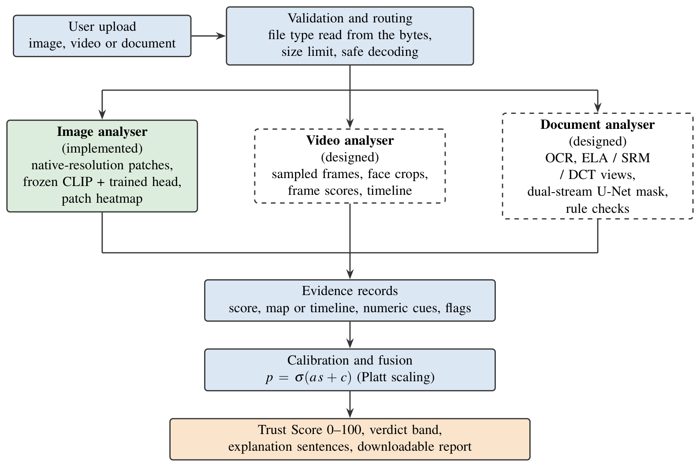
System Architecture
Dataset link: https://huggingface.co/datasets/ComplexDataLab/OpenFake
Notes:
Layered architecture. The upload is validated and routed to the image, video or document analyser. All analysers return the same evidence record, which is calibrated into a Trust Score and explained. Solid boxes are built (image); dashed boxes are designed (video, document).

Slide 10
UML Diagrams
Use Case Diagram
DFD Level 0
DFD Level 1
Control Flow Diagram
Sequence Diagram
Class Diagram
Notes:
The next six slides show the diagrams. Each one is explained in the speaker notes.

Slide 11
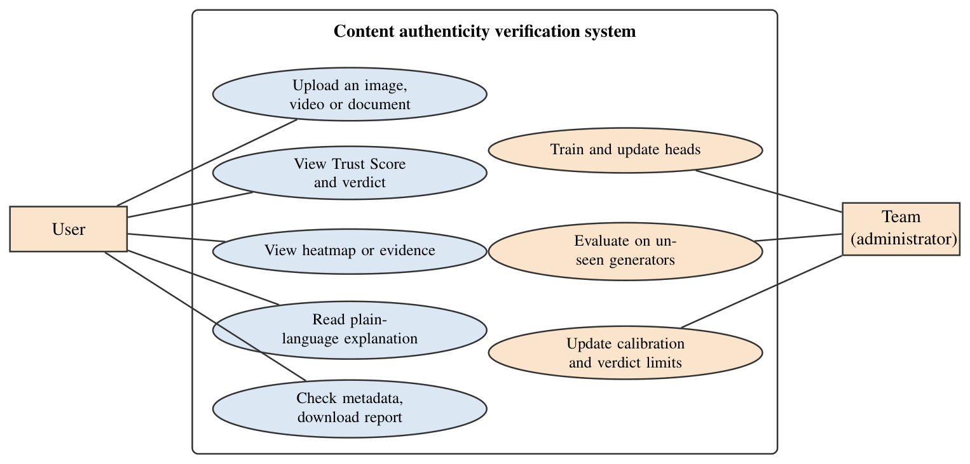
Use Case Diagram
Notes:
Two kinds of users. The User uploads a file, sees the Trust Score and verdict, the heatmap, the explanation, and can download a report. The project team trains and updates the models, evaluates them on unseen generators and updates the calibration.

Slide 12
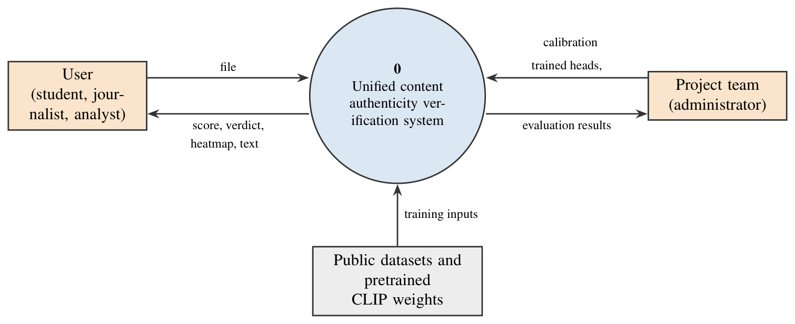
DFD Level 0
Notes:
Context diagram: the whole system is one process. The user sends a file and receives score, verdict, heatmap and text. The team supplies trained heads and calibration and receives evaluation results. Public datasets and CLIP weights feed the training.

Slide 13
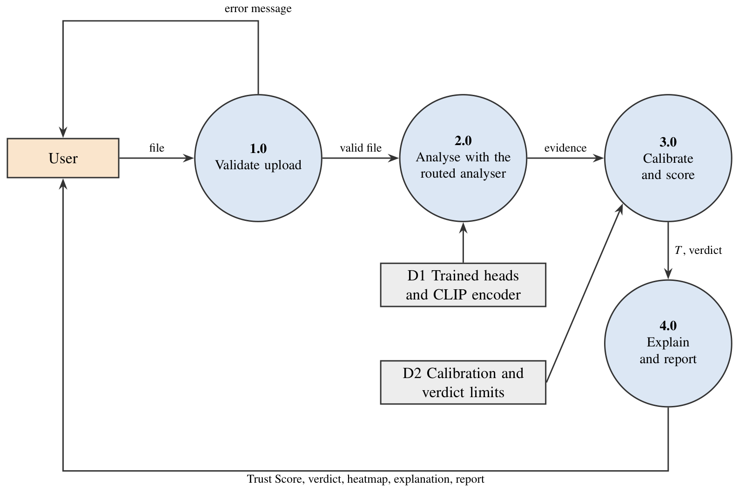
DFD Level 1
Notes:
Four processes: 1.0 validate the upload (bad files get an error message), 2.0 analyse with the routed analyser using the stored heads, 3.0 calibrate and score using the stored calibration limits, 4.0 explain and report back to the user.

Slide 14
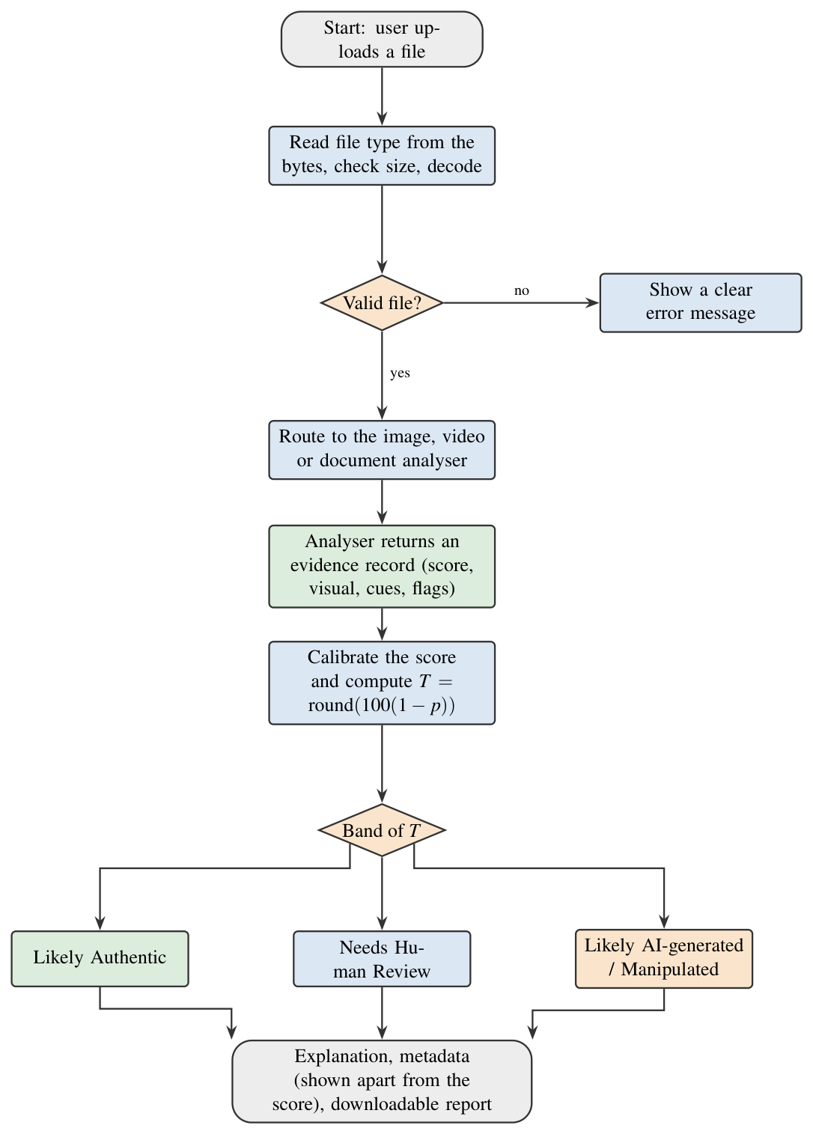
Control Flow Diagram
Notes:
Step by step: read the true file type from the bytes, check size, decode; if invalid show a clear error. Otherwise route to the analyser, get the evidence record, calibrate to a Trust Score, and choose the band: 54 or more Likely Authentic, 17 or less Likely AI-generated, otherwise Needs Human Review.

Slide 15
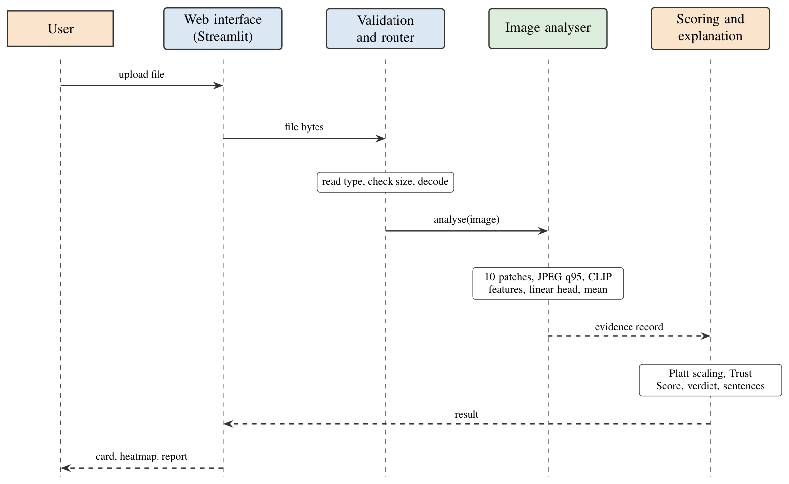
Sequence Diagram
Notes:
One image check over time. The web interface passes the bytes to the validator and router, which asks the image analyser. The analyser cuts ten patches, re-saves them as JPEG, encodes them with CLIP and scores them with the linear head. The scoring layer applies Platt scaling, makes the Trust Score, verdict and sentences, and the card, heatmap and report come back to the user.

Slide 16
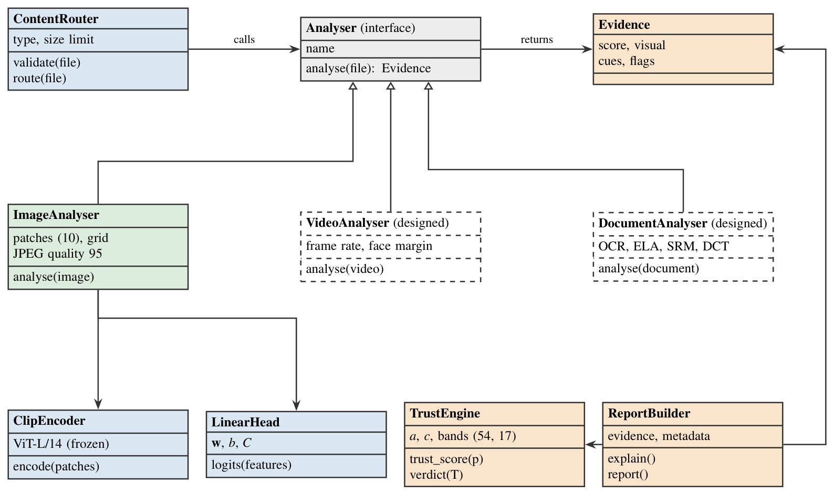
Class Diagram
Notes:
Main software components. Every analyser implements the same Analyser interface and returns an Evidence record; the image analyser owns the CLIP encoder and the linear head; the trust engine holds the calibration and the band limits; the report builder writes the explanation. Dashed classes (video, document) are designed, not built yet.

Slide 17
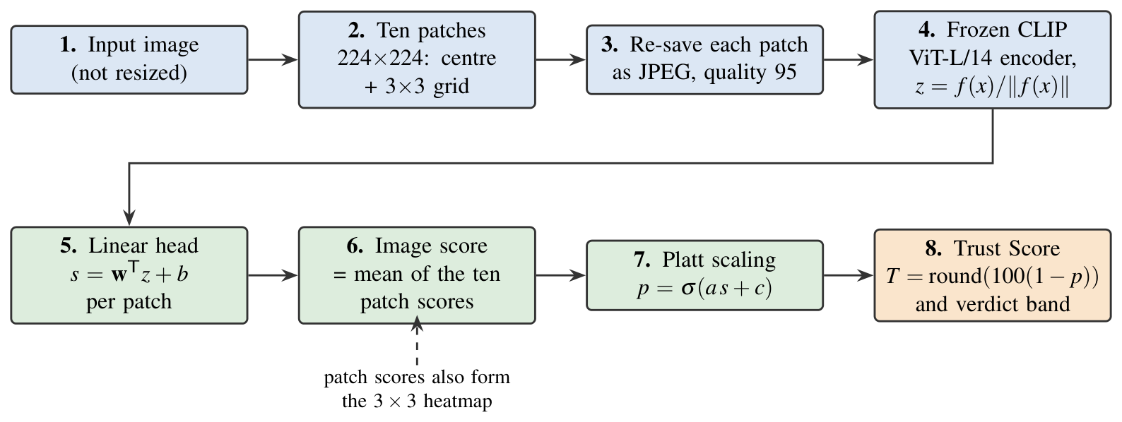
Algorithm
Patch score: s_i = wT z_i + b, image score: s = mean of the ten patch scores
Probability: p = sigmoid(a s + c) (Platt scaling), Trust Score: T = round(100 (1 - p))
Verdict: T >= 54 Likely Authentic, T <= 17 Likely AI-generated, otherwise Needs Human Review
Notes:
The image algorithm: do not resize; cut ten 224 by 224 patches; re-save each as JPEG quality 95 so real and fake share one compression history; encode with frozen CLIP ViT-L/14; score with a linear head; average the ten scores; calibrate with Platt scaling; Trust Score = 100 x (1 - p).

Slide 18
Data Preprocessing
The image is not resized, because resizing removes the fine traces that give AI images away.
Ten patches of 224 x 224 pixels (the centre and a 3 x 3 grid) are cut at the image's own resolution.
Every patch is re-saved as JPEG with quality 95, so real and generated images share one compression history and the file format cannot leak the answer.
Notes:
Preprocessing keeps the evidence and removes shortcuts. Native-resolution patches keep fine noise; the common JPEG re-save stops a detector from learning 'PNG means AI'.

Slide 19
Data Augmentation
Every training image also gives a randomly damaged copy: resized, blurred and JPEG-compressed (quality 50 to 95).
Reason: pictures are resized and compressed every time they are shared, and this removes much of the evidence.
Effect: AI images caught after JPEG quality 70 rose from 14% (first prototype) to 66%.
Training data: real photographs and about sixty generators from OpenFake, plus patches of edited photographs.
Notes:
Augmentation is the main reason the final model survives sharing. Without it, only 14% of compressed AI images were caught; with it, 66%.

Slide 20
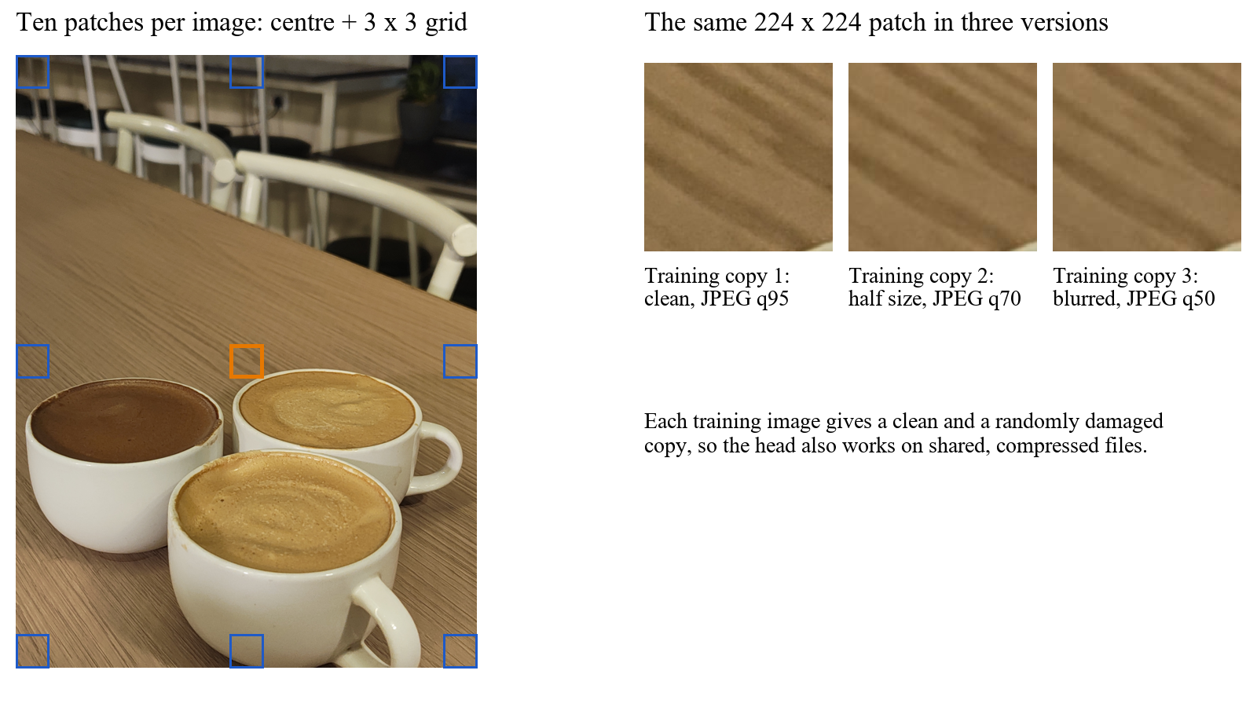
Preprocessing Results
Notes:
Left: a real photograph with its ten patches (orange = centre patch). Right: the same patch in the three training versions.

Slide 21
CLIP Encoder and Trained Head
CLIP is a vision-language model of OpenAI; we use its ViT-L/14 image encoder as it is (frozen).
Only a small linear head (768 weights and a bias) is trained, by L2-regularised logistic regression.
The head is a few kilobytes, so training takes minutes on a laptop and the app runs on a CPU.
ROC-AUC: 0.982 on 20 unseen generators (EfficientNet-B0 baseline: 0.831)
Notes:
Why this design: the heavy model is not trained; only a tiny head is. That keeps the app small and lets us retrain in minutes. AUC of 0.982 means a randomly chosen AI image gets a higher score than a randomly chosen real photo 98% of the time.

Slide 22
Deployment: Streamlit
Using Streamlit we built the web interface of our system.
Streamlit is a Python based web framework.
The application Content Authenticity Checker is hosted on Streamlit Community Cloud and redeploys from GitHub.
Here the user can upload an image and receive the Trust Score, verdict, heatmap and explanation.
The app also warns for drawings, screenshots, small images and compressed files, and recognises the visible Gemini watermark.
Notes:
Live link: https://deepfake-detector-perceptrons.streamlit.app . Uploads are processed in memory and never stored.

Slide 23
Hardware/Software Requirements
Hardware Requirements :
1. Operating System: Windows 10 or 11, or Linux (64-bit)
2. Processor: x86 64-bit CPU, no GPU needed for use
3. Memory: 2 GB for the app (peak about 1.5 GB); 8 GB for development
Software Requirements :
Python 3.11, PyTorch (CPU), open_clip, scikit-learn, Pillow, NumPy, Matplotlib
Streamlit (web interface); Git and GitHub (code and hosting)
Training: free Kaggle GPU for feature extraction
Notes:
Everything is free and open source. No GPU is needed to use the system; a GPU was only used once to compute stored features.

Slide 24
Project Plan
Work Task | Description | Duration
Phase 1: Image | Setup, data, baseline, CLIP model, robustness, calibration, web app | Weeks 1-11 (28 Sep - 13 Dec 2026) - done
Phase 2: Video | Face crops, frame model, video score and timeline | Weeks 12-16 (14 Dec 2026 - 17 Jan 2027)
Phase 3: Document | OCR, forensic maps, dual-stream U-Net, rule checks, integration | Weeks 17-26 (18 Jan - 28 Mar 2027)
System testing | Unseen-source tests, team photographs, notices and checks | In every phase
Initial Report | Preliminary (Stage 1) report, synopsis, abstract | Done
Final Report | Final report and research paper | Week 26
Notes:
Three phases, one medium at a time. Each phase ends with a working demonstration. Phase 1 (image) is finished.

Slide 25
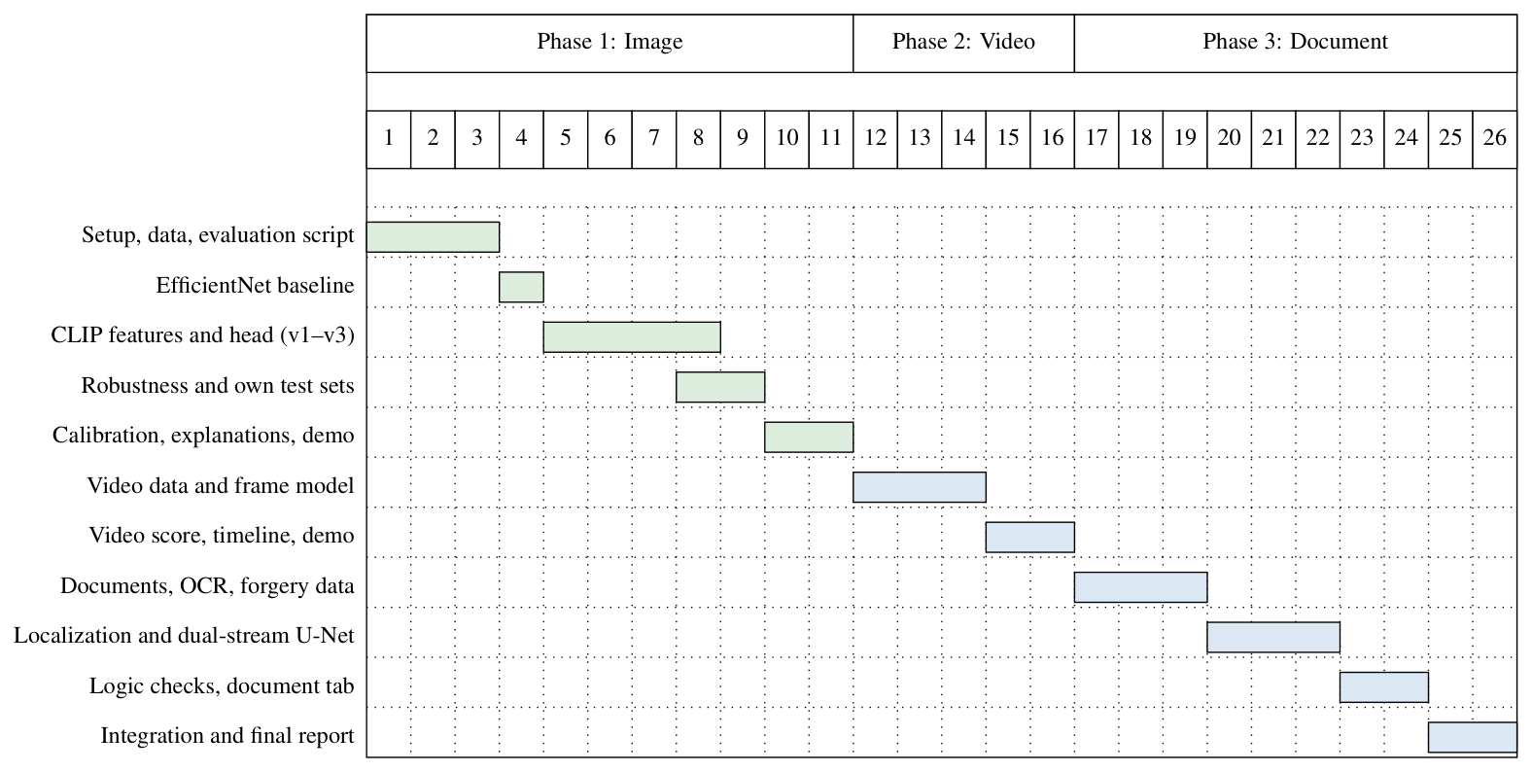
Project Schedule
Notes:
The same plan as a chart: green bars are finished work, blue bars are planned.

Slide 26
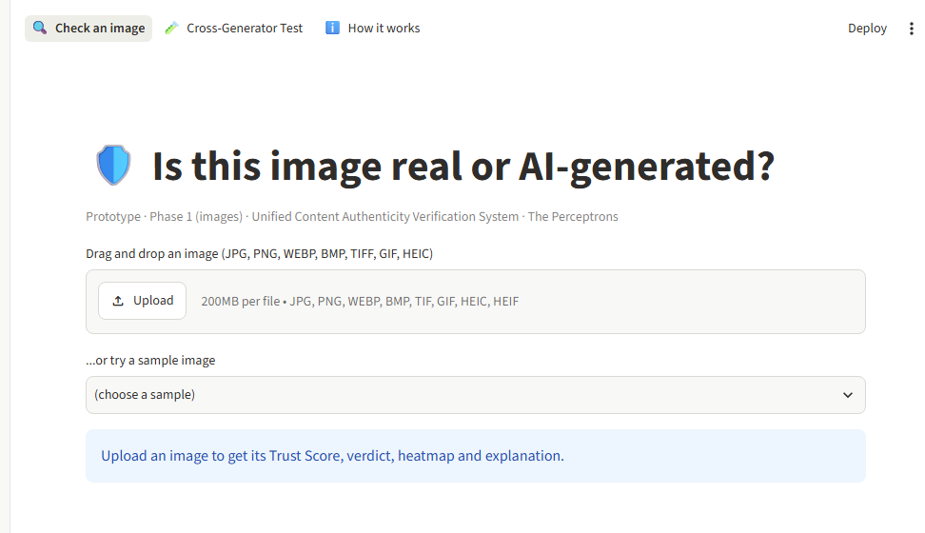
Results
Web Interface
Notes:
Start page of the application: drag and drop an image. A sample image can also be chosen.

Slide 27
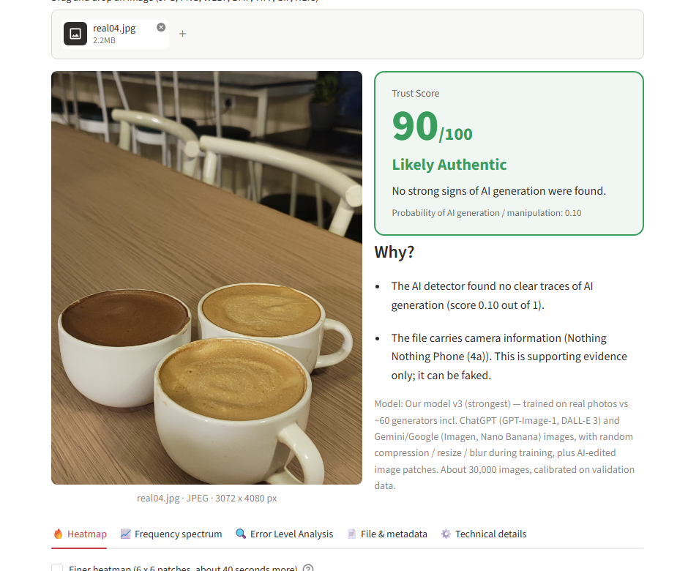
Result: Real Photograph
Trust Score 90 / 100 - Likely Authentic
Notes:
A real full-size phone photograph. The score is high, the explanation says no clear traces of AI were found, and the camera information is shown as supporting evidence only.

Slide 28
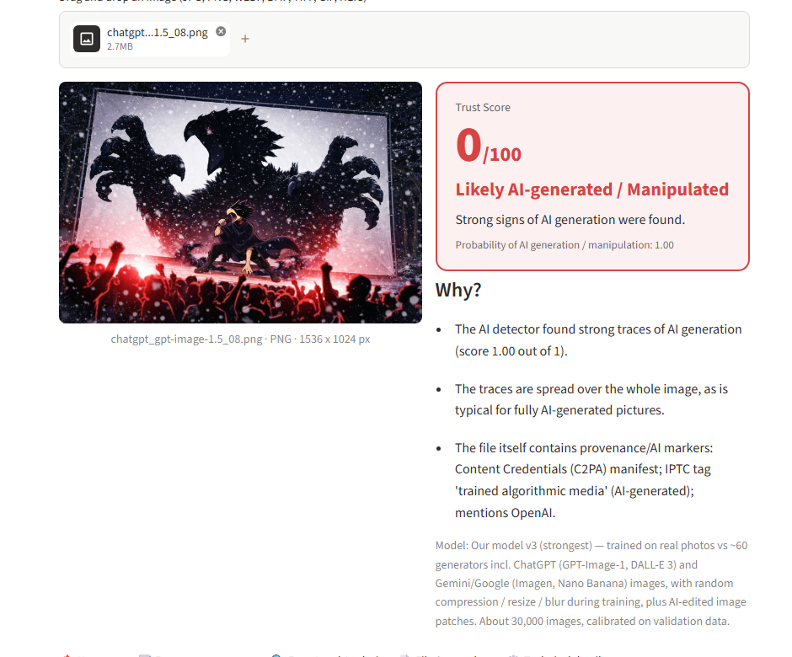
Result: AI-generated Image
Likely AI-generated / Manipulated
Notes:
A ChatGPT image. The score is very low, the traces are spread over the whole image, and the file's own provenance markers are listed.

Slide 29
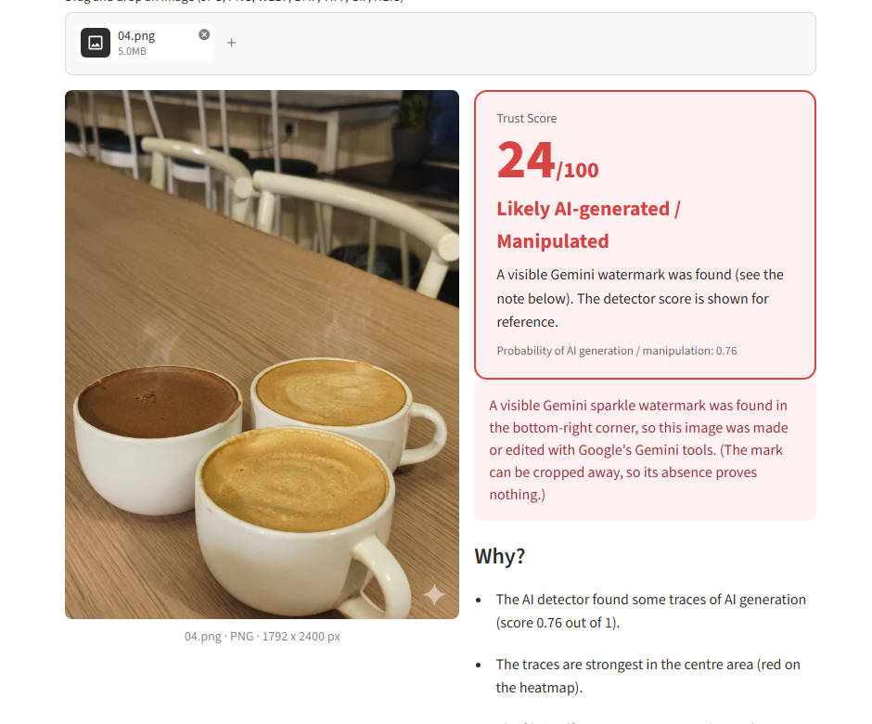
Result: Gemini Watermark
Visible Gemini watermark found - verdict AI-generated
Notes:
Images downloaded from the Gemini app carry a small star at the bottom-right corner. The app finds it and reports it separately from the model score. The mark can be cropped away, so its absence proves nothing.

Slide 30
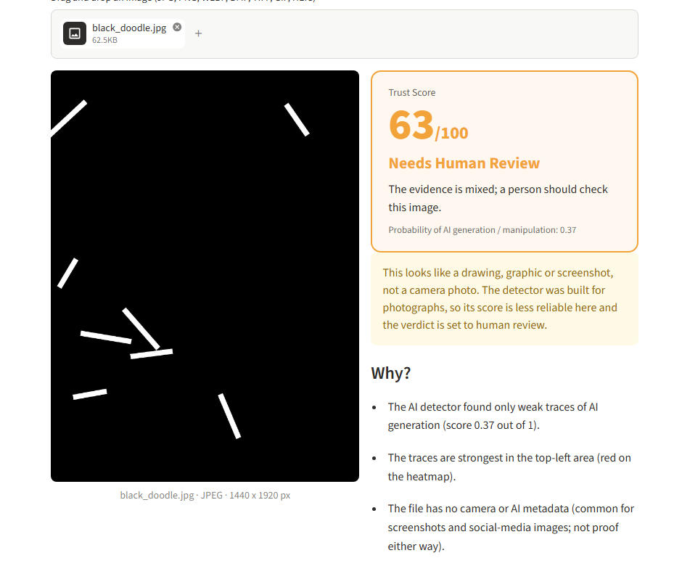
Result: Drawing
Not a camera photo - verdict set to Needs Human Review
Notes:
Drawings, graphics and screenshots are outside what the detector was built for. The app says so and sends them to a person instead of guessing.

Slide 31
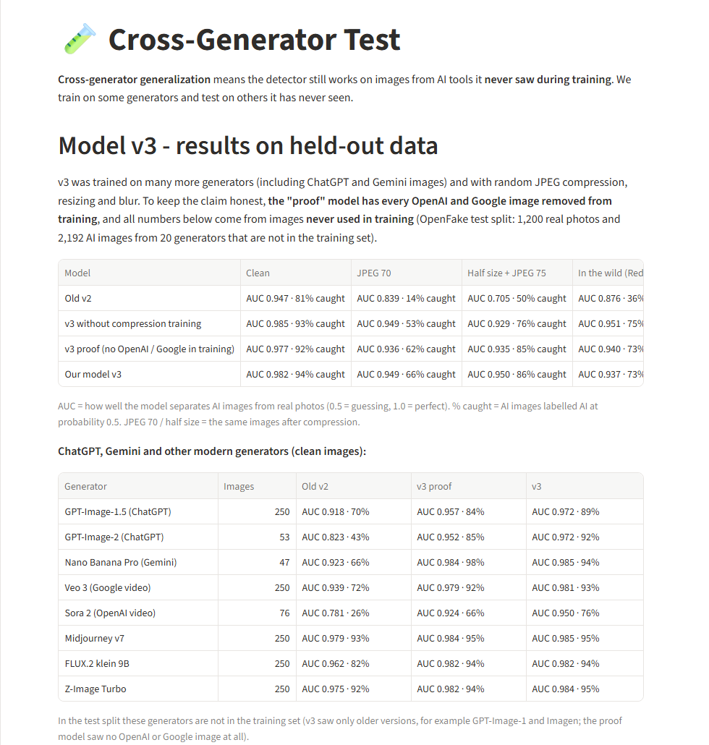
Cross-Generator Test Page
Notes:
A page of the application that shows the held-out results per generator.

Slide 32
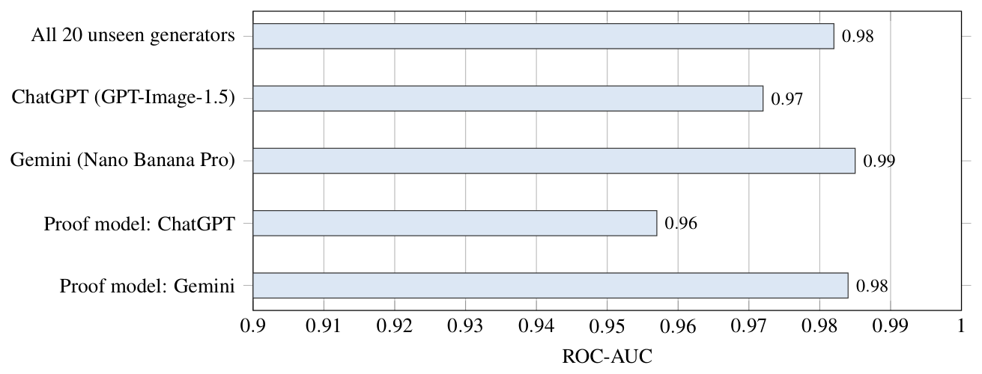
Graph of ROC-AUC of Model
Notes:
ROC-AUC on 20 generators not seen in training (1,200 real and 2,192 AI test images). The proof model never saw an OpenAI or Google image and still reaches 0.957 and 0.984.

Slide 33
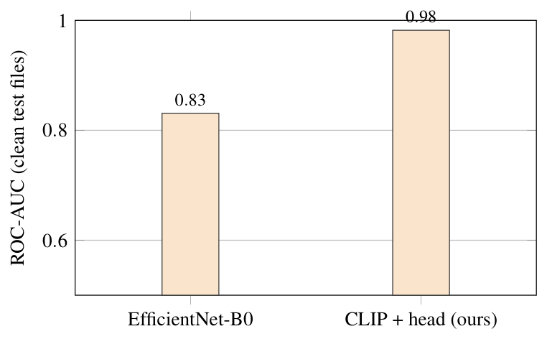
Comparison with Baseline
Notes:
An EfficientNet-B0 trained on the same images reaches 0.831; our CLIP-based analyser reaches 0.982 on the same clean test files.

Slide 34
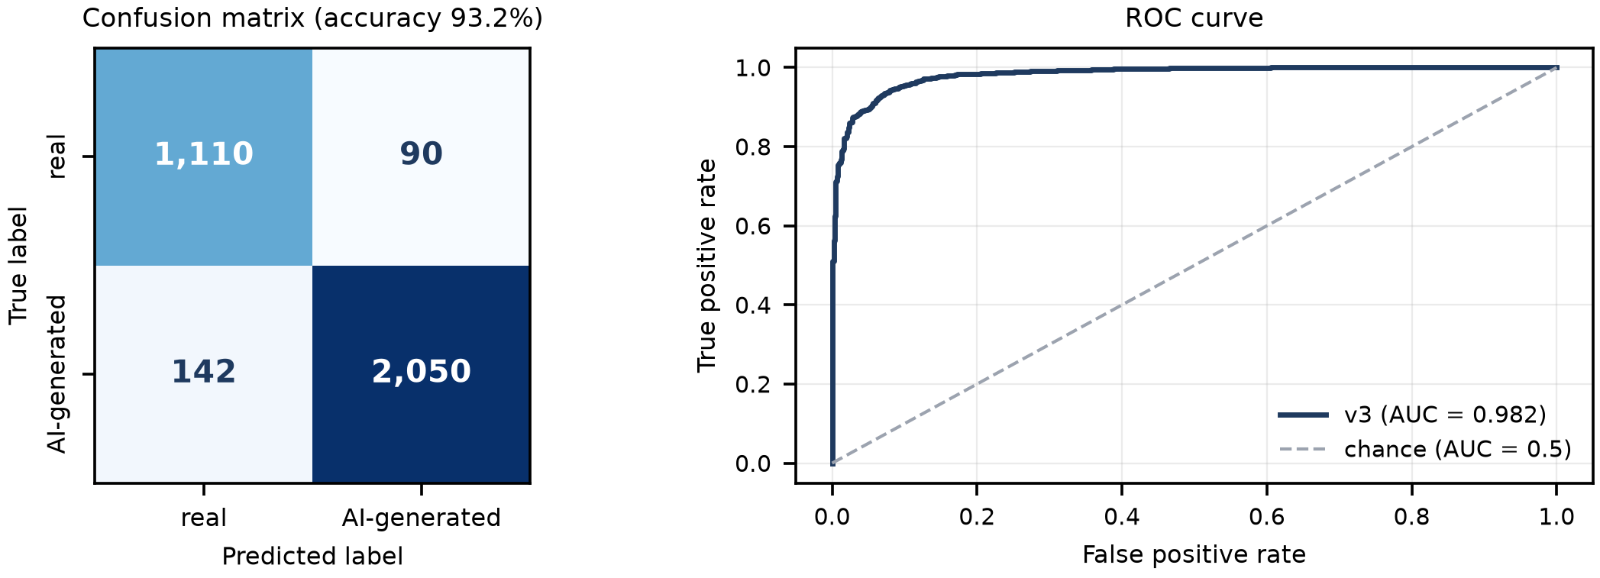
Confusion Matrix and ROC Curve
1,110 of 1,200 real photographs accepted; 2,050 of 2,192 AI images caught (accuracy 93.2%)
Notes:
Left: confusion matrix at threshold 0.5. Right: ROC curve. Errors are not symmetric: 142 AI images missed against 90 real photographs flagged; the review band catches many of both.

Slide 35
Tests on Team Photographs
Measure | ChatGPT edits | Gemini edits
Pairs (photograph and its edit) | 10 | 47
ROC-AUC, edit against original | 0.95 | 0.92
Edit scores more AI-like than its original | 10 of 10 | 47 of 47
Edits called AI-generated | 8 of 10 | 14 of 47
Edits sent to human review | 2 of 10 | 28 of 47
Original photographs called authentic | 9 of 10 | 38 of 47
Notes:
Full-size phone photographs taken by the team and their edits made with the ChatGPT and Gemini apps; used for testing only. The sets are small, so the numbers are indicative. Gemini edits are ranked well but more often sent to human review; the watermark check, reported separately, covers Gemini-app downloads.

Slide 36
Test Cases
Test case ID | Test case | Test case i/p | Actual result | Expected result | P/F
001 | Real phone photo | 4000 x 3000 photo | Authentic (87) | Authentic | P
002 | ChatGPT edit | Edited photo | AI-generated (2) | AI-generated | P
003 | Gemini-app image | Image with star mark | AI + watermark alert | AI-generated | P
004 | Drawing | Black image, white strokes | Review + notice | Human review | P
005 | Very small image | 416 x 752 image | Small-image notice | Notice | P
006 | Corrupt JPEG | Cut-off JPEG file | Clear error message | Error | P
007 | Text file as .jpg | Renamed text file | Clear error message | Error | P
008 | Empty file | 0-byte file | Clear error message | Error | P
009 | PDF document | PDF file (Phase 3) | Clear error message | Error | P
Notes:
Nine test cases. 001 to 005 were run on the application with images from the team test sets; 006 to 009 were run on the file validation code with real bad files. Test 009 shows the present behaviour: the image analyser refuses a PDF with a clear message; the document analyser is planned for Phase 3.

Slide 37
Applications
Fact-checking and newsrooms: first screening of pictures that arrive from the public.
Social media and content moderation: flagging likely AI images for a human reviewer.
Banks, insurers and KYC teams: first-level screening of submitted documents (planned).
Education and awareness: showing why a picture looks synthetic through the heatmap and explanation.
Personal use: checking a picture received in a messaging group.
Notes:
Applications are screening aids: the Trust Score is not forensic proof.

Slide 38
Conclusion
A frozen CLIP encoder with a small trained head, a degraded-copy training set and a calibrated, explainable scoring layer detects most AI images from unseen generators.
The system reaches ROC-AUC 0.982 on 20 unseen generators, against 0.831 for an EfficientNet baseline, and accepts 92% of real photographs.
The proof model, which never saw an OpenAI or Google image, still catches 84% of ChatGPT images.
The layered design lets the same Trust Score serve images, videos and documents.
Notes:
Summary of Phase 1. Video and document analysers are designed for the next phases.

Slide 39
Future Scope
Build and evaluate the video analyser on FaceForensics++ and Celeb-DF.
Build the document analyser (dual-stream U-Net, OCR, rule checks) and test it on DocTamper and human-made forgeries.
Pixel-level maps to find a small machine-made region inside a real photograph.
Better robustness to compression and resizing; add new generators to the unseen-source tests.
A separate front end that calls the analysers through an API.
Notes:
What comes next, in order of the project plan.

Slide 40
References
1. A. Radford et al., “Learning transferable visual models from natural language supervision,” in Proc. ICML, 2021.
2. U. Ojha, Y. Li, and Y. J. Lee, “Towards universal fake image detectors that generalize across generative models,” in Proc. CVPR, 2023.
3. S.-Y. Wang et al., “CNN-generated images are surprisingly easy to spot... for now,” in Proc. CVPR, 2020.
4. R. Corvi et al., “On the detection of synthetic images generated by diffusion models,” in Proc. ICASSP, 2023.
5. P. Grommelt et al., “Fake or JPEG? Revealing common biases in generated image detection datasets,” arXiv:2403.17608, 2024.
6. M. Zhu et al., “GenImage: A million-scale benchmark for detecting AI-generated image,” NeurIPS Datasets and Benchmarks, 2023.
Notes:
Each reference is a clickable link to its arXiv page. The full list of 32 references is in the research paper.

Slide 41
References
7. V. Livernoche et al., “OpenFake: An open dataset and platform toward real-world deepfake detection,” arXiv:2509.09495, 2025.
8. H. Ci et al., “DiffSeg30k: A multi-turn diffusion editing benchmark for localized AIGC detection,” arXiv:2511.19111, 2025.
9. M. Tan and Q. V. Le, “EfficientNet: Rethinking model scaling for convolutional neural networks,” in Proc. ICML, 2019.
10. C. Guo, G. Pleiss, Y. Sun, and K. Q. Weinberger, “On calibration of modern neural networks,” in Proc. ICML, 2017.
11. A. Rössler et al., “FaceForensics++: Learning to detect manipulated facial images,” in Proc. ICCV, 2019.
12. O. Ronneberger, P. Fischer, and T. Brox, “U-Net: Convolutional networks for biomedical image segmentation,” in Proc. MICCAI, 2015.
Notes:
Each reference is a clickable link to its arXiv page. The full list of 32 references is in the research paper.

Slide 42
…Thank You !!!
Notes:
Invite questions. Live demo: https://deepfake-detector-perceptrons.streamlit.app

