Slide 1


ReGen Hackathon 2025
TITLE PAGE
Problem Statement Title – Smart Transportation: AI for Traffic Management
Team ID - U3RX21W9
Team Name(as registered on unstop ) - ALPHA

Slide 2







ALPHA
Overview
Concept:
A dynamic traffic signal system that maintains a fixed total cycle time (e.g., 120 seconds for 4 directions) while reallocating green signal duration based on real-time vehicle density.
Real-Time Data Collection
Data Preprocessing
Advanced Vehicle Detection Module
Gen AI Integration
Reinforcement Learning
Dynamic Signal Timing Algorithm
Traffic Signal

Slide 3
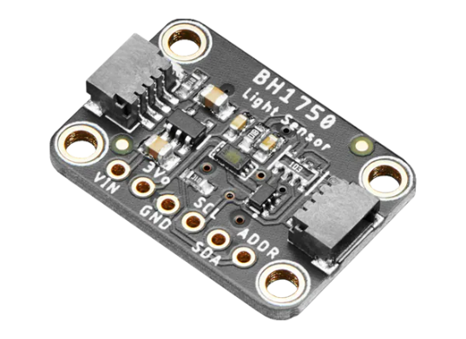
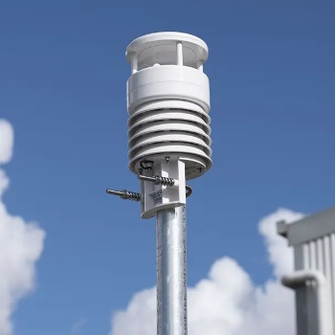
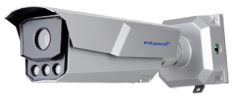
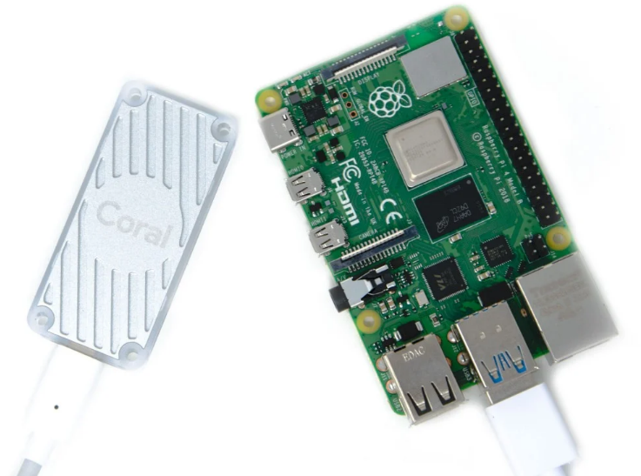


ALPHA
Camera-Based Data Collection
Primary Data Source:
Optional Add-Ons for Data Collection:
IOT Sensors :
Camera: PT-TRXCM202-D
(Already Existing) High Performance ANPR Bullet
Ambient-Light Sensor
Weather Sensor
System Workflow:
Edge-Computing devices (Raspberry Pi 4 + Google Coral) for low-latency & on-site processing
Data Pipeline tool (Apache Kafka) for real-time data streaming to connect Camera, Edge Device & Cloud
Cloud Platforms for intensive computations, data storage, and model training

Slide 4
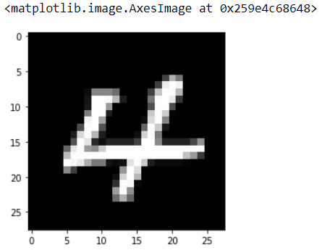
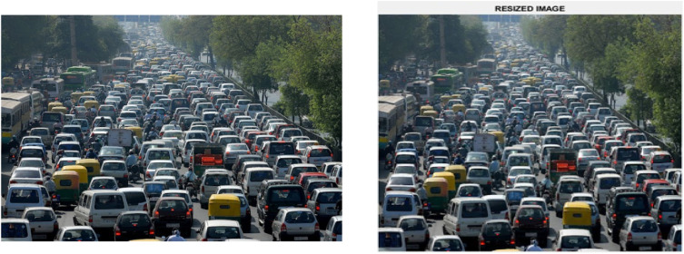


ALPHA
Data Preprocessing
Normalization of Image
(Scale pixel values to [0,1] range)
Image Resizing to 416 x 416 pixels
Tools and Libraries Required:
Optional Enhancements:
1) Color Conversion: Convert from RGB to HSV if it improves segmentation.
2) Minimal Noise Reduction: Apply a light Gaussian blur only if minor noise is observed.
&
The existing ANPR bullet camera delivers clear, high-resolution images, reducing the need for extensive preprocessing and ensuring robust detection.
Preprocessing steps are executed on edge devices (e.g., Raspberry Pi with Coral Edge) to minimize latency. More intensive tasks, if needed, can be offloaded to cloud servers.

Slide 5
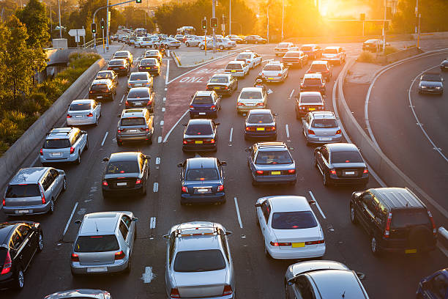
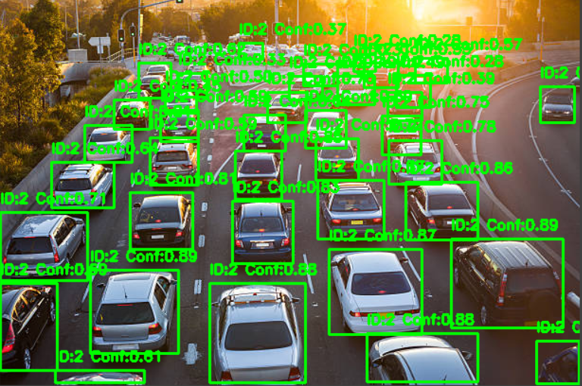

Vehicle Detection Module
ALPHA
Implement YOLOv8(Advanced Deep Learning Model)
Pre-processed Image
YOLOv8 Model
Vehicle-Detected Image
Deploy YOLOv8 Model on Edge Device(Raspberry Pi + Google Coral) for Low Latency
Enhanced Detection Technique(Optional):
Edge-Detection
Multi-Scale Clustering

Slide 6
ALPHA
Traffic Density Calculation
Counting Vehicles Per Lane
Capturing Traffic Data
YOLOv8 (You Only Look Once)
OpenCV lane detection).
Implementation Steps:​
Capture frame from the camera feed.​
Run it through YOLOv8 to detect objects.​
Extract bounding boxes of vehicles.​
Classify vehicle types (cars, bikes, buses, trucks).​
Divides the road into predefined lanes.
Checks vehicle positions inside each lane.
Counts the number of vehicles per lane.
Adjusting Signal Timing Based on Density
Traffic Density Classification
Calculating Traffic Density
Vehicle Count per Lane | Density Level
0-10 | Low
11-20 | Moderate
20+ | High
High Density → Longer Green Light
Moderate Density → Medium Green Light
Low Density → Short Green Light
Density = Number of Vehicles in Lane
lane length (in Meters)

Slide 7
ALPHA
Generative AI Integration
Traffic Flow Prediction
Collect historical traffic data
Preprocess Data (Normalize, Time-Series)
Use Transformer Model
Train Model on Past Traffic Data
Forecast Future Congestion Trends
Adjust Traffic Signals Dynamically
Synthetic Data Generation
Use a Generative Adversarial Network (GAN).
Train on real-world traffic images from CCTV feeds.
Generate synthetic traffic images for different conditions (night, rain, fog, peak hours).
Anomaly Detection (Using Autoencoders)
Train an autoencoder on normal traffic patterns.
Compare real-time data with expected traffic behaviour.
Flag anomalies (sudden vehicle buildup, road blockages)
Tools for Implementation
Traffic Prediction
Hugging Face Transformers, LSTM, Time-Series Transformer
Synthetic Data
GANs (DCGAN, StyleGAN), Variational Autoencoders (VAE)
Anomaly Detection
TensorFlow/Keras Autoencoders, Isolation Forest, LSTM
@ReGen Hackathon Idea Submission - Template

Slide 8
ALPHA
Reinforcement Learning for Signal Timing
RL Agent Design: To Train an AI agent to optimize traffic light duration based on real-time congestion.
Steps:
Defining the Environment
RL Algorithm
Training the Agent
Use SUMO to simulate traffic.
Define traffic density, wait times and actions (signal timings).
Use of Stable Baselines3 (SB3)
Algorithms: Deep Q-Learning (DQN),.
Reward function: Minimize wait times & prioritize emergency vehicles.
Multi-agent setup: Coordinate signals at multiple intersections.
RL Components:
Factor | Effect on Reward | Formulae/Explanation
Vehicle wait Time | Negative Reward (Penalty) | R = - ∑ Wait Time per vehicle (Longer wait times → Higher penalty)
Throughput (Vehicles Passed per Cycle) | Positive Reward | R = + ∑ Vehicles Passed (More vehicles passing → Higher reward)
Emergency Vehicle Clearance | High Positive Reward | R = +100 if emergency vehicle passes within 5s
Traffic Surge Handling | Penalty if Congestion Increases | R = - Congestion Penalty (Traffic buildup → Negative reward)
Approach | Description
Centralized RL | A Single RL Model controls all intersections
Decentralized RL | Each Intersection has an Independent RL agent.
Multi-Agent Coordination | Agents communicate with neighbouring signals to optimize time collectively
Multi-Agent Table
Reward Function Table
@ReGen Hackathon Idea Submission - Template

Slide 9
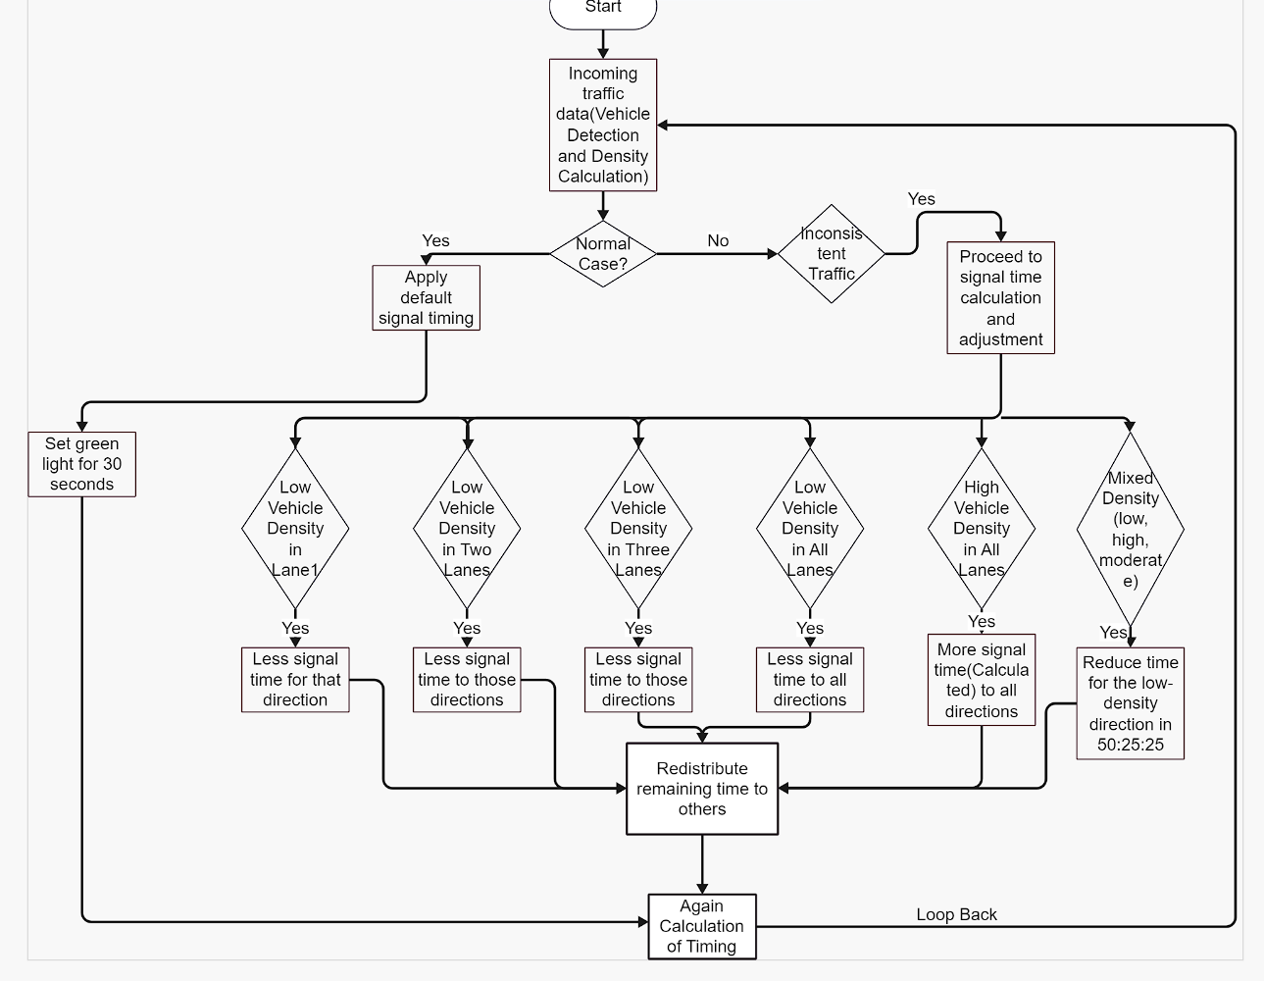
ALPHA
Dynamic Signal Timing & Anti-Clockwise Flow
Fixed cycle time (120 seconds)
Ensure phase splits are optimized based on real-time density.
Consider green wave synchronization for smoother vehicle movement.
Adaptive Reallocation
Reinforcement Learning (RL) models can help optimize time allocation.
Use vehicle detection sensors (LiDAR, computer vision) to assess density.
Signal Sequence (Anti-Clockwise Flow)
Helps avoid deadlocks and congestion.
Microservices (Docker, Kubernetes) ensure flexibility.
Tools & Scalability
Could benefit from predictive modeling to preemptively adjust for surges.
Kafka / MQTT for real-time data streaming.
Our Dynamic Signal Time Algorithm
@ReGen Hackathon Idea Submission - Template

Slide 10





ALPHA
Implementation & Integration Details
Pipeline
Use Kafka to handle real-time streaming from cameras and IoT sensors.
Implement an event-driven architecture for better responsiveness.
Utilize edge AI on NVIDIA Jetson for real-time object detection, reducing cloud dependency.
Optimize OpenCV operations for faster frame processing.
YOLOv8 or EfficientDet for real-time vehicle and pedestrian detection.
Stable Baselines3 (RL) for adaptive signal control based on real-time traffic density.
MPC (Model Predictive Control) for intelligent traffic light adaptation.
Synchronize with emergency services via dedicated API endpoints for ambulance priority.
Data Acquisition
Preprocessing
Detection
AI Analysis (Generative AI & RL)
Signal Control
Category | Enhancements
Hardware | - LiDAR/Radar for better depth perception in low visibility.- 5G/LPWAN (LoRa) for IoT connectivity to reduce latency.
Software Enhancements | - Kafka + Redis for efficient message queuing & real-time caching.- TensorRT for accelerating deep learning inference on Jetson devices.- FastAPI or gRPC for low-latency inter-service communication.
Microservices Architecture | - Docker & Kubernetes for scalable, modular deployment.- Independent modules for Detection, AI Analysis, and Signal Control.- gRPC for high-speed microservice communication.
Cloud-Edge Coordination | - Edge Processing (Jetson): Handles real-time detection & preprocessing.- Cloud Processing (AWS/Azure/GCP): Trains RL models & updates edge AI models.- Federated Learning: Enhances AI without excessive data transfer.
Tech Stack Refinements & Modular Integration

Slide 11
ALPHA
Challenges & Mitigation Strategies
Challenges
Differences in lighting, weather conditions, and camera angles can impact object detection and classification.
Reinforcement Learning models can be unstable, requiring careful reward function tuning and extensive training.
Existing traffic systems may use outdated infrastructure, making seamless AI integration difficult.
Mitigation
Design a modular architecture using containerization (Docker, Kubernetes) and microservices for flexible deployment.
Utilize edge computing to offload real-time processing from cloud to local devices.
Use synthetic data generation via Generative AI to create diverse training samples.
Implement real-time data preprocessing (denoising, normalization, adaptive thresholding).
Conduct iterative RL model tuning with simulation-based testing in SUMO (Simulation of Urban Mobility).
Implement reward shaping techniques and transfer learning from pre-trained models.
@ReGen Hackathon Idea Submission - Template

Slide 12
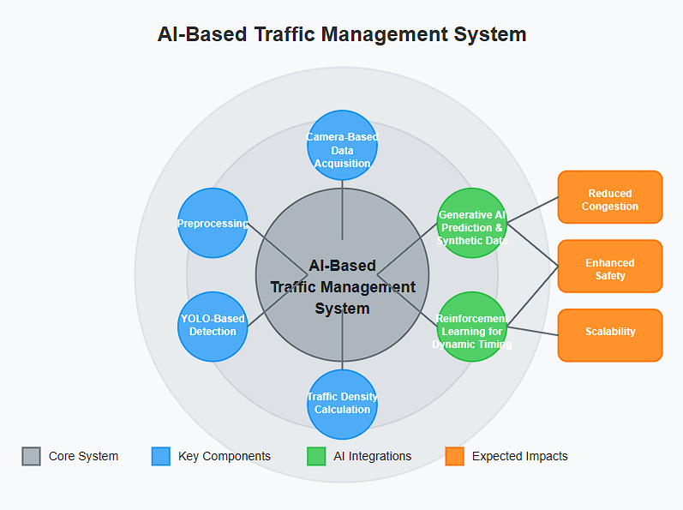
Summary
ALPHA
Call to Action:
Ready for deployment and integration with smart city initiatives, offering a transformative approach to urban mobility

