Slide 1

Patna College
Project
On
ATTENDANCE MANAGEMENT SYSTEM
By:-
BHAWESH RAJ-08
PAWAN KUMAR-04
RAHUL RANJAN-13

Slide 2

INTRODUCTION
Attendance Management System is software developed for daily student attendance in schools, colleges and institutes. It facilitates to access the attendance information of a particular student in a particular class.
There are two modules in this tool.
1.Admin
2.User

Slide 3

OBJECTIVE
The objective of the Project Attendance Management System is to computerized the tradition way of talking attendance and manage the Attendance of students. It will also help parents to see the attendance of their child.
Our job is to convert these entire manual jobs to a computerized system to make the task of marking attendance convenient and easy and keeping record of the attendance.

Slide 4
PROBLEMS OF EXISTING SYSTEM
Time consuming.
Consumes large volume of paper work.
Needs manual calculations.
No facility for parents to see their child attendance

Slide 5
PROPOSED SYSTEM
Ensure data accuracy’s.
Parents can check attendance of their child.
Minimize manual entry.
Minimum time needed for the various processing.
Greater efficiency.
Better service.
User friendliness and interactive.
Minimum time required.

Slide 6
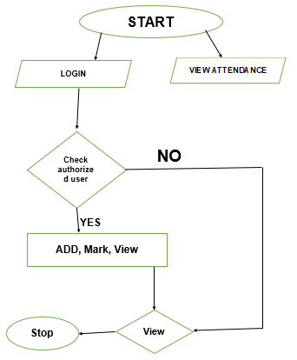
FLOW CHART

Slide 7
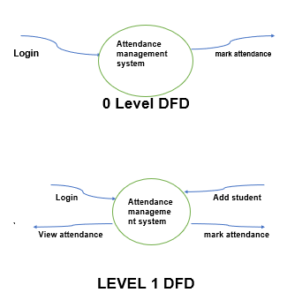
DFD

Slide 8
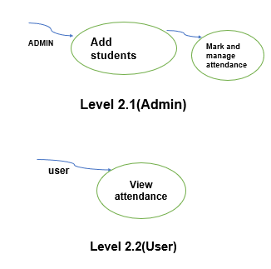

Slide 9
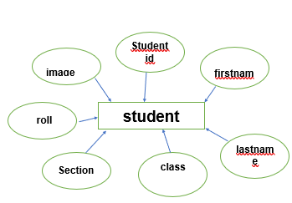
ERD

Slide 10
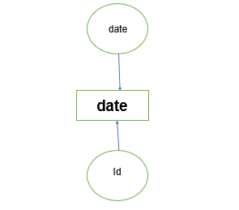

Slide 11

WELCOME TO OUR PROJECT

Slide 12

FUTURE SCOPE OF THE PROJECT
The project has a very vast scope in future. The project can be implemented on intranet in future. Project can be updated in near future as and when requirement for the same arises, as it is very flexible in terms of expansion. With the proposed software of database Space Manager ready and fully functional the client is now able to manage and hence run the entire work in a much better, accurate and error free manner.

Slide 13

Thank You

