Slide 2
Insights about history of INR/USD exchange rate

Slide 3
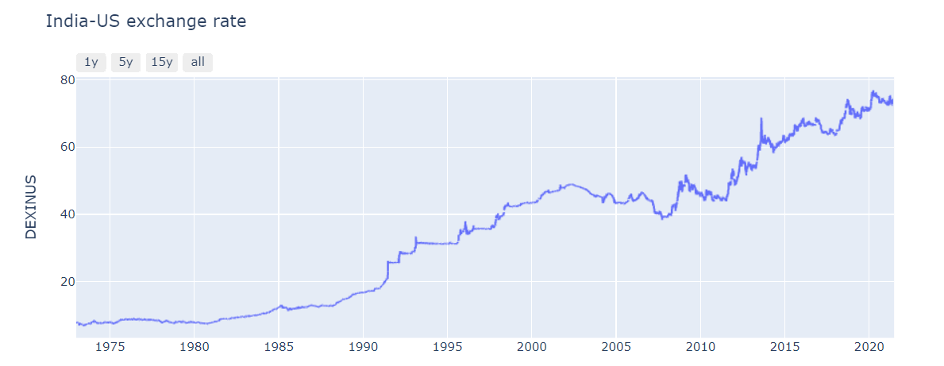
The inception:
Indian currency began to be measured against the US dollar in 1947 after India gained its independence. The value of 1 INR then could be taken as 1 USD, considering that the national balance sheet was free from any credit or debit.
However, the value of Indian currency was derived from the British pound, which then was 1 £ equal to 13 INR. And owing to the absence of a standard form of currency comparison until 1944, this valuation of INR against the British pound remained dominant.

Slide 4
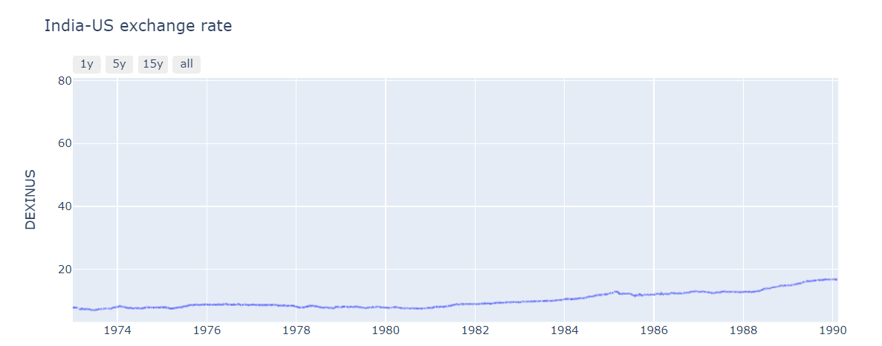
Fall in Rupee Value- 1973 Oil Crisis
Rupee value fell to 8.10 in 1974 following the Oil Shock that took place in 1973 due to the decision of the OAPEC or Organisation of Arab Petroleum Exporting Countries to reduce production.
To combat the situation and the subsequent political crisis, India had to borrow foreign currency. This resulted in the fall of the Indian currency value. The exchange rate deteriorated throughout the 1980s and reached a value as high as 17.50 in 1990.

Slide 5
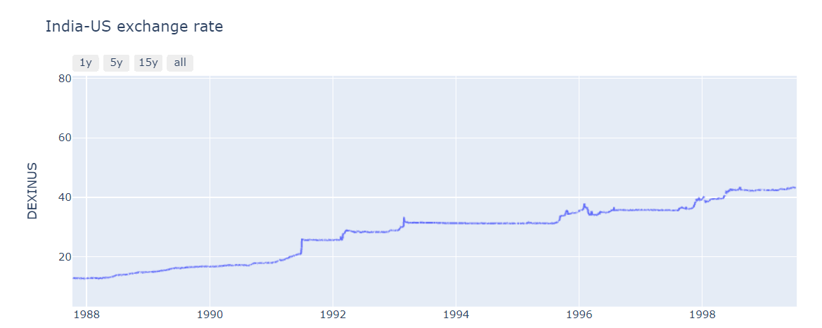
1 USD to INR in 1990 – the Economic Crisis
India’s economy was going through a tough time in the 1990s. Interest payment accounted for 39% of the revenue that the government collected at the time. Fiscal deficit reduced to 7.8% of GDP, and India on the verge of being declared a defaulter in the international market.
This crisis called for a devaluation of the Indian currency. Devaluation is a process where countries reduce the value of their currency in the international market while keeping their internal value intact. India took a similar approach to make its export market cheaper and its import market costlier.

Slide 6
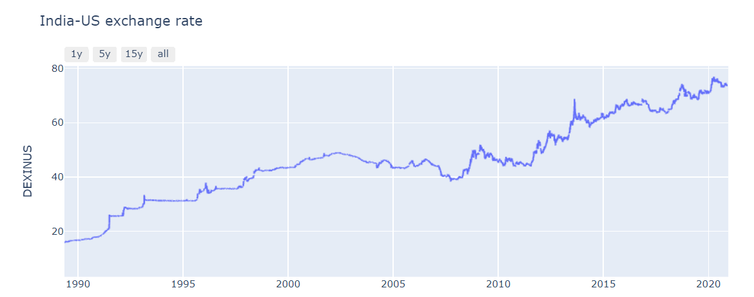
INR value since 1992- the effect of Devaluation
The devaluation turned the exchange rate of 1 USD to 25.92 INR in the year 1992. The Indian currency value began falling since then, with a current rate of 74.57 INR. Dollar price in 2004 was 45.32 INR, and in the next ten years, it rose to 62.33. In 2016, February was the month to witness Dollar to INR highest rate ever, amounting to 68.80 INR.

Slide 7
Augmented Dickey Fuller Test: To Test the Stationarity of Given Data

Slide 8
AD Fuller:
The data selected for the test is from 2020-06-25 to 2021-06-25.
Assumption in test:
Null Hypothesis H0 = If failed to be rejected, it suggests the time series has a unit root, meaning it is non-stationary
Alternative Hypothesis H1 = The null hypothesis is rejected and suggests the time series does not have a unit root, meaning it is stationary
Since the p-value after the test is 0.04, which is less than 0.05 we reject the null hypothesis.
Which means time series does not have a unit root and it is stationary.

