Slide 1
Issues and Suggestions for the Development of A Biodiversity Data Visualization Support Tool
Pawandeep Kaur*, Friederike Klan*, Birgitta König-Ries*
* Heinz-Nixdorf-Stiftungsprofessur für Verteilte Informationssysteme, Institut für Informatik, Friedrich-Schiller-Universität Jena, Germany
Eurovis 2018, Brno, 06.06.2018

Slide 2
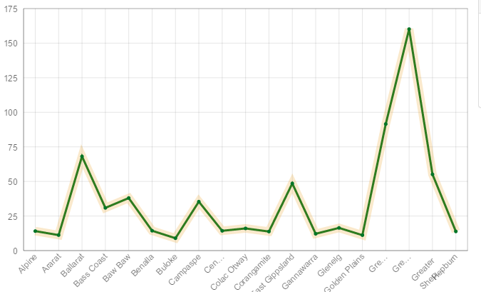
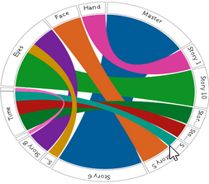
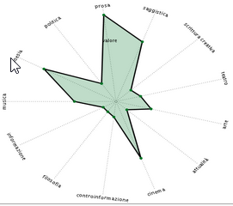


VISUALIZATION SELECTION PROBLEM
?
?
?
Too many options..... ☺
Which one is appropriate? ☹
I don‘t have time to learn all ☹
I am expert in chemistry ☺
I don‘t know these visualizations ☹
Generated lots of data ☺
How to present that in publications ? ☹

Slide 3
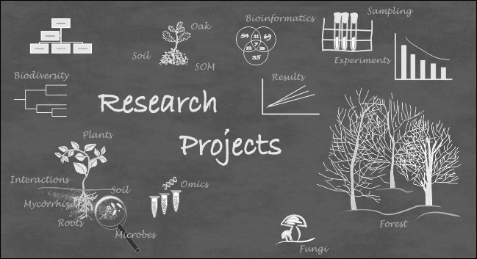
?
Notes:
Biodiversity domain, where scientists produce lots of data to address the critical challenges of biodiversity conservation and
study its impact on the ecosystem

Slide 4

Visualization Recommendation SYSTEM
Visualization Recommendation System
Data
Characteristics
User Preferences
Goals
Domain Knowledge
Visual
Analytics
Use data properties, data relationship, visual mapping
Gather users‘ intentions from their behaviours and interactional records
Infers the representational goal or user’s intentions
Characterize the task and data in the vocabulary of the problem domain
Kaur, P., & Owonibi, M., (2017). A Review on Visualization Recommendation Strategies .

Slide 5
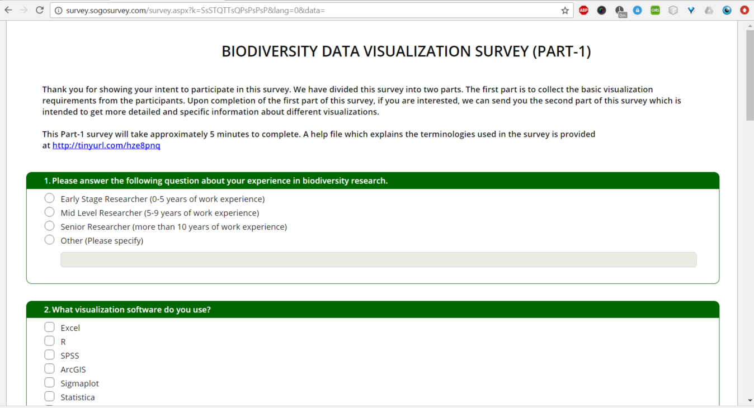

USER STUDY
Survey
Online form and paper questionnaire
German and international biodiversity organizations
Commentary Paper
August 2015 till December 2017
Only 100 responses ☹
Limited willingness to share knowledge !
Kaur, P., Gaikwad, J., & König-Ries, B. (2016). Towards recommending visualizations for biodiversity data. Biodiversity and Conservation, -3.
Notes:
Our first finding is that, considering the outreach of participants through all these venues this number is low.
It shows the limited willingness to share knowledge across interdisciplinary domain

Slide 6
USER STUDY
Current visualization usage patterns
What do they use most often

Slide 7
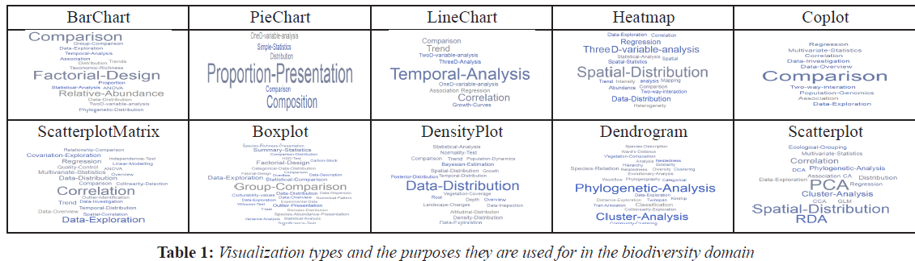
Current Visualization Usage
We showed various visualizations and asked them the purpose they use them for

Slide 8
Current Visualization Usage
Researchers use a spectrum of different visualizations for similar tasks
However, there are typically only one or two tasks that are prominent to each visualization
Notes:
for example, the representation of data grouping and its comparison is done by these multiple charts
for example, Scatterplot is used to illustrate the result of a principal component analysis (PCA) or to visualize the spatial distribution and Dendrograms are frequently used for facilitating phylogenetic or a cluster analysis.

Slide 9
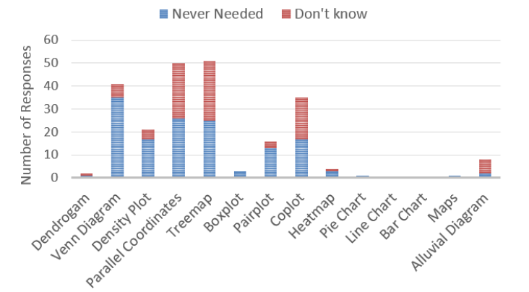

Current Visualization Usage
Parallel Coordinates, Treemap, Venn Diagram and Coplot (conditioning scatterplot) are much less used compared to the other visualizations
Reasons:
“parallel coordinates are difficult to interpret and hard to look. Better to use avid 3d plots.”
“treemaps are usually dynamic and thus are hard to include in a paper”
“I rather like venn diagrams when its area and colours also are meaningful.”
Notes:
Some of the more advanced and efficient multidimensional visualization are less used compared to other ones
although at least half of the respondents were aware of those types of visualizations.

Slide 10
USER STUDY
Current visualization usage patterns
What do they use most often
Challenges they face while selection and creation
Problems within their visualization usage
What could be the cause?

Slide 11
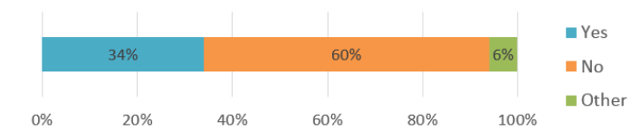
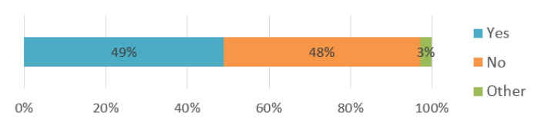
Issues with Visualization Selection
Do users find it difficult to select a visualization for presenting their research data?
Are users interested in having a software tool that can guide them in the selection of suitable visualizations?

Slide 12
Issues with Visualization Selection
Issues
Visualization Selection Dilemma
Large and Complex Datasets
Dependency on the Visualization Publication Medium
Lack of Knowledge
Notes:
Visualization Selection Dilemma: ample of visualizations available, visualization selection become challenging as, like one said for a visualization layman, every other visualization looks the same.
Lack of knowledge: they are unaware of alternative types of visualization techniques, selection is limited to what they have developed
earlier or have seen before. Thus they end up using similar visualization types again and again
Large and Complex Datasets: It is problematic to convey a message within multi-dimensional datasets clearly and precisely using a single
figure.

Slide 13
USER STUDY
Current visualization usage patterns
What do they use most often
Challenges they face while selection and creation
Problems within their visualization usage
What could be the cause?
Solution requirements
Visualization tool requirements
Specific features

Slide 14
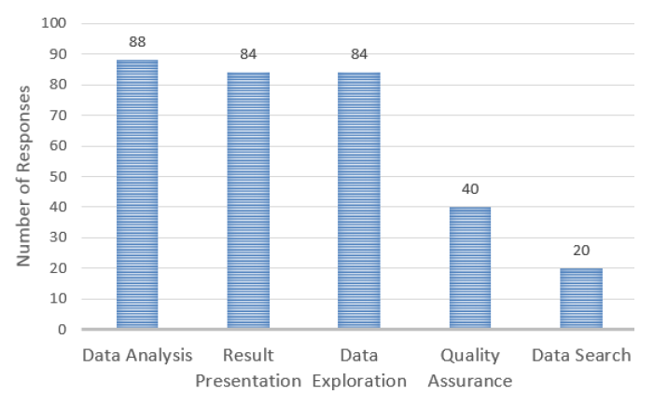
Visualization Tool Requirement
Visualization support for data management task
Notes:
There is a high necessity of visualization support for other data management related tasks.
This chart conveys that researchers have started realizing the usefulness of visualization for data exploration, quality assurance and data search.

Slide 15
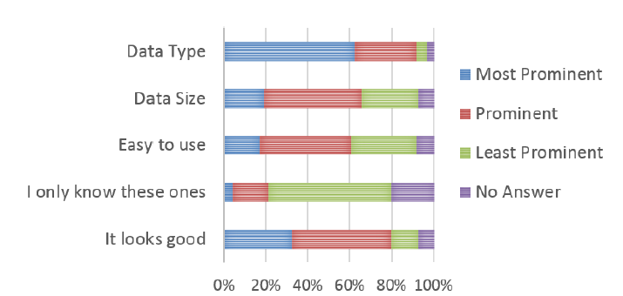

Visualization Tool Requirement
Factors for visualization selection
Notes:
scientists consider these three factors: data type, aesthetics and data size as most prominent for visualization selection
Here aesthetics refers to the clarity and comprehensibility of a visualization

Slide 16
Visualization Tool Requirement
User Centric : not be too prescriptive or conditional
Easy to use
Showcasing : visualization knowledgebase
Interactivity : visualization interactivity and customization
Multi-platform support : platform-independent
Colour-blinded friendly
Visualization audience
Notes:
User centric: solutions should not be based on preset conditions only. Range of solutions for the selection need to be there. Adapt to user response in real time
Easy to use: easy to use, acces and understand. Instead of making a user to guess on what procedure to follow in order to go to the next step, the s/w should guide the user in following the procedure
Showcasing: make them aware what options are available.. And what is the meaning of different elements
Interaction: within viz to explore different data dimensions, provide viz customization and enable audience engagement
Multi-platform support: easy to import and export. Not depend on any graphical tool for further customization
Color blinded friendly: avoid RGB, more patterns and textures
Viz audience: selection is different if the audience are researchers, grad student etc…

Slide 17
Conclusion
Biodiversity researchers feel comfortable with their current visualization practices
Need software support in order to choose proper visualizations to represent their data
Major challenges arise from the large number of visualizations and from the increased size and complexity of the data
Usefulness of visualization for other data management tasks like data exploration, data search and quality assurance
Research dimension to provide visualization as a service to the data management processes at its different stages
Requirements for such a support tool include the possibility to showcase available visualizations, interactivity and multi-platform support

Slide 18
Thank you for your attention
?

