Slide 1
|| ॐ श्री गणेशाय नमः || Machine Learning with Python
KMeans Clustering

Slide 2
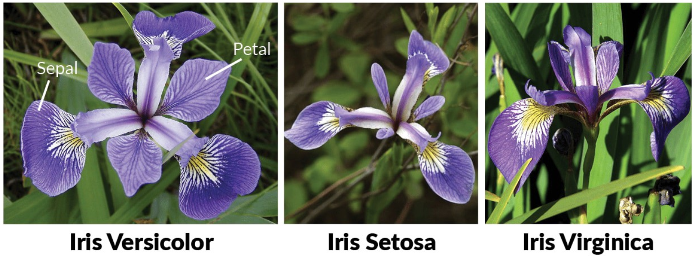
Project-1 : Iris Flower species classifications
Use iris flower dataset from ‘sklearn’ library and try to form clusters of flowers. Figure out if any preprocessing such as scaling would help here.

Slide 3
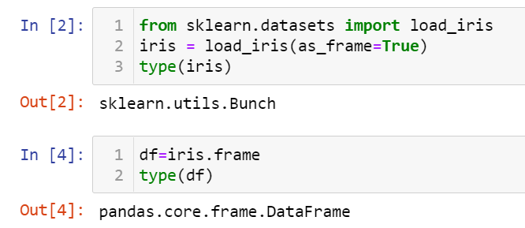
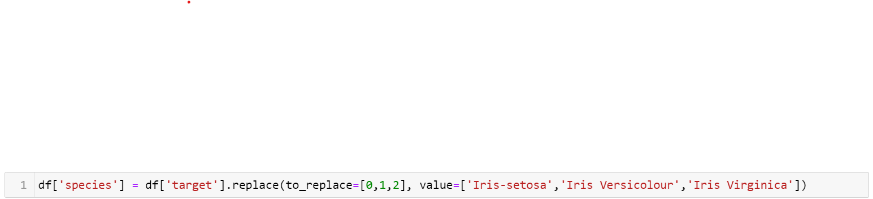
Iris Flower species classifications
Hints :
Load the dataset :
Use the below pattern to convert the target and predicted value to species name.
Plot the elbow chart to find the optimum number of cluster.
Predict the accuracy by comparing given ‘species’ and ‘predicted species’.
Find out the best the features for the better accuracy ?
Try ‘MinMaxscaler’ & Check out .. Is it affecting the accuracy or not?
Use the attractive graph to show the species cluster and centroid points.

Slide 4
Project-2 : Indian Stock Market
Task:
Firstly, screen the companies and visualise them according to sub-sectors using a pie chart or a bar charts.
Secondly, visualize the companies by segregating them according to Market Cap in three categories: Large Cap(>20,000 crore), Mid Cap (5,000 to 20,000 crore) & Small Cap(<5,000).
Thirdly, pick 10 random companies from the entire group and visualize the following through a line chart Find the Intrinsic Value of the company based on 3 cases of growth (g): Assume 3 Cases for g (Growth) : Good (15% Growth) ; Bad (-5% Growth); Best (25%Growth)
Visualise these 10 companies on a line chart for all 3 cases of growth going forward against its current market cap.

Slide 5
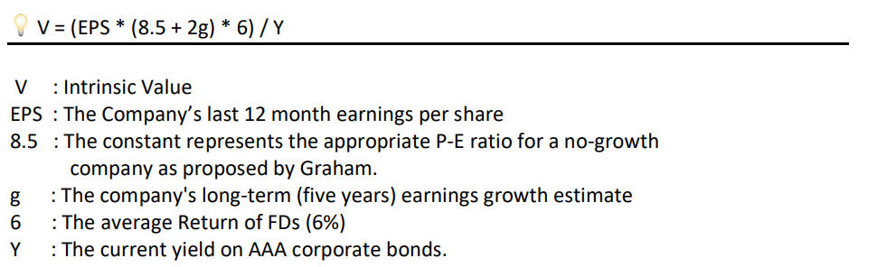
Indian Stock Market

