Slide 1
3-D Model of house By
Pooja Sah -074/BEX/421 Prava Basnet – 074/BEX/430 Rabindra Kumar Yadav - 074/BEX/432 Sabin Sharma Gaire-074/BEX/436

Slide 2
INTRODUCTION
Computer graphics have become a powerful tool for the rapid and economical production of pictures. Thus, our project is based on designing a 3D model of a House. In this project we are going to use OpenGl to render a 3d model of a house. For the calculations of the coordinate we are initially going to use blender software and extract the vertices and vertex normal from the obj file. We created a class using Assimp that reads and stores the vertices, edges, surfaces, normal as objects of reVarious 2D and 3D transformations are done to realize 3D house in 2D plane using perspective projection. Z buffer algorithm is used to determine the visible surface.

Slide 3
Objectives
The prime objectives of this project can be listed as follows:
To learn and be familiar with the concepts of Computer Graphics
To get familiar with 2D and 3D rendering pipeline
To build an interactive way of modelling any 3D object
To learn practical implementation of mathematical equations in digital world
To learn about the programs that resides on the GPU i.e. Shaders
To perform different transformations like rotation about coordinate axes, translation, scaling, etc. on the object.
To color and create lighting effects for the objects.
To learn the essence and ethics of working as a team

Slide 4
Resterization
- the process in which vetrex geometric shapes are changed into pixel form.
- process in which primitives are changed into 2D images.
Triangle resterization is used.

Slide 5
OpenGl
API
-as demanded lines will be drawn as in next command instead of triangle.

Slide 6
Shaders: programs for GPU - vertex shader - fragment shader

Slide 7
Depth Buffer - decides which elements of the object are visible or not. -while rendering , an object is projected, the depth value (z) is stored in the depth or Z buffer - Z- value is the measure of perpn. distance from pixel to its corresponding 3d coordinate.

Slide 8
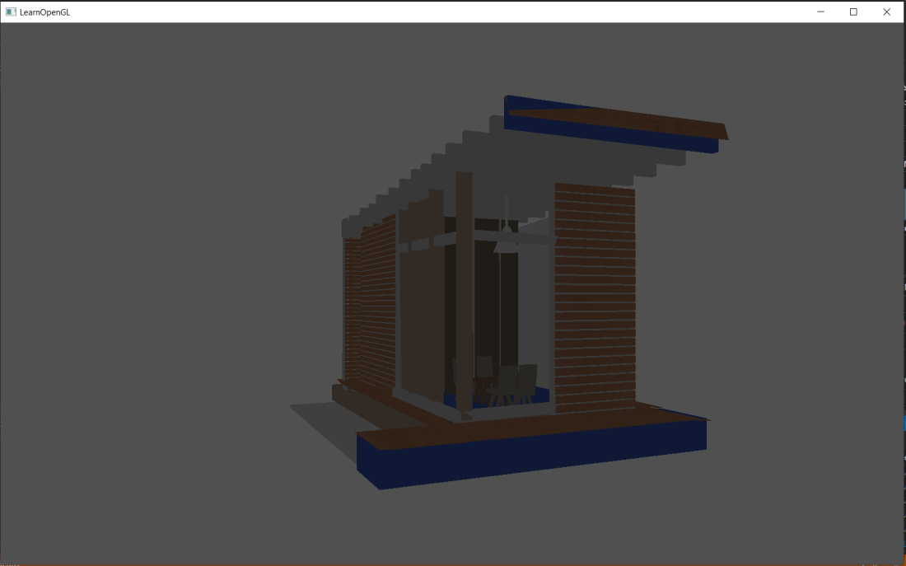
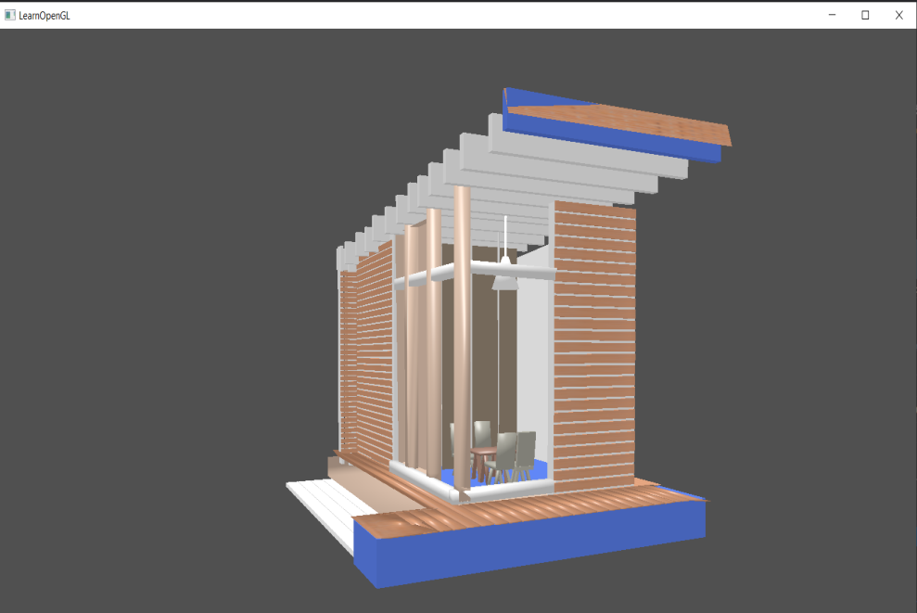
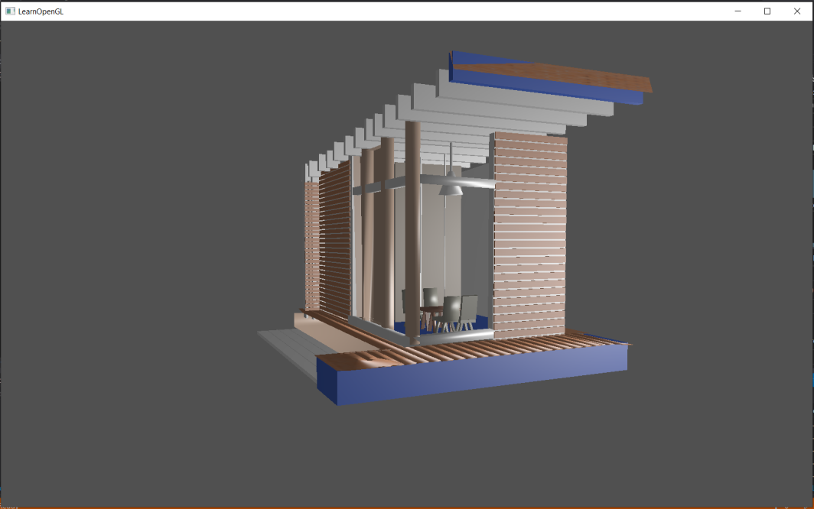
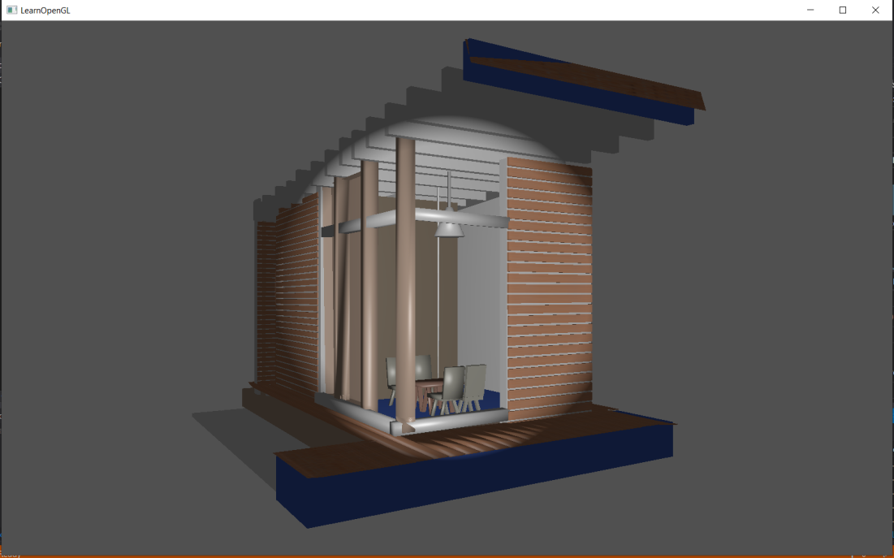
Output modes:

Slide 9
Problem Faced
The development of 3D modeling led us through a lot of problems regarding shader programs and rendering.
The logic of model loading was difficult while combining all the meshes
We didn’t find some easy methods for shadow rendering.
It took a lot of time for setup and to draw triangles as the way OpenGL works is quite difficult.
We were not very much familiar with the GPU programs
We find difficult to make different textures in blender and spent lots of time finding error as some textures has no coordinates

Slide 10
Limitations and Future Enhancement
Due to time limitations and OpenGL being a hard topic there are some limitations in our project. We can extend its features and make it even better. We don't consider much about advanced lighting.We do not use our own framebuffers for storing data and do not use other topics like Gamma Correction,Cube Maps, Advanced Data, HDR and Bloom.All these can be added to our recent project and enhance the beauty of model and make it more realistic.

Slide 11
Conclusion and Recommendations
Hence, with a lot of hardwork and failures, finally a sweet model was created using blender and OpenGL library in Visual Studio. If anyone has a great desire to know the logic and mathematics behind 3D Graphics pipeline, OpenGL is best to learn. It makes everyone familiar with GPU programming and helps to understand everything from scratch.

