Slide 1
Data Hub Framework 5.2
Sharu Radhakrishnan

Slide 2
MarkLogic Data Hub
A data hub is a repository that consolidates data from various silos.
MarkLogic Data Hub is a set of tools and libraries that help you quickly build an operational data hub on MarkLogic Server.
An operational data hub performs the following:
Secures all the data and operations at the entity or attribute level.
Traces data lineage. Where did it come from? Who loaded it? When?
2

Slide 3
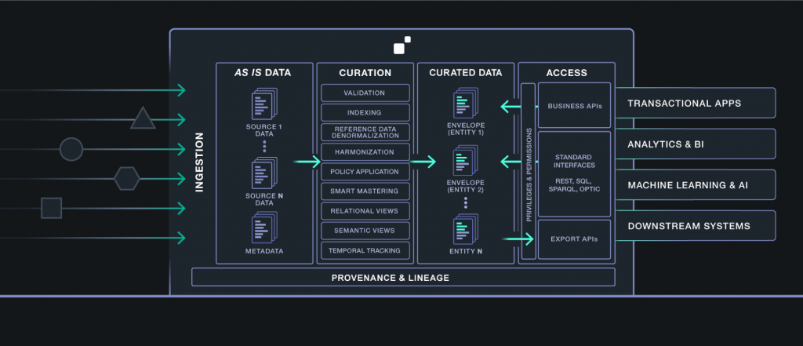
Data Services First
Approach recommended for building DataHub projects
Identify the business problem you’re going to solve. What will bring immediate value?
From there, figure out the business entities that are related to the problem.
From those entities, connect that to the sources of data that you’ll need.
2

Slide 4
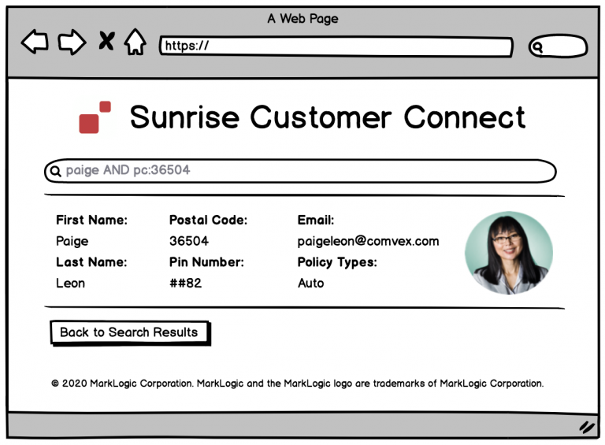
Example : Sunrise Insurance!
Sunrise Insurance
Customer calling the call center operator, call center operator should be able to see a 360 degree view of the customer data from an application, except certain fields to adhere to data privacy and compliance regulations
Home
Auto
End Product
2

Slide 5
Envelope pattern :
Original content and the associated metadata are stored in the same envelope (an entity) but remain separate
Structure of the envelope pattern in XML:
<envelope>
<headers/>
<triples/>
<instance>
your original data goes here
</instance>
</envelope>
Structure of the envelope pattern in JSON:
{
"envelope": {
"headers": [],
"triples": [],
"instance": {
"your original data": "goes here"
}
}
}

Slide 6
Data Hub Framework:
We can use the following tools to run the data hub frame framework:
GUI track - You perform tasks using the QuickStart app.
Command-line track - You perform tasks using Gradle commands.
Programming track - You create apps to perform tasks using APIs
2

Slide 7
Data Hub Framework:
Basic stuff the MarkLogic Data Hub platform will need:
Java 9 JDK (or later).
The MarkLogic Data Hub uses Java to run.
Gradle 4.6 (or later).
The MarkLogic Data Hub deployment tasks are automated with Gradle.
Chrome or Firefox.
The MarkLogic Data Hub has a tool called QuickStart, which is a browser based tool that we’ll use to build our project.
MarkLogic awesomeness:
MarkLogic Server 9.0-10.3 (or later).
The MarkLogic Data Hub platform runs on the MarkLogic database.
MarkLogic Data Hub 5.2 QuickStart *.war file
Java is used to run this *.war file in order to access the QuickStart interface that we’ll use to build our hub.
2

Slide 8
Data Hub Framework (DHF) using QuickStart app:
Prerequisites :
Java SE JDK 8 or later
MarkLogic 9.0-7 or later
Chrome or Firefox for QuickStart
QuickStart cannot be used in production
In production use gradle tasks
2

Slide 9
Steps to set up DHF:
Create a directory for your Data Hub project. This directory will be referred to as "your project root" or simply "root".
Next download the QuickStart app(.war file) and source code from the below mentioned site (https://github.com/marklogic/marklogic-data-hub/releases/). There are different versions available for the DHF (latest version as of may 2020 is Marklogic Data Hub 5.2.0). README.md in source code will give more information on compatibile version of gradle, java and MarkLogic required
Keep .war file in project root directory
Open the Terminal (Linux / Mac) or Command prompt (Windows) from project root directory and run the below command
To use the default port number for the internal web server (port 8080):java -jar marklogic-datahub*.war
To use a custom port number; e.g., port 9000: java -jar marklogic-datahub*.war --server.port=9000
2

Slide 10
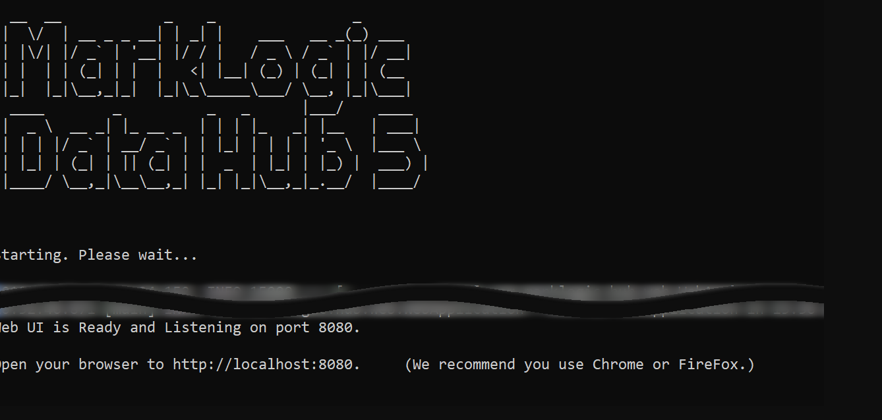
Steps to set up DHF:
Go through the wizard to initialize your project and install Data Hub to your MarkLogic Server.
5. Open a web browser, and navigate to http://localhost:8080 or http://localhost:9000.
2

Slide 11
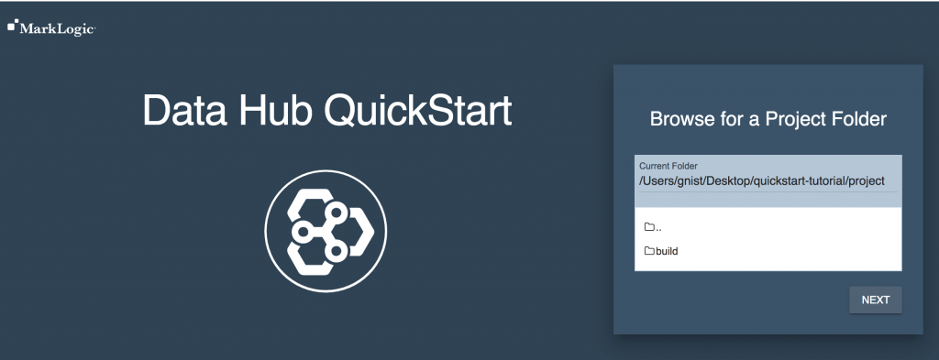
Steps to set up DHF:
Browse to your project root directory and click next
2

Slide 12
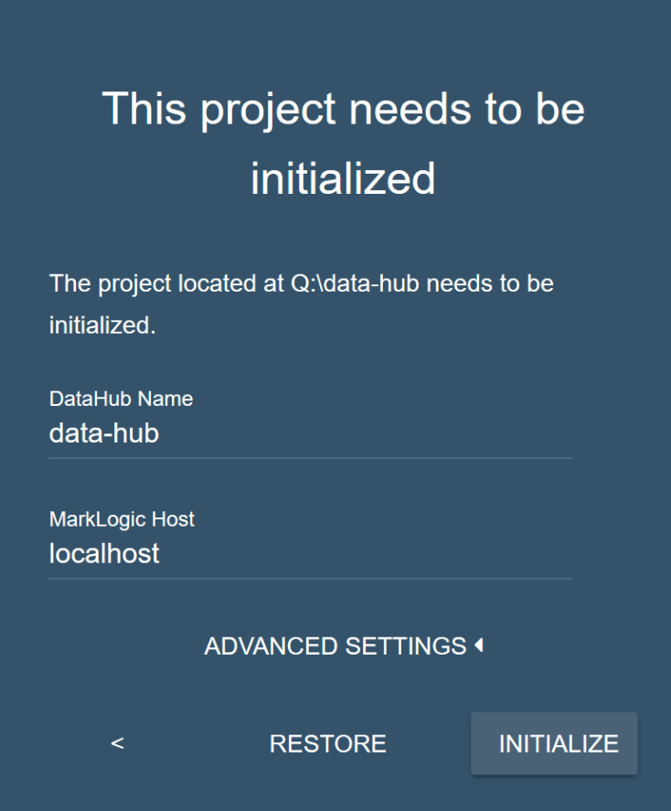
Steps to set up DHF:
Click Initialize to the project directory :
After initializing your Data Hub Framework project,
your project directory contains additional files and
directories. Then click next
2

Slide 13
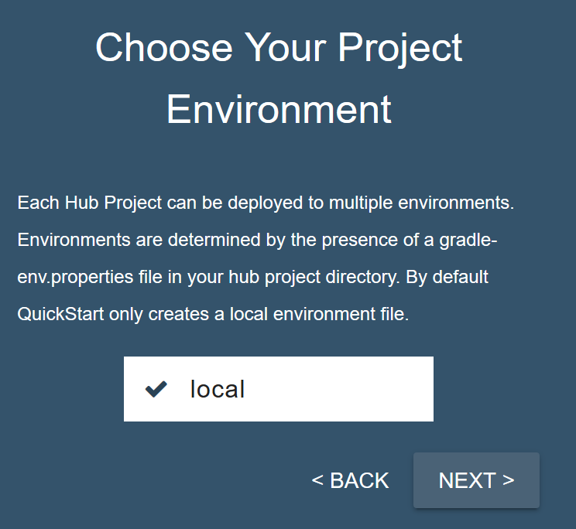
Steps to set up DHF:
Choose the local environment, then click and click next. The various environment is visible based on the gradle.properties file (dev, QA or PROD)
2

Slide 14
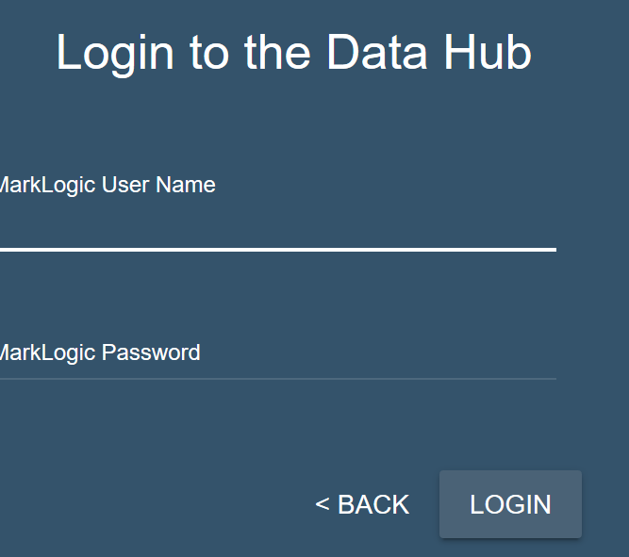
Steps to set up DHF:
Enter your MarkLogic Server credentials, then click login
2

Slide 15
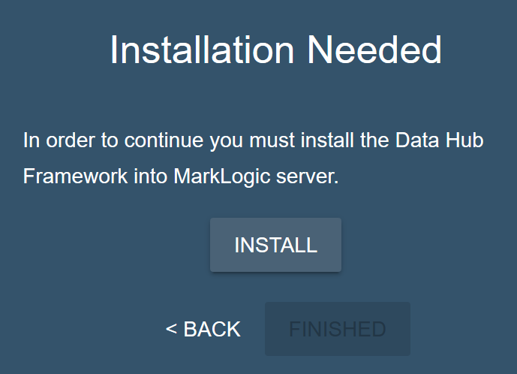
Steps to set up DHF:
Click install to install the Data Hub into MarkLogic.
2

Slide 16
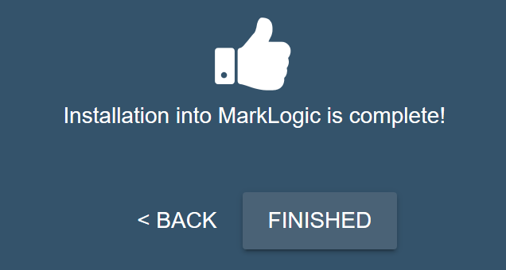
Steps to set up DHF:
When installation is complete, click finished
2

Slide 17
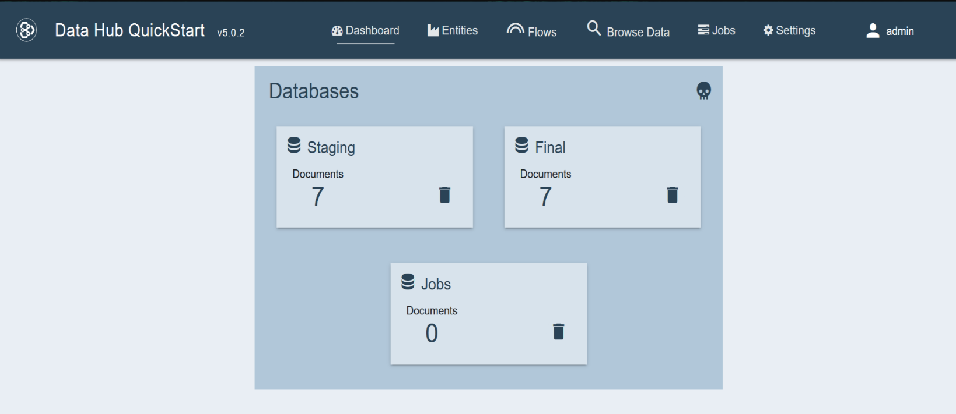
Steps to set up DHF:
When installation is complete, the Dashboard page displays the baseline of ML Data Hub as below :
2

Slide 18
Data Hub Framework:
Ingestion , Harmonization happens in DHF by configuring and running flows.
A flow is a pipeline that will process our data
A data flow is configured as a series of steps :
Ingestion
Mapping
Mastering
2

Slide 19
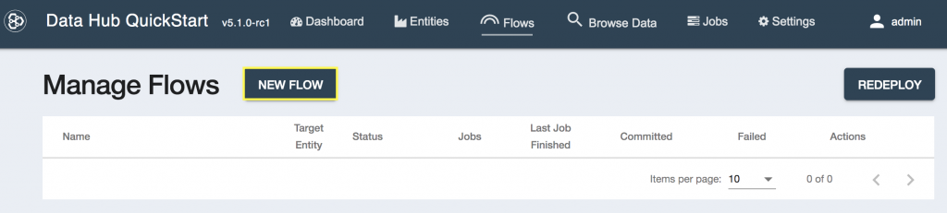
Ingestion:
1. From the Data Hub QuickStart, choose Flows:
2. From the Manage Flows screen, select NEW FLOW:
2

Slide 20
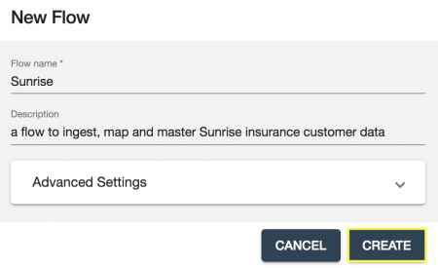
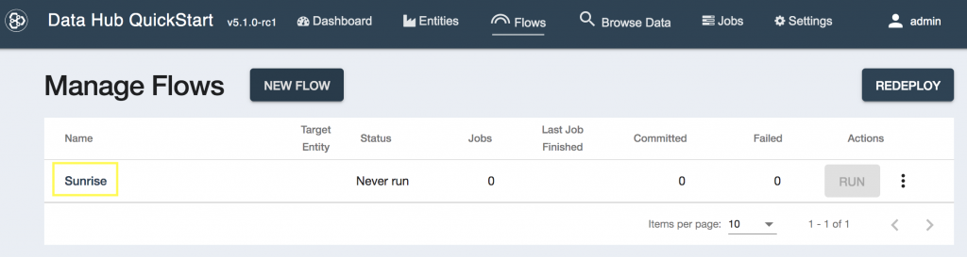
Ingestion:
3. Configure the flow as shown and the click the CREATE button:
4. Click your newly created Sunrise flow:
2

Slide 21
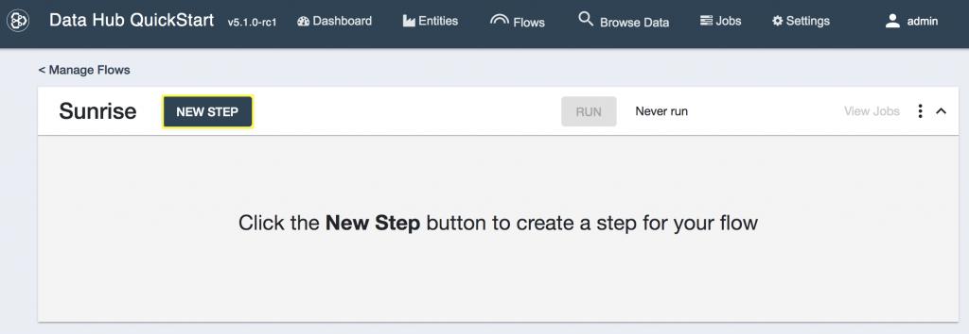
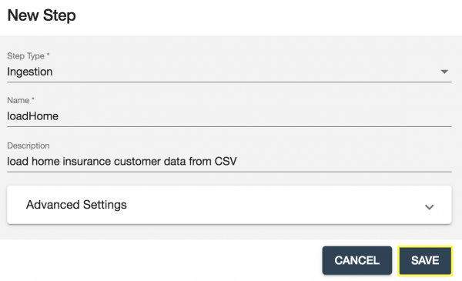
Ingestion:
5. Click New Step:
6. Select Ingestion as the step type,
configure it as shown
2

Slide 22
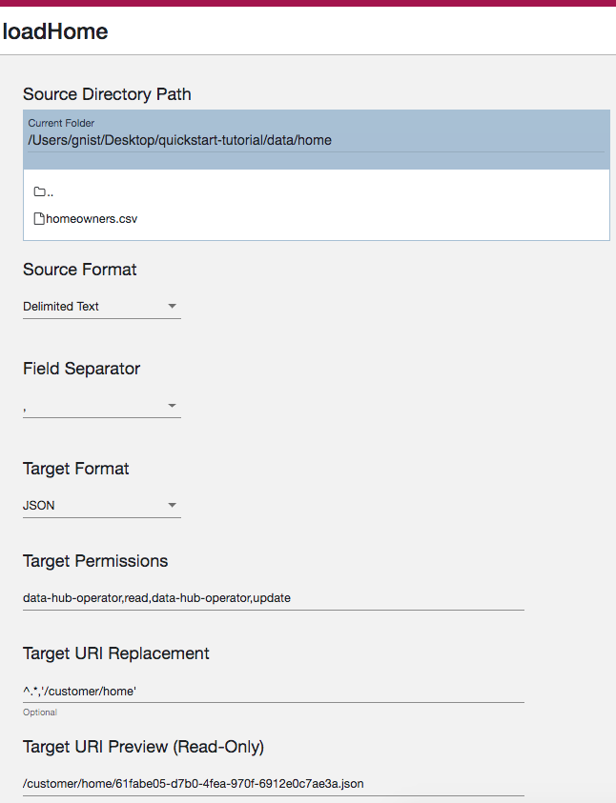
Ingestion:
5. Configure the Ingestion step
2

Slide 23
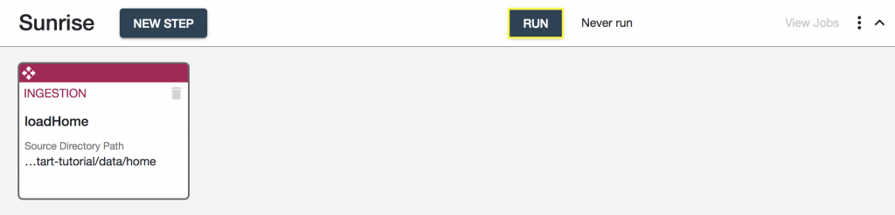
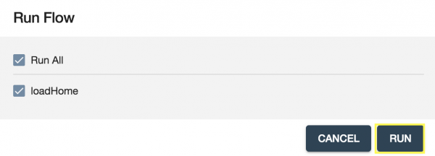
Ingestion:
5. Run the Flow
To view the data click “Browse Data”
2

Slide 24
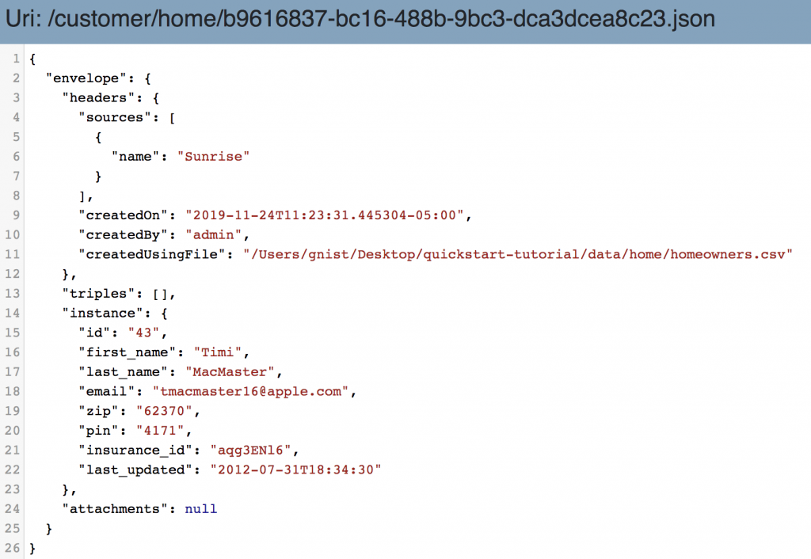
Ingestion (Browse data) :
2

Slide 25
Curate:
The process of data curation is done in order to model the data in order to get it into a shape that can power the data services that the customer needs
Curation starts with creating entities and defining the key data properties that data services will need to consume
At a high-level:
Create an entity with a model for these key properties of data.
Configure mapping steps to map our sources of data to the entity model, and transform data if needed to help us meet the requirements.
Configure Smart Mastering in order to match and merge duplicate customers into a single source.
2

Slide 26

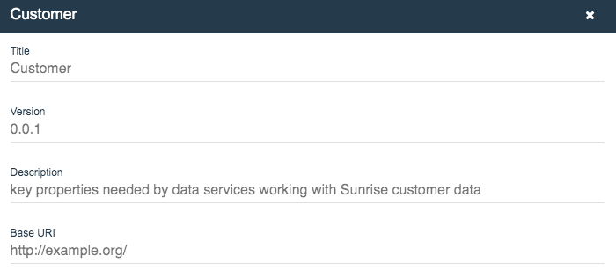
Entity Creation (eg: customer):
Choose Entities
Click the wrench icon and then select NEW ENTITY
Set the Title of the entity to Customer and give it a description:
2

Slide 27
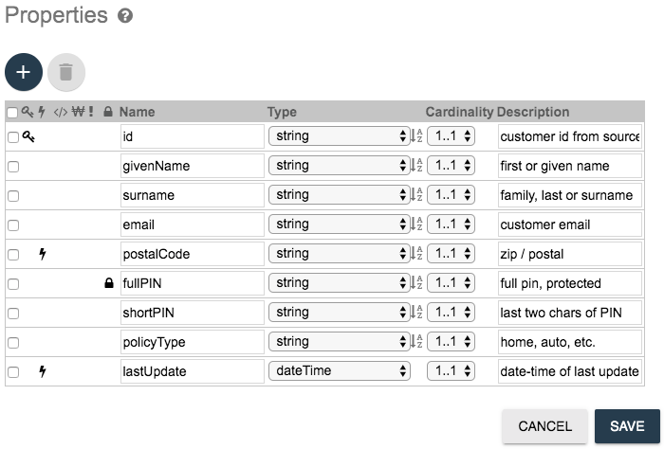
Entity Creation (eg: customer):
4. Add properties and configure
2

Slide 28
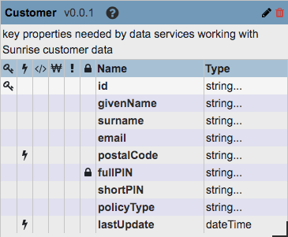
Entity Creation (eg: customer):
4. When promted to update indexes choose “YES”
5. Entity configuration
2

Slide 29
Curate Mapping :
Associate fields in your source data to the fields in your harmonized entity model.
For example, if your source data uses the field “fname” but your entity model uses “first name,” map the two and then run the harmonization flow.
Steps are below :
From “Manage Flows”,
select the flow (example here Sunrise)
Create New Step
2

Slide 30
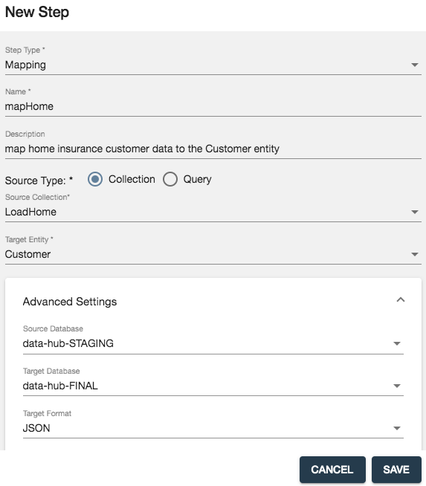
Curate Mapping :
4. Create the new Step and configure it
2

Slide 31
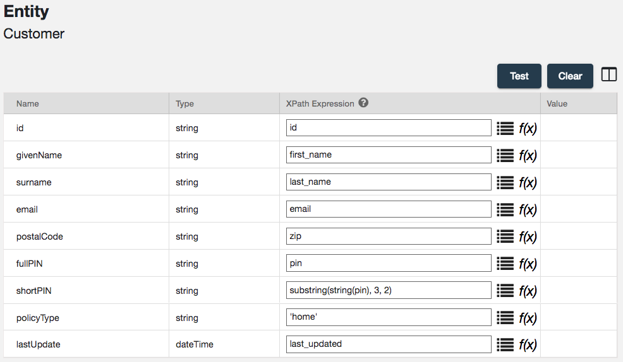
Curate Mapping - configure the mapping step :
4. Configure the step
2

Slide 32
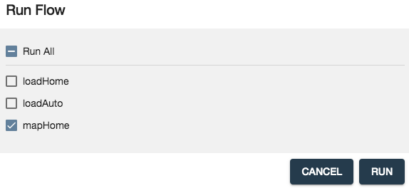
Curate Mapping :
5. Click Test to validate
6. Click “Run” to run the flow
2

Slide 33
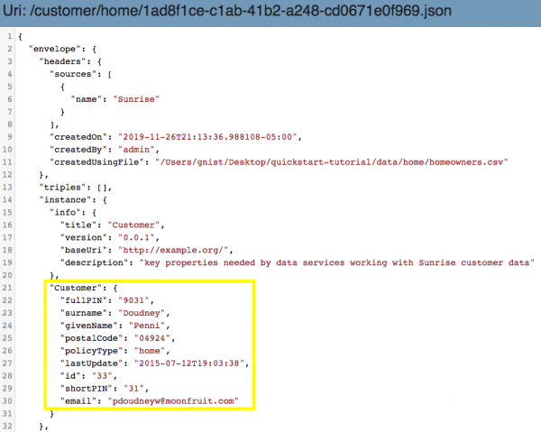
Browse Data:
collection name – “Customer” (named after entity)
2

Slide 34
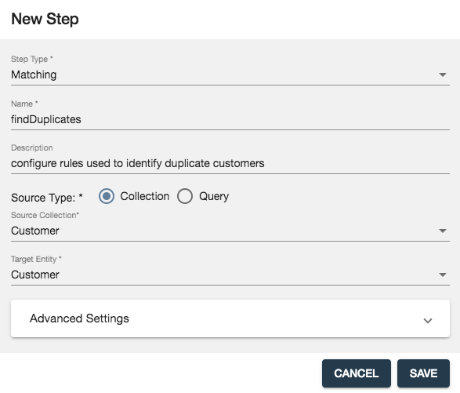
Curate: Mastering(Match + Merge)
Check for possible matches across your records and merge them based on specified criteria set to create an integrated 360 degree view of the data to the business.
Smart Mastering makes it easy to analyze data and automatically match and merge based on logic and the rules configured
Steps to Mastering(match) :
Matching will search duplicates
1. From QuickStart menu choose flows
2. Click the required flow (eg. Sunrise flow)
3. Click New Step
4. Configure the New Step
2

Slide 35
Curate: Mastering(Match)
5. Configure findDuplicates step with Match Options and Match Thresholds
Match Options - things to look for in the data that, when matched, might indicate a duplicate. Each match option will also be assigned a weight
Match Thresholds - Match Thresholds analyze all the “hits” found based on the defined match options and the total score of those options
Actions taken depending on the total score of the options :
Merge
notify
2

Slide 36
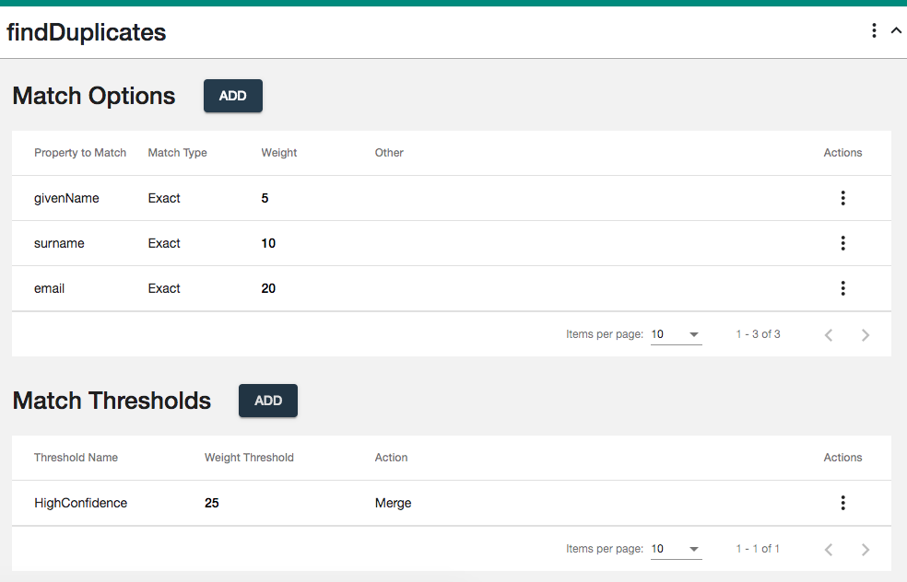
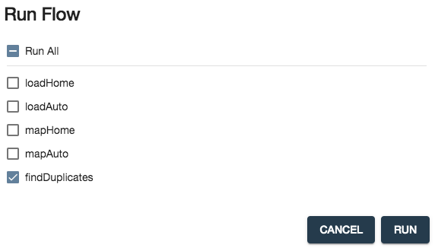
Curate: Mastering(Match)
1
2
2

Slide 37
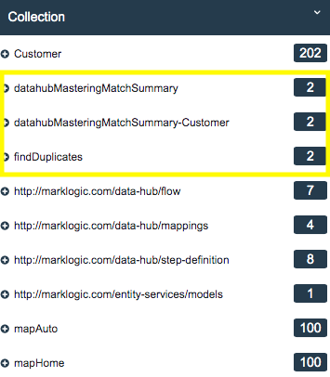
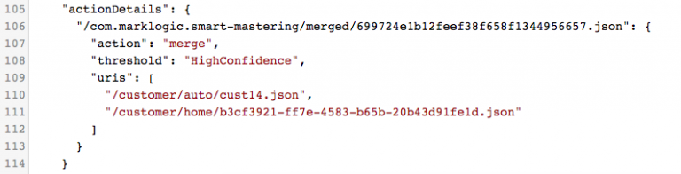
Curate: Mastering(Match)
Ananlyse the data in Final collection
Match summary JSON documents are now part of customer collection, These JSON documents will contain actionDetails
4
3
2

Slide 38
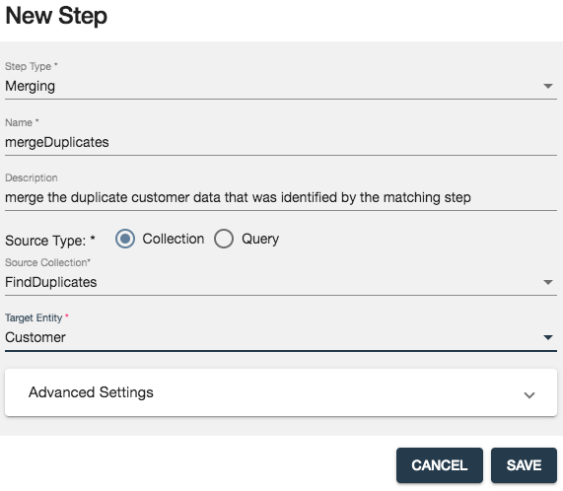
Curate: Mastering (Merge)
Merging will merge the duplicates
A new step created for merge flow - mergeDuplicates
2

Slide 39
Curate: Mastering (Merge)
Merging will merge the duplicates
A new step created for merge flow - mergeDuplicates
2

Slide 40
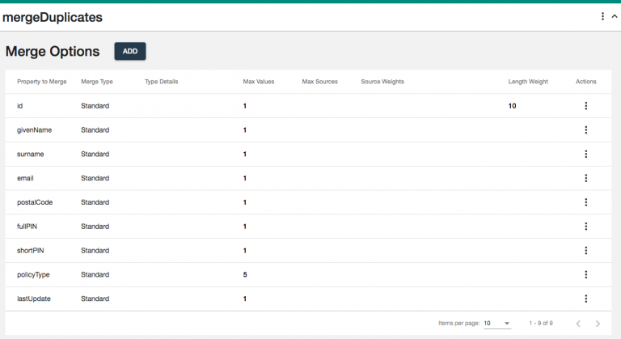
Curate: Mastering (Merge)
Add merge options to create exact configurations
2

Slide 41
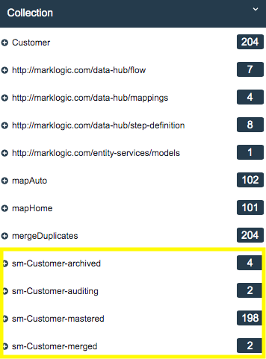
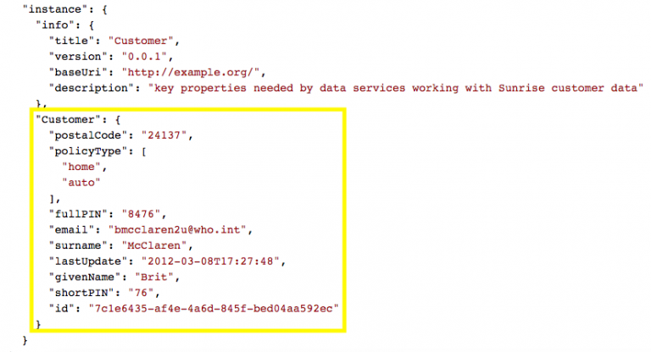
Curate: Mastering (Merge)
Run and mergeDuplicates Flow(merge flow) and check the data.
Sm-Customer-mastered contains all the curated data
2

Slide 42
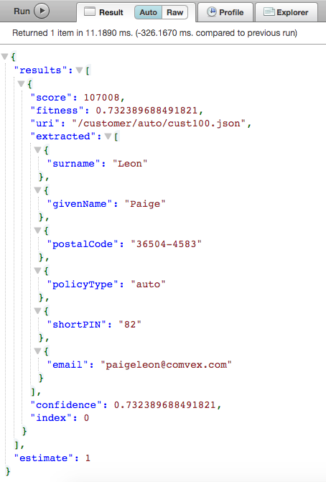
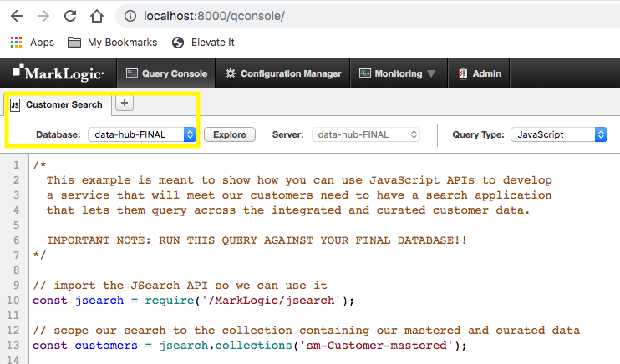
Access
Data in the Data Hub can be accessed from MarkLogic using either of below ways :
JavaScript
Java
Node.js
REST
Xquery
2
1
2

Slide 43
Thank You
Cognizant MarkLogic CoE DL → BigDataMarklogicCOE@cognizant.com

