Slide 1
MarkLogic Architecture
Presented by
PAWAN RAWAT

Slide 2
MarkLogic Architecture
MarkLogic- NoSQL Database
Databases
Forests
Application servers
Hosts (E node / D node concepts)
Groups
Caches
Clusters
Merges
Rebalancing
Scalability
ACID
MVCC(Multi Version Concurrency Control)
Notes:
How presentation will benefit audience: Adult learners are more interested in a subject if they know how or why it is important to them.
Presenter’s level of expertise in the subject: Briefly state your credentials in this area, or explain why participants should listen to you.

Slide 3
MarkLogic- Enterprise NoSQL Database
Its called as “ONLY” Enterprise NoSQL database.
Because it is the only NoSQL database in the market which offers the Enterprise-Software capability like ACID Transactions, Govt. grade Security, HA and DR built into it from its very first release.
Apart from Enterprise Software features, it has all the capability you expect in a Big Data NoSQL platform like Enterprise Full Text Search and Query, Scalability on a commodity hardware, Hadoop support, Semantics and Bitemporal.
So, MarkLogic is a Platform with combination of Database, Enterprise Search and Application Services all bundled into one product.
As a database with built-in search and application services, MarkLogic can ingest documents in a wide variety of formats and structure that are immediately indexed for full-text search, and has APIs for programmers to use to quickly and easily build a variety of applications.

Slide 4
MarkLogic- Enterprise NoSQL Database
Search & Query
ACID Transactions
HA/DR and Replication
Government-grade Security
Scalability & Elasticity
On-premises or Cloud Deployment
Hadoop for Storage & Compute
Semantics
Bitemporal
Faster Time-to-Results
DATABASE
SEARCH
APPLICATION SERVICES

Slide 5
MarkLogic- Enterprise NoSQL Database
MarkLogic is often used in a cluster, to provide scalability and high availability. Each node in a MarkLogic cluster has the same capabilities. There are no master or slave nodes. With each node having the same functionality, it makes it easy to scale a cluster, adding nodes as needed, or to remove nodes, if no longer needed.
MarkLogic's support for MVCC (multi-version concurrency control) results in ACID transactions, even at huge scale.
MarkLogic has the highest security certification of any NoSQL database, with NIAP Common Criteria certification, providing fine-grained, government-grade security at the database level.
MarkLogic was designed so that search is built into the database. As data is loaded into MarkLogic, it is indexed and immediately searchable. This provides lightning-fast, sub-second search results across the data. MarkLogic's indexes support a wide range of search features including full-text search, stemming, type-ahead suggestions, proximity searches, snippets, highlighting, structure-aware, co-occurrence relationships, facets, geospatial, semantic inferencing, as well as support for multi-lingual content.
As a database supporting unstructured, semi-structured, and structured data, providing scalability, high availability, ACID transactions, government-grade security, and search, MarkLogic can serve as the database in a three-tier stack, or can deliver all of the components to provide a single-tier architecture.

Slide 6
MarkLogic Architecture
Node.js
Java
REST
XCC
ODBC
Interfaces
Evaluator
JavaScript | XQuery | XSLT | XPath | SQL | SPARQL
Cache
Expanded Tree Cache | Module Cache
Evaluation Layer
Broadcaster / Aggregator
Transaction Controller
Multiversion Concurrency Control
Cache
Compressed Tree Cache | List Cache
Transaction Journal
Data Layer
Indexes
Values | Structure | Text | Scalar | Metadata | Security | Geospatial | Reverse | Triple
Compressed Storage
JSON | XML | Binary | Text

Slide 7
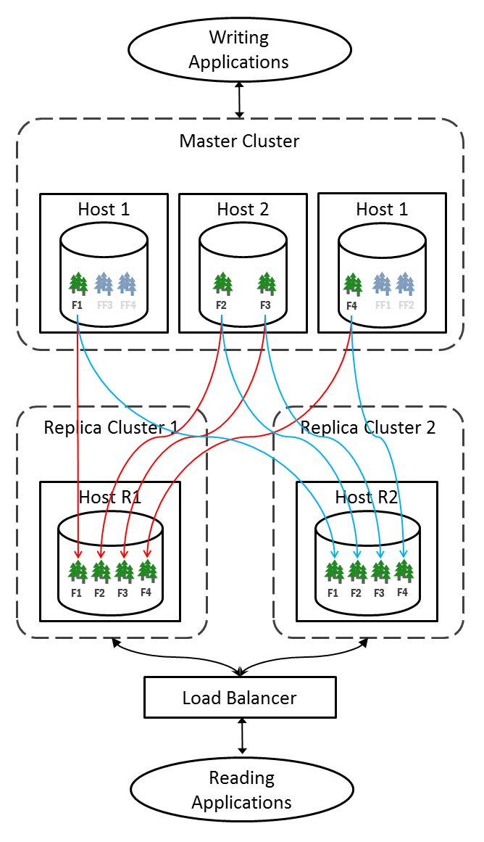
Database
A database consists of one or more forests.
Structure in green are forests.
Notes:
Lesson descriptions should be brief.

Slide 8
Forests
A forest is a collection of documents that is implemented as a physical directory on disk.
Each forest holds a set of documents and all of their indexes.
Forests can be queried in parallel, so placing more forests on a multi-core server can help with concurrency.
A rule of thumb is to have one forest for every 2 cores on a box, with each forest holding millions or tens of millions of documents. In a clustered environment, you can have a set of servers, each managing their own set of forests, all unified into a single database.
Notes:
Example objectives
At the end of this lesson, you will be able to:
Save files to the team Web server.
Move files to different locations on the team Web server.
Share files on the team Web server.

Slide 9
Application servers
MarkLogic Server provides a platform to build application that store all kinds of data, including content, geospatial data, numeric data, binary data, and so on.
Developers build applications using XQuery and/or Server-Side JavaScript both to search the content and as a programming language in which to develop the applications.
The applications can integrate with other environments via client APIs (Java, Node.js, and REST), via other web services, or via an XCC interface from Java or .NET.
It is possible to create entire applications using only MarkLogic Server, and programmed entirely in XQuery or Server-Side JavaScript.
Types of application servers
HTTP
XDBC
ODBC
WebDav

Slide 10
E-Nodes and D-Nodes
MarkLogic servers placed in a cluster are typically configured for one of two types of operations. They can be Evaluators (E-nodes) or they can be Data Managers (D-nodes).
E-nodes listen on a socket, parse requests, and generate responses.
D-nodes hold data along with its associated indexes, and support E-nodes by providing them with the data they need to satisfy requests and process updates.

Slide 11
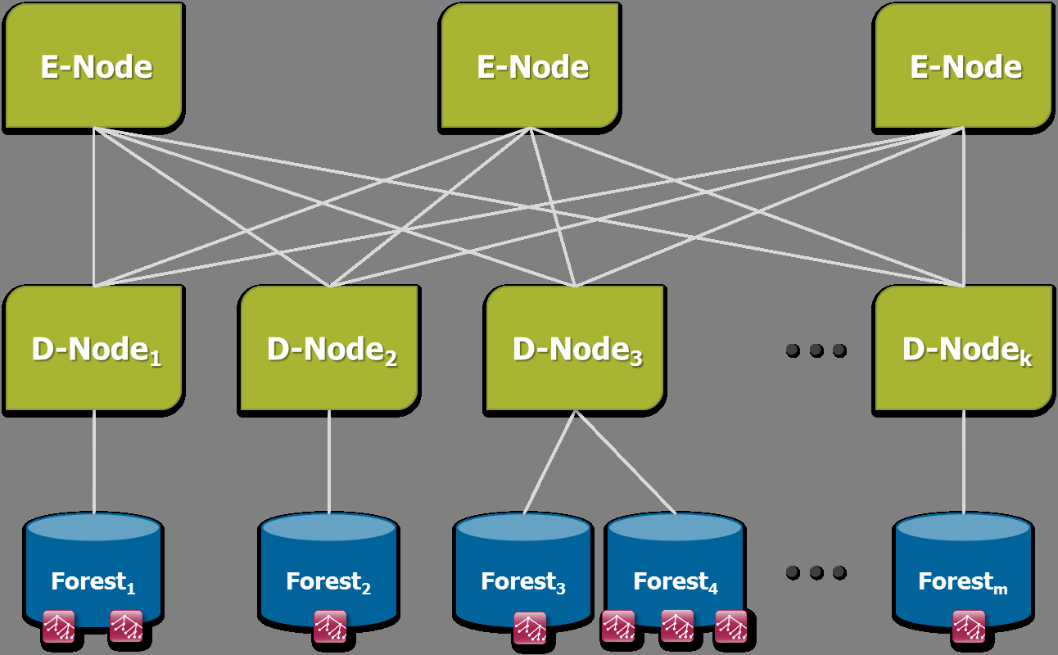
E-Nodes and D-Nodes

Slide 12
Groups
A group is a set of similarly configured hosts within a cluster.
To understand better :
A host is an instance of MarkLogic Server running on a single machine.
A cluster is a set of hosts that work together.
For single-node configurations, you can only use one group at a time (because there is only one host). For clusters configurations with multiple hosts, you can have as many group configurations as makes sense in your environment.

Slide 13
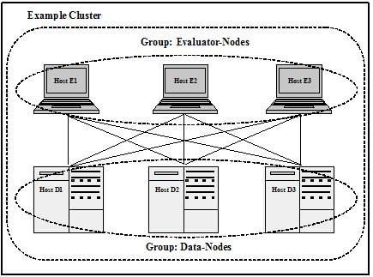
Groups
Groups allow you to have several configurations, each of which applies to a distinct set of hosts.
Different configurations are often needed when different hosts perform different tasks, or when the hosts have different system capabilities (disk space, memory, and so on).
In cluster configurations, a common configuration is to have one group defined for the evaluator nodes and another group defined for the data nodes.

Slide 14
Caching
On database creation, MarkLogic assigns default cache sizes optimized for your hardware, using the assumption that the server will be acting as both E-node and D-node.
You can improve performance in a clustered environment by optimizing each group's cache sizes.
With an E-node group, you can increase the size of the caches related to request evaluation at the expense of those related to data management. For a D-node, you can do the opposite.

Slide 15
Caching
List Cache
This cache holds term lists after they've been read off disk. Index resolution only happens on D-nodes, so in a D-node group you'll probably want to increase the size of the List Cache. On an E-node, you can set it to the minimum (currently 16 Megs).
Compressed Tree Cache
This cache holds the XML fragments after they've been read off disk. The fragments are stored compressed to reduce space and improve IO efficiency. Reading fragments off disk is solely a D-node task, so you will probably want to increase the size of this cache for D-nodes and set it to the minimum for E-nodes.
Expanded Tree Cache
Each time a D-node sends an E-node a fragment over the wire, it sends it in the same compressed format in which it was stored. The E-node then expands the fragment into a usable data structure. This cache stores the expanded tree instances. For binary documents it holds the raw binary data.

Slide 16
Cluster
You can combine multiple instances of MarkLogic to run as a cluster. The cluster has multiple machines (hosts), each running an instance of MarkLogic Server. Each host in a cluster is sometimes called a node, and each node in the cluster has its own copy of all of the configuration information for the entire cluster.
When deployed as a cluster, MarkLogic implements a shared-nothing architecture. There is no single host in charge; each host communicates with every other host, and each node in the cluster maintains its own copy of the configuration. The security database, as well as all of the other databases in the cluster, are available to each node in the cluster. This shared-nothing architecture has great advantages when it comes to scalability and availability. As your scalability needs grow, you simply add more nodes.

Slide 17
Cluster
Clustering MarkLogic provides four key advantages:
The ability to use commodity servers, bought for reasonable prices.
The ability to incrementally add (or remove) new servers as need demands.
The ability to maximize cache locality, by having different servers optimized for different roles and managing different parts of the data.
The ability to include failover capabilities to handle server failures.

Slide 18
Merges
A database consists of one or more forests, and each forest consists of one or more stands. Each stand consists of one or more fragments.
When a document is updated, new versions of all of the fragments associated with the document update are created in a new stand.
Any old versions of the fragment remain in the old stand with a system timestamp that lets MarkLogic Server know that they are old versions of the fragments.
When a document is deleted, its fragments remain in the old stand with a system timestamp that lets MarkLogic Server know that they are old versions of the fragments.
Merges occur to move any unchanged fragments from an old stand into a new stand, deleting any old versions of fragments (including deleted fragments), thereby freeing up disk space and compacting the usable fragments so they are all together on disk. Additionally, merges combine index data for all of the fragments in a stand, thereby optimizing the indexes.

Slide 19
Merges
Merges are a normal part of database operation, and they ensure that the system continues to perform at its best as updates and deletes occur.
To summarize, as part of merging, the following occurs:
Multiple stands are combined into one for improved performance.
Disk space is reclaimed.
Indexes and lexicons are combined and re-optimized based on their new size.
The result is a database that is smaller and can resolve queries much faster than before the merge.

Slide 20
Rebalancing
MarkLogic includes a database rebalancing mechanism that enables it to evenly distribute content among the database forests.
Database rebalancer consists of two parts: an assignment policy for data insert and rebalancing and a rebalancer for data movement.
The rebalancer can be configured with one of several assignment policies, which define what is considered 'balanced' for a database. You choose the appropriate policy for a database.
The rebalancer runs on each forest and consults the database's assignment policy to determine which documents do not 'belong to' this forest and then pushes them to the correct forests.

Slide 21
Rebalancing
When you add a new forest to a database configured with a rebalancer, the database will automatically redistribute the documents among the new forest and existing forests.
You can also retire a forest in a database to remove all of the documents from that forest and redistribute them among all of the remaining forests in the database.
In addition to enabling and disabling on the database level, the rebalancer can also be enabled or disabled at the forest level. For the rebalancer to run on a forest, it must be enabled on both the database and the forest.

Slide 22
Scalability
MarkLogic Server is designed for extremely large content sets, and to support these large content sets, scales to clusters of hundreds of machines, each of which runs MarkLogic Server.
Each machine in a MarkLogic Server cluster is called a host, and a host is sometimes referred to as a node in the cluster.

Slide 23
Scalability
Factors To Consider in Large-Scale Deployments
Extremely Large Amounts of Content
To handle extremely large content sets, you scale the number of data nodes in the MarkLogic Server cluster. MarkLogic Server is designed to scale to 100s of nodes or beyond.
Fast Query Performance, Regardless of the Content Size
MarkLogic Server evaluates queries on an evaluator node (e-node), and the e-node gathers any needed content from the data nodes (d-nodes). If the content set is large and spread across several d-nodes, each of those d-nodes is involved in the query even if only to inform the e-node that it has no content matching the query.
Large Numbers of Users
If your scalability challenge is large numbers of users, you can add e-nodes to a MarkLogic Server cluster and be able to see immediate benefits by routing queries across the various e-nodes in the cluster. The process of adding an e-node is simply a matter of bringing another MarkLogic Server machine online and joining that machine to the cluster.

Slide 24
Scalability
Forest Sizes Per Data Node Host
Average sized fragments of 10k to 100k.
The rule-of-thumb maximum size for a forest on a 64-bit system is 256GB per forest, or 128-million fragments, whichever comes first.
All binary documents should be considered in fragment count estimations, but large and external binary documents may be excluded from the 256GB per forest limit since they contribute little to the size of stands within a forest.
Each forest should ideally have two CPUs (or cores) per forest.

Slide 25
Scalability
High Availability
When examining your system requirements, if you find that having extreme levels of system uptime is critical to your application, then high availability is clearly an important requirement for your system. When thinking about high availability for a system, you perform a thorough examination of all points of failure for your system, throughout the entire software and hardware stack in which your application runs.

Slide 26
Scalability
Hardware and Memory Considerations
MarkLogic Server is designed to take advantage of 64-bit systems. MarkLogic Server running on 64-bit systems will scale to sizes orders of magnitude higher than on 32-bit systems. For most deployments, a 64-bit system is recommended. In general, you should use 64-bit systems for all deployments, but particularly if your database size is greater than 2GB. Additionally, 64-bit systems can address much more memory than 32-bit systems, so you can both install more memory and address more virtual memory on a 64-bit system.

Slide 27
ACID
MarkLogic stores documents within its own transactional repository that was purpose-built with a focus on maximum performance and data integrity. Because the MarkLogic database is transactional, you can insert or update a set of documents as an atomic unit and have the very next query able to see those changes with zero latency. MarkLogic supports the full set of ACID properties:
Atomicity -- a set of changes either takes place as a whole or doesn't take place at all.
Consistency -- system rules are enforced, such as that no two documents can have the same identifier.
Isolation -- uncompleted transactions are not otherwise visible.
Durability -- once a commit is made the changes are not lost.
ACID transactions are considered commonplace for relational databases but they are not common for document-centric databases and search-style queries.

Slide 28
MarkLogic Several key features enable it to support the ACID properties:
Document locks (Consistency & Isolation) to protect data during updates and keep transactions from conflicting with one another
Timestamps on documents (Isolation) that ensure a query only sees copies of documents that are valid at the time the query is run (also known as Multi-Version Concurrency Control)
Journaling of updates (Durable) before they are committed to ensure transactions can be replayed in the face of system failures
A commit process (Atomicity) to ensure changed data is changed all at once or not at all, even across multiple hosts

Slide 29
Multi Version Concurrency Control
In an MVCC system, changes are tracked with a timestamp number that increments for each transaction as the database changes. Each fragment gets its own creation-time (the timestamp at which it was created) and deletion-time (the timestamp at which it was marked as deleted, starting at infinity for fragments not yet deleted). On disk, you can see these timestamps in the Timestamps file, which is the only file in the stand directory that is not read-only.
For a request that does not modify data (called a query, as opposed to an update that might make changes), the system gets a performance boost by skipping the need for URI locking. The query is viewed as running at a certain timestamp, and throughout its life it sees a consistent view of the database at that timestamp, even as other (update) requests continue forward and change the data.
MarkLogic does this by adding to the normal term list constraints two extra constraints: first, that any fragments returned have to have been 'created at or before the request timestamp' and second, that they have to have been 'deleted after the request timestamp.' It is easy to create from these two primitives what is in essence a new implicit term list of documents in existence at a certain timestamp. This timestamp-based term list is implicitly added to every query as a high-performance substitute for locks.

Slide 30
MVCC
/articles/doc1.xml
/articles/doc1.xml
MVCC Benefits:
ACID transactions
Zero-latency search indexing
High throughput
Lock-free reads
Point-in-time query
Fast database rollback
Enables serial writes
Document
Document
Title
Author
Title
Author
Section
Metadata
Section
Metadata
Last
Last
First
First
Year
Section
Section
Section
Section
Section
Section
Section
Section
Section
Section
∞
628
628
∞
423
∞
∞
C
Creation Timestamp
D
Deletion Timestamp

Slide 31


