Slide 1
MarkLogic Search
September 2016
Author: Rashmi Ranjan Acharya

Slide 2
Content
Overview Of Search Features
APIs For Multiple Programming Language
Query Options
cts:search API
Filtered vs Unfiltered
Search:search API
Search Relevancy
Query Weighting
Query Performance
Query Profiling
Query Tuning Tips

Slide 3
Overview Of Search Features
MarkLogic Server is designed to scale to extremely large databases (100s of terabytes or more).
Search functionality operates directly against the database, no matter how many documents are there in the database or what is the size of the database.
Marklogic search capabilities : Text Search, Geospatial Search, Semantic Search and alerting (Reverse search)
Search features include facets, highlighting, snippets, relevance ranking, document structure-based search, proximity boosting, wild carded search, stemming, case sensitive, diacritic sensitive etc.
Searches automatically use the indexes. Features such as the xdmp:estimate XQuery function and the unfiltered search option allow you to return results directly out of the MarkLogic indexes.

Slide 4
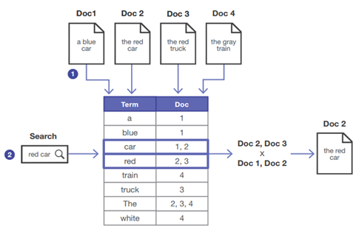
Overview Of Search Features
During ingestion, MarkLogic takes the terms in your documents and organizes them into an inverted index, which maps each term to the documents in which it appears. MarkLogic uses the index to resolve search queries.
Inverted index because instead of documents having words, it's words having document identifiers.
Each entry in the inverted index is called a term list.

Slide 5
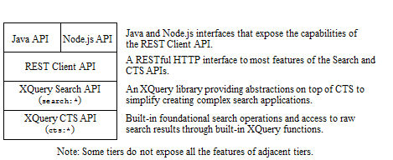
APIs For Multiple Programming Language
Through a set of layered APIs, MarkLogic Server provides search features which supports multiple programming languages. The above diagram illustrates the layering of the MarkLogic search APIs.
The core text search foundation in MarkLogic Server is the CTS API, a set of built-in XQuery functions in the cts namespace that perform full-text search. These capabilities are also exposed through Server-Side Javascript functions with a 'cts.' prefix.
Example: cts.elementValueQuery
cts:elementRangeQuery

Slide 6
Query Options
MarkLogic Server search supports a wide range of full-text features.
cts:word-query ( $text as xs:string,
[$options as xs:string*],
[$weight as xs:double]
) as cts:word-query
Options include:
"case-sensitive“ Specifies a case-sensitive query
"case-insensitive“ Specifies a case-insensitive query
"punctuation-sensitive“ Specifies a punctuation-sensitive query
"punctuation-insensitive“ Specifies a punctuation-insensitive query
"stemmed“ Specifies a stemmed query
"unstemmed“ Specifies an unstemmed query
"wildcarded" Specifies a wildcarded query
"unwildcarded“ Specifies an unwildcarded query
"lang=en“ Specifies, (e.g.) that the query is in English

Slide 7
cts: search API
cts:search(
$expression as node()*,
$query as cts:query?,
[$options as (cts:order|xs:string)*],
[$quality-weight as xs:double?],
[$forest-ids as xs:unsignedLong*]
) as node()*
cts:search require the XPath expression which should be fully searchable.
Options:
Filtered/ Unfiltered
score-logtfidf /score-logtf / score-simple / score-random / score-zero: Score computation logics; default is score-logtfidf
Checked/Unchecked : Word positions are checked /not checked when resolving the query. The default is "checked".
relevance-trace : Collect relevance score computation details with which you can generate a trace report using cts:relevance-info.
Faceted / Unfaceted: To save or not to save faceting information about fragments. The default is "unfaceted".
Quality-weight: The default is 1.0 . It is used at the time of computing scores.
Forest-id : A sequence of IDs of forests to which the search will be constrained

Slide 8
Filtered vs Unfiltered
Filtered Searches
In a typical search, MarkLogic Server will first do index resolution from the D-Nodes - which results in unfiltered search results. As a second step, the Server will then do filtering of those unfiltered search results on the E-Nodes to remove false positives from the result set - which then results in filtered search results.
Unfiltered Searches
In order to maximize search performance , we should avoid filtering whenever possible . We can do that by structuring the documents and configure the indexes to maximize both query accuracy and speed through unfiltered index resolution alone. We can use the "unfiltered" option in both cts:search() and search:search() to test the accuracy of your unfiltered queries.
Default search option is “Filtered” in cts:search().

Slide 9
Search: Search API
search:search(
$qtext as xs:string+,
[$options as element(search:options)?],
[$start as xs:unsignedLong?],
[$page-length as xs:unsignedLong?]
) as element(search:response)
This function parses and invokes a query according to specified options, returning up to $page-length result nodes starting from $start.
The output of search:search returns a <response> element, which in turn contains a total attribute. The value of the total attribute is an estimate, based on the index resolution of the query, and it is not filtered for accuracy. The accuracy of the index resolution depends on the index configuration of the database, on the query, and on the data being searched.

Slide 10
Search: Search API
additional-query - Additional query(s) to apply to the search.
constraint - Limit the scope of a search and define facets.
forest - Limit a search or lexicon query to specific forests.
fragment-scope - Control the global fragment scope (properties or documents) over which to search.
grammar - Define a custom search grammar.
page-length - The number of results to return in each page of results.
quality-weight - A document quality weight to use when computing scores
return-facets - Whether or not to include facets in the search response.
return-query - Whether or not to include the final representation of the input query in the search response.
return-results - Whether or not to include search result details in the search response.
search-option - Specify an advanced option to pass to the underlying cts query layer
searchable-expression - An XPath expression that selects the documents to include in a search.
sort-order - Define elements, attributes, fields, or JSON properties on which to order results.

Slide 11
Search Relevancy
Default order of search results: Relevance
Marklogic fetches results that includes items matching cts:query and each item, there is a score.
Score Calculation:
It’s a number which is calculated based on
Number of documents in a database
The frequency in which the search terms appear in the database
The frequency in which the search term appears in the document
APIs to get the score value / explore relevance details :
cts:score Returns the score of a node
cts:relevance-info Return the relevance score computation report for a node.
Example : cts:search (/node, ”Hello World”, "relevance-trace”)

Slide 12
Query Weighting
Using a weight in a query sub-expression can increase / decrease the sub-expression contribution to the relevance score.
The default weight is 1.0. Use the following guidelines for choosing custom weights:
To boost the score contribution, set the weight higher than 1.0.
To lower the score contribution, set the weight between 0 and 1.0.
To contribute nothing to the score, set the weight to 0.
To make the score contribution negative, set the weight to a negative number.
For proximity boosting, we can use “distance-weight” option to cts:query.
Example: cts:word-query((“cat”, “dog”), “distance-weight = 3”)

Slide 13
Query Performance
There are several things to consider when looking at query performance:
Application requirements:
The factors we need to consider are who will be using the application, what any user expectations for performance are, and whether the application will be publicly available are important considerations in defining performance requirements.
Indexing options:
Indexing options play an important role in how well queries can be resolved from the indexes. The fastest way to resolve a query is directly from the indexes.
XQuery code:
Performance degrades due to redundant codes and unneeded function calls. We need to use more efficient built-in functions such as xdmp:estimate, cts:search, lexicon functions, and so on which are all designed for fast performance.
Scalability:
MarkLogic Server is designed to scale to very large clusters with extremely large amounts of content. Memory, disk space and quality, swap space, number of processors, and number of servers all contribute to the overall scalability of a MarkLogic Server system.

Slide 14

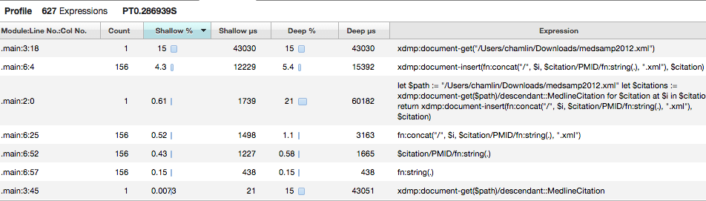
Query Profiling
Marklogic provides an application which measures the performance characteristics of a running XQuery program.

Slide 15
Query Profiling
shallow time | The time spent evaluating a specific expression, not including time spent evaluating any expressions contained within the specific expression.
deep time | The total time spent evaluating an expression, including time spent evaluating any expressions contained within the specific expression.
elapsed time | Both shallow and deep time are expressed in elapsed wall clock time.

Slide 16
Query Tuning Tips
xdmp:query-meters() :
provides statistics about query execution. To use xdmp:query-meters, concatenate the xdmp:query-meters() function to the end of your query. For example, the following query produces both the initial query results and the query-meters output.
It returns XML output that list the number of hits and misses on the query caches.
Cache hits indicates the query is running in an optimized fashion.
Cache misses indicate that the query could not retrieve its results directly from the cache, and had to read the data from disk. Because disk I/O is expensive relative to reading from memory, cache misses indicate that the query might be able to be optimized.

Slide 17
Query Tuning Tips
xdmp:query-trace() :
Add xdmp:query-trace(true()) to the beginning of the portion of the query you want to analyze, with the concatenate operator (,) after the function. Then add xdmp:query-trace(false()) at the end of the portion of the query you want to analyze, with the concatenate operator (,) before the function.
This function prints INFO-level messages to the log file while a query is executing. It prints at least one log message for each step in the XPath expression. It also prints messages for predicates and other parts of query evaluation. Therefore, xdmp:query-trace can potentially log a large number of messages to the log file, particularly for complex queries that contain very deep XPath expressions and many searches.
Example:
xdmp:query-trace(true()), doc("/myDocuments/hello.xml")//a/b/c, xdmp:query-trace(false())

Slide 18
Query Tuning Tips
xdmp:plan() :
Returns an XML element recording information about how the given expression will be processed by the index. The information is a structured representation of the information provided in the error log when query trace is enabled. The query will be processed up to the point of getting an estimate of the number of fragments returned by the index.
Running an xdmp:plan on a search is similar to running an xdmp:estimate on a search, but it returns a report on the search instead of just an estimate. As part of the report, the qry:result element includes the estimate. If the search expression argument cannot be run in the plan because it is not partially searchable, then an XDMP-UNSEARCHABLE exception is returned as part of the xdmp:plan output.
Example:
xdmp:plan (cts:search (fn:doc(), cts:word-query(“xml")))

Slide 19
Query Tuning Tips
Registered Queries
Registered queries are another performance optimization. They allow you to register a cts:query as something you plan to use repeatedly and whose results you'd like MarkLogic to remember for later use.
cts:register() returns an xs:long identifier for the registration.
cts:registered-query() turns that xs:long into a live cts:query object
Registered queries are tracked in a memory cache, and if the cache grows too big, some
registered queries might be aged out of the cache. Also, if MarkLogic stops or restarts,
any queries that were registered are lost and must be re-registered.

Slide 20
Query Tuning Tips
Avoid queries that return the entire database. Instead, return the results in batches.
If you do not have sufficient memory on your server, consider adding more memory to the system.
Increase the size of various cache s .
64-bit systems are recommended. 64-bit systems can hold a lot more memory
Effective usage of fn:count and xdmp:estimate functionality.
Use cts:element-values() / element-value-cooccurances() as they use indexes to fetch the distinct values.
Increase number of nodes in the cluster and instead of hitting a single node use a load balancer to distribute the requests among them.
Multithreading concept is also very useful to improve application performance.

Slide 21
Q&A

Slide 22
Thank you

