Slide 1
XPATH

Slide 2
XPath is a syntax for defining parts of an XML document.
XPath uses path expressions to navigate in XML documents.

Slide 3
XPATH Terminology
Node:
7 type of nodes - element, attribute, text, namespace, processing-instruction, comment, and document nodes.
For eg.
<bookstore> <!-- Sample XML --> <book> <title lang="en">Harry Potter</title> <author>J K. Rowling</author> <year>2005</year> <price>29.99</price>
<publisher/> </book> </bookstore>
Root element node
Comment node
Element node
Attribute node
Text node

Slide 4
Bookstore
Book
Title
Author
Ancestor/Parent/Descendant
Children/Siblings/Descendant
Year
Price
Ancestor/Parent
2. Relationship of Nodes

Slide 5
Axes
AxisName | Result
ancestor | Selects all ancestors (parent, grandparent, etc.) of the current node
ancestor-or-self | Selects all ancestors (parent, grandparent, etc.) of the current node and the current node itself
attribute | Selects all attributes of the current node
child | Selects all children of the current node
descendant | Selects all descendants (children, grandchildren, etc.) of the current node
descendant-or-self | Selects all descendants (children, grandchildren, etc.) of the current node and the current node itself
following | Selects everything in the document after the closing tag of the current node
following-sibling | Selects all siblings after the current node
namespace | Selects all namespace nodes of the current node
parent | Selects the parent of the current node
preceding | Selects all nodes that appear before the current node in the document, except ancestors, attribute nodes and namespace nodes
preceding-sibling | Selects all siblings before the current node
self | Selects the current node

Slide 6
Use of Axes
Basic syntax:
axisname::nodetest[predicate]
Where
an axis (defines the tree-relationship between the selected nodes and the current node)
a node-test (identifies a node within an axis)
zero or more predicates (to further refine the selected node-set)

Slide 7
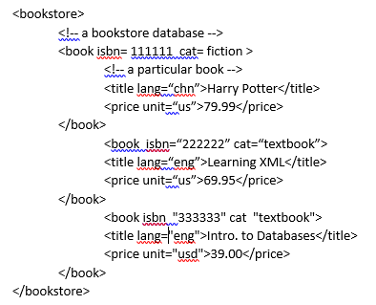
Example
Select book element node
=>/descendant::book
Select all isbn attribute
=>//book/attribute::isbn
Select title and price element
=>//book/title | //book/price
Select empty set
=>/child::book
Select second book element
=>/bookstore/book/following-sibling::book
Select all nodes except attrinute after fist title node
=>/descendant::title/@*/parent::title/following::node()

Slide 8
FLWOR Expression

Slide 9
What is FLOWR
For - selects a sequence of nodes (for loop)
Let - binds a sequence to a variable
Where - filters the nodes
Order by - sorts the nodes
Return - what to return (gets evaluated once for every node)
NOTE: For/let must have atleast 1 corresponding return statement

Slide 10


For vs let
A for clause always iterates over a sequence, binding a variable to each item; a let clause simply binds a variable to the entire sequence.
Returns 8 (say)
Returns: 1 1 1 1 1 1 1 1

Slide 11
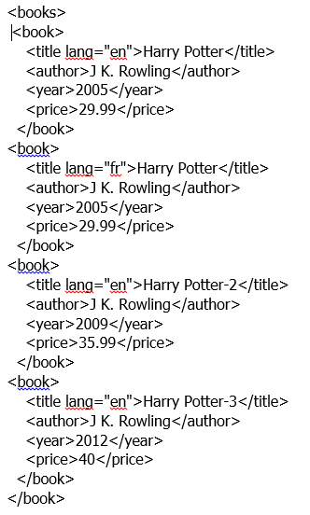
Select a node from the xml doc using xpath:
fn:doc("books.xml")/bookstore/book[price>30]/title
=>
<title lang="en">Harry Potter-2</title>
<title lang="en">Harry Potter-3</title>
Select a node from the XML using FLWOR expression:
for $x in doc("books.xml")/bookstore/book where $x/price>30 order by $x/title return $x/title
=>
<title lang="en">Harry Potter-2</title>
<title lang="en">Harry Potter-3</title>

Slide 12
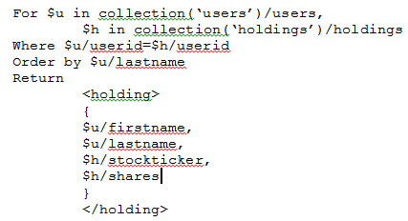
This expression finds every pair of users elements and holdings elements whose userid child element has the same value, and then builds a holding element that describes the user and his holdings.

Slide 13
Conditional Statements
If –then –else
if ($x//book/price > 39)
then fn:true()
else ()
2. Typeswitch
let $str := "book1"
let $x := element {$str} {}
return typeswitch($x)
case element(book) return "books“
case element(pen) return "pens"
default return "in default condition"

Slide 14
xQuery Programming Structure and Syntax

Slide 15
xQuery Structure
XPath—Most XPath 2.0 functions are supported in XQuery, as is the axis model used to navigate over XML structures.
Functions—Analogous to SQL stored procedures, you can define functions in XQuery using the XPath language that can be called inline in an XML query.
Namespaces—A feature of XML rather than SQL. The declare namespace function associates a namespace URI with a prefix, crucial for indicating functionality.

Slide 16
User defined functions
declare function prefix:function_name($parameter as datatype) as returnDatatype { ...function code here... };
Use the declare function keyword
The name of the function must be prefixed
The data type of the parameters are mostly the same as the data types defined in XML Schema
The body of the function must be surrounded by curly braces

Slide 17
(:function definition:)
declare function local:sum($val1 as xs:integer,$val2 as xs:integer)
as xs:integer
{
let $sum := ($val1 + $val2)
return $sum
};
(: function call :)
local:sum(5,6)

Slide 18
Importing functions from another xquery module
xquery version "1.0-ml";
import module namespace search = "http://marklogic.com/appservices/search"
at "/MarkLogic/appservices/search/search.xqy";
search:search("Vannevar Bush",
<options xmlns="http://marklogic.com/appservices/search">
<return-results>false</return-results>
<return-facets>true</return-facets>
</options>)

Slide 19
Syntax Rules
XQuery is case-sensitive
XQuery elements, attributes, and variables must be valid XML names
An XQuery string value can be in single or double quotes
An XQuery variable is defined with a $ followed by a name, e.g. $bookstore
XQuery comments are delimited by (: and :), e.g. (: XQuery Comment :)

Slide 20
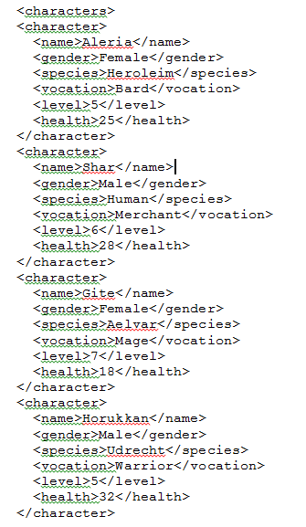
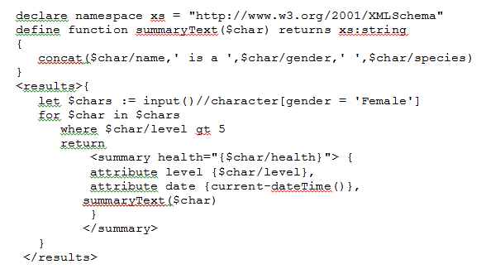
Sample xQuery
Result

Slide 21
Exercise

Slide 22
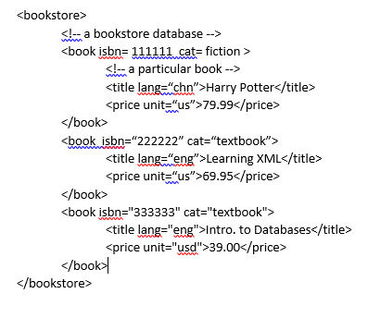
Find the title and isbn of non-fiction books with a price more than 50 USD.
Find average price of text books.
Find the titles of textbooks on XML.
Create a new document which contain only the isbn and title of textbooks.
Find the title and price of the book with isbn “222222”.
Produce a list of non-fictions with their title and price, sorted by price.
Find the title of textbook with highest price.

Slide 23
Answer 1:
/bookstore/book[attribute::cat!="fiction" and price>50.00]/title | /bookstore/book[attribute::cat!="fiction" and price>50.00]/@isbn
Answer 2:
sum(/bookstore/book[attribute::cat="textbook"]/price/number(text())) div count(/bookstore/book[attribute::cat="textbook"]/price)
Answer 3:
/bookstore/book[attribute::cat="textbook" and contains(title, "XML")]/title/text()
Answer 4:
<textbooks>
{for $book in doc("bookstore.xml")//book
where $book/@cat="textbook"
return <textbook isbn="$book/@isbn">{$book/title}</textbook>
}
</textbooks>

Slide 24
Answer 5:
for $book in doc(“bookstore.xml”)//book
where $book[@isbn=“222222]
return <book>{$book/title, $book/price}</book>
Answer 6:
<nonfiction-list>
{
for $book in doc(“bookstore.xml”)//book, $title in $book/title, $price in $book/price
where $book/@cat!=“fiction”
order by $price/text()
return <nonfiction>{$title, $price}</nonfiction>
}
</nonfiction-list>

Slide 25
Answer 7:
<textbooks>
{
let $prices := doc(“bookstore.xml”)//book[@cat=“textbook”]/price
let $max := max($prices)
return
<max-price-textbook price=“{$max}”>
{for $book in doc(“bookstore.xml”)//book
where $book/price = $max
return $book/title
}
</max-price-textbook>
}
</textbooks>

Slide 26
References
https://docs.marklogic.com/guide/xquery/langoverview
http://www.w3schools.com/xsl/xquery_intro.asp
http://www.informit.com/articles/article.aspx?p=101764&seqNum=4
https://www.w3.org/TR/xquery/
https://www.progress.com/xquery/resources/tutorials/using-xquery
http://www.cs.toronto.edu/~leijiang/teaching/cscc43-s09/content/tutorial/xpath-xquery/xquery.pdf

Slide 27
XSLT

Slide 28
Extensible Stylesheet Language Transformation
Language for transforming XML to XML/HTML/TEXT
Uses xpath to navigate XML document
Contains the set of transformation rules to be applied on source XML

Slide 29
<?xml version="1.0" encoding="UTF-8"?> <xsl:stylesheet version="1.0" xmlns:xsl="http://www.w3.org/1999/XSL/Transform"> <xsl:template match="/"> <html> <body> <h2>My CD Collection</h2> <table border="1"> <tr bgcolor="#9acd32"> <th>Title</th> <th>Artist</th> </tr> <xsl:for-each select="catalog/cd"> <tr> <td><xsl:value-of select="title"/></td> <td><xsl:value-of select="artist"/></td> </tr> </xsl:for-each> </table> </body> </html> </xsl:template> </xsl:stylesheet>

Slide 30
<xsl:template> Element
This contains set of rules to be applied when matching node is found
The match attribute is used to associate a template with an XML element
<xsl:template match="catalog">
<html>
<body>
<h2>My CD Collection</h2>
<table border="1">
<tr bgcolor="#9acd32">
<th>Title</th>
<th>Artist</th>
</tr>
<xsl:for-each select="cd">
<tr>
<td><xsl:value-of select="title"/></td>
<td><xsl:value-of select="artist"/></td>
</tr>
</xsl:for-each>
</table>
</body>
</html>
</xsl:template>

Slide 31
<xsl:value-of> Element
<xsl:value-of> element is used to extract the value of a selected node.
<xsl:value-of select="title"/>
<xsl:for-each> Element
<xsl:for-each> element allows you to do looping in XSLT
<xsl:for-each select="cd">
<xsl:sort> Element
<xsl:sort> element is used to sort the output
<xsl:sort select="artist"/>

Slide 32
<xsl:if> Element
<xsl:if> element is used to put a conditional test against the content of the XML file.
There is no else in XSLT
<xsl:if test="expression"> ...some output if the expression is true... </xsl:if>
<xsl:choose> Element
<xsl:choose> element is used in conjunction with <xsl:when> and <xsl:otherwise> to express multiple conditional tests

Slide 33
<xsl:choose> <xsl:when test="expression"> ... some output ... </xsl:when> <xsl:otherwise> ... some output .... </xsl:otherwise> </xsl:choose>
<xsl:apply-templates> Element
The <xsl:apply-templates> element applies a template to the current element or to the current element's child nodes.
If we add a select attribute to the <xsl:apply-templates select=“cd”> element it will process only the child element that matches the value of the attribute.

Slide 34
References
https://www.w3.org/Style/XSL/
https://www.w3schools.com/xml/xsl_intro.asp

