Slide 1


Slide 2
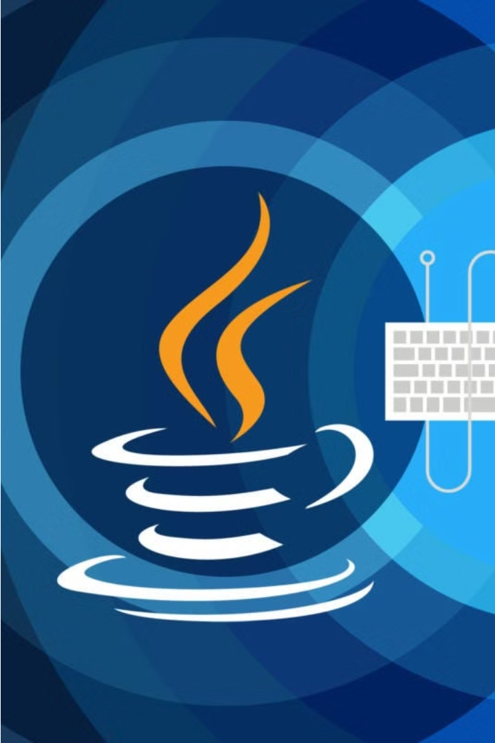
Definition of Utility Classes
Utility classes are Java classes that contain static methods and fields, which provide commonly used utility functions that can be used across different Java applications.

Slide 3
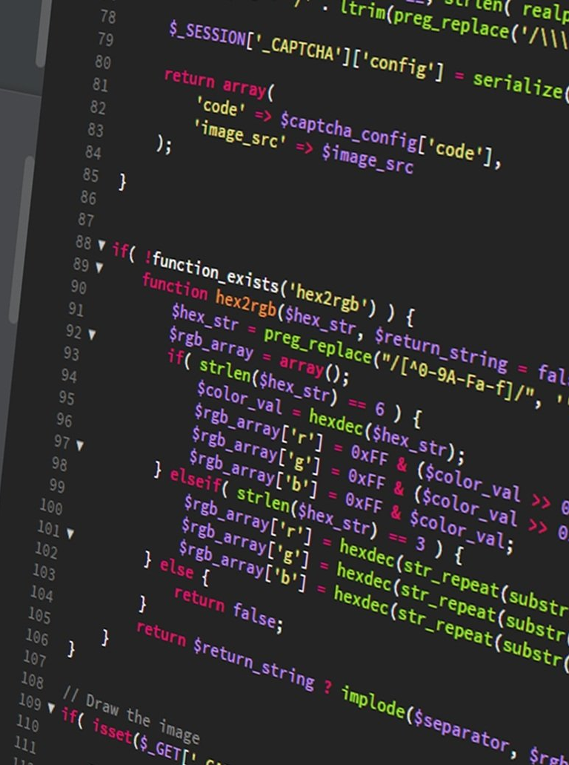
Benefits of Utility Classes
Reusability: Common functionality is centralized, making it reusable across different parts of the application.
Organization: Related methods are grouped together, making the code more organized and easier to manage.
Convenience: Static methods can be called directly without needing to create an object, simplifying the code.

Slide 4

java.util.Arrays Utility Class
Sorting
Searching
Comparison
Manipulation
The Arrays class provides methods to easily sort arrays of primitive types and objects. This simplifies complex sorting tasks and ensures consistent ordering.
Binary search algorithms allow you to efficiently find elements in sorted arrays. The Arrays class offers search methods for both primitive and object arrays.
Comparing arrays can be tricky, but the Arrays class has methods to compare the contents of arrays, making it easy to determine equality or ordering.
Beyond sorting and searching, the Arrays class has utility methods to copy, fill, and convert arrays - essential operations for working with array data structures.

Slide 5
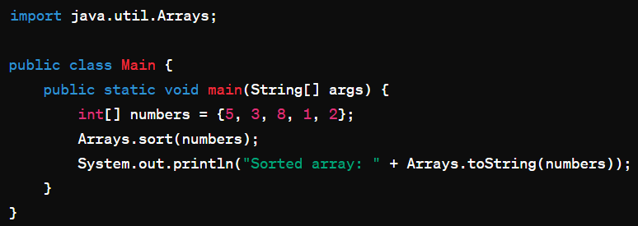
java.util.Arrays Utility
Class Demonstration

Slide 6

java.lang.Math Utility Class
Comprehensive Math Functions
Precise Calculations
The Math class ensures accurate and reliable mathematical computations, making it essential for scientific, financial, and engineering applications that require precise numerical operations.
The Math class provides a wide range of mathematical functions, including trigonometric, exponential, and logarithmic operations, as well as random number generation and rounding.
Performance Optimization
The methods in the Math class are highly optimized for speed and efficiency, allowing for rapid processing of complex mathematical operations.

Slide 7
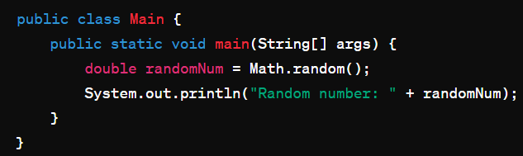
java.lang.Math Utility
Class Demonstration

Slide 8



java.util.StringJoiner Utility Class
String Manipulation
Searching and Comparison
Type Conversion
The String class provides a wealth of methods for manipulating textual data, such as concatenation, substring extraction, and character-level operations.
The String class can be easily converted to and from other data types, such as numbers and booleans, using methods like parseInt() and valueOf().
Utility methods like indexOf(), contains(), and equals() enable efficient searching and comparison of string values.

Slide 9
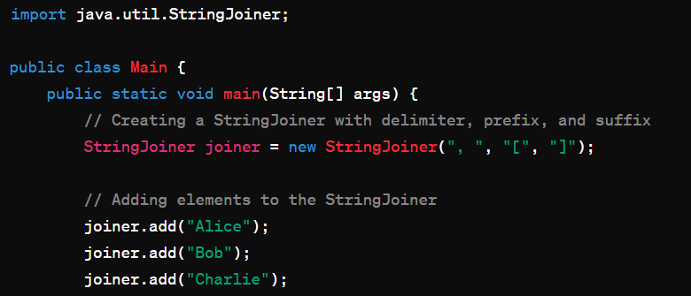
Java.util.StringJoiner Utility
Class Demonstration

Slide 10
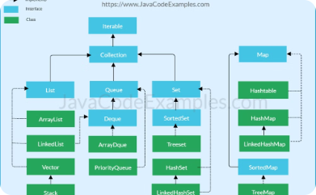
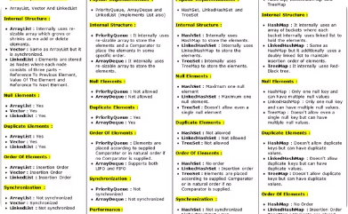
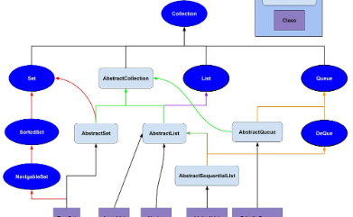
java.util.Collections Utility Class
Comprehensive Collection Management
Powerful Algorithms
Seamless Integration
The class features algorithms for common collection operations like binary search, shuffle, and reverse, making it a valuable tool for optimizing collection-based functionality.
The Collections utility class seamlessly integrates with Java's collection framework, providing a consistent and intuitive API for developers to work with collections effectively.
The Collections utility class provides a wide range of methods for efficiently managing and manipulating collections, from sorting and searching to synchronization and immutable views.

Slide 11
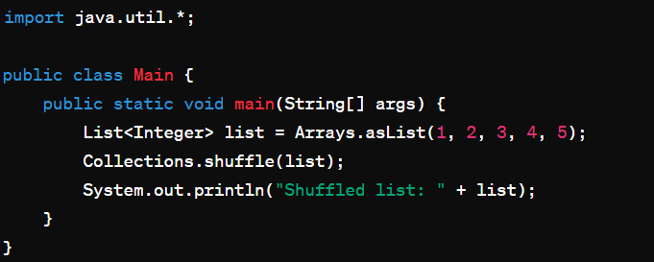
Java.util.Collections Utility
Class Demonstration

Slide 12
File Utility Class
1
File Management
2
Path Handling
3
Stream Utilities
Simplifies working with file paths across different operating systems with platform-independent methods.
Offers convenient utilities to work with file input/output streams, enabling efficient data processing.
Provides methods to create, read, write, and manipulate files and directories on the file system.

Slide 13
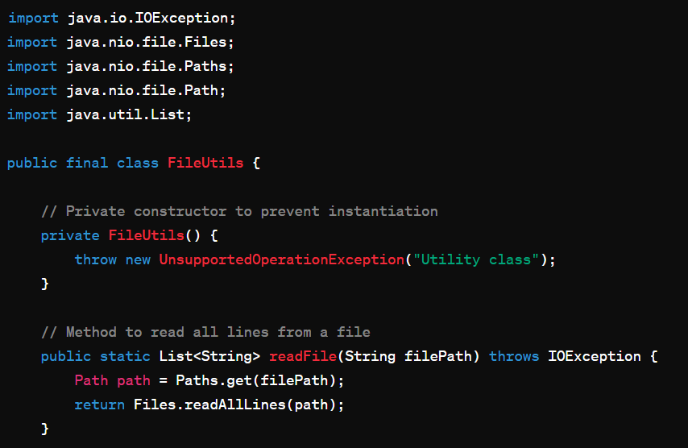
File Utility Class
Demonstration

Slide 14
Date and Time Utility Classes
java.time
java.time.format
Provides a comprehensive set of classes for working with dates, times, and durations, including LocalDate, LocalTime, and Instant.
Enables flexible parsing and formatting of date and time values using patterns like "yyyy-MM-dd HH:mm:ss".
java.util.Calendar
java.util.Date
Offers a traditional approach to working with dates and times, with methods for getting and setting date/time components.
Represents a specific instant in time, with methods for converting to and from different time representations.

Slide 15
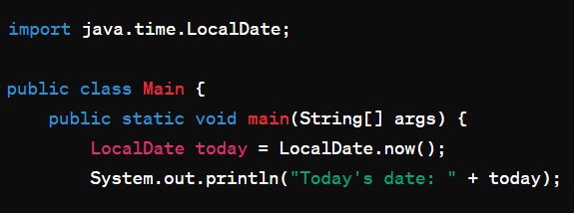
Date and Time Utility Class
Demonstration

Slide 16
Networking Utility Classes
1
InetAddress
2
URL
Provides methods to work with IP addresses, including determining the local machine's address and resolving hostnames to IP addresses.
Allows you to parse, construct, and manipulate Uniform Resource Locators (URLs), making it easy to work with web-based resources.
3
HttpURLConnection
4
DatagramSocket
Enables sending HTTP requests and handling the responses, simplifying network communication for building web-based applications.
Supports connectionless, packet-based network communication using the UDP protocol, useful for building real-time, low-latency applications.

Slide 17
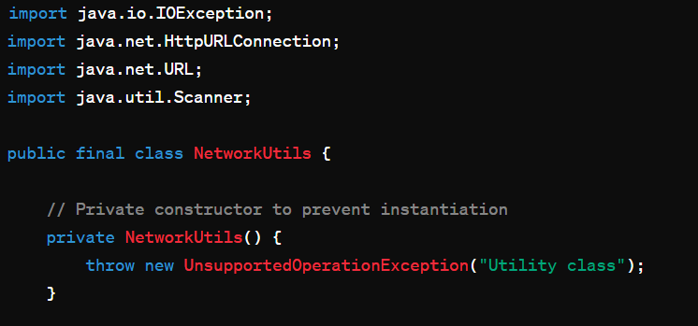
Networking Utility Class
Demonstration

Slide 18



Logging Utility Classes
Java Logging API
Logging Frameworks
Debugging and Monitoring
The Java Logging API provides a powerful and flexible way to add logging capabilities to your applications. It allows you to log messages at different severity levels and customize output formats.
Popular logging frameworks like Log4j and Logback build on the Java Logging API, offering advanced features such as log file rotation, remote logging, and integration with other libraries.
Effective logging is crucial for debugging, troubleshooting, and monitoring the health of your Java applications in production environments.

Slide 19
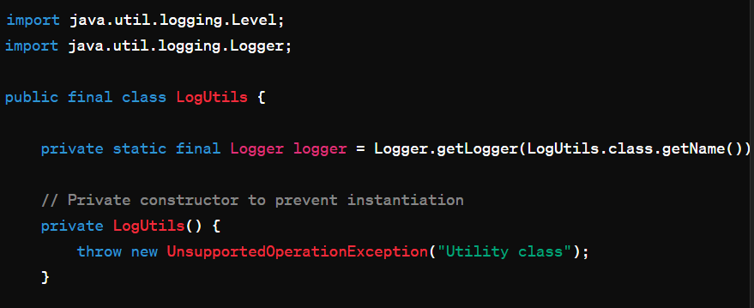
Logging Utility Class
Demonstration

Slide 20
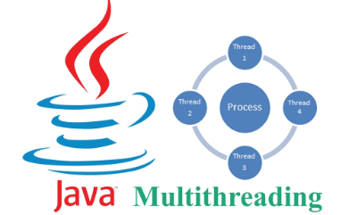

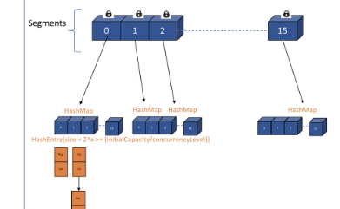
Concurrency Utility Classes
Executor Framework
Atomic Types
Concurrent Collections
Atomic types like AtomicInteger and AtomicReference provide thread-safe, lock-free access to shared variables, simplifying concurrent programming.
The Executor framework provides a high-level API for executing asynchronous tasks, including thread pools that can efficiently manage the lifecycle of worker threads.
Concurrent collections like Concurrent HashMap and Copy on Write Array List offer highly scalable, thread-safe alternatives to their non-concurrent counterparts.

Slide 21
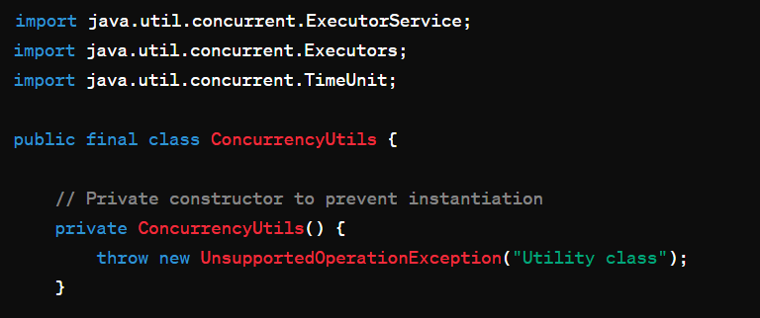
Concurrency Utility Class
Demonstration

Slide 22
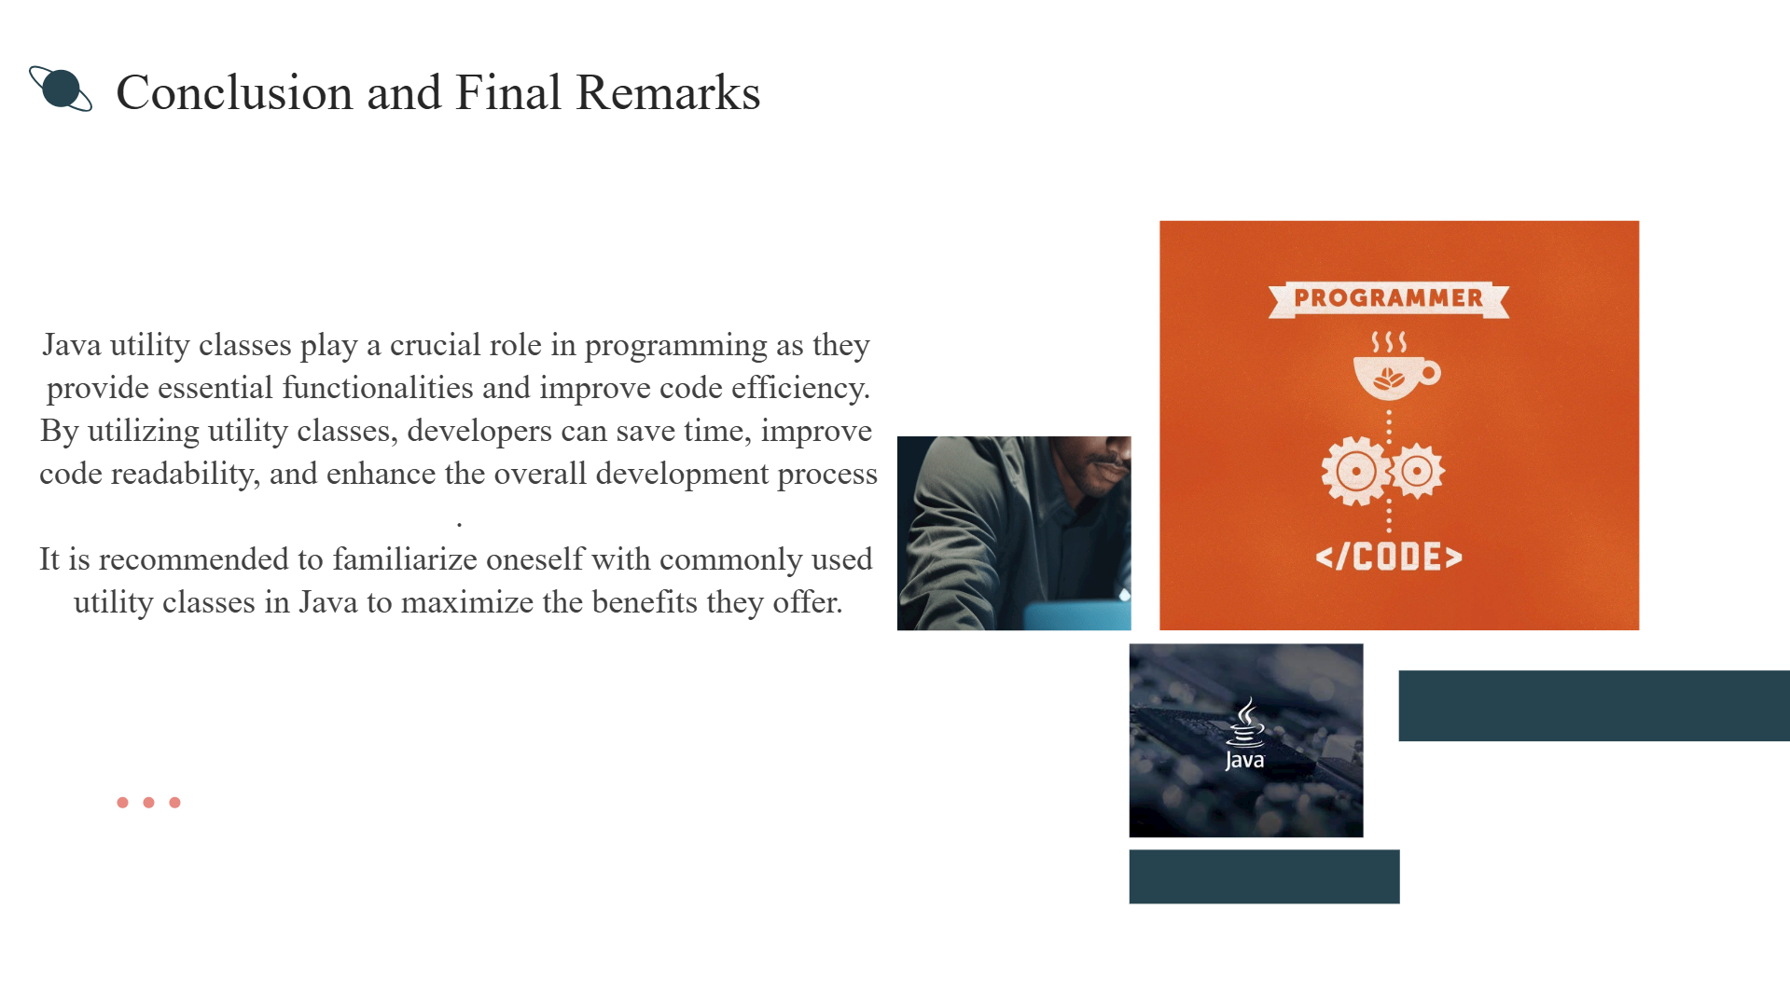

Slide 23


