Slide 1

Playing Atari with Deep Reinforcement Learning
By :
Harmeet Singh-2017A3PS0333P
Sikawat Pawankumar-2017A7PS0039P
Kamal Khemka-2017A1PS0691P

Slide 2
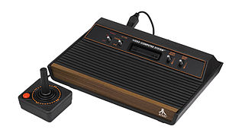
Atari 2600
Video Game Console Released in 1977.
Gained Popularity in 1980 with the launch of “Space Invaders”.
Became the best selling console with more than a million units sold in 1979 and sales doubling every year.
Atari developers and other companies released more than 500 games during it’s whole lifespan.
Specifications
1.19 MHz 8 bit Processor
128 bytes Ram
MOS 6507 Technology

Slide 3

About the Paper
Deep mind, a company founded in 2010 and acquired by Google in 2014, demonstrated an AI system that could surpass Human abilities on various games from Atari 2600.
The Algorithm is applied on 7 Atari games and the results showed that it surpassed humans in 3 of them.
Model prepared is a Convolutional Neural Network, with some variation of Q-Learning.
Input given is raw pixels and output is a value function which estimates future rewards.

Slide 4
Deep Reinforcement Learning
Efficient Algorithms that can be applied to various areas like Robotics , Video Gaming , Finance etc.
A RL-task is about training an agent to interact with the environment
Agent Arrives at different scenarios called states after performing certain actions.
There’s only one purpose- to maximize it’s total reward across an episode.
Each state is a consequence of its previous state and storing all this information for even short games is infeasible.

Slide 5
Deep RL ( Ctd.)
Assumption: Each state follows a Markov Property, each state depends only on the previous state and the transition.
Total Reward that the agent gets is also called Q-Value and is given by: Q(s,a)=r(s,a) + gamma*Q’(s’,a) where gamma is called the discount factor.
In our model we have take gamma=0.99. Gamma controls the contribution of rewards in the future.
In Deep Q-Learning, We use a neural network to estimate Q Value as the number of cells in the table (states vs actions) can be huge.
The state is given as the input and Q-value of all the possible outputs is generated.

Slide 6
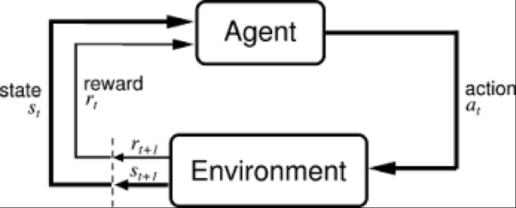
Steps in a DQN.
All the past Experience is stored in the user memory.
Next action to be performed is determined by the maximum output of the Q-Network.
The loss function is mean squared error of the predicted Q-Value and the target Q-Value : Q*.

Slide 7
Q-Learning vs Deep Q-Learning
Q Learning helps to figure out the agent exactly what action to play
But it has 2 limitations:
The amount of time required to explore each state from the table is large.
The memory stored will be huge, in the paper implementation, approx. 9 Gb of space will be required for storing 10 million frames. ‘
This is where Deep Q-Learning is helpful.
The algorithm is predicting its own value ahead, but still it will be able to converge eventually to the correct Q-function.

Slide 8
ε-Policy
Policies simply indicate what action to take for any given state.
The network should not follow a random policy otherwise it wont learn anything.
Still, Sometimes the network should select a random policy so that it can learn about some advanced states in the game.
Strategy known as ε-greedy: the probability that we choose an action at random and otherwise we choose the greedy action.
Starting with a high ε(1), we linearly decrease it’s value to 0.1 after a few iterations.

Slide 9
What our code does??
Render an environment for the game
Takes a snapshot of game screen
Process it through CNN to obtain a low-dimensional grayscale image which serves as a ‘state’ of the game.
Applying ε-greedy policy, chooses an action from the possible actions provided from emulator.
Obtain the change in game score by the emulator and obtain reward.
Chooses the best possible action using Q-Learning algorithm.
Stores the state for future reference

Slide 10
What and Why
Stochastic method is used : Actions Required at every step.
4 frames used: To reduce computations and increase the number of games played by the agent.
Variable Epsilon Value: To fill the Q-table faster. After some time, it settles to a value of 0.1 and the actions are selected at random.
One Output per action: Ability to compute Q-values for all possible actions in a state with only one forward pass.
Image is processed ,turned to grayscale and cropped to a size of 84x84: To decrease the computation and have even less memory storage.

Slide 11
Improvement Methods
Different minibatch sizes – 20/30/40
Different Discount Rate
Variable ε(epsilon) rate
Different Replay Memory Size – 0.5m/1m/2m (m-million)
Inclusion of learning rate
Different replay start size – 5k/10k/15k (k-thousand)
Different Action Repeat States – 4/6/8/10
Variable/Different Learning Rate

Slide 12
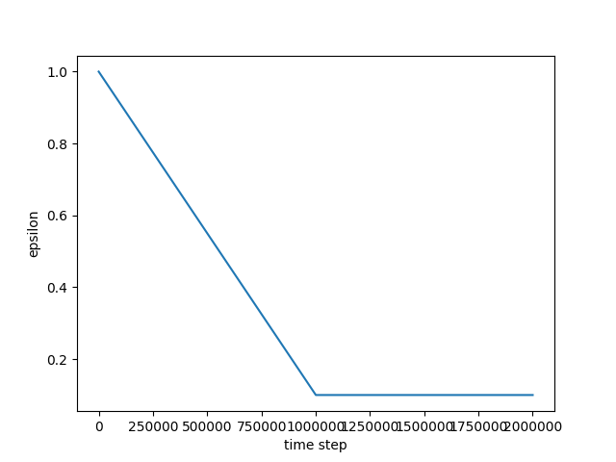
Variable ε(epsilon) rate

Slide 13
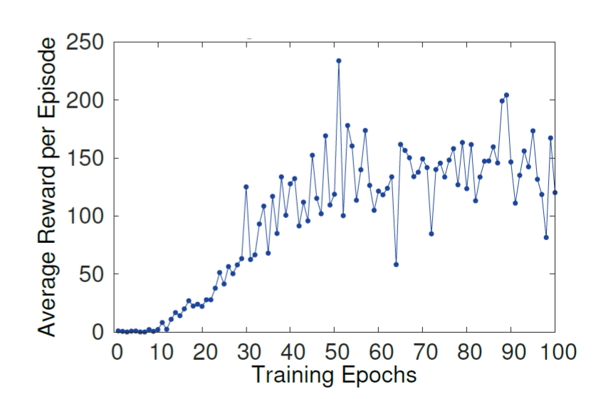
Training Progress

Slide 14
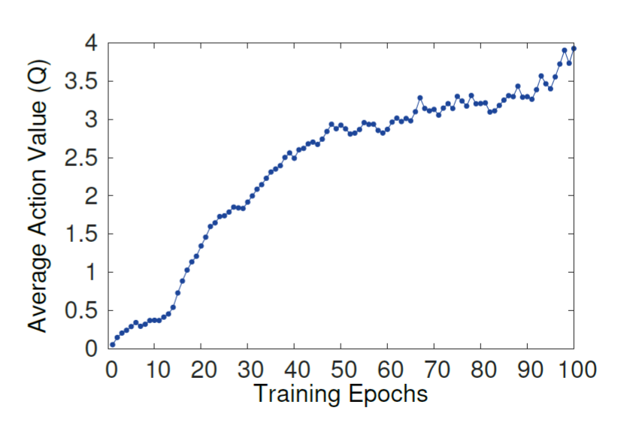
Training Progress (Contd.)

Slide 15
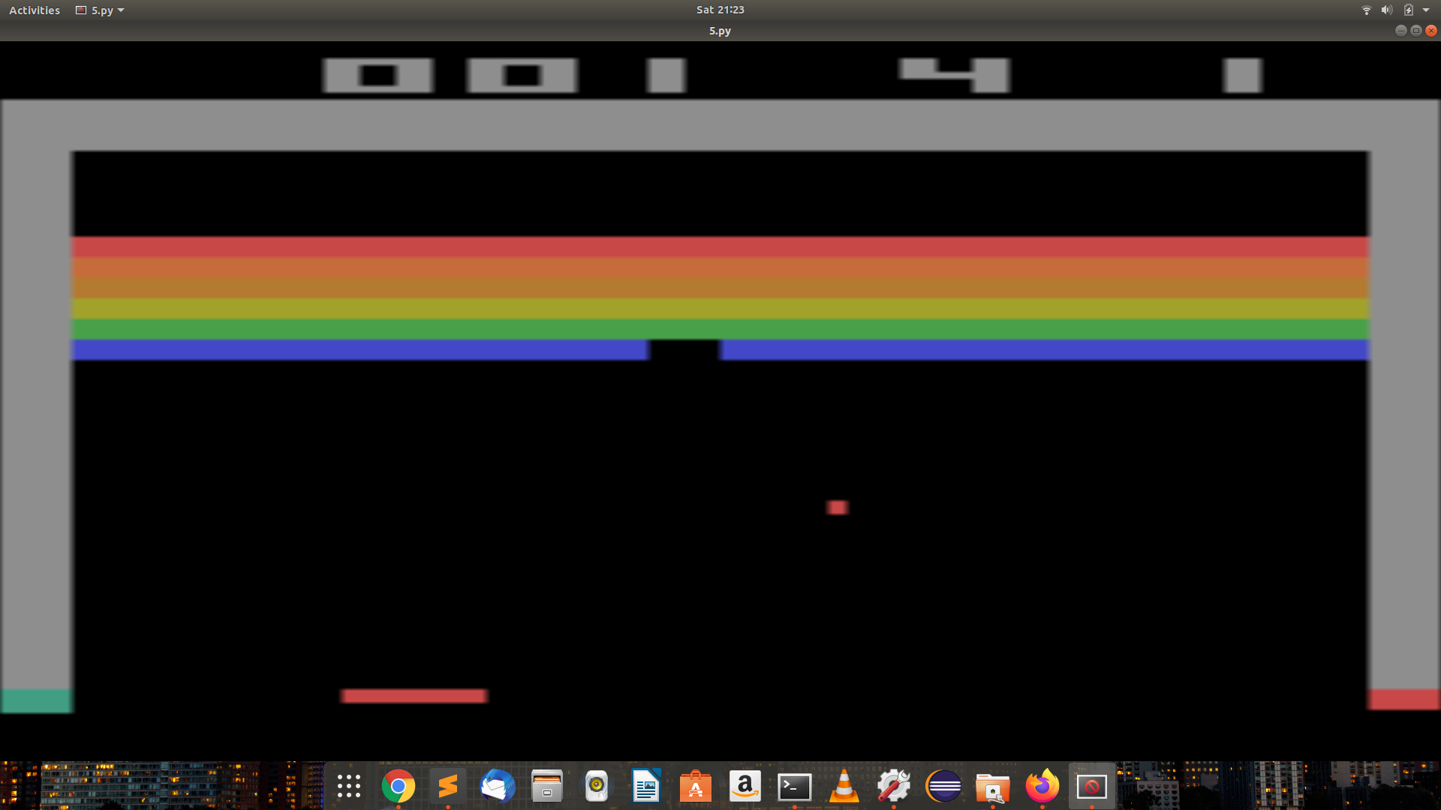
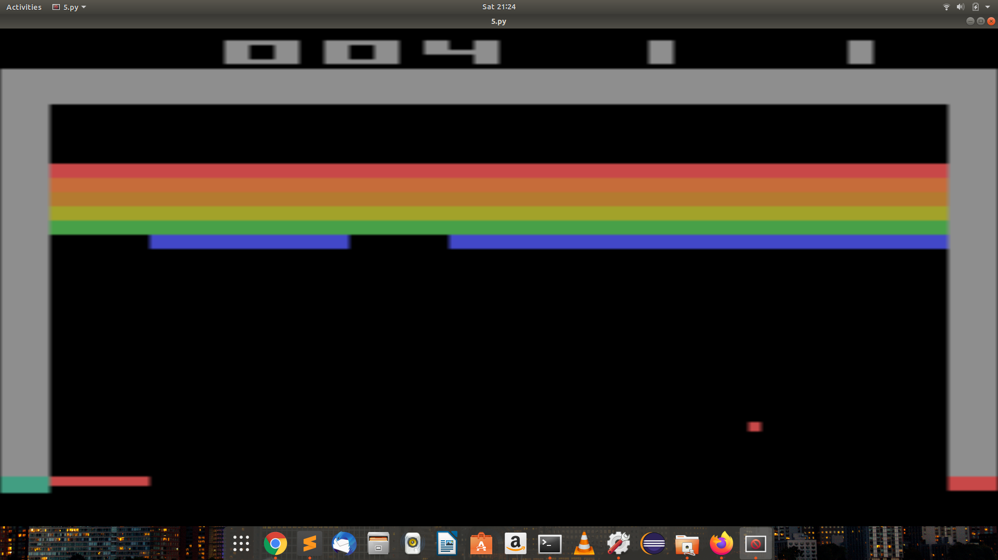
Snapshots of our Game in start

Slide 16
Game after a little training

Slide 17
THANK YOU

