Slide 1


Presentation By:Pawan Singh Koranga
B.Tech 6th sem. University roll no:1018541
Class Roll no:44 Sec:C

Slide 2
Table of contents
Introduction
System Requirement
Method used
How Our Software works(encoding)
RSA method
How Our Software works(decoding)
Snapshots of Project

Slide 3
INTRODUCTION
Nowadays, information security is becoming more important in data storage and transmission. Images are widely used in different-different processes. Therefore, the security of image data from unauthorized uses is important. Image encryption plays a important role in the field of information hiding. Image encryption method prepared information unreadable. Therefore, no hacker or eavesdropper, including server administrators and others, have access to original message or any other type of transmitted information through public networks such as internet

Slide 4
SYSTEM REQUIREMENT
OS: Win Xp 32
Processor: Intel Pentium III / AMD Athlon MP
System Memory: 256 MB RAM
Storage: 75 MB Hard drive space
DirectX 9 Compatible Graphics Card

Slide 5
METHOD USED
RSA
RSA algorithm is a public key encryption technique and is considered as the most secure way of encryption. It was invented by Rivest, Shamir and Adleman in year 1978 and hence name RSA algorithm.
Algorithm
The RSA algorithm holds the following features −
RSA algorithm is a popular exponentiation in a finite field over integers including prime numbers.
The integers used by this method are sufficiently large making it difficult to solve.
There are two sets of keys in this algorithm: private key and public key.

Slide 6

HOW OUR SOFTWARE WORKS (encoding)
[1, 256]
Range of color
Passed to function en( color number[1,256] )
Uses RSA algorithm to encrypt.

Slide 7
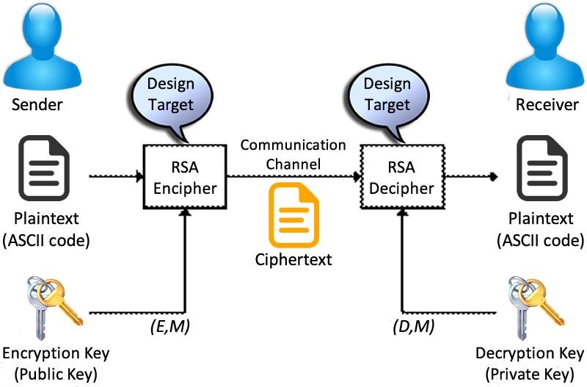
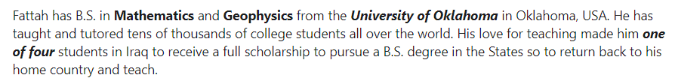
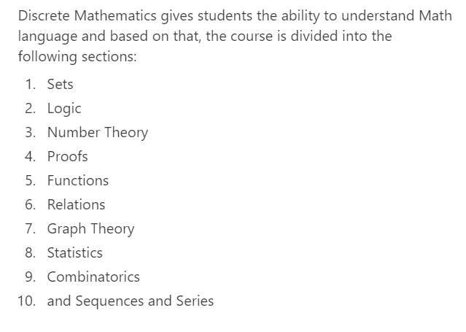
.
.

Slide 8
HOW OUR SOFTWARE WORKS (decoding)
[1, 256]
Range of color
Passed to function dn( color number[1,256] )
Uses RSA algorithm to Decrypt.

Slide 9
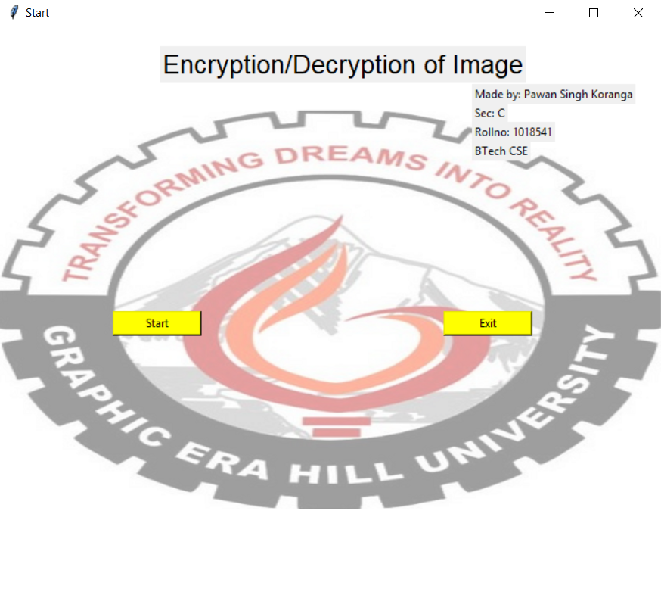
SNAPSHOT OF PROJECT

Slide 10
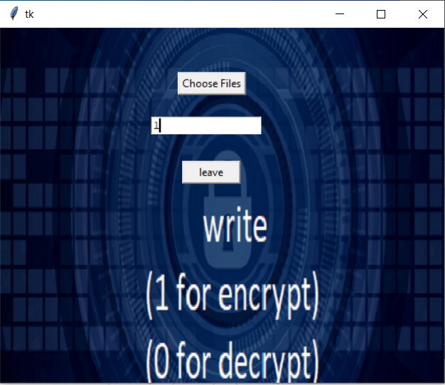
SNAPSHOT OF PRJOECT
1 is for encryption and 0 is for decryption

Slide 11
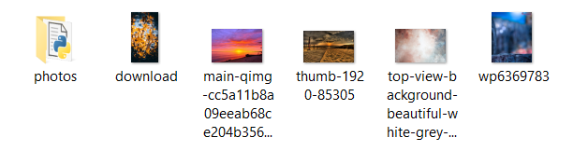
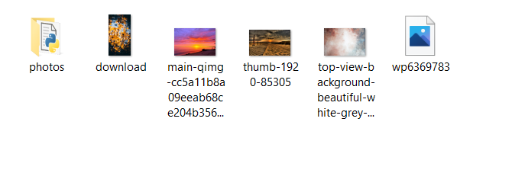
Image before encryption
Image after encryption

Slide 12
THANK YOU
.

