Slide 1

Object tracking using Optical flow

Slide 2
Keep in mind
Light intensity do not change of object you tracking
Some neighbouring pixels move as well

Slide 3
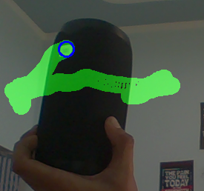
Inputs
User have to feed in inital points
Algo will attempt to find those points in the next frame.

Slide 4
Opencv built-in function
new_pts,status,err = cv2.calcOpticalFlowPyrLK
(old_gray,
new_gray,
old_pts,
winSize=None,
maxLevel=1,
criteria=(cv2.TERM_CRITERIA_EPS | cv2.TERM_CRITERIA_COUNT,
15, 0.08))

Slide 5
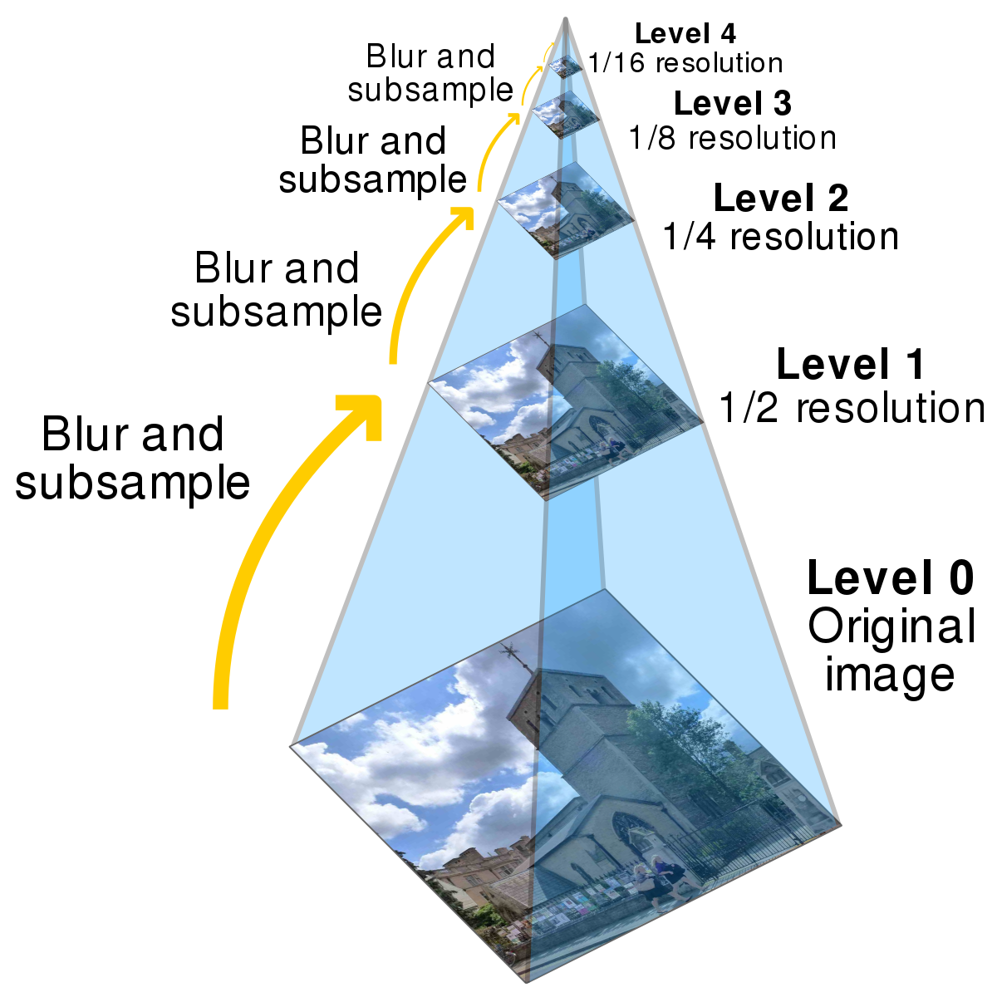
Image pyramid
Source :wikipedia

