Slide 1
Large Language models
Overview of LLM’s
Submitted by:
Pawandeep Singh
57194
Submitted to:
Dr. Chetan Singh Negi

Slide 2

Content
Introduction
History of LLMs
How LLMs work
Paradigm
Applications of LLMs
Advancements in LLMs
Cons of LLMs / Ethical considerations

Slide 3
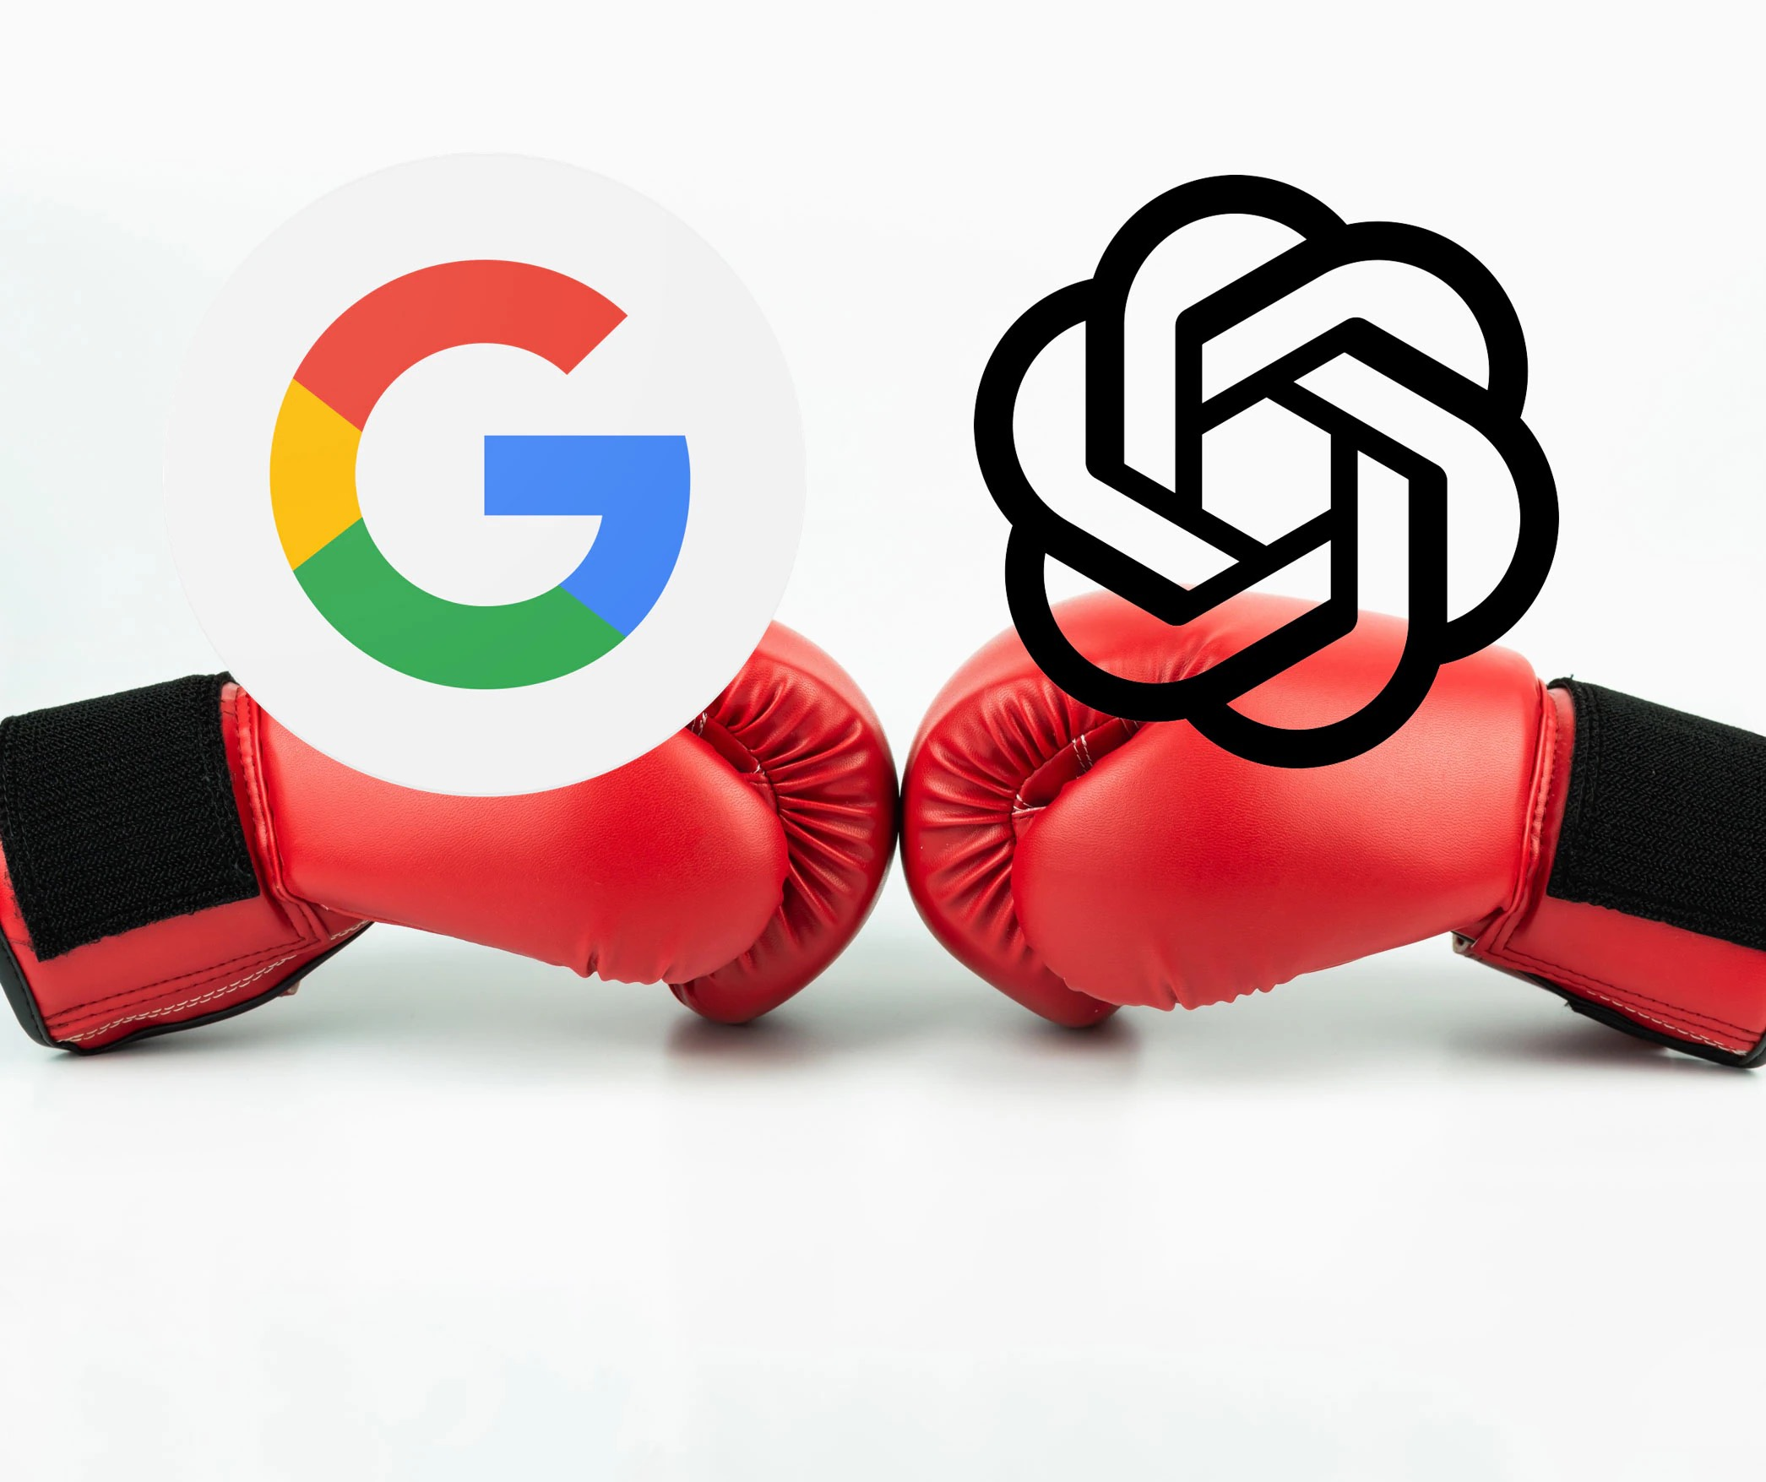
Introduction
LLMs or Large Language Models are artificial intelligence models that can generate human-like language
LLMs are used in a variety of NLP(Natural Language Processing) applications such as language translation, text classification, chatbots and much more.

Slide 4
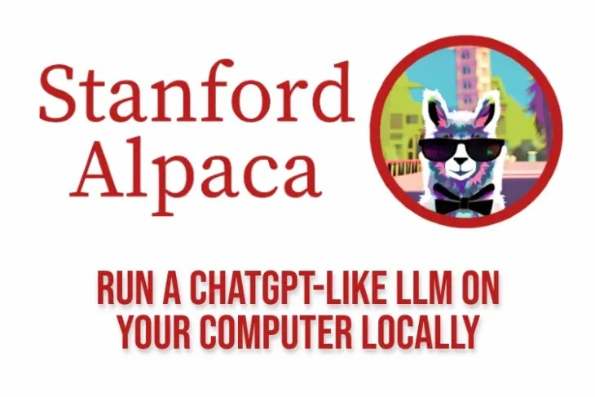
Introduction
Popular examples of LLMs are GPT-3, LLaMa and T5.
LLMs are important in NLP because they enable machines to understand, interpret, and generate human language, bridging the communication gap between humans and machines.

Slide 5
History
Milestones in LLM development include the introduction of recurrent neural networks (RNNs) and long short-term memory (LSTM) models, which paved the way for language modeling.
Breakthroughs like the development of the Transformer architecture revolutionized LLMs by enabling parallel processing and capturing long-range dependencies in language.

Slide 6
History
All Started with the release of
Google’s paper
“Attention is all you need”
“I arrived at the bank after crossing the _”
Depends on last word {river/ road}

Slide 7
History
Notable researchers and contributors in the field of LLM development include Geoff Hinton, Yann LeCun, Yoshua Bengio, and the OpenAI team, among others. Their groundbreaking work has shaped the progress of LLMs and NLP as a whole.

Slide 8
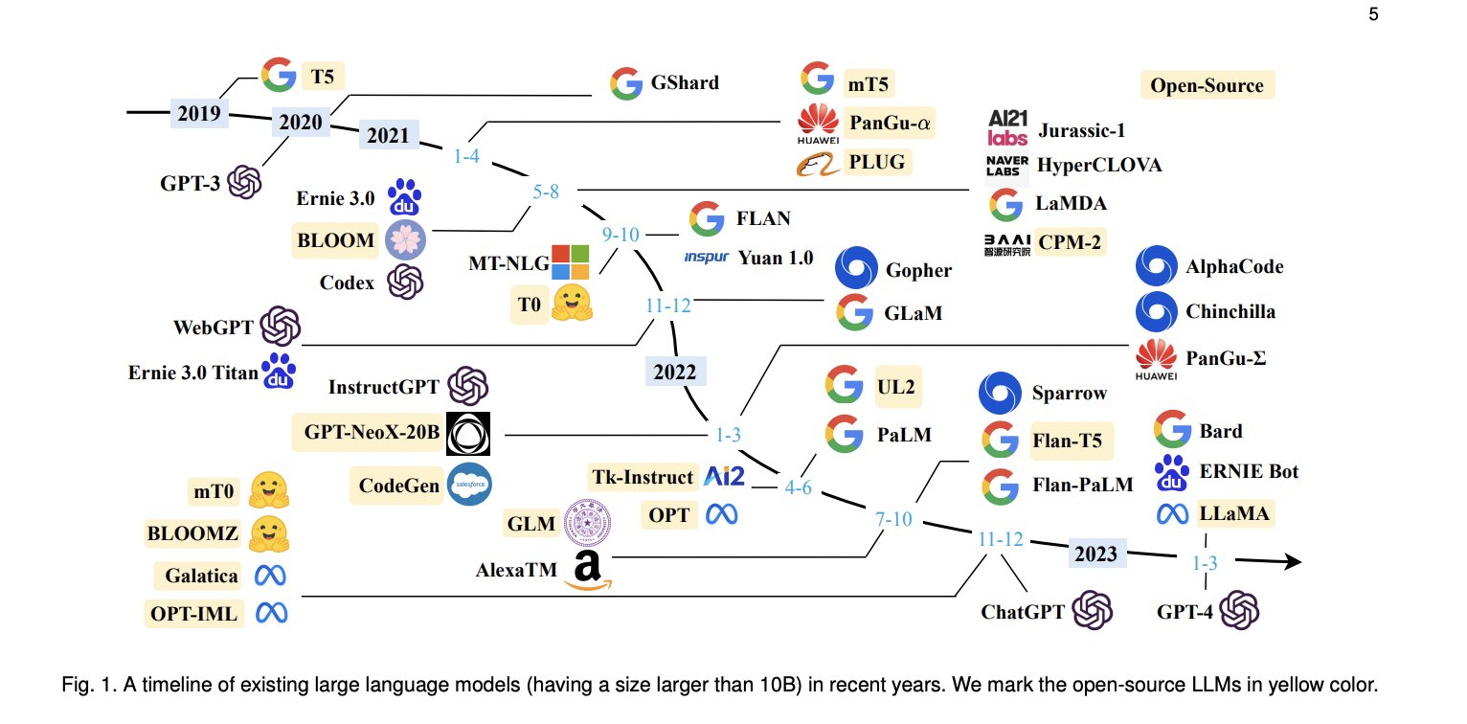
History

Slide 9
How llm work
Tokens: Smallest individual unit.
For example: “today I am going to ….” >> tokens {to, day, I, a, m, go, ing}
Dictionary: Collection of token mapped with unique Int.
For example: {to: 1, day: 2, I: 3, a: 4, m: 5 ……}

Slide 10
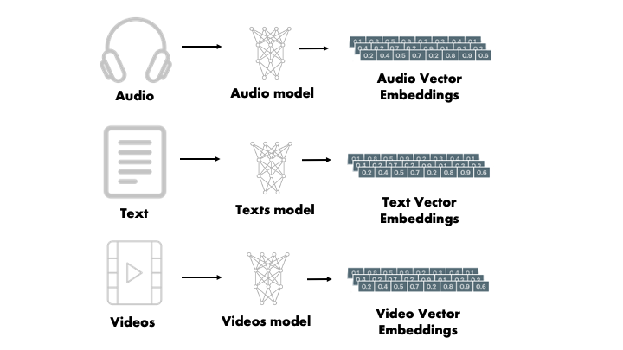
Embeddings
Embedding: Popular trending method where one entity/object is represented by a vector
Popular database emerged called vector database

Slide 11
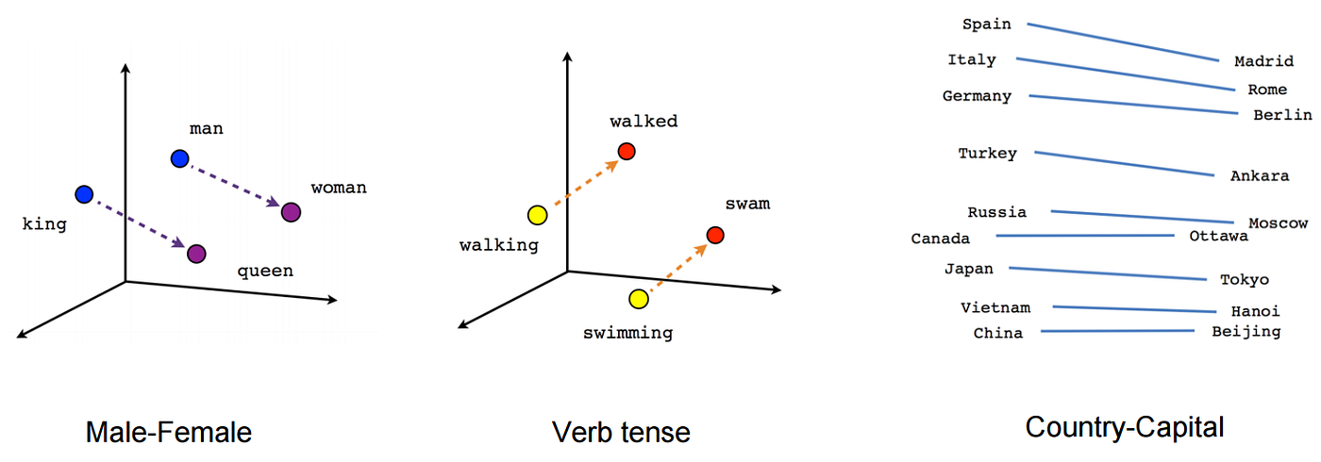
Embeddings
Advantage: It maps similar entity with closer values

Slide 12
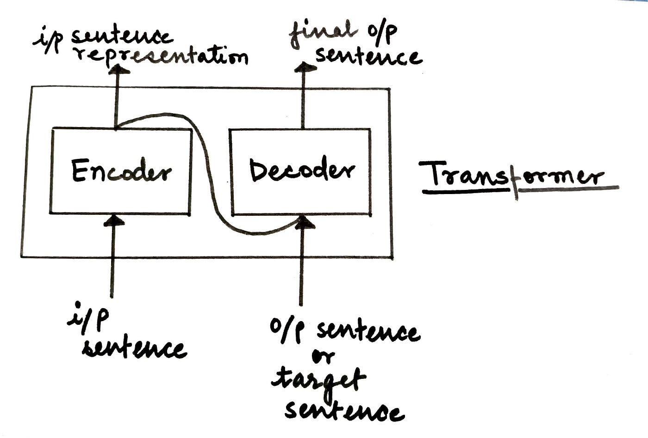
How llm work
LLMs utilize a basic architecture consisting of layers of neural networks, typically built with transformer models
Tokenization is the process of breaking down text into smaller units called tokens, such as words or subwords, to be processed by LLMs.
Dictionaries play a vital role in LLMs by mapping tokens to numerical representations that can be processed by neural networks.

Slide 13
How llm work
LLMs are trained on large-scale datasets, often composed of diverse text sources, to learn patterns and language representations.
Fine-tuning is a process where pre-trained LLMs are further trained on specific tasks or domains to improve their performance in those areas.
Transformers, a key component in LLMs, allow for efficient parallel processing of tokens and capture contextual relationships in language, enhancing performance and understanding within LLMs.

Slide 14
Paradigm
They generally use self-supervised learning paradigm to learn the patterns in the data.
Further those models are fine-tuned via supervised learning to do specific work such as chatbot.
Example: GPT-3 is LLM which has fine-tuned version called chatgpt.

Slide 15
Self supervised learning
It perform the pre-training in one of 2 ways:
1: Auto-Regressive: GPT-style, given input predict next word.
2: Masked: Generate artificial labels.

Slide 16
Auto-regressive training
In this huge corpus of data is taken from online sources like github, web crawl, etc.
Then based on input next word is predicted.
Example: input: “I want to eat ice cream” >> with input processed upto “I want to eat _____” , next word to be predicted ?

Slide 17
Masked training
Generally in LLM huge corpus of data is given to model
Then model generate artificial labels in case of Masked training
Further model trained via those artificial labels
For example: original: The cat sit on mat -> The cat sit on [MASK] -> predict the token [MASK].

Slide 18
Applications of llm
LLMs have diverse applications in Natural Language Processing (NLP), including chatbots, language translation, text summarization, sentiment analysis, question answering, and more.
Companies and organizations leverage LLMs in their NLP products and services.

Slide 19
Applications of llm
LLMs enable more accurate and contextually relevant language translation, empowering platforms such as Google Translate and DeepL to deliver improved multilingual communication.
Text summarization tools like SummarizeBot and news aggregation platforms use LLMs to generate concise and coherent summaries of lengthy texts.
While LLMs offer significant benefits, challenges include addressing biases in training data, potential misuse of generated content, and the need for ethical considerations in their application. Striking a balance between the advantages and challenges is essential for responsible use of LLMs in NLP.

Slide 20
Advancements in llm
Advancements in LLMs include the development of more powerful and efficient architectures, such as GPT-4, BERT, PaLM, which have significantly improved language understanding and generation.
New applications of LLMs are emerging, such as code generation, document summarization, and dialogue systems, extending their reach beyond traditional NLP domains.
LLMs are reshaping the future of NLP by enabling more accurate and contextually aware language processing, facilitating human-like interactions with machines, and advancing the capabilities of automated language-related tasks.

Slide 21
Ethical considerations
Bias can be introduced in LLMs through biased training data, leading to biased outputs and potential discrimination in language generation.
It is crucial to address bias in LLMs to ensure fairness, inclusivity, and prevent reinforcing societal biases or perpetuating harmful stereotypes.

Slide 22
Ethical considerations
LLM developers have a responsibility to proactively mitigate bias by carefully curating diverse and representative training data and employing fairness evaluation metrics.

Slide 23
References
Images taken from :
towardsdatascience.com
nextbigfuture.com
Text Content
chat.openai.com
bard.google.com
wikipedia.org

Slide 24
Thanks

