Slide 1

Screenshots of the Project

Slide 2
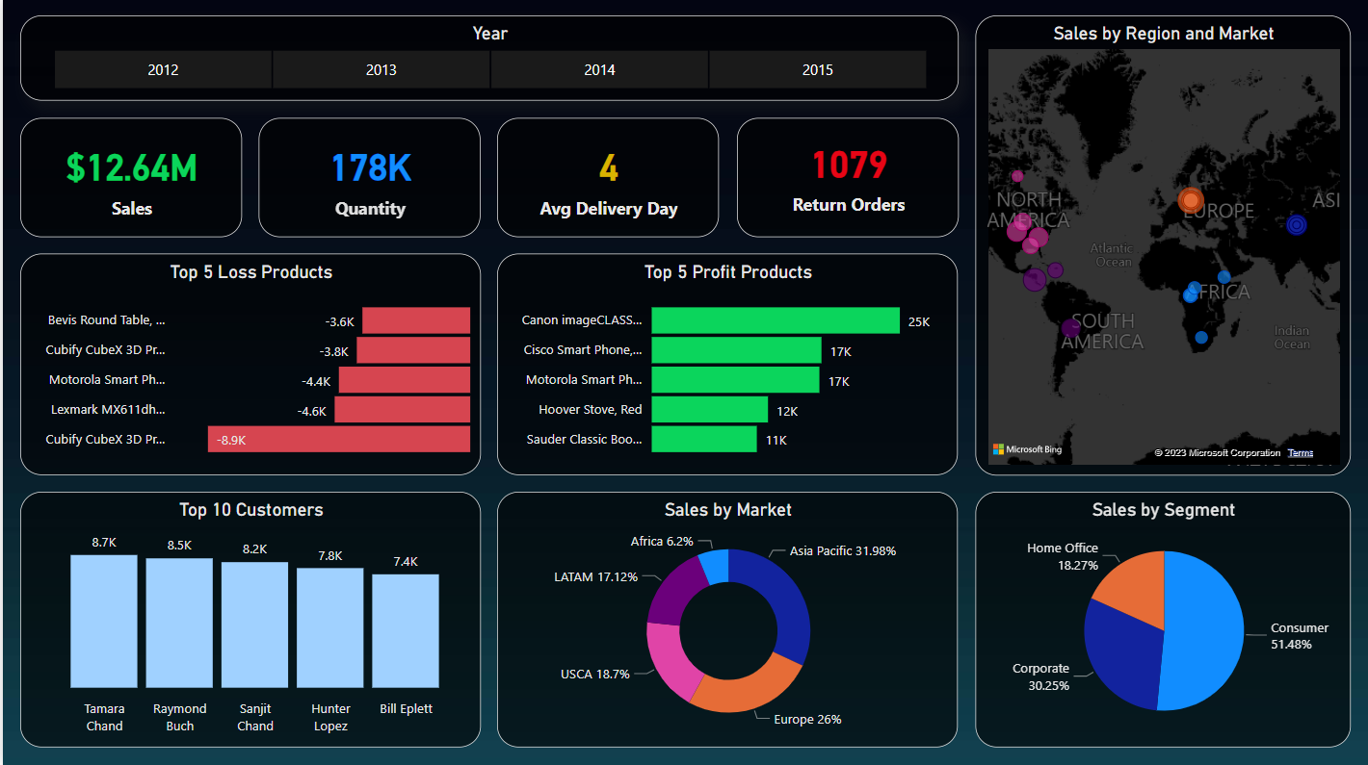
Four Years Sales Dashboard

Slide 3
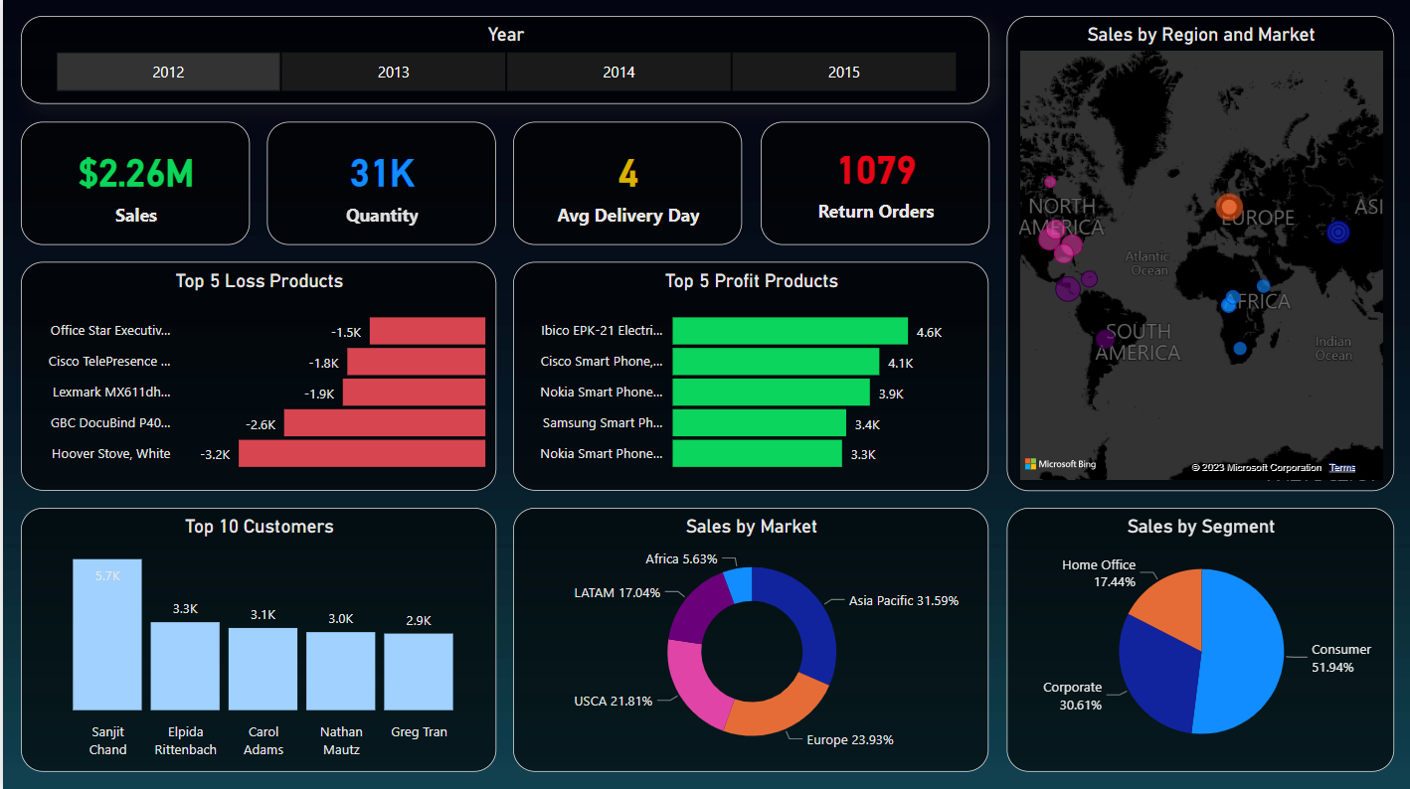
2012 Sales Report

Slide 4
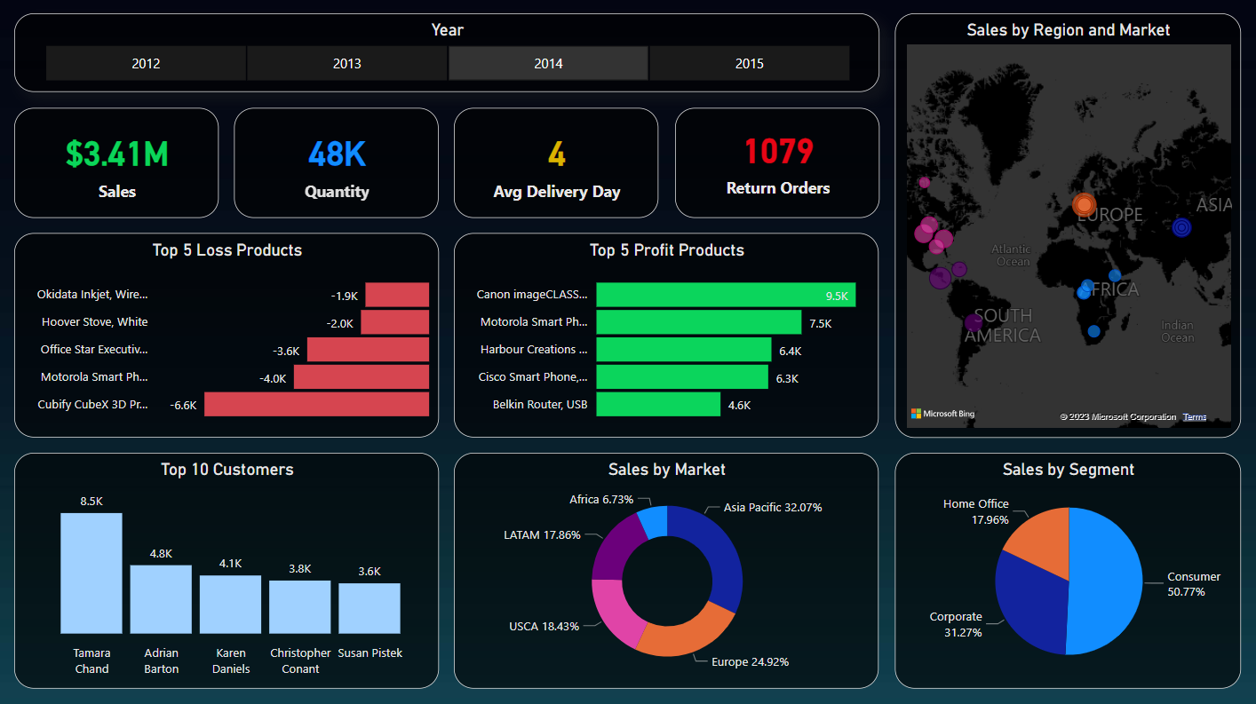
2014 Sales Report

