Slide 1
UE19CS334 – NLP Project Approval
Sarcasm Detection USING NLP
AND ML
Project ID : 05

Slide 2
Project Team Members
Name | SRN
Rithika Reddy Kara | PES2UG19CS331
Phani Kumar Vedurumudi | PES2UG19CS281
Pawan Prasad P | PES2UG19CS280

Slide 3
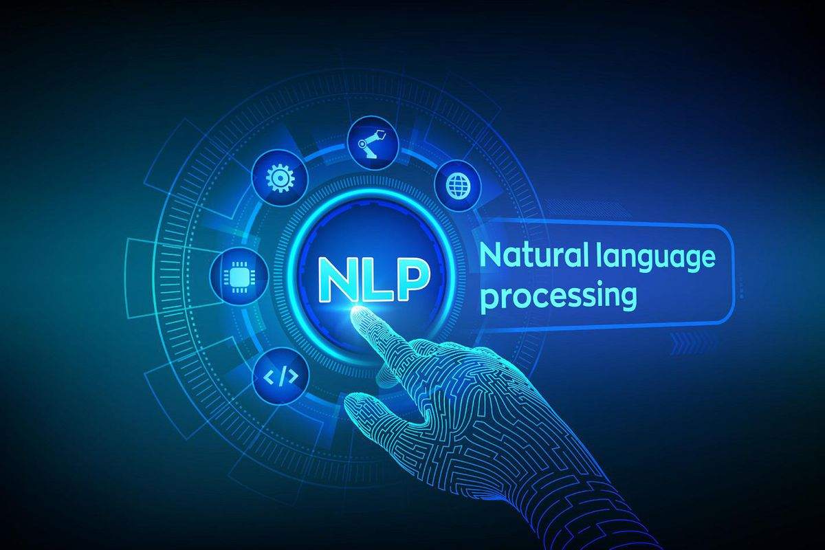
Outline
Problem Statement
Scope and Feasibility study
Applications/Use cases
Expected Deliverables
Any other information

Slide 4
Problem Statement
Sarcasm detection is a very narrow research field in NLP, a specific case of sentiment analysis where instead of detecting a sentiment in the whole spectrum, the focus is on sarcasm. Therefore the task of this field is to detect if a given text is sarcastic or not.

Slide 5
Scope and Application of the Problem
Scope is in the field of Sentiment Analysis
APPLICATIONS:
Sarcasm detection is the task of identifying irony containing utterances in sentiment-bearing text.
Sarcasm Detection is used to find the sentiment of the sentence.

Slide 6
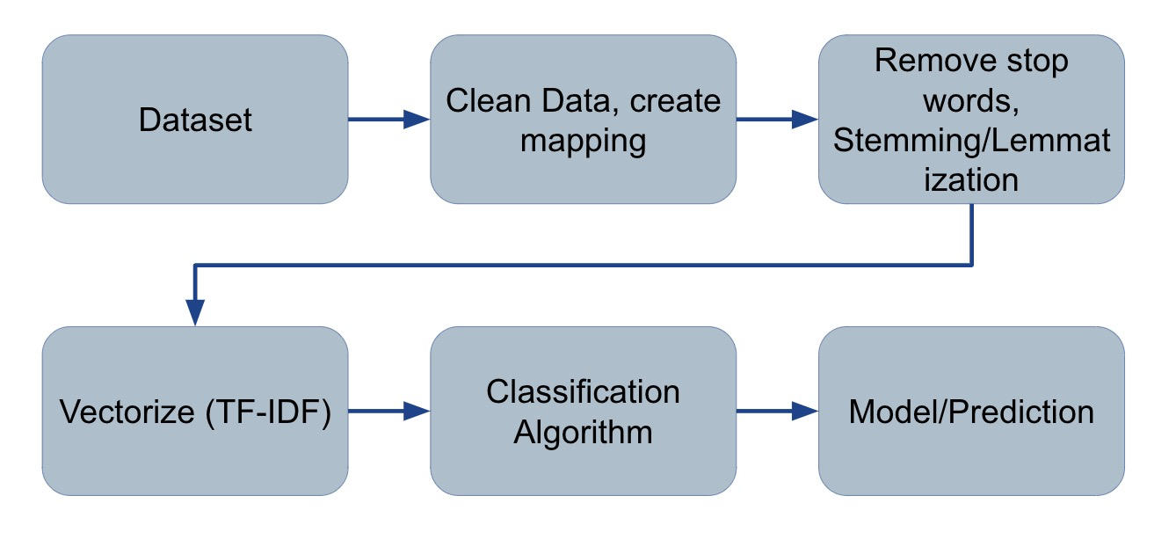
High level design

Slide 7
NLP Concept used in this Project
NLP Techniques:
We are about to use various NLP pre-processing techniques like
Tokenization
Stemming
Lemmatization
Removing Capitalization
Removing the stop words, Punctuation and Unwanted Symbols in the text
CountVectorizer

Slide 8
Any other information
Bibliography:
Paper : Bharti SK, Babu KS, Jena SK. Parsing-based sarcasm sentiment recognition in twitter data. In 2015 IEEE/ACM International Conference on Advances in Social Networks Analysis and Mining (ASONAM); 2015. p. 1373–1380. IEEE.
Paper : Amir S, Wallace BC, Lyu H, Carvalho P, Silva MJ. Modelling context with user embeddings for sarcasm detection in social media. In Proceedings of The 20th SIGNLL Conference on Computational Natural Language Learning; 2016. p. 167–177.
Dataset Link : https://www.kaggle.com/rmisra/news-headlines-dataset-for-sarcasm-detection

Slide 9


