Slide 1
SQL Server

Slide 2
Introduction
MS SQL Server is a database server
Product of Microsoft
Enables user to write queries and other SQL statements and execute them

Slide 3
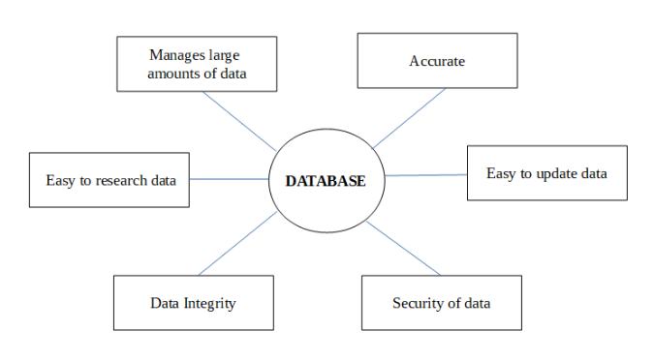
Why Database?
A database is a collection of data, usually stored in electronic form. A database is typically designed so that it is easy to store and access information.
A good database is crucial to any company or organization. This is because the database stores all the pertinent details about the company such as employee records, transactional records, salary details etc.
Manages large amounts of data
A database stores and manages a large amount of data on a daily basis. This would not be possible using any other tool such as a spreadsheet as they would simply not work.
Accurate
A database is pretty accurate as it has all sorts of build in constraints, checks etc. This means that the information available in a database is guaranteed to be correct in most cases.
Easy to update data
In a database, it is easy to update data using various Data Manipulation languages (DML) available. One of these languages is SQL.
Security of data
Databases have various methods to ensure security of data. There are user logins required before accessing a database and various access specifiers. These allow only authorised users to access the database.
Data integrity
This is ensured in databases by using various constraints for data. Data integrity in databases makes sure that the data is accurate and consistent in a database.
Easy to research data
It is very easy to access and research data in a database. This is done using Data Query Languages (DQL) which allow searching of any data in the database and performing computations on it.
Why do we need a Database (tutorialspoint.com)

Slide 4
Normalization

Slide 5
Normalization
Normalization is the process of organizing data in a database.
This includes creating tables and establishing relationships between those tables according to rules designed both to protect the data and to make the database more flexible by eliminating redundancy and inconsistent dependency.

Slide 6
Normalization
First normal form
Eliminate repeating groups in individual tables.
Create a separate table for each set of related data.
Identify each set of related data with a primary key.

Slide 7
Normalization
Second normal form
Create separate tables for sets of values that apply to multiple records.
Relate these tables with a foreign key.
Third normal form
Eliminate fields that do not depend on the key.

Slide 8
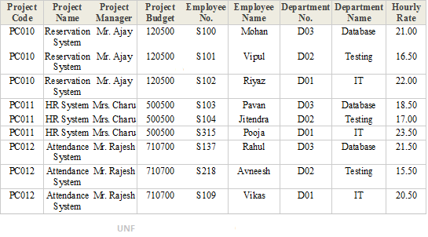
The Data Collection (Without Normalization)
Understanding Database Normalization with Example (dotnettricks.com)

Slide 9
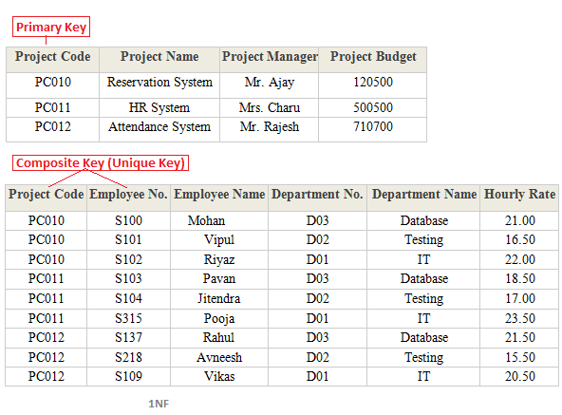
First Normal Form
A database table is said to be in 1NF if it contains no repeating fields/columns. The process of converting the UNF table into 1NF is as follows:
Separate the repeating fields into new database tables along with the key from the unnormalized database table.
The primary key of new database tables may be a composite key
Understanding Database Normalization with Example (dotnettricks.com)

Slide 10
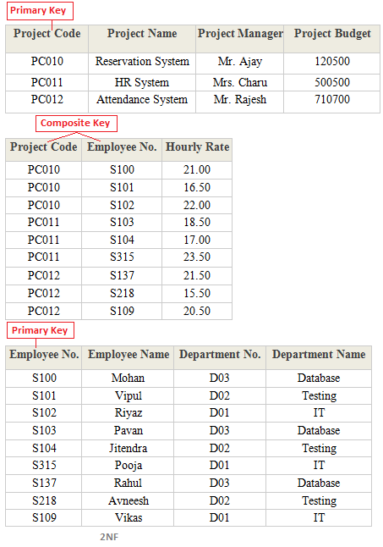
Second Normal Form
A database table is said to be in 2NF if it is in 1NF and contains only those fields/columns that are functionally dependent(means the value of the field is determined by the value of another field(s)) on the primary key.
In 2NF we remove the partial dependencies of any non-key field
The process of converting the database table into 2NF is as follows:
Remove the partial dependencies(A type of functional dependency where a field is only functionally dependent on the part of the primary key) of any non-key field.
If field B depends on field A and vice versa. Also for a given value of B, we have only one possible value of A and vice versa, Then we put the field B into a new database table where B will be the primary key and also marked as a foreign key in a parent table.
Understanding Database Normalization with Example (dotnettricks.com)

Slide 11
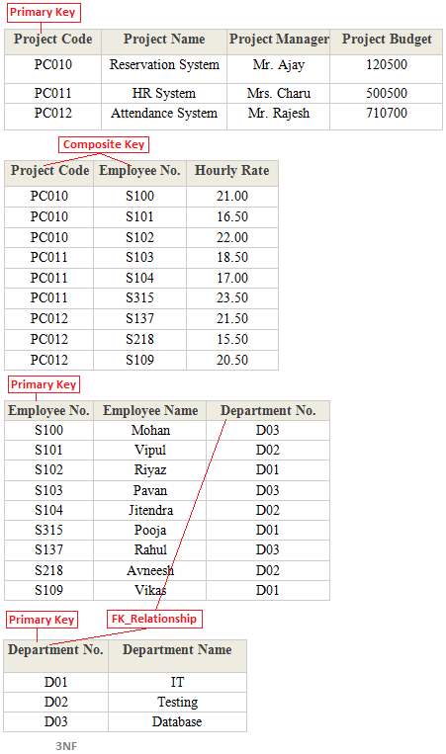
Third Normal Form
A database table is said to be in 3NF if it is in 2NF and all non-keys fields should be dependent on the primary key We can also say a table to be in 3NF if it is in 2NF and no fields of the table are transitively functionally dependent on the primary key. The process of converting the table into 3NF is as follows:
Remove the transitive dependencies(A type of functional dependency where a field is functionally dependent on the Field that is not the primary key. Hence its value is determined, indirectly by the primary key )
Make a separate table for transitive dependent Fields.
Understanding Database Normalization with Example (dotnettricks.com)

Slide 12
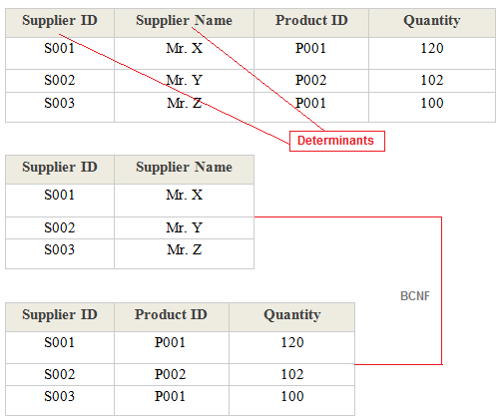
Boyce Code Normal Form (BCNF)
A database table is said to be in BCNF if it is in 3NF and contains each and every determinant is a candidate key. The process of converting the table into BCNF is as follows:
Remove the nontrivial functional dependency.
Make a separate table for the determinants.

Slide 13
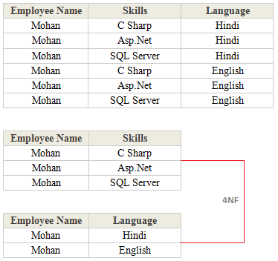
Fourth Normal Form (4NF)
A database table is said to be in 4NF if it is in BCNF and the primary key has a one-to-one relationship to all non-keys fields We can also say a table to be in 4NF if it is in BCNF and contains no multi-valued dependencies. The process of converting the table into 4NF is as follows:
Remove the multivalued dependency.
Make a separate table for multivalued Fields.
Understanding Database Normalization with Example (dotnettricks.com)

Slide 14
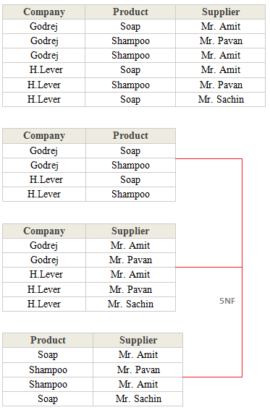
Fifth Normal Form (5NF)
A database table is said to be in 5NF if it is in 4NF and contains no redundant values or We can also say a table to be in 5NF if it is in 4NF and contains no join dependencies. The process of converting the table into 5NF is as follows:
Remove the join dependency.
Break the database table into smaller and smaller tables to remove all data redundancy.
Understanding Database Normalization with Example (dotnettricks.com)

Slide 15
SQL Database Objects
A SQL Server database has lot of objects like
Tables
Views
Stored Procedures
Functions
Rules
Defaults
Cursors
Triggers

Slide 16
System Databases
By default SQL server has 4 databases
Master : System defined stored procedures, login details, configuration settings etc
Model : Template for creating a database
Tempdb : Stores temporary tables. This db is created when the server starts and dropped when the server shuts down
Msdb : Has tables that have details with respect to alerts, jobs. Deals with SQL Server Agent Service

Slide 17
Relational Databases
Entities are represented as relations (tables), in which their attributes are represented as domains (columns)
Most relational databases are normalized, with relationships defined between tables through primary and foreign keys
SalesOrderDetail
OrderID | LineItemNo | ProductID | Quantity
1 | 1 | 3 | 1
2 | 1 | 2 | 5
2 | 2 | 3 | 1
3 | 1 | 1 | 1
Customer
CustomerID | FirstName | LastName
1 | Dan | Drayton
2 | Aisha | Witt
3 | Rosie | Reeves
SalesOrderHeader
OrderID | OrderDate | CustomerID
1 | 1/1/2015 | 1
2 | 1/1/2015 | 3
3 | 1/2/2015 | 1
Product
ProductID | Name | ListPrice
1 | Widget | 2.99
2 | Gizmo | 1.79
3 | Thingybob | 3.49

Slide 18
Creating a database
We need to use Master database for creating a database
By default the size of a database is 1 MB
A database consists of
Master Data File (.mdf)
Primary Log File (.ldf)

Slide 19
Database operations
Changing a database
Use <dbname>
Creating a database
Create database <dbname>
Dropping a database
Drop database <dbname>
Notes:
Use master;
Create database dbtest
On primary
(
name = softsmith,
filename = ‘c:\test\softsmith.mdf’,
size = 10 MB,
maxsize = 20,
filegrowth = 2
)
Log on
(
name = softsmithlog,
filename = ‘c:\test\softsmith.ldf’,
size = 10 MB,
maxsize = 20,
filegrowth = 2
)
This creates a database with the name softsmith. The datafile softsmith.mdf and log file softsmith.ldf will be created in the path c:\test. The size of database is 10 MB.

Slide 20
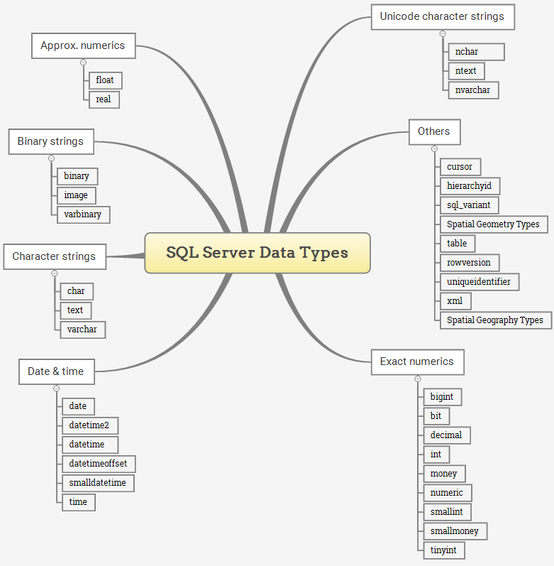
SQL Server DataTypes
SQL Server Data Types (sqlservertutorial.net)

Slide 21
SQL Server DataTypes Exact numeric data types
Data Type | Lower limit | Upper limit | Memory
bigint | −2^63 (−9,223,372, 036,854,775,808) | 2^63−1 (−9,223,372, 036,854,775,807) | 8 bytes
int | −2^31 (−2,147, 483,648) | 2^31−1 (−2,147, 483,647) | 4 bytes
smallint | −2^15 (−32,767) | 2^15 (−32,768) | 2 bytes
tinyint | 0 | 255 | 1 byte
bit | 0 | 1 | 1 byte/8bit column
decimal | −10^38+1 | 10^381−1 | 5 to 17 bytes
numeric | −10^38+1 | 10^381−1 | 5 to 17 bytes
money | −922,337, 203, 685,477.5808 | +922,337, 203, 685,477.5807 | 8 bytes
smallmoney | −214,478.3648 | +214,478.3647 | 4 bytes
SQL Server Data Types (sqlservertutorial.net)

Slide 22
SQL Server DataTypes Approximate numeric data types
Data Type | Lower limit | Upper limit | Memory | Precision
float(n) | −1.79E+308 | 1.79E+308 | Depends on the value of n | 7 Digit
real | −3.40E+38 | 3.40E+38 | 4 bytes | 15 Digit
SQL Server Data Types (sqlservertutorial.net)

Slide 23
SQL Server DataTypes Date & Time data types
Data Type | Storage size | Accuracy | Lower Range | Upper Range
datetime | 8 bytes | Rounded to increments of .000, .003, .007 | 1753-01-01 | 9999-12-31
smalldatetime | 4 bytes, fixed | 1 minute | 1900-01-01 | 2079-06-06
date | 3 bytes, fixed | 1 day | 0001-01-01 | 9999-12-31
time | 5 bytes | 100 nanoseconds | 00:00:00.0000000 | 23:59:59.9999999
datetimeoffset | 10 bytes | 100 nanoseconds | 0001-01-01 | 9999-12-31
datetime2 | 6 bytes | 100 nanoseconds | 0001-01-01 | 9999-12-31
SQL Server Data Types (sqlservertutorial.net)

Slide 24
Character strings data types
Data Type | Lower limit | Upper limit | Memory
char | 0 chars | 8000 chars | n bytes
varchar | 0 chars | 8000 chars | n bytes + 2 bytes
varchar (max) | 0 chars | 2^31 chars | n bytes + 2 bytes
text | 0 chars | 2,147,483,647 chars | n bytes + 4 bytes
SQL Server Data Types (sqlservertutorial.net)

Slide 25
Unicode character string data types
Data Type | Lower limit | Upper limit | Memory
nchar | 0 chars | 4000 chars | 2 times n bytes
nvarchar | 0 chars | 4000 chars | 2 times n bytes + 2 bytes
ntext | 0 chars | 1,073,741,823 char | 2 times the string length
SQL Server Data Types (sqlservertutorial.net)

Slide 26
Binary string data types
Data Type | Lower limit | Upper limit | Memory
binary | 0 bytes | 8000 bytes | n bytes
varbinary | 0 bytes | 8000 bytes | The actual length of data entered + 2 bytes
image | 0 bytes | 2,147,483,647 bytes
Other data types

Slide 27
Other data types
Data Type | Description
cursor | for variables or stored procedure OUTPUT parameter that contains a reference to a cursor
rowversion | expose automatically generated, unique binary numbers within a database.
hierarchyid | represent a tree position in a tree hierarchy
uniqueidentifier | 16-byte GUID
sql_variant | store values of other data types
XML | store XML data in a column, or a variable of XML type
Spatial Geometry type | represent data in a flat coordinate system.
Spatial Geography type | store ellipsoidal (round-earth) data, such as GPS latitude and longitude coordinates.
table | store a result set temporarily for processing at a later time
SQL Server Data Types (sqlservertutorial.net)

Slide 28
SQL Server Data types
Integer : Stores whole number
Float : Stores real numbers
Text : Stores characters
Decimal: Stores real numbers
Money : Stores monetary data. Supports 4 places after decimal
Date : Stores date and time
Binary : Stores images and other large objects
Miscellaneous : Different types special to SQL Server.
(Refer to notes for more info)
Notes:
Integer:
Bit - 1 bit
Tinyint - 1 byte
Smallint - 2 bytes
Int - 4 bytes
Bigint - 8 bytes
Float:
Float
Real
Text:
Non unicode string: A character occupies 1 byte
Char
Varchar
Text
Unicode string: A character occupies 2 bytes
Nchar
Nvarchar
Ntext
Decimal: has precision and scale
Decimal(p,s)
Numeric(p,s)
P = total digits in a number
S = number of digits after decimal point
Eg. Numeric(4,2) can store 22.56 and so on
Money: Data like 23.2234
Money
Smallmoney
Date:
Smalldatetime – Range – 1-1-1900 to 6-6-2079
Datetime - Range – 1-1-1753 to 31-12-9999
Binary:
Binary
Varbinary
Image
Misc:
Uniqueidentifier – Unique id – can be accessed and modified through function getUid() and setUid()
Cursor – Special data type meant for row by row operation
Sql_variant – Generic data types
Table – table data type – stores table data
Timestamp – Uniqe value in a database

Slide 29
Operators
Arithmetic
Assignment
Comparison
Logical
String
Unary
Bitwise
Notes:
Arithmetic : +, -, *, /, %
Assignment : =
Comparison : <, >, <=, >= <>, =, !=, !<, !>
Logical : AND, OR, NOT, IN, LIKE, BETWEEN, ANY, ALL, EXISTS, SOME
String : Concatenation (+)
Unary : -, +, ~
Bitwise: &, |, ^

Slide 30
What is Transact-SQL?
Structured Query Language (SQL)
Developed by IBM in 1970s
Adopted as a standard by ANSI and ISO standards bodies
Widely used in industry
Microsoft’s implementation is Transact-SQL
Referred to as T-SQL
Query language for SQL Server and Azure SQL Database
SQL is declarative, not procedural
Describe what you want, don’t specify steps

Slide 31
Tables in SQL
Table name
Attribute names
Product
PName | Price | Category | Manufacturer
Gizmo | $19.99 | Gadgets | GizmoWorks
Powergizmo | $29.99 | Gadgets | GizmoWorks
SingleTouch | $149.99 | Photography | Canon
MultiTouch | $203.99 | Household | Hitachi
Tuples or rows

Slide 32
Schemas and Object Names
Schemas are namespaces for database objects
Fully-qualified names:
[server_name.][database_name.][schema_name.]object_name
Within database context, best practice is to include schema name:
schema_name.object_name
Sales
Production
Order
Product
Production.Product
Sales.Order
Sales.Customer
Customer
Order
Production.Order

Slide 33
SQL Statement Types
Data Manipulation Language (DML) | Data Definition Language (DDL) | Data Control Language (DCL)
Statements for querying and modifying data: SELECT INSERT UPDATE DELETE | Statements for defining database objects: CREATE ALTER DROP | Statements for assigning security permissions: GRANT REVOKE DENY

Slide 34
The SELECT Statement
Element | Expression | Role
SELECT | <select list> | Defines which columns to return
FROM | <table source> | Defines table(s) to query
WHERE | <search condition> | Filters rows using a predicate
GROUP BY | <group by list> | Arranges rows by groups
HAVING | <search condition> | Filters groups using a predicate
ORDER BY | <order by list> | Sorts the output
5
1
2
3
4
6
SELECT OrderDate, COUNT(OrderID)
FROM Sales.SalesOrder
WHERE Status = 'Shipped'
GROUP BY OrderDate
HAVING COUNT(OrderID) > 1
ORDER BY OrderDate DESC;

Slide 35
Basic SELECT Query Examples
All columns
Specific columns
Expressions and Aliases
SELECT * FROM Production.Product;
SELECT Name, ListPrice
FROM Production.Product;
SELECT Name AS Product, ListPrice * 0.9 AS SalePrice
FROM Production.Product;

Slide 36
Basic SELECT Queries

Slide 37
Working with Data Types Transact-SQL Data Types
Exact Numeric | Approximate Numeric | Character | Date/Time | Binary | Other
tinyint | float | char | date | binary | cursor
smallint | real | varchar | time | varbinary | hierarchyid
int |  | text | datetime | image | sql_variant
bigint |  | nchar | datetime2 |  | table
bit |  | nvarchar | smalldatetime |  | timestamp
decimal/numeric |  | ntext | datetimeoffset |  | uniqueidentifier
numeric |  |  |  |  | xml
money |  |  |  |  | geography
smallmoney |  |  |  |  | geometry

Slide 38
Working with Data Types Data Type Conversion
Implicit Conversion
Compatible data types can be automatically converted
Explicit Conversion
Requires an explicit conversion function
CAST / TRY_CAST
CONVERT / TRY_CONVERT
PARSE / TRY_PARSE
STR

Slide 39
Converting Data Types

Slide 40
Working with NULLs NULL Values
NULL represents a missing or unknown value
ANSI behaviour for NULL values:
The result of any expression containing a NULL value is NULL
2 + NULL = NULL
‘MyString: ‘ + NULL = NULL
Equality comparisons always return false for NULL values
NULL = NULL returns false
NULL IS NULL returns true

Slide 41
Working with NULLs NULL Functions
ISNULL(column/variable, value)
Returns value if the column or variable is NULL
NULLIF(column/variable, value)
Returns NULL if the column or variable is value
COALESCE (column/variable1, column/variable2,…)
Returns the value of the first non-NULL column or variable in the list

