Slide 1
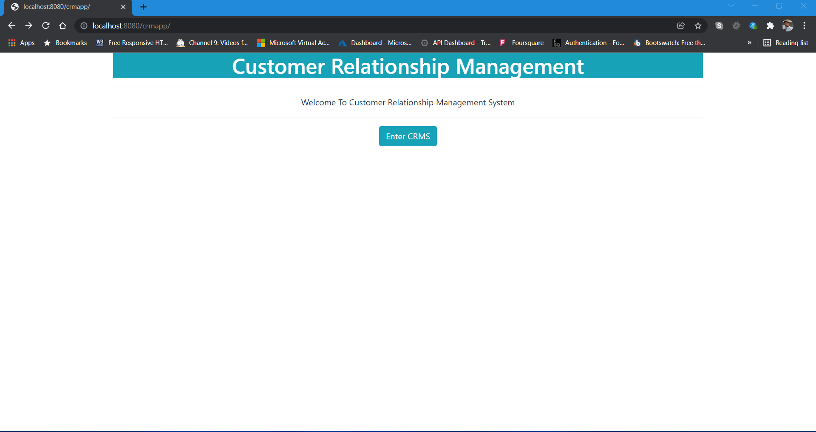
1) Home Page

Slide 2
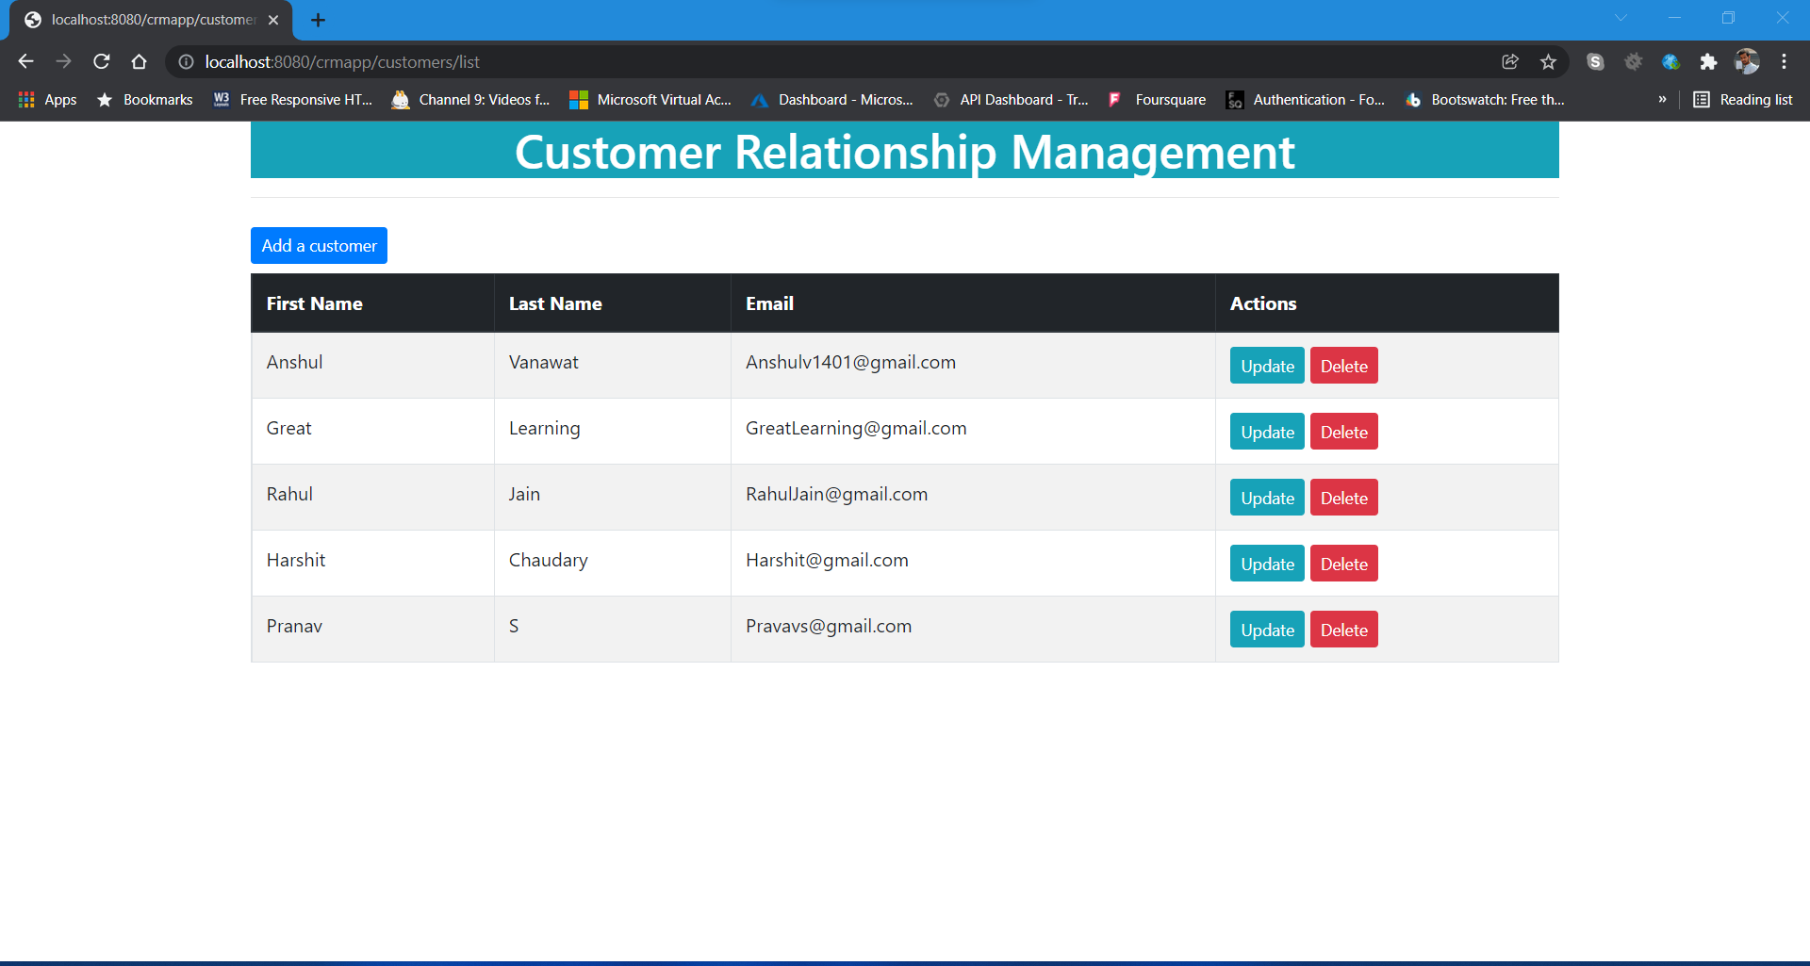
2)Main page – Customer list

Slide 3
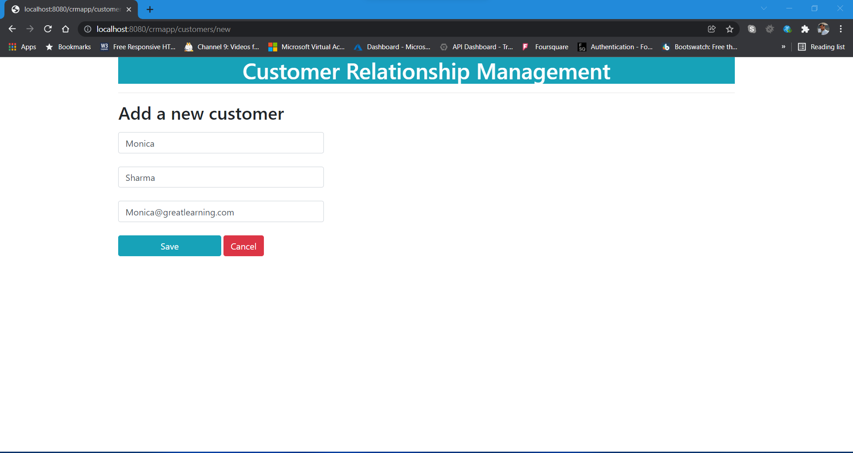
3) Add new customer

Slide 4
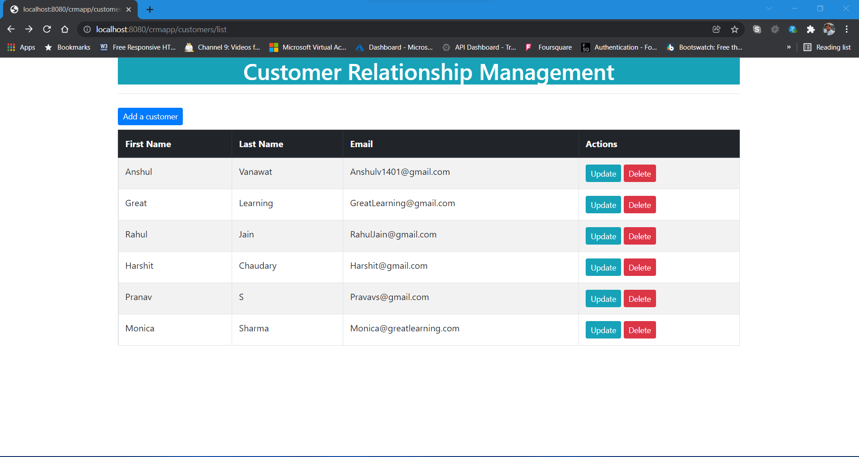
4) Added customer Successfully

Slide 5
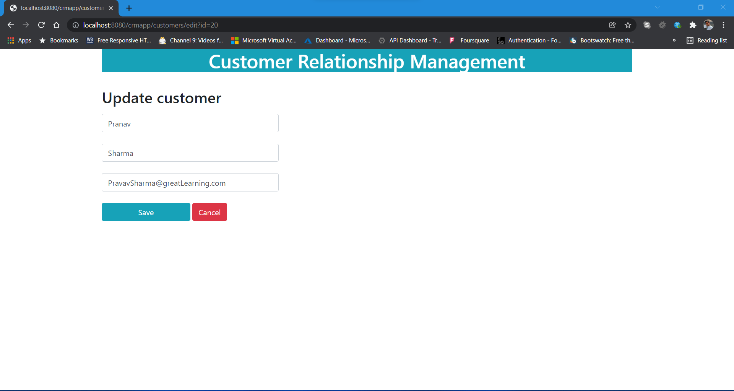
5) Update Customer

Slide 6

6) Updated Successfully (customer “Pranav”)

Slide 7
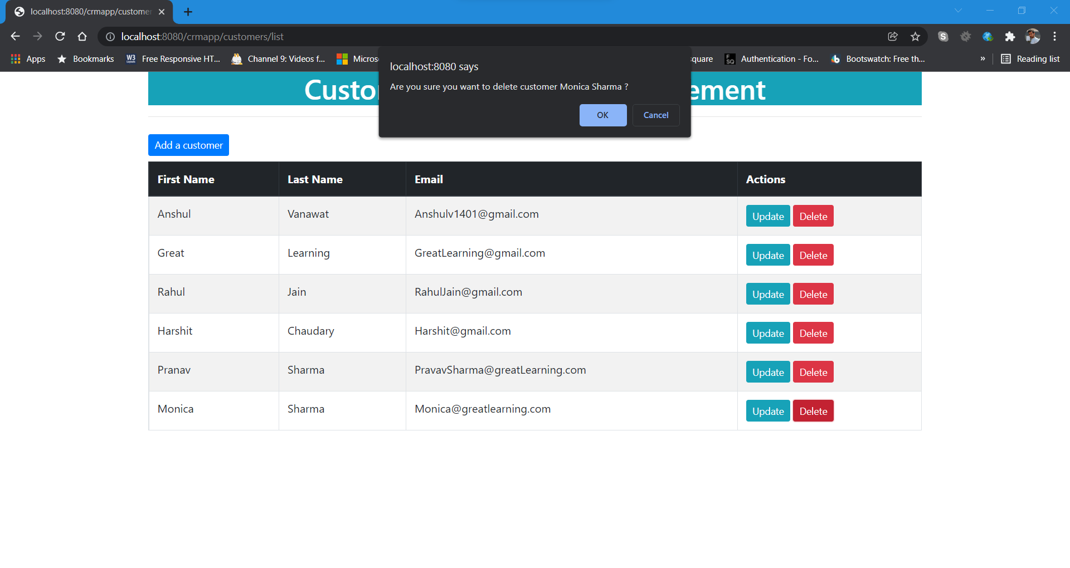
7) Delete customer

Slide 8
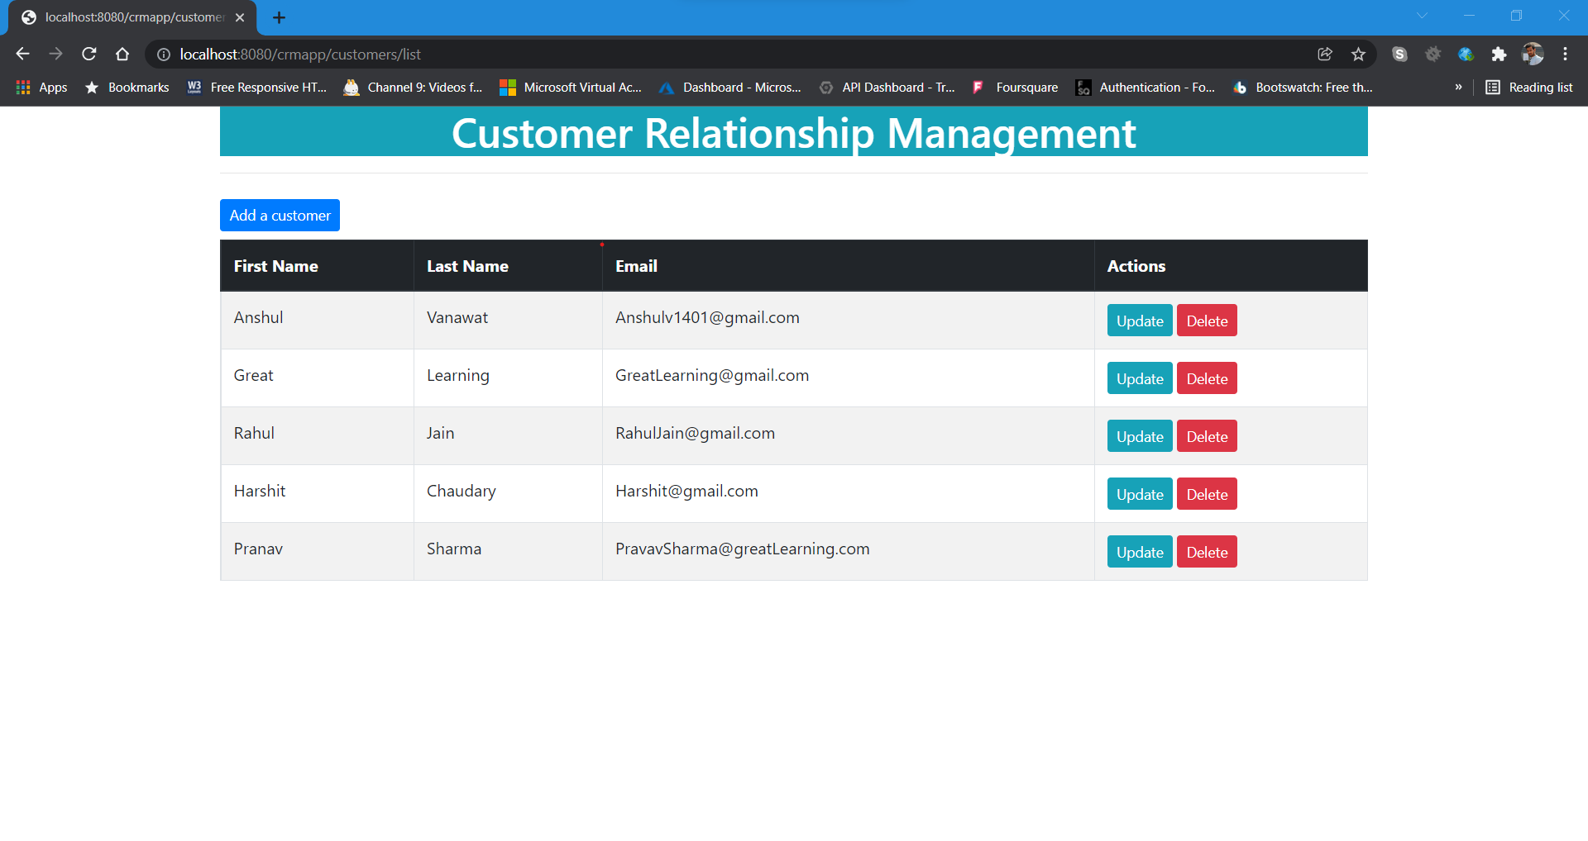
8) Customer Deleted Successfully

