Slide 1

Assignment week 5
Paween wongkornchaovalit

Slide 2
Section
Introduction
Problem
Mission
Data
Zipcode
Geographical data
Foursquare API
Methodology
Data Wrangling
Data Extraction
Obtaining the venues
Ranking the venues
Result
Toronto
York
Scorborough
Closing
Discussion
Conclusion

Slide 3
Introduction
Obtain data in selected area before launching new project
See top 10 businesses in each neighborhoods

Slide 4
Data
Zipcode with area names
Locational data via geographical technique
Foursquare API for venues list

Slide 5
Methodology
Data Wrangling
Data Extraction
Obtaining venues from Foursquare API
Rank the venues based on neighborhood

Slide 6
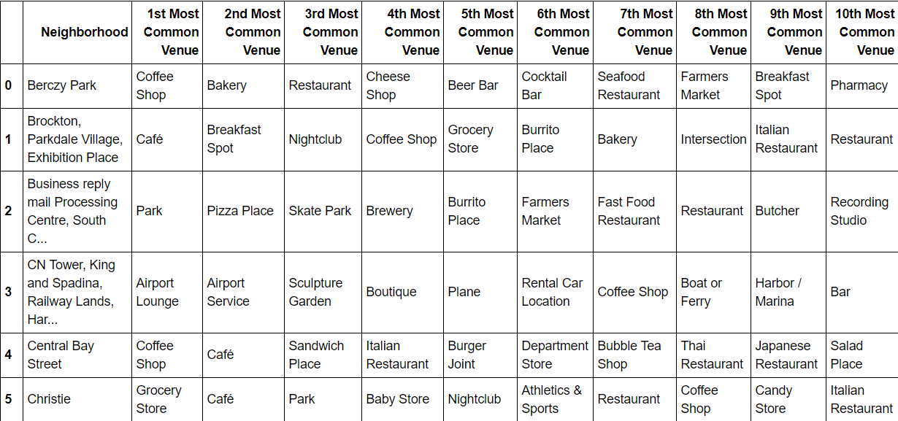
Result
Toronto

Slide 7
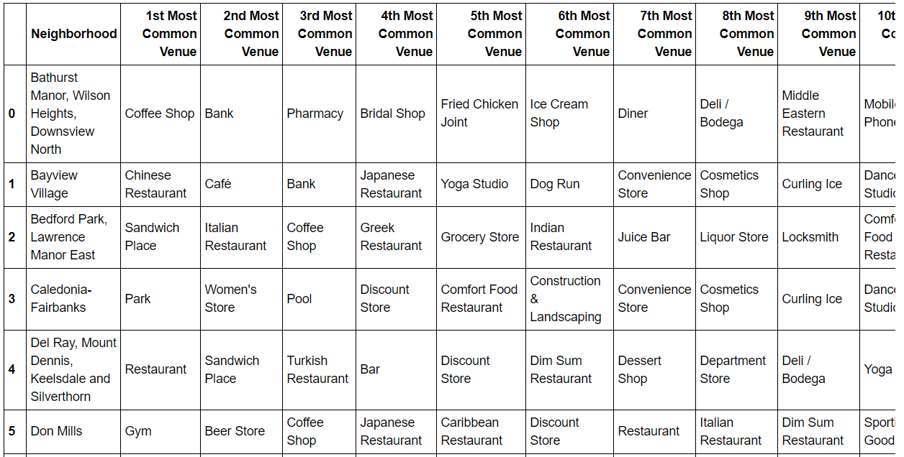
Result
York

Slide 8
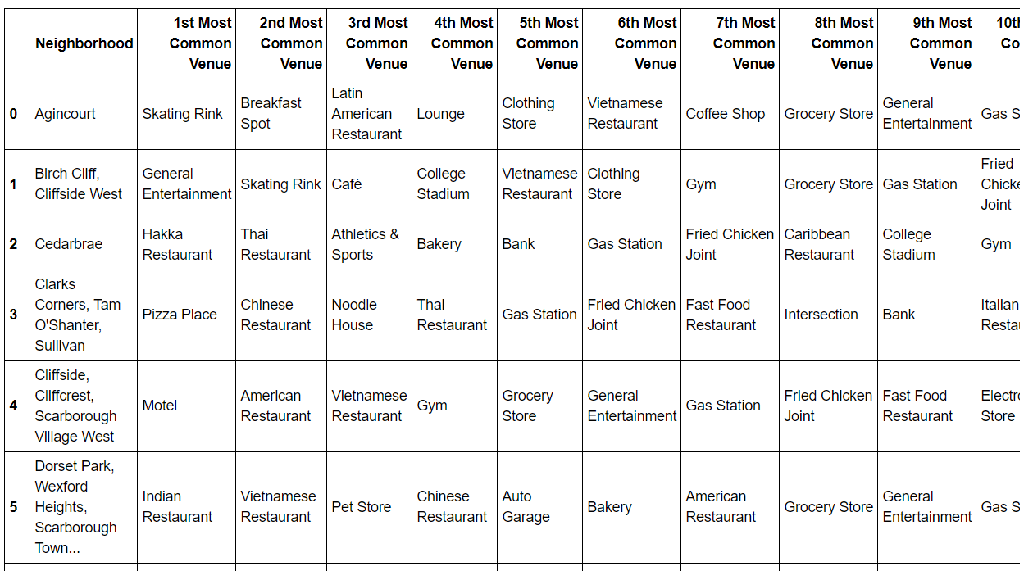
Result
Scarborough

Slide 9
Closing
To launch a business model, we need to have data and understand it well before making a decision
In each areas, i.e. neighborhoods, the popularity of each businesses is different
Popularity of businesses in each areas can be used as an indicator before deciding to launch a new business in that area

Slide 10
Thank you

