Slide 1
Generative AI

Slide 2
W3 Agenda
LLM Flow orchestration
Combining multiple LLM calls
How to monitor complex LLM flow
AI Agents
What is an AI Agent?
How LLMs can take actions with tools?
End of Course Assignment summary
Chat Bots
Biggest challengs in building chatbots
How to balance performance, costs and latency

Slide 3
LLM Flow orchestration

Slide 4
Combining multiple LLM calls

Slide 5
LLMs perform best when they have single, clear objective, for more complex tasks its better to split tchem to multiple calls
Split complex task to multiple flows
More specific goal and instructions
Clear LLM attention focused
Ability to route downstream tasks
Multiple calls can get job done with smaller models
Performing multiple tasks e.g. mining, validation and scoring at the same time leads to worst results
More tasks -> more prompt -> dillution of attention, which can lead to worse results
You can use results from one stage to power following calls, or even route next steps to be taken
Multiple calls with routing save prompt making it faster, cheaper and more attentive
You can use programtaic validation between them

Slide 6
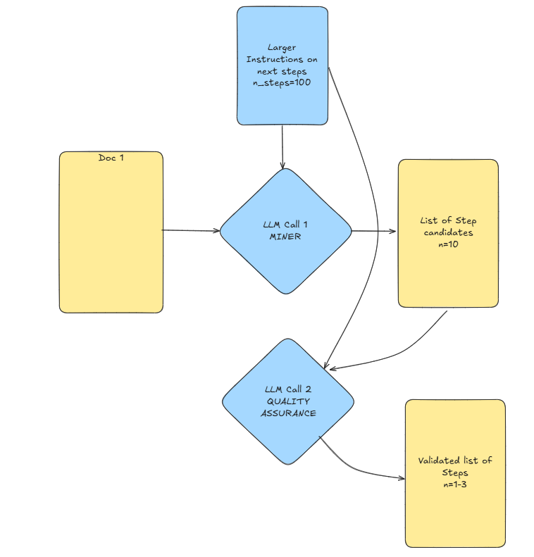
Chaining multiple calls can give LLM different roles e.g. Miner/Extractor and Judge/Quality Assurance
Solving next steps to be taken based on the sales meeting transcript with mutliple call example
Imagine you have a 30 min recording and need to select best 1-3 steps based on 100 possibilities
With so much context it is hard to do in single call
But if we select some candidate steps in first call
And then select which of these are really best fit in 2nd call we can get a more focused results
Output of LLM call 1 feed directly to prompt for LLM call 2 to narrow down search criteria

Slide 7
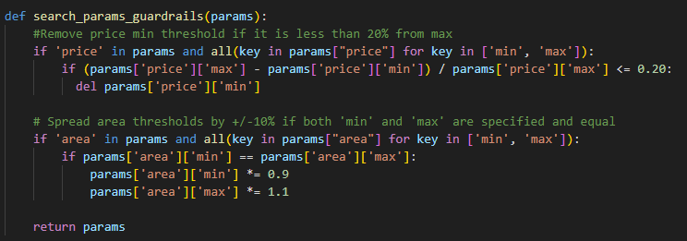
Validating / Modyfing outputs programatically between calls can make systems more predictable
If you can solve some problem in a few lines of code, DO NOT USE a multi B params model
If you need to match some values to a finite list, you can use fuzzy match
If you need to implement some logic like loose matching try doing it programatically instead of trying to prompt LLMs to let through anything between +/- 10% from X
Example of guardrails funciton for LLM powered real estate search

Slide 8
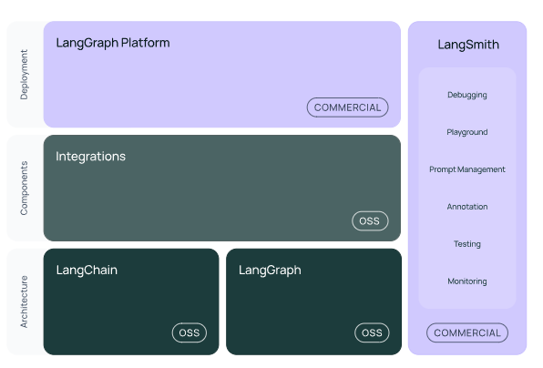
Validating / Modyfing outputs programatically between calls can make systems more predictable
LangChain is a framework for developing applications powered by large language models (LLMs).
LangChain simplifies every stage of the LLM application lifecycle:
Development: Build your applications using LangChain's open-source components and third-party integrations. Use LangGraph to build stateful agents with first-class streaming and human-in-the-loop support.
Productionization: Use LangSmith to inspect, monitor and evaluate your applications, so that you can continuously optimize and deploy with confidence.
Deployment: Turn your LangGraph applications into production-ready APIs and Assistants with LangGraph Platform.
Source: langchain.com

Slide 9
Most important langchain concepts [1/2]
LLM (Large Language Model)
Core building block that provides text generation and reasoning capabilities
Abstracted in LangChain via classes like BaseChatOpenAI and others
Handles prompting, token limits, and output generation
Can be configured with parameters like temperature, max_tokens, and model name
Acts as the "brain" that processes textual inputs and generates responses
Prompts
Templates for generating instructions to LLMs
Can incorporate variables using f-strings or LangChain template syntax
Structured via ChatPromptTemplate, HumanMessagePromptTemplate, etc.
Support different message types (system, human, assistant)
Can include examples for few-shot learning

Slide 10
Most important langchain concepts [2/2]
Chain
Connects multiple components in a processing pipeline
Enables sequential execution of operations on data
Can combine prompts, LLMs, and other tools in a reusable workflow
Allows for modular, reusable components that can be composed together
Chains can consists of other chains, creating readable levels of abstraction
RunnableBranch:
Provides conditional logic in LangChain workflows
Routes execution based on predicates (conditions)
Takes a list of (condition, runnable) pairs and a default runnable
Enables dynamic, conditional processing paths
RunnablePassthrough
Passes inputs through without modification
Often used with .assign() to add new fields to the data context
Maintains existing data while adding or transforming specific fields
Helps manage state throughout a complex workflow
Enables data transformation without losing context

Slide 11
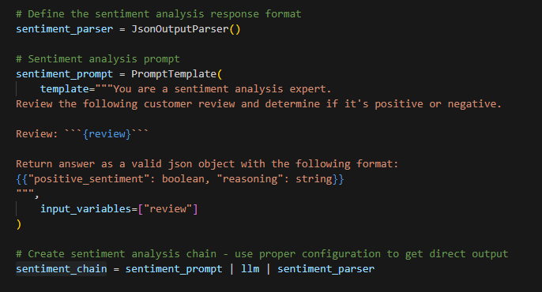
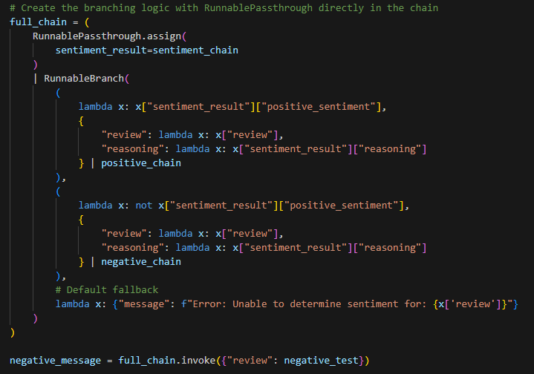
Simple langchain example
Runable Passhtorugh.asisgn fetches output of one sub-chain to be fed to next steps
Parser makes sure that final output is a JSON
Prompt gives instructions and sets up argument
RunableBranch Executes one off possible LLMs based on value of previous step
LLM manages which models is used

Slide 12
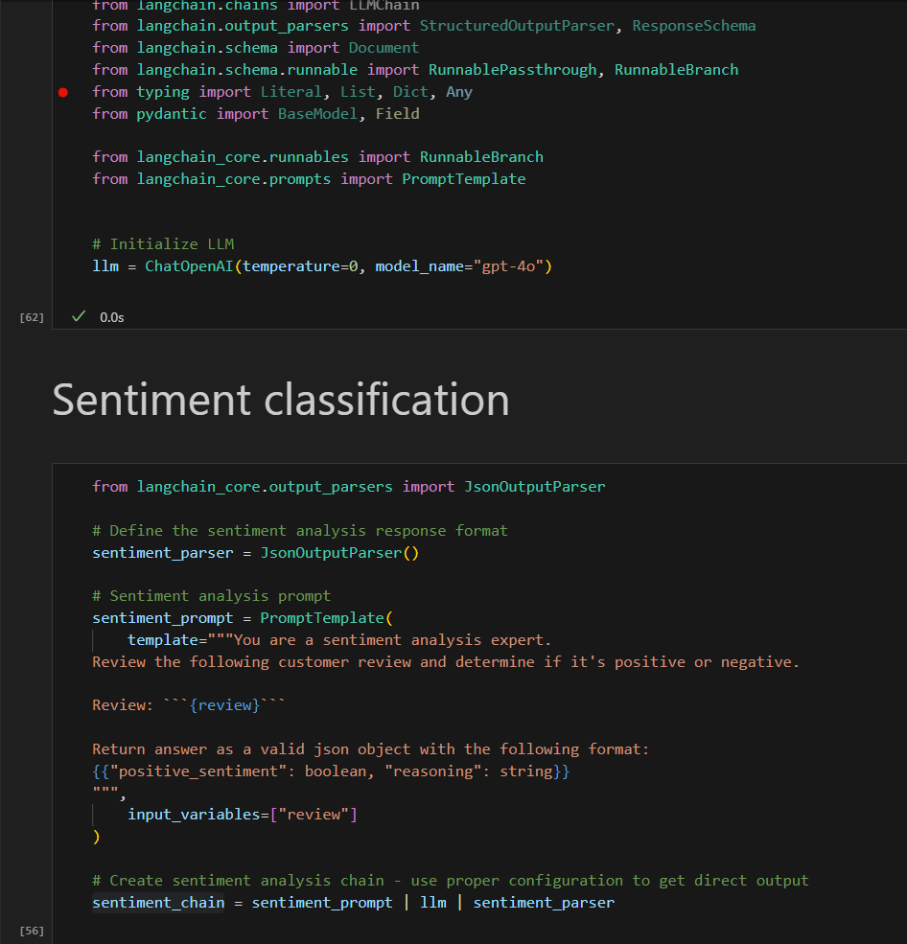
Introduction to Langchain
Start in W3-llm-flows-and-monitoring

Slide 13
LLM Flow Monitoring

Slide 14
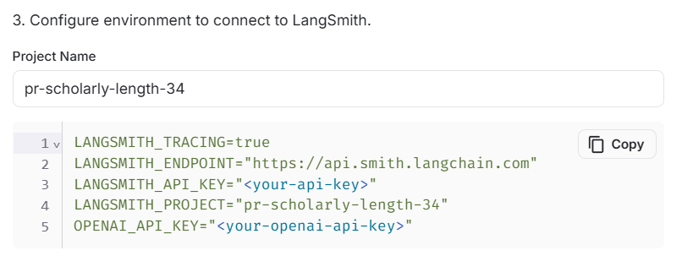
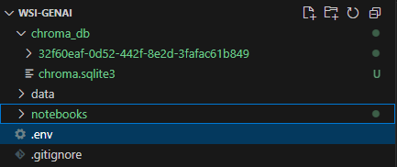
Setting up Langsmith
Go to https://smith.langchain.com/
Make a free account
Go to Set Up Tracing
Generate API_KEY
Copy first code snippet
Paste it to .env file
Remove „” for strings as .env file does not need tchem
Change project to something meaningful

Slide 15
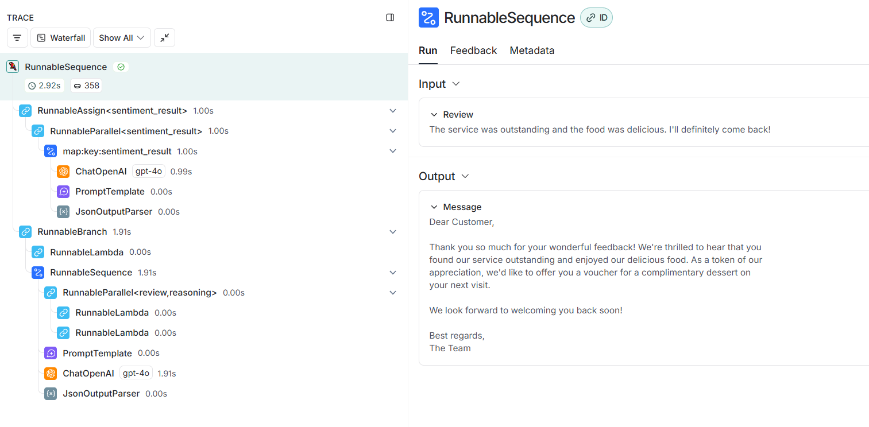
How to navigate logs for full LLM observability

Slide 16
Debugging through logs
As LLM flows become more complex and they take multiple, non deterministic inputs (e.g. from previous steps) clear logging is crucial to understand their mistakes
Due to non-deterministic nature is is often easier to debug logs than try to replicate all states
Minor mistakes such as incorrect setup of some prompt inputs or missing memory are easiest to find in logs
Small upstream changes can lead to significant shifts 2-3 calls further

Slide 17
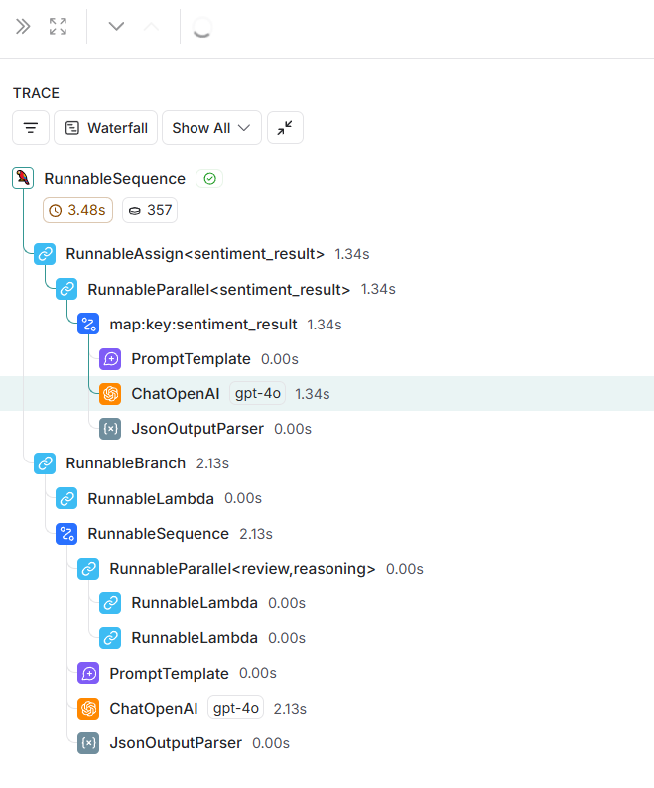
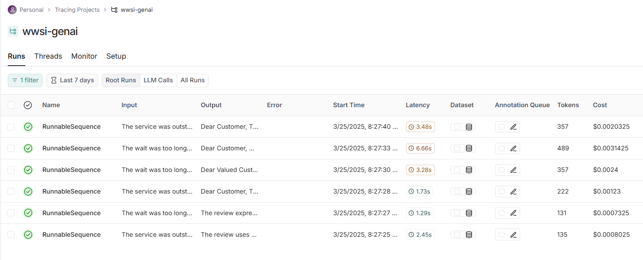
Jupyter exercise Reranking
Rerun W3-llm-flows-and-monitoring after setting up langchain

Slide 18
AI Agents

Slide 19
What is an AI Agent?

Slide 20
What makes LLMs Agentic
What Are AI Agents?
Autonomous systems powered by AI that can perceive their environment, make decisions, and take actions
Combine LLMs with the ability to use tools and execute tasks over multiple steps
Designed to achieve specific goals with varying degrees of autonomy
LLM serves as the `brain` of the system, but it also be connected to classical programs, databases, email etc
Key Capabilities
Contextual Memory: Short and long-term memory systems
Reasoning: Ability to make logical inferences
Learning: Improving performance through experience
Multimodal Understanding: Processing different types of inputs (text, images, etc.)

Slide 21
Interacting with online world through tools and iterative improvements is what makes Agentic LLMs so powerful
Iterative Decision Making
Plan-Execute-Reflect Loop: Form a plan, take actions, evaluate results
Self-Correction: Adjust strategy based on feedback and outcomes
Decomposition: Break complex tasks into manageable subtasks
Memory Management: Maintain context across multiple decision points
Re-planning: Update approach when facing unexpected obstacles
How AI Agents Use Tools
Tool Integration: Access to APIs, databases, code execution, web browsing
Tool Selection: Choose appropriate tools based on the current task requirements
Tool Chaining: Coordinate multiple tools to solve complex problems
Tool Augmentation: Overcome LLM limitations (computation, up-to-date info, specific actions)

Slide 22
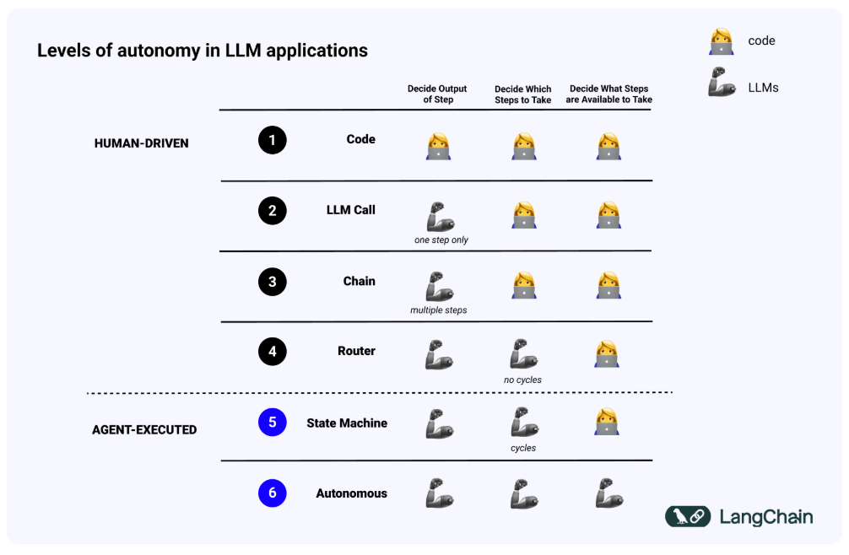
Levels of Autonomy in LLM aplpications
Everything below this line is currently called an agent
Level 6 Autonomy without any control is still extremely rare

Slide 23
Empowering LLMs to take actions with tools

Slide 24
Why do agents need tools?
LLMs are more powerfull than just chatbots -> tools allow them to interact with online world through API, Databases, Email or anything that you can trigger with a script
Tools also enable them to leverage more data for answers, by query API, SQL Databases etc
Tools can improve reliability where LLMs typically fail e.g. Math, Physics, Word Counting, Dates processing -> if LLMs are smart enough to use a calculator why should they try to replicate it??

Slide 25
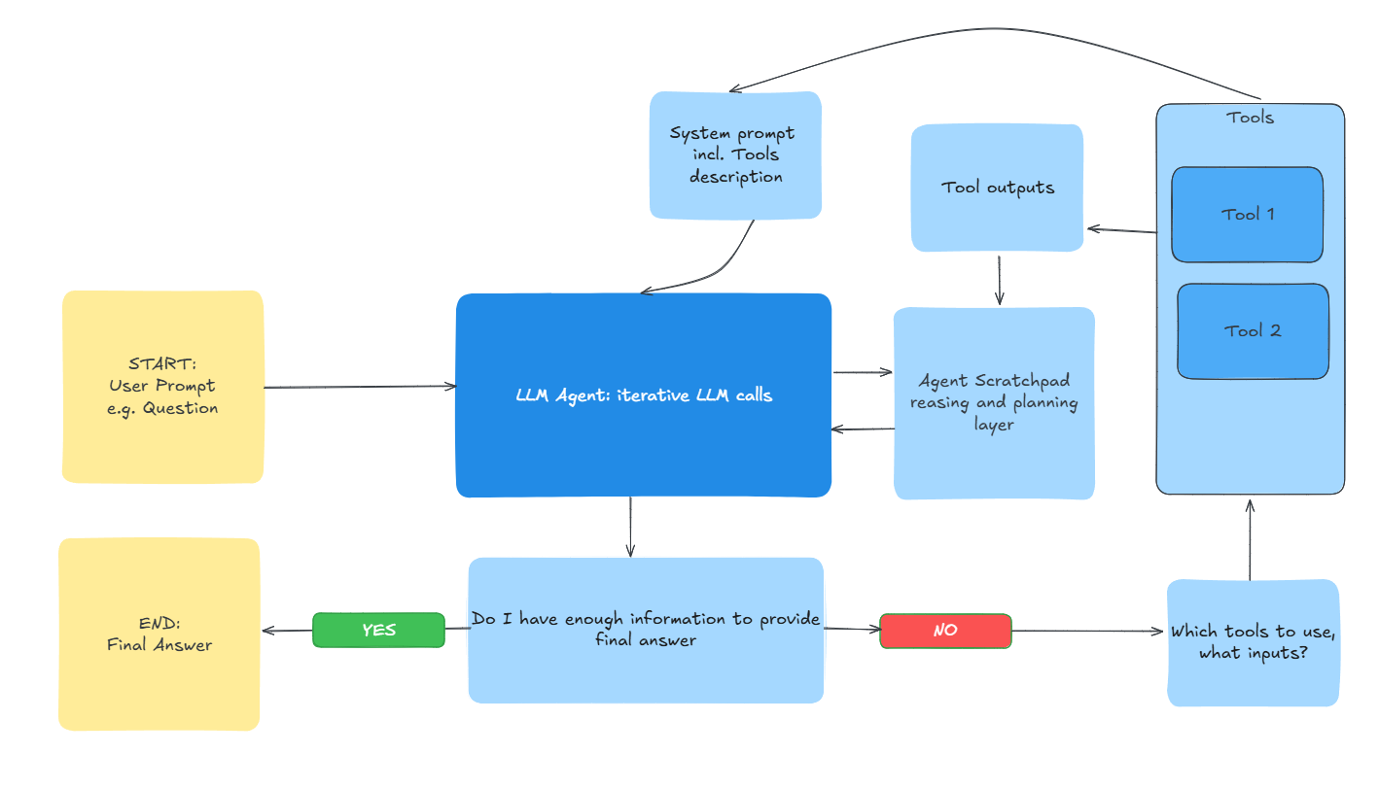
How to convert LLM calls into iterative LLM Agent?

Slide 26
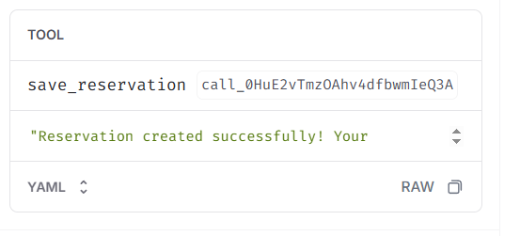
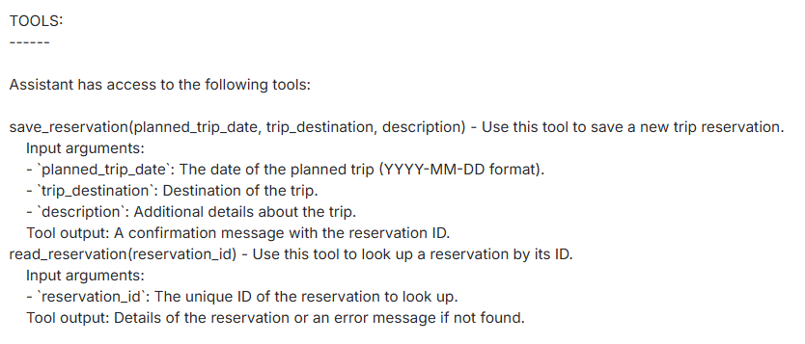
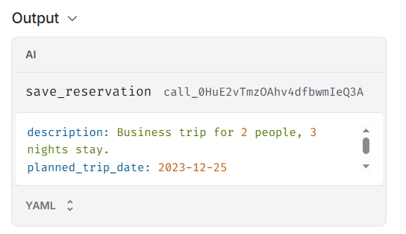
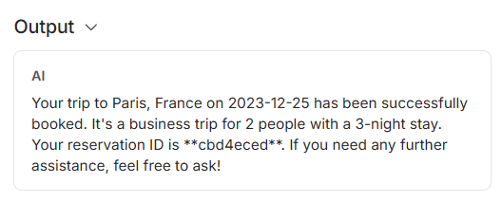
How tools work from LLM calling perspective
Call #1
Call #2
LLM sees available tools in prompt together with usage guideliness
1st call output is fed to tool, triggering an execution and a tool output
LLM decides to use tool -> 1st output is just a tool trigger
Tool output is fed to 2nd LLM call to power final response, or trigerring another iteration

Slide 27
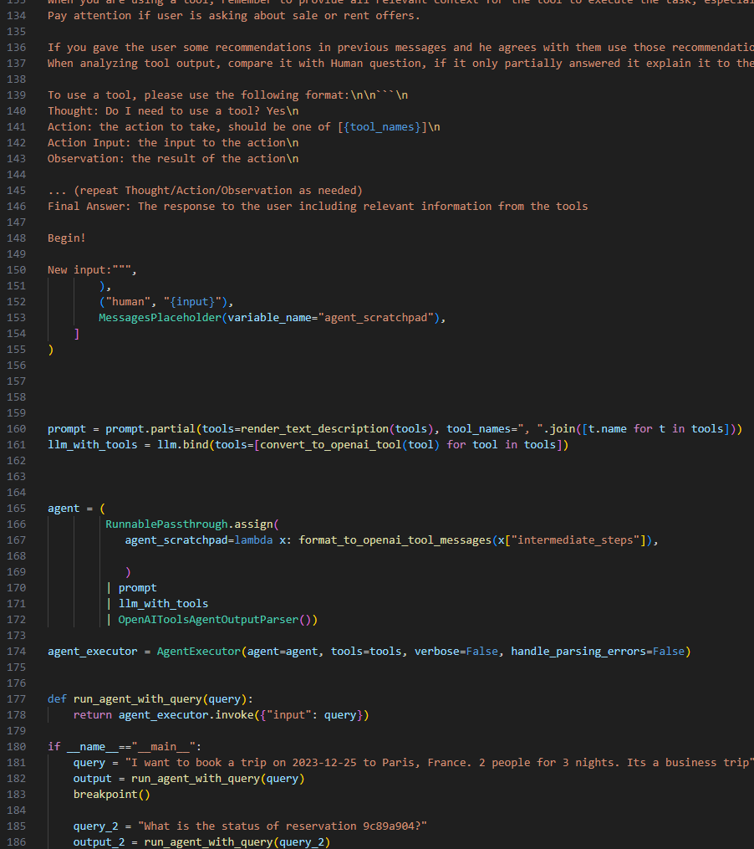
Jupyter exercise Reranking
Start with W3-agent_with_tools_BLANK.py

Slide 28
Chat Bots

Slide 29
What are chatbots
Key Concepts
Definition: AI systems designed for human-like conversation
Evolution: Rule-based → ML-powered → LLM-powered
Capabilities: Text completion, knowledge access, tool use
Most popular topic of 2024-> real-life showed that Chat bots are harder than they seem
Chatbots combine LLMs, Tools and managing short and long conversation memory
Real-World Applications
Customer service automation
Virtual assistants (Siri, Alexa)
Technical support
Educational tutoring
Healthcare triage
Limitations and Risks
Chats are pretty much as open as its possible -> this creates a lot of risks including:
Toxic behaviour
Prompt Injection
Customers trying to get benefits from ChatBot errors -> they have unlimited tries

Slide 30
5 steps to building your first bot with memory
Step 1: Choose a Foundation Model
Select an appropriate Large Language Model (like GPT-4o in this example)
Consider capabilities, cost, and performance requirements for your use case
Step 2: Design the Agent's Personality
Create a system prompt that defines how the agent should behave
Set boundaries and establish the agent's role and tone
Enable the agent to maintain consistent personality across interactions
Step 3: Implement Memory Management
Store conversation history to provide context continuity
Allow the agent to recall previous interactions and user details
Memory can be as simple as saving messages to a file or database
Step 4: Build the Communication Loop
Create a function to handle user input and generate responses
Process the conversation context before sending to the LLM
Return responses in a structured format that maintains the conversation flow
Step 5: Enhance with Additional Capabilities
Add tools for specific tasks (like web search, calculations, etc.)
Implement error handling and fallback responses
Consider privacy features and user identification mechanisms

Slide 31
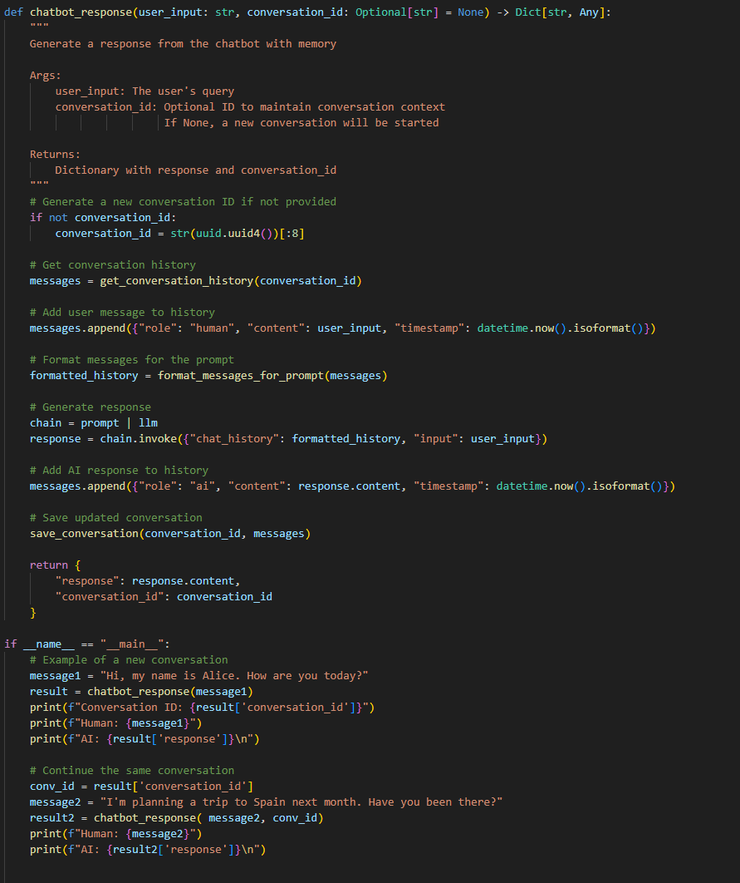
Jupyter exercise Reranking
Start with W3_chat_with_memory_BLANK.py

Slide 32
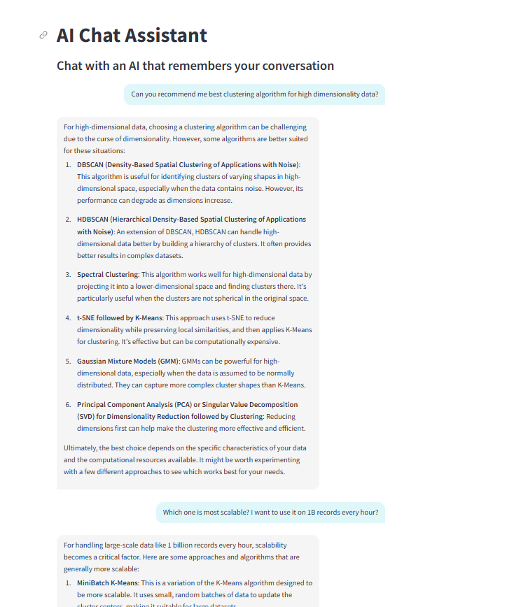
How to build UI for Demos in
minutes?
One of the key reasons why LLMs accelerated AI adoption is by reducing barriers of entry to get smart predictions
Once we start interacting with LLMs through API, we go back to code, which is harder to read by non-tech people
Fortunatelly Streamlit allows us to quickly create mockup Chat/App interface for easier testing and demo
SoTa LLMs are amazing at building these aps, often in single prompt

Slide 33
End of course assignment

Slide 34
Tasks definition
Travel agency chatbot
Customer Satisfaction processing bot
RAG with FAQs
Check trips availability from csv
Basic memory
Guardrails against toxic behaviour
Extract all mentioned locations with NER
LLM classification and summary based on customizable prompt
Decide whether to assign discount or recommend next trip
DATA
500 FAQs
Available trips csv
DATA
500 customer reviews with true sentiment labels
Available trips csv

Slide 35
Travel agency chat bot hints
Expected features
Most important steps
Base
Answer questions about company travel policies passed on the FAQ files
Working memory -> being able to use contents from previous messages in answers
Extra
Streamlit app for easier interaction
Ability to fetch trips details from a file based on its id
Guardrails against toxic behavious and jailbreaking
Base
Vectorize FAQs based on `W2-llm-calling-and-vector-search`
Prepare RAG tool based on previous notebook and `W3-agent_with_tools`
Implement memory stored in json file based on `W3_chat_with_memory`
Extra
Retool streamlit app from `W3-chat_app` to show this chat
Connect tool from and `W3-agent_with_tools` for interactions with csv
Read about jailbreaking and toxicity filters, try preventing them with system prompt instructions

Slide 36
Customer Satisfaction processing bot hints
Expected features
Most important steps
Base
Fetch Customer Satisfaction records from folder and classify sentiment
Send a customized discount for negative reviews
Recommend 3 best trips for positive reviews
Save output to a csv file
Extra
Use NER to extract all mentioned locations and save them to csv
Compare classification metrics vs ground truth data
Base
Retool chain from `W3-llm-flows-and-monitoring` to work with new data and instructions
Find a solution to find best trips related to NER -> can be purely RAG, possibly expanded by filtering by metadata e.g. location
Extra
Leverage model from `W2-NER-Intro` to implement location processing into pipeline
Calculate accuracy, recall and precision of sentiment analysis and visualize results

Slide 37
Customer Satisfaction processing Hints
Extract all mentioned locations with NER
LLM classification and summary based on customizable prompt
Decide whether to assign discount or recommend next trip
DATA
500 customer reviews with golden labels
Available trips csv

