Slide 1
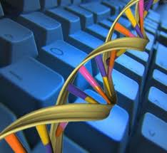
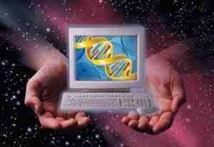
Komputer na bazie DNA - stan badań na dziś
Paweł Troka, Fizyka Techniczna: Fizyka Stosowana
Semestr VII, Nr indeksu 132334

Slide 2
PLAN PREZENTACJI
Wstęp
Historia
Możliwości
Zastosowania
Metody
Stan badań na dziś
Podsumowanie
Bibliografia

Slide 3
1.1 Wstęp: definicja
Właściwie nie „komputer na bazie DNA” ale obliczenia oparte na DNA/biocząsteczkach
Wraz z komputerem kwantowym rozpatrywane jako przyszłościowa alternatywa dla komputerów opartych o krzem
Podobnie jak w przypadku komputera kwantowego wyniki obliczeń mają charakter probabilistyczny
Obliczenia zachodzą dzięki reakcjom chemicznym między cząsteczkami DNA
Szybko się rozwijająca, interdyscyplinarna dziedzina nauki
Do niedawna wszystkie komputery oparte na DNA wymagały specjalnego środowiska do działań (np. konkretna sól w konkretnym stężeniu)

Slide 4
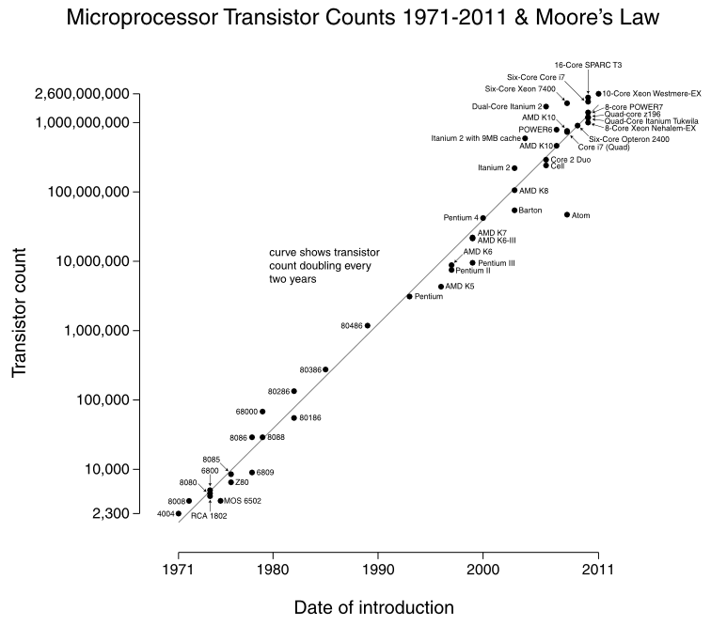
1.2 Wstęp: po co? (1)
Wykonujemy coraz więcej obliczeń, potrzebujemy coraz większej wydajności, do tego w obecnej technologii jest potrzebne coraz więcej tranzystorów
Zgodnie z prawem Moore’a liczba tranzystorów w procesorach komputerów podwaja się co dwa lata

Slide 5
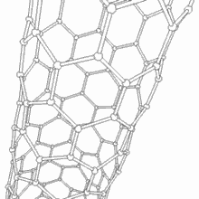

1.2 Wstęp: po co? (2)
Aby upakować coraz więcej tranzystorów na tej samej powierzchni, potrzeba mniejszego procesu technologicznego
Współczesne procesory osiągają 1,4 miliarda tranzystorów i są wykonane w technologii 22nm
Niestety technologia krzemowa ma swoje granice i osiągając w przybliżeniu w roku 2028 proces 1nm, po prostu nie będziemy w stanie produkować mniejszych tranzystorów
Alternatywy to takie materiały jak Silicene, nanorurki krzemowe, jednak i one mają swoje granice
Ostatecznie więc wcześniej czy później będziemy zmuszeni „przesiąść się” na inny model obliczeń – oparty na DNA lub na zjawiskach kwantowych

Slide 6
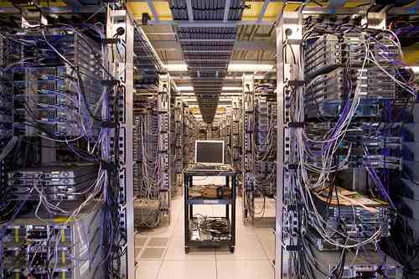
1.2 Wstęp: po co? (3)
Obecnie mimo zmniejszania procesu technologicznego kompuetery, klastry, serwery wciąż zużywają za dużo prądu i wytwarzają za dużo ciepła
Ocenia się nawet, że współczesne duże serwerownie (takie jak użytkowane przez formy Google, Facebook, Amazon) mogą mieć duży wpływ na efekt cieplarniany
Technologia oparta na DNA/biocząsteczkach nie zużywałaby prawie nic energii i nie wytwarzałaby dużo zbędnego ciepła

Slide 7
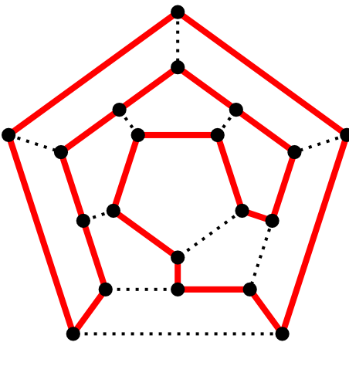
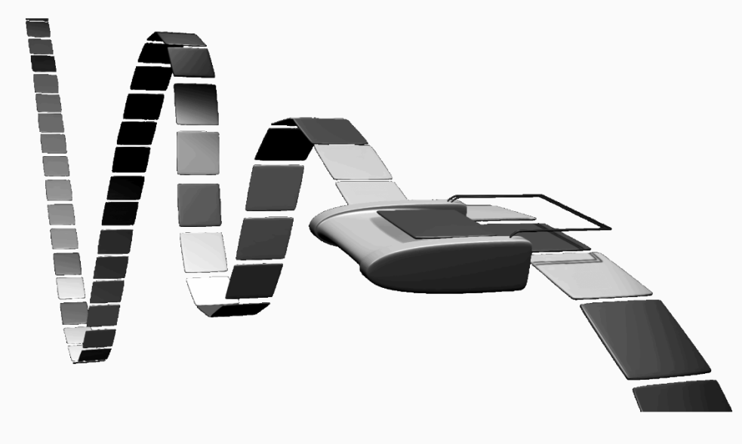
2.1 Historia: początki
This field was initially developed by Leonard Adleman of the University of Southern California, in 1994. Adleman demonstrated a proof-of-concept use of DNA as a form of computation which solved the seven-point Hamiltonian path problem. Since the initial Adleman experiments, advances have been made and various Turing machines have been proven to be constructible.
While the initial interest was in using this novel approach to tackle NP-hard problems, it was soon realized that they may not be best suited for this type of computation, and several proposals have been made to find a "killer application" for this approach. In 1997, computer scientist Mitsunori Ogihara working with biologist Animesh Ray suggested one to be the evaluation of Boolean circuits and described an implementation.

Slide 8

2.2 Historia: dzisiaj
In 2002, researchers from the Weizmann Institute of Science in Rehovot, Israel, unveiled a programmable molecular computing machine composed of enzymes and DNA molecules instead of silicon microchips. On April 28, 2004, Ehud Shapiro, Yaakov Benenson, Binyamin Gil, Uri Ben-Dor, and Rivka Adar at the Weizmann Institute announced in the journal Nature that they had constructed a DNA computer coupled with an input and output module which would theoretically be capable of diagnosing cancerous activity within a cell, and releasing an anti-cancer drug upon diagnosis.
In January 2013, researchers were able to store a JPEG photograph, a set of Shakespearean sonnets, and an audio file of Martin Luther King, Jr.'s speech I Have a Dream on DNA digital data storage.
In March 2013, researchers created a transcriptor (a biological transistor).

Slide 9
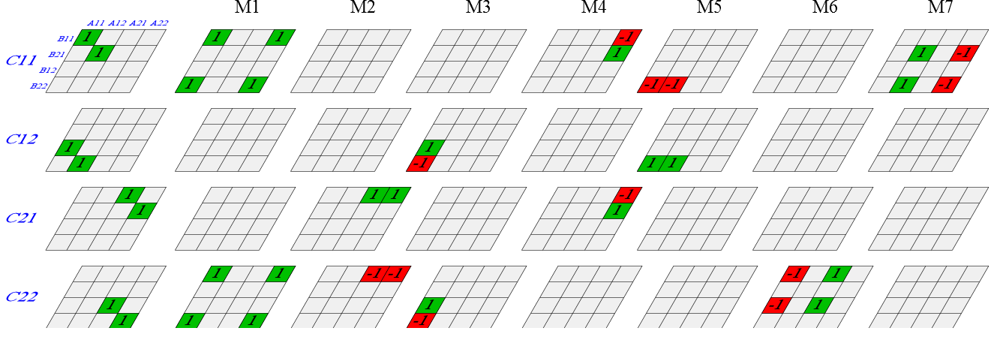
3.1 Możliwości: obliczenia równoległe
DNA computing is fundamentally similar to parallel computing in that it takes advantage of the many different molecules of DNA to try many different possibilities at once.
For certain specialized problems, DNA computers are faster and smaller than any other computer built so far. Furthermore, particular mathematical computations have been demonstrated to work on a DNA computer. As an example, Aran Nayebi has provided a general implementation of Strassen's matrix multiplication algorithm on a DNA computer, although there are problems with scaling.
Caltech researchers have created a circuit made from 130 unique DNA strands, which is able to calculate the square root of numbers up to 15.

Slide 10
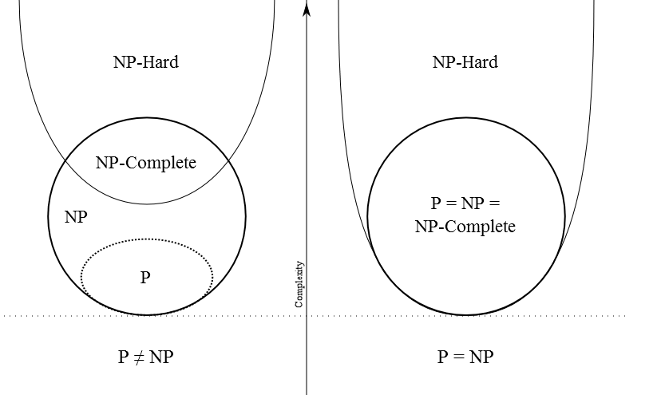
3.2 Możliwości: NP pozostaje NP…
DNA computing does not provide any new capabilities from the standpoint of computability theory, the study of which problems are computationally solvable using different models of computation. For example, if the space required for the solution of a problem grows exponentially with the size of the problem (EXPSPACE problems) on von Neumann machines, it still grows exponentially with the size of the problem on DNA machines. For very large EXPSPACE problems, the amount of DNA required is too large to be practical.

Slide 11
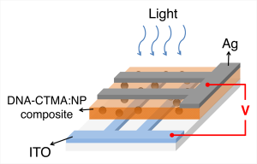
3.3 Możliwości: pamięć
DNA stores memory at a density of about 1 bit per cubic nanometer. This is about trillion times the data stored on the normal CD.
One pound of DNA has the capacity to store more information than all the electronic computers ever built
Some of the advantages of storing data into DNA are that it can be easily copied, and often still readable after thousands of years. So much for the magnetic tape and DVD.
Digital data is usually stored as binary code—using the digits one and zero. DNA, on the other hand, stores data using four digits: A, C, G, and T. However, to minimize errors and to avoid the need to create very long sequences of codes, Church’s team maintained the binary code using A and C as zero, and G and T, as one.
Recently crack team of nanoengineers and biologists have created a non-volatile memory device out of salmon DNA and silver nanoparticles.
In the August 16 issue of Science magazine, the research team lead by Church came out with a study showing that they were able to use DNA to encode 53,426 words, 11 images, and a computer program.

Slide 12
3.4 Możliwości: wydajność
DNA computer operates in parallel – with countless molecules shimmying around together at once. This is equivalent to each car having a valet inside who will listen to the customer read his list over a PA system and will drive off the lot the moment his car fails one of the conditions. By the time the customer finishes his list, his dream car will be waiting alone on the lot.
While the time needed to solve problems of this class (called "NP-complete problems") increases exponentially (2, 4, 8, 16 ... ) for serial computers, it increases only linearly (2, 4, 6, 8 ...) for parallel computers.
In principle, then, the DNA computer should outstrip the electronic computer on savagely complex combinatorial problems – breaking encryption schemes, for example.
Process of recording data (5.27 megabits) into DNA based memory took the researchers days to complete as the the speed of the chemical reactions involved is not as fast as conventional electronics.
Computing power of a teardrop-sized DNA computer, using the DNA logic gates, will be more powerful than the world's most powerful supercomputer. More than 10 trillion DNA molecules can fit into an area no larger than 1 cubic centimeter (0.06 cubic inches). With this small amount of DNA, a computer would be able to hold 10 terabytes of data, and perform 10 trillion calculations at a time. By adding more DNA, more calculations could be performed.

Slide 13
3.5 Możliwości: efektywność
As we’ve seen in the computing world, size matters. For the past several decades we’ve gone from colossal transistors to tiny micro computers. A DNA computer would stretch the imagination of “size matters” to the absurd. One pound of DNA material would have the capacity to contain more data than all the electronic computers every built. A DNA computer the size of a teardrop, using DNA logic gates, would theoretically be more powerful than the world’s greatest super computer.
In terms of power, a DNA based computer uses much less than a standard computer. They DNA hybridization and rebinding is done using stored potential energy within the bonds themselves.
As long as there are cellular organisms, there will always be a supply of DNA.
The large supply of DNA makes it a cheap resource.
Unlike the toxic materials used to make traditional microprocessors, DNA biochips can be made cleanly.
DNA computers are many times smaller than today's computers.

Slide 14
4.1 Zastosowania: oprócz obliczeń
„The biocomputer would sense biomarkers and immediately react by releasing counter-agents for the disease,” says Itamar Willner of the Hebrew University of Jerusalem, Israel.
problem with earlier DNA computers is that they use enzymes to manipulate the DNA, and so function only in certain chemical environments that cannot easily be reproduced inside the body. Willner's team use DNA-like molecules to do this job.
Being enzyme-free, it has potential in future diagnostic and medical applications," says Benny Gil of the Weizmann Institute of Science in Rehovot, Israel. He is impressed with the new gate system but recognises that it will take years of research and development to bring "smart drugs" to medicine.
Mar, 2013 - The biological transistor developed by Jerome Bonnet and colleagues could be used inside living cells to record when cells have been exposed to certain external stimuli, or even to turn on and off cell reproduction as needed.

Slide 15
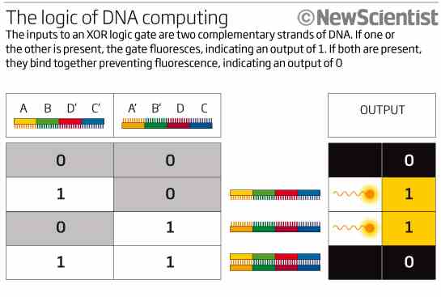
5.1 Metody: wstęp
There are multiple methods for building a computing device based on DNA, each with its own advantages and disadvantages. Most of these build the basic logic gates (AND, OR, NOT) associated with digital logic from a DNA basis. Some of the different bases include DNAzymes, deoxyoligonucleotides, enzymes, DNA tiling, and polymerase chain reaction.

Slide 16
5.2 Metody: Enzymy
Enzyme based DNA computers are usually of the form of a simple Turing machine; there is analogous hardware, in the form of an enzyme, and software, in the form of DNA.
Benenson, Shapiro and colleagues have demonstrated a DNA computer using the FokI enzyme and expanded on their work by going on to show automata that diagnose and react to prostate cancer: under expression of the genes PPAP2B and GSTP1 and an over expression of PIM1 and HPN. Their automata evaluated the expression of each gene, one gene at a time, and on positive diagnosis then released a single strand DNA molecule (ssDNA) that is an antisense for MDM2. MDM2 is a repressor of protein 53, which itself is a tumor suppressor. On negative diagnosis it was decided to release a suppressor of the positive diagnosis drug instead of doing nothing. A limitation of this implementation is that two separate automata are required, one to administer each drug. The entire process of evaluation until drug release took around an hour to complete. This method also requires transition molecules as well as the FokI enzyme to be present. The requirement for the FokI enzyme limits application in vivo, at least for use in “cells of higher organisms”. It should also be pointed out that the 'software' molecules can be reused in this case.

Slide 17
5.3 Metody: DNAzymes
Catalytic DNA (deoxyribozyme or DNAzyme) catalyze a reaction when interacting with the appropriate input, such as a matching oligonucleotide. These DNAzymes are used to build logic gates analogous to digital logic in silicon; however, DNAzymes are limited to 1-, 2-, and 3-input gates with no current implementation for evaluating statements in series.
The DNAzyme logic gate changes its structure when it binds to a matching oligonucleotide and the fluorogenic substrate it is bonded to is cleaved free. While other materials can be used, most models use a fluorescence-based substrate because it is very easy to detect, even at the single molecule limit. The amount of fluorescence can then be measured to tell whether or not a reaction took place. The DNAzyme that changes is then “used,” and cannot initiate any more reactions. Because of this, these reactions take place in a device such as a continuous stirred-tank reactor, where old product is removed and new molecules added.
Two commonly used DNAzymes are named E6 and 8-17. These are popular because they allow cleaving of a substrate in any arbitrary location. Stojanovic and MacDonald have used the E6 DNAzymes to build the MAYA I and MAYA II machines, respectively; Stojanovic has also demonstrated logic gates using the 8-17 DNAzyme. While these DNAzymes have been demonstrated to be useful for constructing logic gates, they are limited by the need for a metal cofactor to function, such as Zn2+ or Mn2+, and thus are not useful in vivo.
A design called a stem loop, consisting of a single strand of DNA which has a loop at an end, are a dynamic structure that opens and closes when a piece of DNA bonds to the loop part. This effect has been exploited to create several logic gates. These logic gates have been used to create the computers MAYA I and MAYA II which can play tic-tac-toe to some extent.

Slide 18
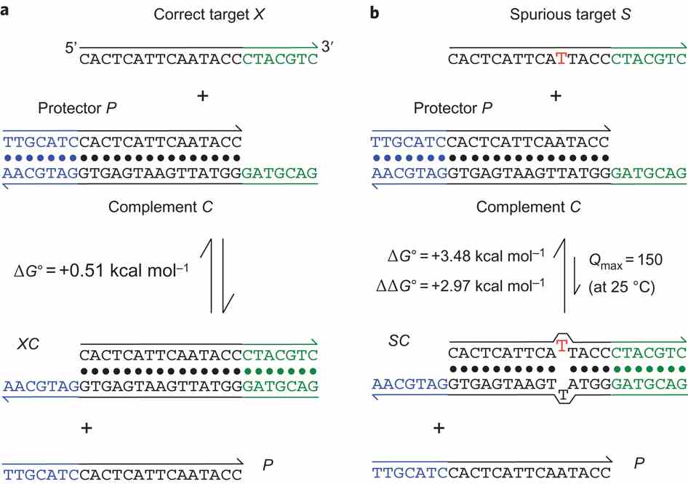
5.4 Metody: Toehold exchange
DNA computers have also been constructed using the concept of toehold exchange. In this system, an input DNA strand binds to a sticky end, or toehold, on another DNA molecule, which allows it to displace another strand segment from the molecule. This allows the creation of modular logic components such as AND, OR, and NOT gates and signal amplifiers, which can be linked into arbitrarily large computers. This class of DNA computers does not require enzymes or any chemical capability of the DNA.

Slide 19
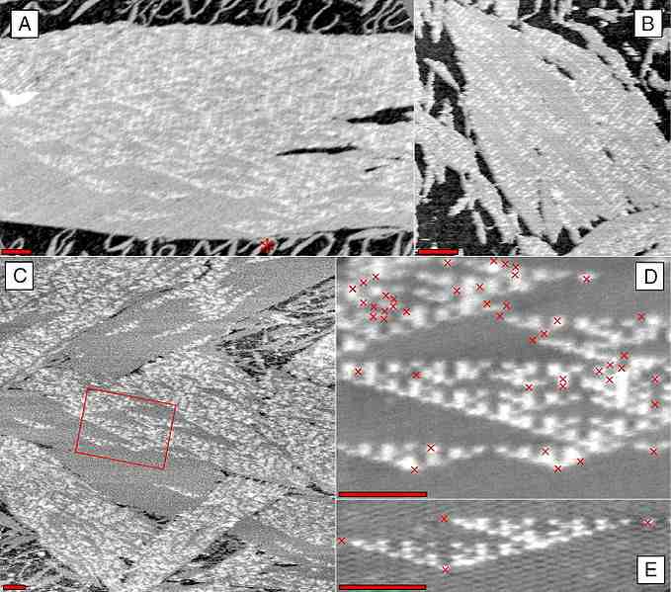
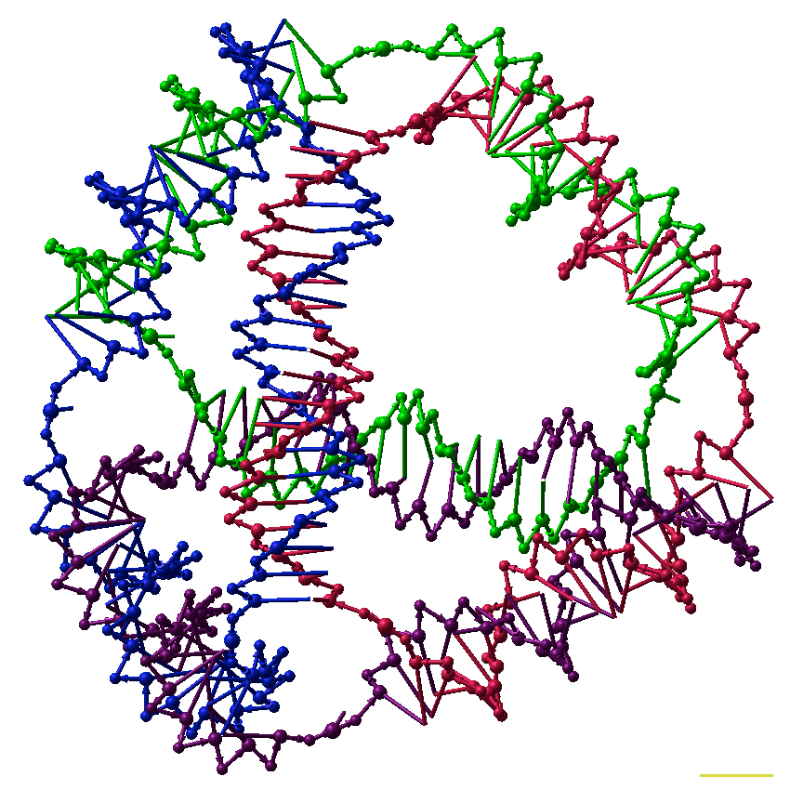
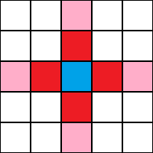
5.5 Metody: Algorithmic self-assembly
DNA nanotechnology has been applied to the related field of DNA computing. DNA tiles can be designed to contain multiple sticky ends with sequences chosen so that they act as Wang tiles. A DX array has been demonstrated whose assembly encodes an XOR operation; this allows the DNA array to implement a cellular automaton which generates a fractal called the Sierpinski gasket. This shows that computation can be incorporated into the assembly of DNA arrays, increasing its scope beyond simple periodic arrays.

Slide 20
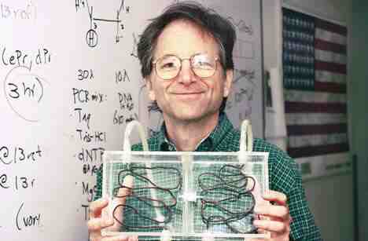
6.1 Stan badań na dziś: Komputer DNA rozwiązuje złożony problem
marzec 2002
A DNA-based computer has solved a logic problem that no person could complete by hand, setting a new milestone for this infant technology that could someday surpass the electronic digital computer in certain areas.
The new experiment was carried out by USC computer science professor Leonard M. Adleman, who made headlines in 1994 by demonstrating that DNA – the spiraling molecule that holds life’s genetic code – could be used to carry out computations.
The idea was to use a strand of DNA to represent a math or logic problem, then generate trillions of other unique DNA strands, each representing one possible solution. Exploiting the way DNA strands bind to each other, the computer can weed out invalid solutions until it is left with only the strand that solves the problem exactly.
Although they are still nowhere near prime time, "DNA computers do have several attractive features," said Adleman, Distinguished Professor of Computer Science and holder of the Henry Salvatori Chair in Computer Science in the USC School of Engineering. "They are massively parallel, compute with extremely high energy-efficiency and store enormous quantities of information."
Adleman’s new experiment solves a problem requiring the evaluation of more than a million possible solutions – too complex for anyone to solve without the aid of a computer, it required a set of 20 values that satisfy a complex tangle of relationships. Adleman’s research assistant
"In the past century we’ve become really good at controlling electrons," he said. "It would take a breakthrough in the technology of working with large biomolecules like DNA for molecular computers to beat their electronic counterparts."

Slide 21

6.2 Stan badań na dziś: obliczenia wewnątrz ciała
czerwiec 2010
DNA-based logic gates that could carry out calculations inside the body have been constructed for the first time. The work brings the prospect of injectable biocomputers programmed to target diseases as they arise.
"The biocomputer would sense biomarkers and immediately react by releasing counter-agents for the disease," says Itamar Willner of the Hebrew University of Jerusalem, Israel, who led the work.
The new logic gates are formed from short strands of DNA and their complementary strands, which in conjunction with some simple molecular machinery mimic their electronic equivalent. Two strands act as the input: each represents a 1 when present or a 0 when absent. The response to their presence or absence represents the output, which can also be a 1 or 0.
Take the "exclusive OR" or XOR logic gate. It produces an output when either of the two inputs is present but not when both are present or both are absent. To put the DNA version to the test, Willner and his team added molecules to both the complementary strands that caused them to fluoresce when each was present in isolation, representing a logical 1 as the output. But when both were present, the complementary strands combined and quenched the fluorescence, representing a 0 output.

Slide 22
6.3 Stan badań na dziś: biotranzystor – obliczenia wewnątrz komórki
marzec 2013
When Charles Babbage prototyped the first computing machine in the 19th century, he imagined using mechanical gears and latches to control information. ENIAC, the first modern computer developed in the 1940s, used vacuum tubes and electricity. Today, computers use transistors made from highly engineered semiconducting materials to carry out their logical operations.
And now a team of Stanford University bioengineers has taken computing beyond mechanics and electronics into the living realm of biology. In a paper published March 28 in Science, the team details a biological transistor made from genetic material — DNA and RNA — in place of gears or electrons. The team calls its biological transistor the “transcriptor.„
The biological transistor developed by Jerome Bonnet and colleagues could be used inside living cells to record when cells have been exposed to certain external stimuli, or even to turn on and off cell reproduction as needed.
In electronics, a transistor controls the flow of electrons along a circuit. Similarly, in biologics, a transcriptor controls the flow of a specific protein, RNA polymerase, as it travels along a strand of DNA.
“We have repurposed a group of natural proteins, called integrases, to realize digital control over the flow of RNA polymerase along DNA, which in turn allowed us to engineer amplifying genetic logic,” said Endy.
Using transcriptors, the team has created what are known in electrical engineering as logic gates that can derive true-false answers to virtually any biochemical question that might be posed within a cell.
To bring the age of the biological computer to a much speedier reality, Endy and his team have contributed all of BIL gates to the public domain so that others can immediately harness and improve upon the tools.

Slide 23
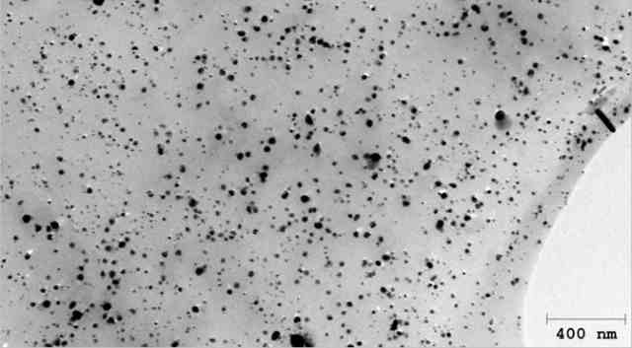
6.4 Stan badań na dziś: pamięć komputerowa oparta na DNA łososia
luty 2012
A crack team of nanoengineers and biologists have created a non-volatile memory device out of salmon DNA and silver nanoparticles.
The memory is write-once-read-many (WORM), just like an optical disc. Basically, the researchers created a thin polymer film containing salmon DNA and silver nanoparticles. The DNA molecules are arranged in a regular pattern. By shining UV light on the biopolymer, the silver nanoparticles cluster around the DNA. This process seems to be permanent and irreversible, and according to the researchers the data is stored indefinitely.
To read the data, the biopolymer is sandwiched between two electrodes and the DNA-silver bits are read by passing a voltage through them. The “read” voltage is just 2.6V, which is comparable to existing DRAM and flash memory.
With regards to the salmon-based WORM memory, the researchers say that this technique could eventually be used to create optical storage devices. Because electricity is used to read the data instead of a laser, though, we are probably looking at optical chips with built in circuitry, rather than discs. The fact that data is written using UV light means that there could be a plasmonic application for the biopolymer, too.
Whether DNA-based chips can be more cost effective than DVDs or SD cards, however, remains to be seen.

Slide 24
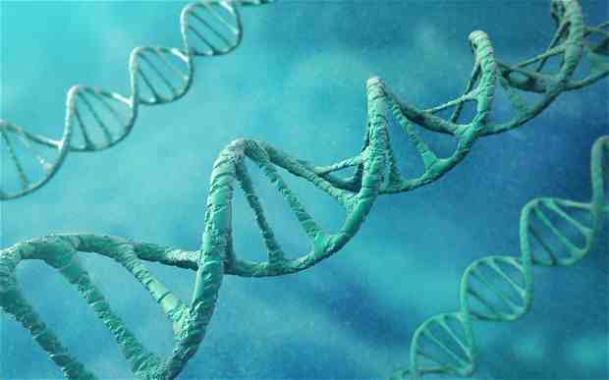
6.5 Stan badań na dziś: pliki komputerowe przechowane w DNA
styczeń 2013
Scientists have recorded data including Shakespearean sonnets and an MP3 file on strands of DNA, in a breakthrough which could see millions of records stored on a handful of molecules rather than computer drives.
Although the method is expensive, it could still be much more efficient than hard drives or magnetic tape for long-term storage of large sets of data such as government records, the scientists said.
Within a decade, they expect the technique to have become cheap enough that DNA storage could become cost-efficient for the public to store lifelong keepsakes like wedding videos.
Dr Nick Goldman of the European Bioinformatics Institute, who led the study, said: "We already know that DNA is a robust way to store information because we can extract it from bones of woolly mammoths, which date back tens of thousands of years, and make sense of it.
"It's also incredibly small, dense and does not need any power for storage, so shipping and keeping it is easy.„
The advantage of using DNA over hard drives is that it does not require a constant supply of electricity, while "no-power" archiving materials such as magnetic tape degrade within a decade.
Scientists have long been able to read DNA, a code comprising four "letters", but using it to store information has been difficult because it is prone to decoding errors when the same letter is repeated.
In a study published in the Nature journal, the researchers demonstrated they could avoid the problem by translating computer files, made up of ones and zeroes, into a form of DNA code which did not allow letters to repeat themselves.
First they converted an audio file of Martin Luther King's "I have a dream" speech, a photograph of their laboratory, a PDF file of an academic paper and a text version of all Shakespeare's sonnets into the DNA code.
The code was sent to a US lab where experts converted it into synthetic strings of DNA which resembled a tiny grain of dust.
The researchers then sequenced the synthetic DNA to retrieve the code, before converting it back into the original computer files with 99.9 per cent accuracy.
Dr Goldman said: "Because it is expensive and one of its big advantages is longevity, the potential applications will initially be in really high value information which you are determined to keep safe but you do not expect to read very often, such as government records or the Doomsday Book.

Slide 25
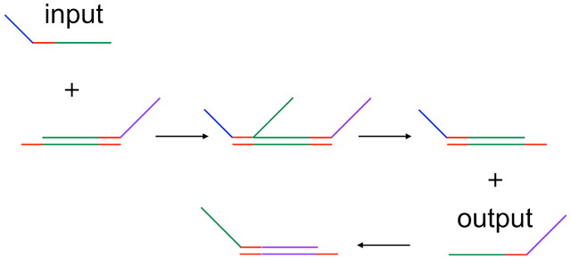
6.6 Stan badań na dziś: komputer oparty na DNA oblicza pierwiastek kwadratowy
czerwiec 2011
A new study has developed a DNA computer that is able to calculate the square root of whole numbers up to 15 and round the answer to the nearest whole number. By using nothing but strands of DNA, Qian and Winfree (2011), have been able to design a biochemical circuit able to perform this basic calculation. To do it, DNA strands that encoded for the input (one strand per binary digit of the input number, up to four binary digits possible, thus up to 15) were added to the solution which contained the system of DNA logic gates, which were composed out of double-stranded DNA molecules with some ‘openings’ where the input strands could get a hold and ‘unzip’ the double strand while binding to one of the strands, thereby making a new double-stranded molecule by ‘pushing’ a strand off
After a while, the chemical cascade caused by the DNA gate system can be interpreted by using fluorescent colors. Four such colors represent each possible state in the two-digit answer, with one color representing ‘0’ and another one ‘1’ for each digit of the answer.
As the calculation can last up to 10 hours, it seems highly unlikely that these DNA computers will ever rival regular computers. But that has never been the goal of this research. The idea is that, through incorporating such DNA computers in living cells (which still poses a great challenge), they could subsequently be used as, for example, disease detector. There are even ideas to link the output to biological functions, such as gene expression. By doing so, these disease detectors could even perform some sort of therapeutically relevant role.

Slide 26
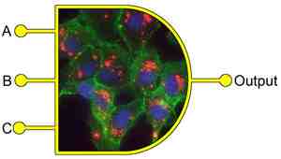
6.7 Stan badań na dziś: toksyny komórkowe na użytek modyfikacji stanu komórek
listopad 2013
Bacterial toxins that undergo unique cell interactions have been used to perform logic functions by researchers in Germany. In a similar way to how we store letters and words on computer disks, these proteins provide a new approach to storing information within whole cells.
Synthetic biologists have already modified the genetic code of cells to create biocircuits capable of performing specific Boolean logic functions, for example AND gates and OR gates, for sensing, diagnostics and therapeutics. These genetic logic gates require sophisticated and extensive modifications of the cell DNA. Now, Erwin Märtlbauer and his team at the University of Munich have developed a comparably simple approach where proteins interact with the membrane of whole cells to produce a variety of combinatorial and sequential logic operators.
A unique enterotoxin protein made up of three components that must individually bind in a specific order to the cell membrane to cause cell death is central to Märtlbauer’s system. By using this sequential binding as the input of the logic gate and cell death as the output the team have created a logic operator with memory that is similar to a keypad lock, where unless the right key is pressed in the right order nothing will happen.
This strategy could be used to effectively steer cellular uptake or cell behaviour to construct more devices for cellular computation, but could also serve in diagnostic and therapeutic tools. ‘There are many bacterial toxins and they can be used as a toolkit to manipulate cells,’ says Märtlbauer. In principle it will be possible to determine the virulence of bacteria and even to selectively target and kill cells.
‘It is an elegant example where the creative use of a limited number of biological components can lead to predictable programing of complex circuit functions.’
The three components of the enterotoxin must bind to the cell membrane in a specific order to activate the logic gate

Slide 27
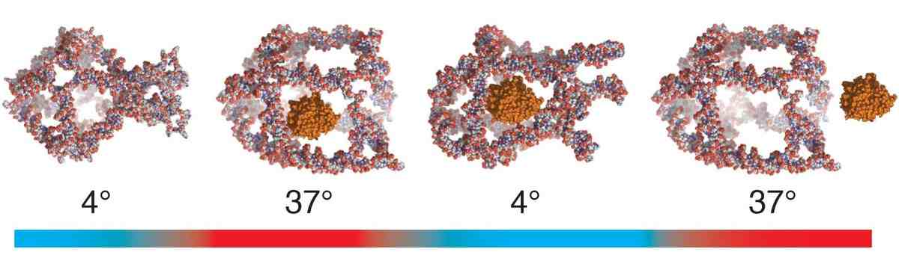
6.8 Stan badań na dziś: naukowcy zbudowali nanobota który pomoże leczyć choroby
grudzień 2013
Nanorobots that can deliver and release biomolecules based on temperature.
Built from molecules, this “DNA Nanocage” (sounds cool because it is) was designed by researchers, but self-assembled from the human “body’s own molecules.” The hope, while far off, is that the Nanocages could be ingestible in pill form, containing medicine to effectively trap diseases or cancers at the molecular level.
The tiny cage responds to surrounding temperatures to open and close its lattice. Researchers from Aarhus University in Denmark, working with teams at Duke University in North Carolina and the University of Rome in Italy, used it to hold an active enzyme called horseradish peroxidase (HRP). According to researchers, the cage’s central cavity is large enough for the enzyme, while the lattice-work holes are too small for it to escape. It releases the HRP only when the right temperature conditions exists, at which point the lattice opens wide enough to let the enzyme pass through. Awaiting cells can then consume it.
Juul told us that DNA structures are not new and are based on the core principles of DNA binding. DNA has four bases: adenine (A), cytosine (C), guanine (g) and thymine (T). Each base naturally pairs with a certain other base (always in pairs; A with T and C with G). “So the sequence of the DNA, which molecule comes after which molecule, will tell us how it will assemble,” said Juul.
The researchers then added an enzyme that links all the single strands together, leaving no open ends. Juul explained that the human body naturally degrades free DNA strands, which would effectively make the DNA Nanocage useless.
The big innovation here, however, is the DNA cage’s functional element: the ability to open and close based on temperature. Some previous DNA structures have included a molecular lock that can only be opened with an external key.
With her DNA cage “you don’t have to add anything. [You] don’t have to ruin the cage,” said Juul.

Slide 28
7.1 Podsumowanie
+
Rozwój obliczeń opartych o DNA jest bardzo szybki
Więcej zastosowań niż tylko obliczenia
Wcześniej czy później będziemy zmuszeni wybrać coś innego niż krzem i zapewne będzie to albo technologia oparta o DNA albo o zjawiska kwantowe
Możliwości tej technologii są ogromne – wydajność, pełne zrównoleglenie, oszczędność prądu i miejsca, ogromna pojemność
-
Ale obecne możliwości nie powalają, obliczanie pierwiastka z liczby do 15 trwające 10 godzin, probabilistyczny charakter wyników działań, długo trwający zapis danych(kilka dni pojemność dyskietki)
Straty informacji po cyklu zapis/odczyt danych do 0,1%
/
Istnieją różne modele budowy i implentacji takiego komputera
Po prostu potrzeba czasu i badań, bo jest to młoda technologia
Być może powstaną różne komputery oparte na DNA – jedne zdolne do pracy w różnych środowiskach, ale za to mniej wydajne a inne wymagające ścisłego środowiska

Slide 29
8.1 Bibliografia
http://en.wikipedia.org/wiki/DNA_computing
http://en.wikipedia.org/wiki/Turing_machine
http://en.wikipedia.org/wiki/Hamiltonian_path_problem
http://en.wikipedia.org/wiki/Hamiltonian_path
http://en.wikipedia.org/wiki/Silicene
http://en.wikipedia.org/wiki/Silicon_nanotubes
http://en.wikipedia.org/wiki/Moore's_Law
http://en.wikipedia.org/wiki/5_nanometer
http://en.wikipedia.org/wiki/Haswell_(microarchitecture)
http://en.wikipedia.org/wiki/NP-hard
http://en.wikipedia.org/wiki/Strassen_algorithm
http://www.tribuneindia.com/2002/20020527/login/hardware.htm
http://www.newscientist.com/article/dn18989-dna-logic-gates-herald-injectable-computers.html
http://www.usc.edu/uscnews/stories/7881.html
http://med.stanford.edu/ism/2013/march/bil-gates.html
http://www.gmanetwork.com/news/story/271082/scitech/technology/are-we-ready-for-dna-based-computer-memory
http://www.extremetech.com/extreme/117191-computer-memory-made-out-of-salmon-dna
http://www.cs.uaf.edu/2010/fall/cs441/proj1/dna/DNAComputingHTMLNotes.html
http://www.howstuffworks.com/dna-computer2.htm
http://en.wikipedia.org/wiki/Cellular_automaton
http://en.wikipedia.org/wiki/DNA_nanotechnology
http://www.science20.com/curious_cub/dna_computer_calculates_square_roots-79671
http://www.telegraph.co.uk/science/science-news/9821895/Computer-files-stored-accurately-on-DNA-in-new-breakthrough.html
http://www.rsc.org/chemistryworld/2013/11/biocomputers-logic-operators-bacterial-toxins
http://mashable.com/2013/12/04/researchers-build-dna-nanocage/

