Slide 1
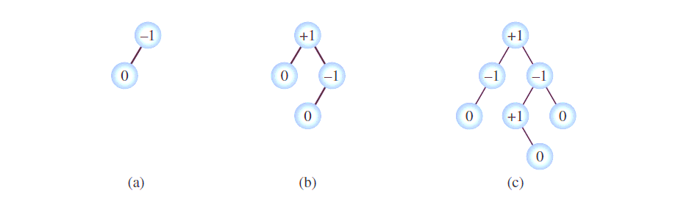
AVL Trees
The sub-trees of every node differ in height by at most one
Every sub-tree is an AVL tree
When an item is inserted or deleted, the two properties above must be preserved
How: every node has a “balance factor”: a number that indicates the difference between the height of the right and the left branch (bf = h(right) – h(left))
In a valid AVL tree, every node has a balance factor of
-1, 0, or +1
When an item is inserted/deleted, the balance factors are checked, and if the balance is lost, the tree is rebalanced

Slide 2
AVL Trees: Insertion
How can a tree get out of balance?
Can a tree get out of balance if its left and right branches are of the same height?
Can a tree get out of balance if the left branch is longer than the right branch?
If the right branch is longer than the left branch?
G
C
H
G
G
C
H
C
I
B
D
H
J
For visually impaired student:

Slide 3
B-Trees: Insert
29
57
29
41
29
57
12
29
41
57
15
15
29
12
41
57
53
55
56
29
56
12 | 15
41
57
57
55
57

Slide 4
B-Trees: Insert
20
29
55
27
23
23
12 | 15
20
27
41 | 53
56 | 57
18
10
20
29
55
16
10
12
15
16
18
23 | 27
41 | 53
56 | 57
58
59
58
60
15 | 20
29
55
60
10 | 12
16 | 18
23 | 27
41 | 53
56 | 57
58
59

