Slide 1
COS 212
Dynamic Programming:
Using Tables instead of Recursion

Slide 2

Dynamic Programming
Often used for optimisation and recurrence relation problems
Steps:
  Break problem down into sub-problems
    Sub-problems need to be overlapping
    Otherwise → Divide and Conquer
  Store sub-problem solutions to prevent re-computation
    Memoisation
  Combine sub-problem solutions for final solution
    Bottom-up or Top-down approach
E.g. Fibonacci sequence

Slide 3
Excessive Recursion
There is a price associated with using recursion
  Slower execution time
  Wasted storage on the run-time stack
If the recursion continues to a deep enough level
  We can run out of stack space
  The program will then terminate abnormally
  The program also raises an unrecoverable StackOverflowError

Slide 4
Fibonacci Sequence
Consider the Fibonacci sequence:
Named after an Italian mathematician from the Republic of Pisa
Recurrence Relation
  F(n) = F(n - 1) + F(n - 2)
Initial conditions
  F(0) = 1, F(1) = 1
F(n) =
1, 1, 2, 3, 5, 8, 13, 21, 34, …
1 if n < 2 (Base case, or anchor)
F(n–1) + F(n–2) if n ≥ 2 (Inductive, or recursive step)
F(n) =

Slide 5
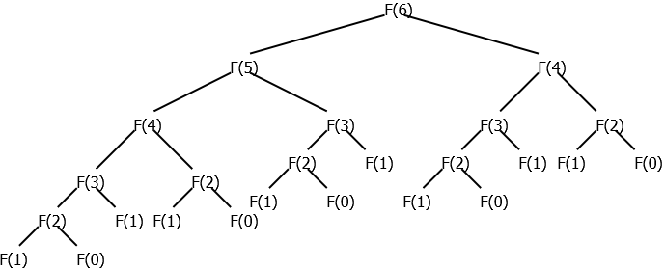
Fibonacci: Recursive Implementation
Finding n^{th} Fibonacci number: Recursive solution
  long fibonacci(long n) {
  if (n < 2) {
  return 1;
  } else {
  return fibonacci(n - 1) + fibonacci(n - 2);
  }
  }
25 items

Slide 6
Fibonacci: Recursive Implementation
The recursive implementation is very simple and intuitive
But if we run the implementation, it becomes very slow!
Implementation eventually runs out of stack space for very large values of n
Can we implement this iteratively?
  Not directly – It is a non-tail recursive function
Dynamic programming to the rescue:
  We need to save the previous solutions
    Use a temp “table”
  We use a bottom-up approach
    F(0) and F(1) are known
    All that is needed to calculate F(2)

Slide 7
Fibonacci: Iterative Implementation
Finding n^{th} Fibonacci number: Iterative solution
  long fibonacci(long n) {
  if (n < 2) {
  return 1;
  } else {
  long temp;
  long current = 1;
  long last = 1;
  for (long i = 2; i <= n; i++) {
  temp = current;
  current += last;
  last = temp;
  }
  return current;
  }
  }
i | Init | 2 | 3 | 4 | 5 | 6 | 7
temp | null | 1 | 2 | 3 | 5 | 8 | 13
current | 1 | 2 | 3 | 5 | 8 | 13 | 21
last | 1 | 1 | 2 | 3 | 5 | 8 | 13

Slide 8
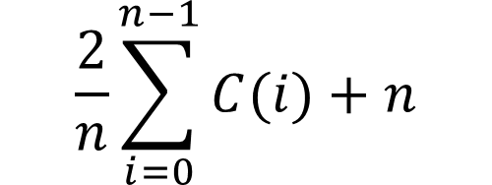
Recurrence Sequences
Consider the recurrence sequence:
Recurrence relation
  C(n) = 2/n * [C(n - 1) + C(n - 2) + … + C(0)] + n
Initial condition
  C(0) = 1
C(n) =
$$\frac{2}{n}\sum_{i=0}^{n−1}{C(i)}+n$$
1 if n = 0 (Base case)
2/n[C(n–1)+ .. +C(0)] + n if n > 0 (Recursive step)
C(n) =

Slide 9
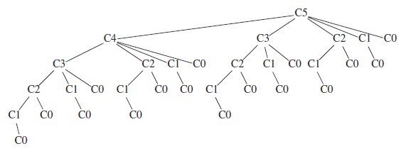
Recurrence: Recursive Implementation
Finding n^{th} Recurrence number: Recursive solution
public static double recur(int n)
{
if (n == 0)
return 1.0;
else
{
double sum = 0.0;
for (int i = 0; i < n; i++)
sum += recur(i);
return 2.0 * sum / n + n;
}
}
32 items

Slide 10
Recurrence: Iterative Implementation
Finding n^{th} Recurrence number: Iterative solution
public static double recur(int n)
{
double[] c = new double [n + 1];
c[0] = 1.0;
for (int i = 1; i <= n; i++)
{
double sum = 0.0;
for (int j = 0; j < i; j++)
sum += c[j];
c[i] = 2.0 * sum / i + i;
}
return c[n];
}
O(n)
O(n)
i | Init | 1 | 2 | 3 | 4 | 5 | 6
c[0] | 1.0 | 1.0 | 1.0 | 1.0 | 1.0 | 1.0 | 1.0
c[1] |  | 3.0 | 3.0 | 3.0 | 3.0 | 3.0 | 3.0
c[2] |  |  | 6.0 | 6.0 | 6.0 | 6.0 | 6.0
c[3] |  |  |  | 9.66 | 9.66 | 9.66 | 9.66
c[4] |  |  |  |  | 13.83 | 13.83 | 13.83
c[5] |  |  |  |  |  | 18.4 | 18.4
c[6] |  |  |  |  |  |  | 23.3
Total complexity?
O(n²)

Slide 11
Recurrence: Iterative Implementation
Finding n^{th} Recurrence number: Iterative solution version 2
public static double recur2(int n)
{
double[] c = new double [n + 1];
double sum = 0.0;
c[0] = 1.0;
for (int i = 1; i <= n; i++)
{
sum += c[i - 1];
c[i] = 2.0 * sum / i + i;
}
return c[n];
}
O(n)
O(1)
Total complexity?
O(n)

