Slide 1
COS 212
Top-Down Splay Trees

Slide 2
Splay Trees
Self-adjusting BST that moves an accessed element to the root via a sequence of rotations:
  Case 1: Zig
  Case 2: Zig-Zag
  Case 3: Zig-Zig
Y
X
access X
X
c
a
Y
a
b
b
c
Z
Z
W
d
X
X
access X
d
a
X
W
c
W
Z
b
c
b
a
b
c
d
a
Z
X
Y
Y
d
a
Y
access X
X
Z
b
X
c
Z
a
b
c
d
a
b
c
d

Slide 3
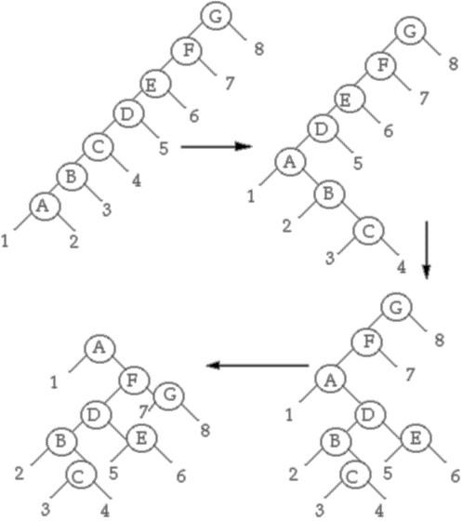
What is wrong with Splay Trees?
Access a node
Backtrack to the root,
performing rotations
along the way
How will you
BACKTRACK?
Recursion!..
What if I really hate
recursion?
What if it is too
expensive to push
the tree on the stack?

Slide 4
Top-Down Splay Trees
A variant of splay trees for people who hate recursion
Splaying is performed in a top-down manner: you splay the tree before you get to the node to be splayed, based on the path taken
Why: it is more memory-efficient!
How: we will iteratively SPLIT the tree into three subtrees:
  left (L),
  right (R), and
  middle.
As we go through the middle
tree, we will perform
rotations and move parts
of middle to either L or R
When we reach the
node to be splayed, we
will reassemble the tree
L
X
R
Y
XR
YL
Yr

Slide 5
Top-Down Splay Trees
Case 1: Zig
L
X
R
L
R
Y
X
Y
XR
YL
Yr
XR
YL
Yr
Right (R) tree contains elements > A; Left (L) tree contains elements < A
If Y should become root, then X and its right subtree are made left children of the leftmost node in R, and Y is made root of “middle” tree

Slide 6
Case 2: Zig-Zig
Top-Down Splay Trees
L
X
R
L
R
Z
Y
XR
Y
Z
ZL
Zr
X
YR
YR
XR
ZL
Zr
The value to be splayed is in the tree rooted at Z. Rotate Y about X and attach as left child of leftmost node in R

Slide 7
Case 3: Zig-Zag (Simplified)
Top-Down Splay Trees
L
X
R
L
R
Y
Y
XR
X
YL
YL
Z
Z
XR
ZL
Zr
ZL
Zr
The value to be splayed is in the tree rooted at Z. To make code simpler, the Zig-Zag rotation is reduced to a single Zig. This results in more iterations in the splay process.

Slide 8
Reassembling the Splay Tree
Top-Down Splay Trees
Done!
Will this method produce the same result as recursive splaying?
L
X
R
X
L
R
XL
XR
XL
XR
When the value to be splayed is at the root of the “middle” tree, we can reassemble the tree.
  Make XL the right child of the rightmost node in L
  Make XR the left child of the leftmost node in R
  Make L and R the left and right children of X

Slide 9
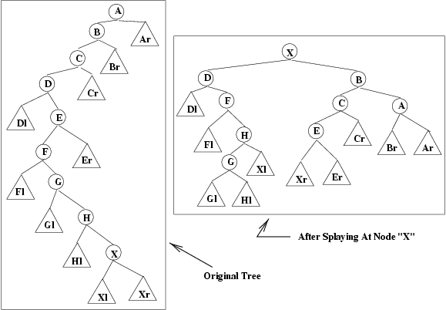
Example (bottom-up):
Top-Down Splay Trees
Will top-down method produce the same result as recursive (bottom-up) splaying?
Note: A to X are node labels, assume the data in the nodes adheres to BST rules (e.g.
A stores 100, X is 55, etc.)

Slide 10
Top-Down Splay Example
L
R
L
R
A
C
Ar
B
B
D
Cr
Br
A
C
Dl
E
Cr
Zig-Zig
Er
Br
Ar
D
F
Dl
E
G
Fl
Er
H
F
Gl
G
Hl
X
Fl
H
Xl
Xr
Gl
Goal: Splay at X
Hl
X
Xl
Xr
Rotate B about A and make it the left child of leftmost node in R (which is now empty)
L is still empty, and R is now the tree rooted at B.

Slide 11
Top-Down Splay Example
L
R
L
R
C
E
Cr
B
D
B
D
Er
A
F
Dl
E
Dl
C
A
Fl
G
Er
Br
Ar
Cr
Br
Ar
F
H
Gl
Fl
G
Hl
X
H
Zig-Zag
Xl
Xr
Gl
Hl
X
Xl
Xr
Just perform Zig on C
L was previously empty and it now consists of node D and D’s left subtree
…And then another Zig on D

Slide 12
Top-Down Splay Example
After X reaches root:
This configuration was achieved by doing by a Zig (node E), a Zig-Zig (of F, G) followed by a Zig (node H)
R
L
X
D
Xl
Xr
B
Dl
G
C
A
F
H
Cr
Br
Ar
E
Fl
Hl
Gl
Er
Reassemble – XL becomes right subtree of H, XR becomes left subtree of E, and then L, R are reattached to X
X
B
D
C
A
NOT the same tree as was obtained by doing Bottom-Up splaying!
Dl
G
H
Cr
Br
Ar
F
E
Hl
Xl
Xr
Er
Fl
Gl

Slide 13
Top-Down Splay Tree: Insert
How can we add an element in a top-down fashion?
Same secret: split the tree into subtrees, then reassemble
To insert X: splay on X;
X is not in the tree, so Y becomes root
If Y < X: Y becomes left child of X;
If Y > X: Y becomes right child of X.
T
splay(X)
L
R
X
X
Y
Y
OR
L
R
L
R
< x
  ≥ x

Slide 14
Top-Down Insert Example
L
1
R
6
6
splay(5)
4
1
9
9
2
4
7
7
2
L
4
R
1
6
insert(5)
2
9
7

Slide 15
Top-Down Insert Example
4
4
6
6
splay(5)
1
6
1
9
1
9
2
9
2
7
4
7
7
2
5
4 < 5
4
6
insert(5)
1
9
2
7

Slide 16
Top-Down Splay Tree: Delete
How can we delete an element in a top-down fashion?
Same secret: split the tree into subtrees, then reassemble
X
splay(X)
delete X
L
R
L
R
< X
> X
Splay X and then delete it
Splay left subtree on X again to get the largest value Y as root
Right subtree becomes
right child of Y
Y
Y
L
L
R
splay(X)
R

Slide 17
Top-Down Delete Example
4
6
6
1
6
1
9
1
9
splay(4)
2
9
2
7
4
7
splay(4)
7
2
2
2
1
6
1
6
delete(4)
9
9
7
7

Slide 18
Summary
Top-Down Splay Trees
  Splaying is done top-down: iteratively split the tree on the way to node X, then reassemble
Top-Down Insert
  Splay on X prior to inserting X
  Insert X at the root
Top-Down Delete
  Splay on X prior to deleting X
  Delete X, and find a new root by splaying + reassembling
Next lecture: Red-Black Trees

