Slide 1
COS 212
Red-Black Trees

Slide 2
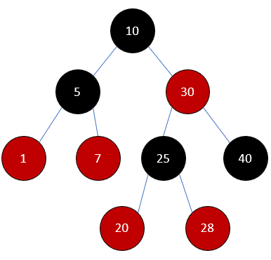
Red-Black Trees
Alternative to AVL trees invented in 1978
A red-black tree is a binary search tree (BST) with nodes colored red and black such that:
  The paths from the root to any null reference have the same number of black nodes.
  There are no two consecutive red nodes on a path.
    If a node is red, then both of its children are black
  The root is black.
How are we going to maintain the balance of a red-black tree?
Every time a node is inserted or deleted, ensure that every path from root to null has the same number of black nodes

Slide 3
Red-Black Trees: Insertion
Suppose we insert a value into a red-black tree.
  We have to pick a colour: red or black.
Can we make the new node black?
  No: that would violate the black path length property.
Thus, we MUST make the new node RED.
Now, “no consecutive red nodes”
property could be violated.
Fix (rebalance!) the tree
via re-colouring and rotations
3
3

Slide 4
Red-Black Trees: Insertion
Easiest case: parent of X is black.
Do nothing!
G
P
U
X

Slide 5
Red-Black Trees: Insertion
Case 0: X is the root.
Simply colour it black, because the root must be black. Done!
X
X

Slide 6
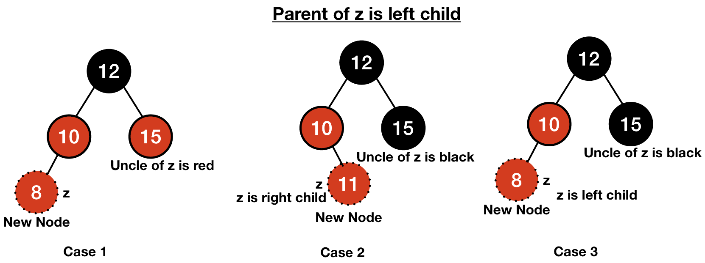
Red-Black Trees: Insertion
Uncle: sibling of the parent node
Case 1: both parent (P) and uncle (U) are red
Cases 2 and 3: P is red, U is black
Mirror versions exist!
NB: Null nodes are considered to be BLACK. If P has no siblings, it counts as having a black U.

Slide 7
Red-Black Trees: Insertion
What if G is root?
If G is root and it’s red, simply colour it black: Case 0
Case 1: Both P and U are red
Re-colour:
  P and U become black, grandparent (G) becomes red.
What if grandparent is in trouble now (consecutive reds)?
  Repeat the algorithm recursively, from G upwards.
G
G
P
U
P
U
Z
Z

Slide 8
Red-Black Trees: Insertion
This case is not recursive!
Case 2 (zig-zag): P is red, but U is black,
P is left child, Z is right child (opposite sides)
G and Z swap colours: G becomes red,
Z becomes black
Double rotation: Z around P, then Z around G.
G
Z
P
P
U
G
S
Z
S
U
Similar to the zig-zag case in bottom-up splaying

Slide 9
Red-Black Trees: Insertion
This case is not recursive!
Case 3 (zig-zig): P is red, but U is black,
P is left child, Z is also left child (same side)
P and G swap colours: G becomes red,
P becomes black
Single rotation: P around G
G
P
P
U
Z
G
Z
S
S
U

Slide 10
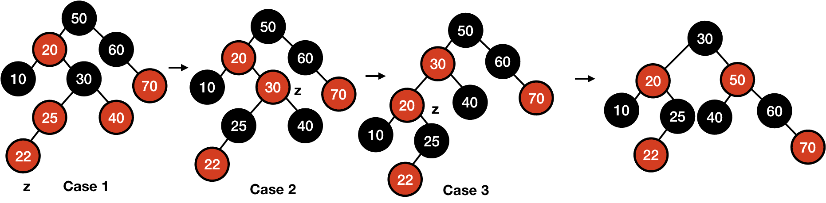
Red-Black Trees: Insertion
Case 1: P and U are red; recolor!
Insert 22:
50
30
Case 2: zig-zag, P and U are different colours, P and Z are opposite-side children (left and right)
50
30
Swap the colours of Z and G, double rotation.

Slide 11
Bottom-Up VS Top-Down Insertion
Bottom-up:
  Insert into BST, percolate upwards (backtrack) to fix up the tree
  Recursion is expensive!
Top-down:
  Corrections are done while traversing down the tree to the insertion point.
  When the insertion is done, no further
  corrections are needed, so no need
  to backtrack.
Top-down insertion is iterative
Notes:
- So, walking down the tree to perform the insert and then walking back up to perform the rotates is double the work.
-here (top-down approach), shows how this double work can be avoided for the Red-Black tree as follows.

Slide 12
Top-Down Insertion
Insertion is done at a leaf (ordinary BST insertion)
Bottom-Up insertion:
  if Uncle of a newly inserted node Z is black, the Red-Black tree properties are restored by one or two local rotations and recoloring
  NB: We only need to backtrack in case both P and U are red
Top-Down insertion:
  Traverse from the root to the insertion point such that Red-Black properties are maintained, and at the insertion point, the uncle is Black.
That way we may have to rotate and recolor, but not propagate back up the tree

Slide 13
Possible insertion configurations
X (Red or Black)
Y
Z
If a new node is inserted as a child of Y or Z, there is no problem since the new node’s parent is black

Slide 14
Possible insertion configurations
X
Y
Z
If new node is child of Z, no problem since Z is black.
If new node is child of Y, no problem since the new node’s uncle (Z) is black – do a few rotations and recolor…. Done!

Slide 15
Possible insertion configurations
X
Y
Z
If new node is inserted as child of Y or Z, it’s uncle will be red and we will have to go back up the tree. This is the only case we need to avoid.

Slide 16
Top-Down Traversal
If we encounter this case at insertion, we will recolor and do some rotations such that backtracking is avoided.
There are 3 cases to consider.
X
Y
Z
Remember the goal – to create an insertion point at which the parent P of the new node is Black, or the uncle U of the new node is Black.
Notes:
If on the way down we come across a node X with two red children, colour-flip it immediately!
But what if X's parent is also red? We break the invariant!

Slide 17
Case 1 – X’s Parent is Black
P
P
X
X
Y
Z
Y
Z
Just recolor and insert
What to recolor: X (current node) becomes red, children of X become black.
Special case (case 0): if X is root, recolor it black

Slide 18
Case 2: zig-zig
X’s Parent is Red (so Grandparent is Black) and X and P are both left/right children (same side)
  Rotate P around G
  Color P black, color G red
  X, Y, Z adhere to Case 1: recolor!
G
P
P
U
X
G
X
S
Y
Z
S
U
Y
Z

Slide 19
Case 3: zig-zag
X’s Parent is Red (so Grandparent is Black) and X and P are opposite children (left/right or right/left)
  Recolor X, Y, Z
  Rotate X around P
  Rotate X around G
  Recolor X and G
G
G
X
P
U
X
U
P
G
S
X
P
Z
S
Y
Z
U
Y
Z
S
Y

Slide 20
Top-Down Insert Summary
In all cases, we start off by re-coloring X, Y, Z
Case 1
P is Black
Just Recolor
Recolor
X,Y,Z
P
P
X
X
Y
Z
Y
Z
Case 2 [zig-zig]
P is Red
X & P both left/right
G
G
Rotate P around G
Recolor P,G
P
Recolor
X,Y,Z
G
P
P
X
Y
Z
X
X
Y
Z
Y
Z
Case 3 [zig-zag]
P is Red
X and P are opposite children
G
G
X
Recolor X,Y,Z Rotate X around P
Rotate X around G
Recolor X, G
G
P
X
P
P
X
Y
Z
Y
Z
Y
Z

Slide 21
Top-Down Insert
What happens if at the final insertion place you violate Red-Black Tree properties?
  If the parent is black
  If the parent is red
Does not break any properties
P
X
Two consecutive reds!!!
We know the Uncle has to be black, otherwise we would have fixed it
P
We can use Case 2&3 from Bottom-Up Insertion to fix this. These cases never backtrack, and also fixes the problem of two consecutive reds.
X
Notes:
Insert 60

Slide 22
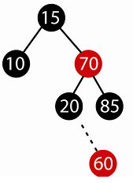
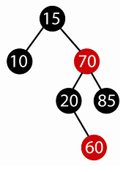
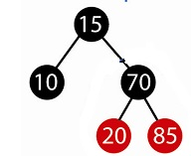
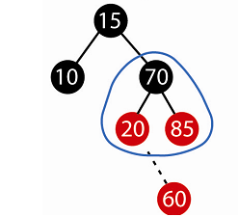
Top-Down Insert Example
Start from the top.
Case 1: P (15) is black.
  Recolor X, Y, Z
  Insert!
Notes:
Insert 60

Slide 23
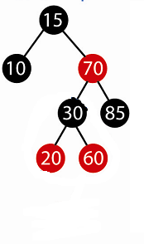
insert 30
30 and 20 swap colours
30 rotates about 60 and 20
Zig-zag:
P is Red
X and P are opposite children
30
20
30
Notes:
Insert 30

Slide 24
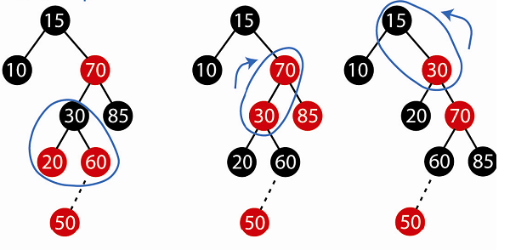

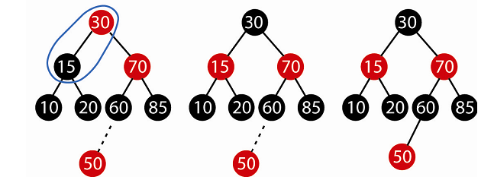
Rotate X around P
Rotate X around G
Case 3
P is Red
X and P are opposite children
Recolor
X,Y,Z
Recolor X, G
Now we can
Insert!
Notes:
Insert 50

Slide 25
Summary
Red-Black Trees
  BST
  Each node is red or black
  The paths from the root to null reference have the
  same number of black nodes,
  There are no two consecutive red nodes
  The root is black.
Insertion
  Bottom-up: insert at the leaf, percolate upwards, recoloring and rotating to restore red-black properties
  Top-down: perform recolourings and rotations on the way to the leaf
Next lecture: Deletion from red-black trees.

