Slide 1
COS 212
Red-Black Trees: Deletion

Slide 2
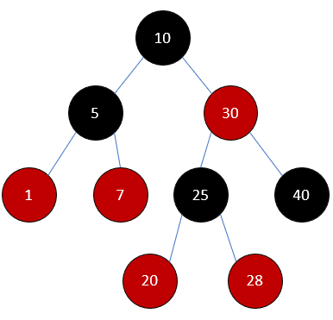
Red-Black Trees
A red-black tree is a binary search tree (BST) with nodes colored red and black such that:
  The paths from the root to any null reference have the same number of black nodes.
  There are no two consecutive red nodes on a path.
    If a node is red, then both of its children are black
  The root is black.
Every time a node is inserted or deleted, ensure that every path from root to null has the same number of black nodes

Slide 3
How do you delete from a BST?
If node to be deleted is a leaf, just delete it.
If node to be deleted has only one child, replace it with that child
If node to be deleted has two children, replace the value of the node by node’s in-order predecessor’s value, then delete the in-order predecessor (delete by copying)
3
5
5
1
8
3
7
3
7
6
10
1
4
6
9
1
6
9
5
7

Slide 4
How do you delete from a red-black BST?
If node to be deleted is a leaf, just delete it.
If node to be deleted has only one child, replace it’s value with child’s value and delete the child
If node to be deleted has two children, replace the value of the node by node’s in-order predecessor’s value, then delete the in-order predecessor
If case 3 leads to case 2 (in-order predecessor has a child), reduce case 2 to case 1.
7
28

Slide 5
What can go wrong?
What If the node to be deleted is red?
  Not a problem – no Red-Black properties will be violated
And if the deleted node is black?
Deleting a black leaf will
change the black path
height along some path
We need an
algorithm to
restore Red-Black
properties

Slide 6
Top-Down (T-D) Deletion
Top-Down procedures are iterative
  Restructure the tree on the way down
  so we don’t have to backtrack
What is easy to delete?
  A red leaf node!
Goal of T-D deletion is to
delete a red leaf.
As we traverse the tree on the way to the leaf to delete, we change every node we encounter to red.
  If this causes a violation of the Red-Black properties, we fix it.

Slide 7
Terminology
Matching textbook section 12.2:
  X is the node being examined (current node)
  T is X’s sibling
  P is X’s (and T’s) parent
  R is T’s right child
  L is T’s left child
This discussion assumes
X is the left child of P.
There are also mirror cases.
P
X
T
L
R

Slide 8


Basic Strategy of T-D Deletion
As we traverse the tree, we change every node we visit, X, to red.
When we change X to red, we know:
  P is also red (we just came from there!)
  T is black (since P is red, it’s children are black)
P
X
T

Slide 9
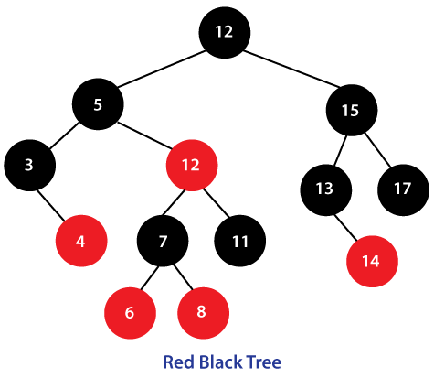
Step 1 – Examine the root
…But the root must be BLACK!
Yes – we will fix this later
If both of the root’s children are Black
  Make the root Red
  Move X to the appropriate child of the root (go left or right)
  Proceed to Step 2
Otherwise (non-black children), designate the root
as X and proceed to step 2B.
X
12
X

Slide 10
Step 2 – the main case
As we traverse the tree, we continually encounter this situation:
  P is Red, X and T are Black
  Why?..
  …Because we colored P red earlier, and made sure the tree still adhered to the R-B properties!
Recolor nodes and possibly do
rotation(s) based on the color of
X’s and T’s children
  2A) X has 2 Black children
  2B) X has at least one Red child
P
X
T

Slide 11
Case 2A: X has two Black Children
2A1. T has 2 Black Children
2A2. T’s left child is Red
2A3. T’s right child is Red
** if both of T’s children are Red, we can do either 2A2 or 2A3
P
X
T

Slide 12
Case 2A1: X and T have 2 Black Children
P
P
X
T
X
T
Recolor X, P and T and move down the tree.

Slide 13
Case 2A2: X has 2 Black Children, and T’s Left Child is Red
(Zig-Zag case: T and L are opposite children)
Rotate L around T, then L around P (zig-zag)
Recolor X and P, then continue down the tree
L
P
P
T
X
T
L
L1
L2
X
L1
L2

Slide 14
Case 2A3: X has 2 Black Children,
and T’s Right Child is Red
(Zig-Zig case: T and R are same-side children)
Rotate T around P (zig-zig)
Recolor X, P, T and R, then continue down the tree
T
P
X
T
R
P
R
R1
R2
X
L
L
R1
R2

Slide 15
Case 2B: X has at least one Red child
Continue down the tree to the next level
  2B1) If the new X is Red, continue down again
  2B2) If the new X is Black (T is Red, P is Black)
    Rotate T around P
    Recolor P and T
    Back to main case – step 2
P
X
T
Move down the tree
T
P
P
P
T
X
X
T
X
2B1: Keep going!
2B2: Rotate and recolor

Slide 16
Step 3
Eventually, find the node to be deleted
  If it is a red leaf, then just delete it
  If it is a black leaf, then do Step 2 one more time and then delete it
  If the node has 1 child, then copy the child’s data to the node, and then delete the child.
    If that child is a red leaf, delete the leaf
    Otherwise restart algorithm on that value.
  If the node has 2 children, then delete the node using delete by copy, while following Step 2
Step 4
Done !!
Color the Root Black

Slide 17
Example 1: Delete 10 from this R-B Tree
Delete 10
X
15
6
17
12
20
3
16
10
13
18
23
7
Step 1 – Root has 2 Black children.
Color Root Red
Descend the tree, moving X to 6

Slide 18
Example 1 (cont’d)
Delete 10
15
X
6
17
12
20
3
16
10
13
18
23
7
One of X’s children is Red (case 2B).
Descend down the tree, arriving at 12.
Since the new X (12) is also Red (2B1), continue down the tree, arriving at 10.

Slide 19
Example 1 (cont’d)
Delete 10
15
6
17
12
20
3
16
10
X
13
18
23
7
Step 3: Since 10 is the node to be deleted, replace it’s value with the value of it’s only child (7) and delete 7 (red leaf)

Slide 20
Example 1 (cont’d)
Delete 10
15
6
17
12
20
3
16
7
13
18
23
The final tree after 7 has replaced 10, and 7’s red node deleted.
Step 4: colour the root Black.

Slide 21
Example 2: Delete 10 from this R-B Tree
Delete 10
15
6
17
12
20
3
16
2
4
10
13
Step 1: the root does not have 2 Black children.
Set X = root and proceed to step 2

Slide 22
Example 2 (cont’d)
Delete 10
X
15
6
17
12
20
3
16
2
4
10
13
X has at one Red child (case 2B).
Proceed down the tree, arriving at 6.
Since 6 is also Red (case 2B1), continue down the tree, arriving at 12.

Slide 23
Example 2 (cont’d)
Delete 10
15
P
6
17
T
X
20
3
12
16
2
4
10
13
X has 2 Black children.
X’s sibling (3) also has 2 black children.
Case 2A1– recolor X, P, and T and continue down the tree,
arriving at 10.

Slide 24
Example 2 (cont’d)
Delete 10
15
6
17
P
12
20
3
16
2
4
10
13
X
T
X is now the leaf to be deleted, but it’s Black, so back to
step 2.
X has 2 Black children (null references), and T has 2 Black children (null references) – case 2A1
Recolor X, P and T.
Step 3: Delete 10 as a red leaf.
Step 4: The root is already black, no need to recolor.

Slide 25
Example 2 Solution
15
6
17
12
20
3
16
2
4
13

Slide 26
Example 3: Delete 11 from this R-B Tree
Delete 11
X
15
10
5
12
3
7
11
13
Valid and unaffected Right subtree
2
4
6
9
Step 1: root has 2 Black children. Color Root red.
Set X to appropriate child of root (10)

Slide 27
Example 3 (cont’d)
Delete 11
15
X
10
5
12
3
7
11
13
2
4
6
9
X has one Red child (case 2B)
Traverse down the tree, arriving at 12.

Slide 28
Example 3 (cont’d)
Delete 11
15
P
10
T
X
5
12
3
7
11
13
2
4
6
9
We arrived at a black node (case 2B2): rotate T around P, recolor T and P
Back to step 2

Slide 29
Example 3 (cont’d)
Delete 11
15
5
P
10
X
3
7
T
12
2
4
6
9
11
13
Now X is Black with Red parent and Black sibling.
X and T both have 2 Black children (case 2A1).
Just recolor X, P and T and continue traversal.

Slide 30
Example 3 (cont’d)
Delete 11
15
5
10
P
3
7
12
X
T
2
4
6
9
11
13
We arrive at 11, the leaf to be deleted, but it’s Black, so back to step 2.
X and T both have two Black children (nulls count as black). Recolor X, P and T.
Step 3: Delete 11 as a red leaf.
Step 4: Recolor the root black

Slide 31
Example 3 Solution
15
5
10
3
7
12
2
4
6
9
13

Slide 32
Summary
Deletion from Red-Black Trees
  Any deletion case is reduced to deletion of a leaf
  Leaf needs to be red to be deleted
  Top-down deletion: go down the tree and convert nodes to red, such that when you arrive at the leaf it either is red or becomes red
  Do rotations and recolorings along the way!
Next lecture: Hashing

