Slide 1
COS 212
Hashing

Slide 2
The problem of searching
 | Average case |  |  | Worst case
 | search | insert | delete | search | insert | delete
Unsorted array | O(n) | O(n) | O(n) | O(n) | O(n) | O(n)
Sorted array | O(lg n) | O(n) | O(n) | O(lg n) | O(n) | O(n)
Unsorted linked list | O(n) | O(1) | O(1) | O(n) | O(1) | O(1)
Sorted linked list | O(n) | O(1) | O(1) | O(n) | O(1) | O(1)
Skip list | O(lg n) | O(1) | O(1) | O(n) | O(1) | O(1)
BST | O(lg n) | O(lg n) | O(lg n) | O(n) | O(n) | O(n)
B-Tree | O(lg n) | O(lg n) | O(lg n) | O(lg n) | O(lg n) | O(lg n)
What if we invented a function that, given the object key, can instantly calculate the index of the object?

Slide 3
Hash functions
Basic idea: Save items in a key-indexed table (index is a function of the key)
Hash function: Method for computing table index from key
What is the search complexity if the index can be
instantaneously derived from the object key?
O(1)
The holy grail: you can’t do better
What we want from a
hash function:
  Easy to compute
  No collisions
K
index
key K
h(K)
hash(“James”) = 2
hash(“Jane”) = 2
?
0 | 1 | 2 | 3 | 4 | 5 | 6

Slide 4
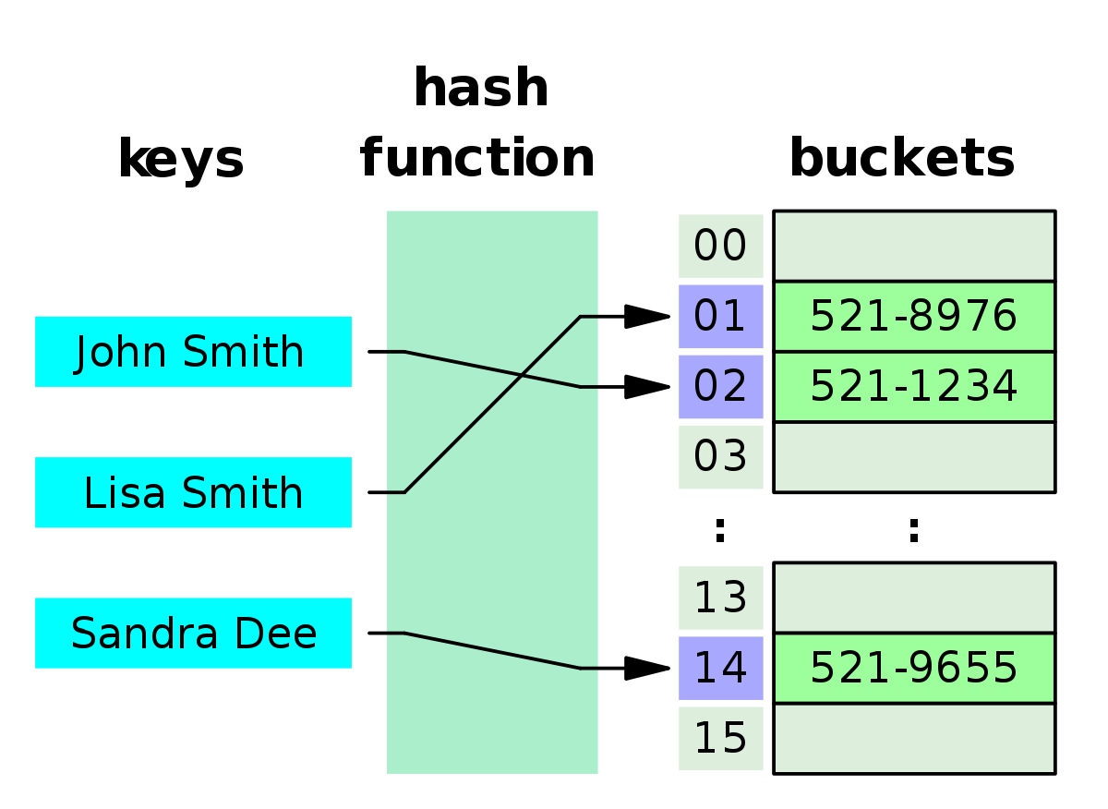
Hash table (hash map)
Array-like data structure: associative array
Maps keys to indexes associated with values
A hash function is used to compute the index of each key

Slide 5
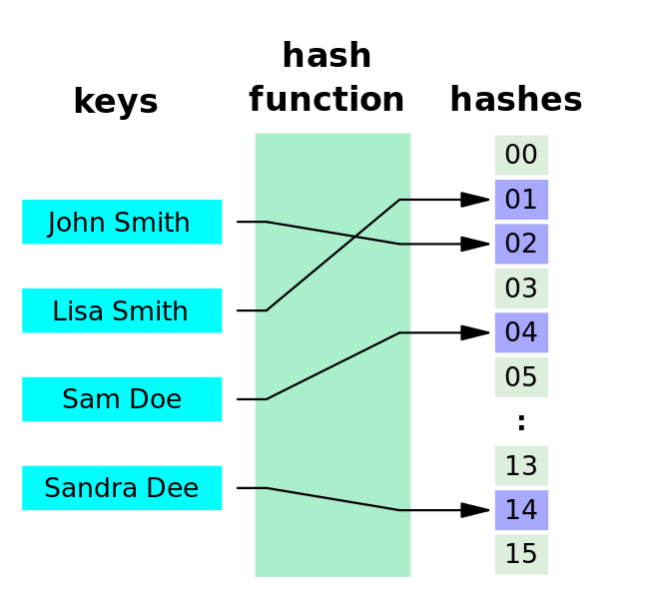
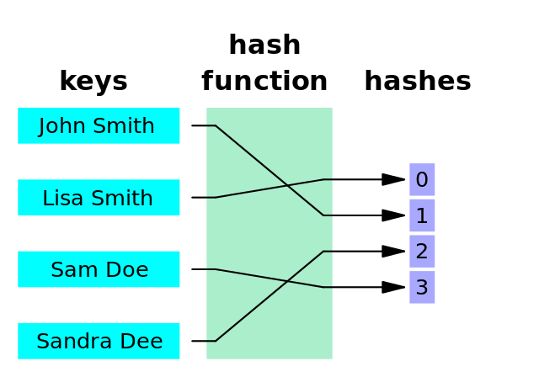
Hash functions
What makes a good hash function?
  It must be easy (efficient!) to calculate
  Each index is equally likely to be generated for each key
    A hash function where every key gets a different hash value is a perfect hash function
  Example: How would you hash phone numbers?
    Bad hashing: use first three digits (shared area codes/mobile provider)
    Better hashing: use last three digits (unique extension)
    Neither is perfect
Perfect Hashing
Minimal Perfect Hashing

Slide 6
Hash functions: Extraction
Use a selection of digits as the key
Eg, use the first three digits; or the last three; or first, last, and middle
Choice of the appropriate subset depends on the application
Part of the key that is least likely to repeat should be chosen
This hashing function is extremely simple => efficient!
Disadvantage: part of the key is used -> less variation
24351871
24001226
871
226
What assumption are we making by extracting 3 digits?

Slide 7
Hash functions: Division
Suppose the size of the hash table is T
The indices generated by the hash function must be in [0, T - 1]
If key K is numeric (or interpreted as such):
  hash(K) = K % T
  Remainder (modulus) operator will return values in the desired range
0
1
2
3
4
5
6
7
8
9
33
16
27
25
18
1
72
The size of the table is 10
Now suppose the majority of your keys end in a 0
Collisions everywhere!
Division hashing works best for T = large prime number
Alternatively:
  hash(K) = (K % p) % T
  p = prime number > T
h(K) = K % 10

Slide 8
Hash functions: Folding
Designed to increase variability of hash codes
Split the key into equal parts
Combine the parts using a simple operation such as addition
Apply division hashing to restrict the index to the desired range
Shift folding:
Boundary folding:
24351871
24 + 35 + 18 + 71 = 148
148 % T
24351871
24 + 53 + 18 + 17 = 112
112 % T

Slide 9
Hash functions: Mid-Square Function
Square the key
Use the middle section of a desired length as the hash value
Advantage: the entire key is used -> more variation
Hash functions can be combined: apply folding first, followed by mid-squaring
To simplify calculation: perform the same procedure on binary representations; logic operations alone (shifting & masking) can accomplish the task
24351871
24001226
593013621200641
576058849503076
621
849

Slide 10
Hash functions: Hashing Strings
Strings are not numbers – how are they to be hashed?
Use ASCII codes!
Concatenate the ASCII codes:
Add the ASCII values:
ROSE
SORE
82, 79, 83, 69
83, 79, 82, 69
82798369 % T
83798269 % T
public static int hash(String key, int tableSize)
{
int hashVal = 0;
for(int i = 0; i < key.length(); i++)
hashVal += key.charAt(i);
return hashVal % tableSize;
}

Slide 11
Hash functions: Hashing Strings
Only 128 ASCII codes (0 – 127)!
  With max 8 character strings → 8*127 = [0 – 1016] possible hash values
  10007 table size (prime after 10000): Only 10% coverage!
Adding the example values would have resulted in a collision:
  82 + 79 + 83 + 69 = 83 + 79 + 82 + 69
Better hash function (Horner’s rule):
Even more efficient:
  Treat strings as binary
  Treat binary as integers
public static int hash(String key, int tableSize)
{
int hashVal = 0;
for (int i = 0; i < key.length(); i++)
hashVal = 37 * hashVal + key.charAt(i);
hashVal %= tableSize;
if (hashVal < 0)
hashVal += tableSize;
return hashVal;
}

