Slide 1
Hashing: Collision Resolution, Cuckoo Hashing

Slide 2
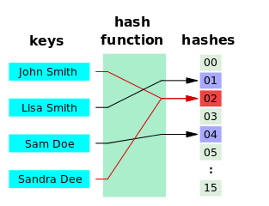
Collisions in Hashing
No matter how good the hash function is, there is always a chance of collision
We map a potentially unbounded space of inputs to a bounded table of entries
The more entries there are, and the smaller the table → the higher is the chance of collision
Should we try harder and invent a perfect hash function for all cases?
Can we perhaps devise an algorithm to resolve the collisions instead?

Slide 3
Collision Resolution
If the cell addressed by the hash code is occupied …
Two simple approaches
  Allow multiple hash codes per cell !
    How do we store these hashes?
    Chaining
  Try another cell !
    But which cell must we try?
    Probing
Allow multiples?
hash(“James”) = 2
hash(“Jane”) = 2
Try another cell?
 |  | James
0 | 1 | 2 | 3 | 4 | 5 | 6

Slide 4
Separate Chaining
What if, we stored multiple keys
per one hash code?
Use a linked list
h(K) = K % 10
33
16
27
23
26
79
88
0
1
2
3
4
5
6
7
8
9

Slide 5
Probing
But which cell must we try?
The key should still be easily accessible – can’t just use a random place
We need a formula that will derive the next possible position of K
Create a probing function p
If a collision occurred, try the positions in the probing sequence:
  norm(h(K) + p(1)), norm(h(K) + p(2)), …, norm(h(K) + p(i))
  i is a “probe”, i = {1, 2, 3, …, T - 1}
  norm is a normalisation function, squashing the indexes to the allowed range (%)
hash(“James”) = 2
hash(“Jane”) = 2
Try another cell?
 |  | James
0 | 1 | 2 | 3 | 4 | 5 | 6

Slide 6
Linear probing
Use the identity function as the probe function: p(i) = i
33
16
27
23
26
79
88
(h(K) + 1)%T, (h(K) + 2) % T, …
0
1
2
3
4
5
6
7
8
9
Search the table sequentially until an open position is found
If the end of the table is reached, start from the top of the table
h(K) = K % 10
The search stops when the original position is reached

Slide 7
Linear probing
Problem with linear probing: colliding data will cause clusters → primary clustering
Clusters will cause more collisions!
0
1
2
3
4
5
6
7
8
9
0.1
0.1
0.1
0.1
0.1
0.1
0.1
0.1
0.1
0.1
0
1
2
3
4
5
6
7
8
9
33
0.1
0.1
0.1
0
0.2
0.1
0.1
0.1
0.1
0.1
12
0
13
0.3
0
0.4

Slide 8
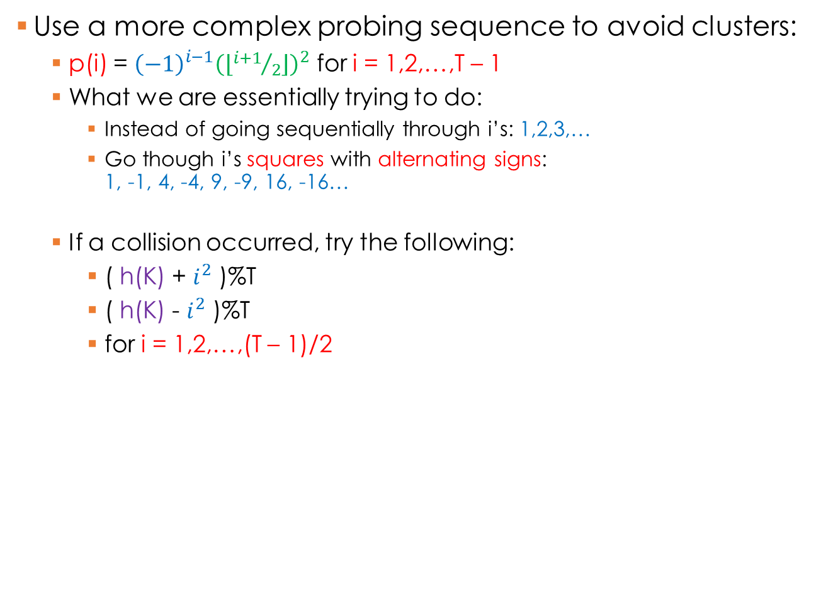
Quadratic probing
Use a more complex probing sequence to avoid clusters:
  p(i) = ${\left(−1\right)}^{i−1}{\left(\left\lfloor {i+1}/2\right\rfloor \right)}^{2}$ for i = 1,2,…,T – 1
  What we are essentially trying to do:
    Instead of going sequentially through i’s: 1,2,3,…
    Go though i’s squares with alternating signs:
    1, -1, 4, -4, 9, -9, 16, -16…
  If a collision occurred, try the following:
    ( h(K) + $i^{2}$ )%T
    ( h(K) - $i^{2}$ )%T
    for i = 1,2,…,(T – 1)/2
Does this approach avoid clusters?
No → secondary clusters!
(2 + 1) % 7 = 3
(2 + 1) % 7 = 3
h(“Janet”) = 2
(2 - 1) % 7 = 1
h(“James”) = 2
h(“Jammie”) = 2
h(“Jane”) = 2
(2 + 1) % 7 = 3
(2 - 1) % 7 = 1
Jane
Janet
(2 + 4) % 7 = 6
 |  | James
Jack
Jammie
0 | 1 | 2 | 3 | 4 | 5 | 6
(2 - 4) % 7 = ?
(-2) % 7 = – 2 + 7 = 5
h(“Jack”) = 2

Slide 9
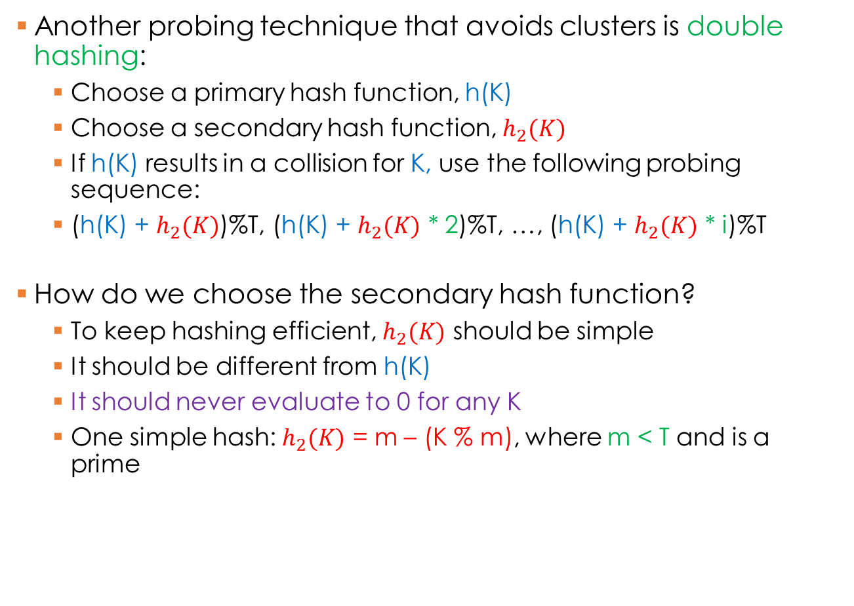
Double hashing
Another probing technique that avoids clusters is double hashing:
  Choose a primary hash function, h(K)
  Choose a secondary hash function, $h_{2}(K)$
  If h(K) results in a collision for K, use the following probing sequence:
  (h(K) + $h_{2}(K)$)%T, (h(K) + $h_{2}(K)$ * 2)%T, …, (h(K) + $h_{2}(K)$ * i)%T
How do we choose the secondary hash function?
  To keep hashing efficient, $h_{2}(K)$ should be simple
  It should be different from h(K)
  It should never evaluate to 0 for any K
  One simple hash: $h_{2}(K)$ = m – (K % m), where m < T and is a prime

Slide 10
Double hashing
33
16
27
23
46
79
38
0
1
2
3
4
5
6
7
8
9
h(K) = K % 10
h’(K) = 7 – (K % 7)
h’(23) = 7 – (23 % 7) = 5
(h(23) + h’(23))%10 = (3+5)%10 = 8
h’(46) = 7 – (46 % 7) = 3
(h(46) + h’(46))%10 = (6+3)%10 = 9
h’(79) = 7 – (79 % 7) = 5
(h(79) + h’(79))%10 = (9+5)%10 = 14%10 = 4
h’(38) = 7 – (38 % 7) = 4
(h(38) + h’(38))%10 = (8+4)%10 = 12%10 = 2

Slide 11
Disadvantages
What is the problem with chaining?
  Efficient if collisions are few
  Disastrous if collisions are many
    Search potentially becomes O(n)
What’s the problem with probing?
  If a lot of collisions occur, you loose the benefit of direct access
  Before the item is accessed, you have to find where it ended up as a result of avoiding collisions

Slide 12
Cuckoo hashing
Collision resolution algorithm invented in 2001
Guaranteed O(1) look-up time for all entries
Two hash tables are used, each associated with its own hash function
Each K can be either in one or in other table
K | h(k) | h'(k)
20 | 9 | 1
50 | 6 | 4
53 | 9 | 4
75 | 9 | 6
100 | 1 | 9
67 | 1 | 6
105 | 6 | 9
3 | 3 | 0
36 | 3 | 3
0
1
2
3
4
5
6
7
8
9
10
0
1
2
3
4
5
6
7
8
9
10
h(K) = K % 11
100
67
h’(K) = (K / 11) % 11
3
36
53
50
105
20
75
53

Slide 13
Cuckoo hashing
Problem: Cuckoo hashing may produce an infinite loop
  Add max # of displacements to the algorithm
  In case of insertion failure
    Rehash both tables OR
    Use different hash functions
Variation: If possible, place new item in second hash location if collision occurs
K | h(k) | h'(k)
A | 0 | 2
B | 0 | 0
C | 1 | 4
D | 1 | 0
E | 3 | 2
F | 3 | 4
G | 1 | 2
0
1
2
3
4
A
B
0
1
2
3
4
C
D
E
F
G?

Slide 14
Cuckoo hashing cycle analysis
Probability of cycle very low if load factor < 0.5
  Maximum of O(lg n) displacements
Variation 1: Use more than two hash functions/tables
  Improves load factor before cycles are likely
Variation 2: Allow multiple keys per cell
  Improves load factor before cycles are likely
Both variations can be combined
  Even better available load factor!
 | 1 item/cell | 2 items/cell | 3 items/cell
2 hash functions | 0.49 | 0.86 | 0.93
3 hash functions | 0.91 | 0.97 | 0.98
4 hash functions | 0.97 | 0.99 | 0.999
Maximum load factors

