Slide 1
Rehashing,
Perfect Hashing, Hopscotch Hashing, Universal Hashing

Slide 2
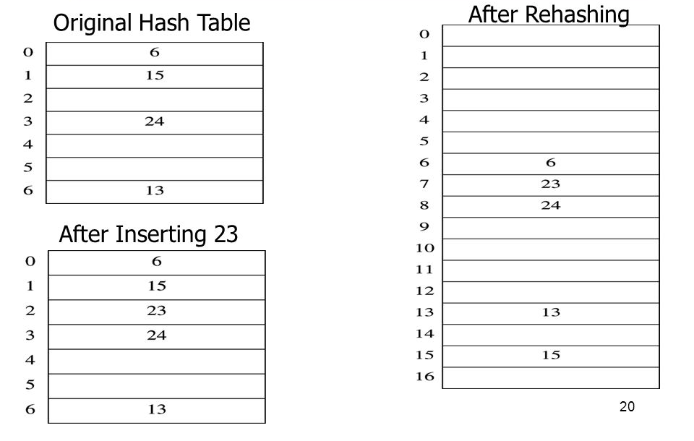
Rehashing
What if you run out of space in the hash table, or the table is so full that finding an empty slot is very hard?
Rehashing: create a new larger hash table, and bring the elements over
  Same or different hash function with the new T can be used
  Double the size, or, even better, choose new T = large prime closest to old T * 2
K = 13, 15, 6, 24
h(K) = K % 7
h(K) = K % 17
K = 6, 15, 23, 24, 13

Slide 3
Rehashing – Quadratic Probing
Example Code:
Simply rehashes the old values using the same hash function
  Modulus (% T) ensures new array size is utilised
Book Code
  https://users.cs.fiu.edu/~weiss/dsaajava3/code/QuadraticProbingHashTable.java
/* Rehashing for quadratic probing hash table. */
private void rehash()
{
HashEntry<AnyType> [] oldArray = array;
// Create a new double-sized, empty table
allocateArray(nextPrime(2 * oldArray.length));
currentSize = 0;
// Copy table over
for (int i = 0; i < oldArray.length; i++)
if (oldArray[i] != null && oldArray[i].isActive)
insert(oldArray[i].element);
}

Slide 4
Rehashing – Separate Chaining
Example Code:
Rehashes all list items using the same hash function
  Modulus (% T) ensures new array size is utilised
Book Code
  https://users.cs.fiu.edu/~weiss/dsaajava3/code/SeparateChainingHashTable.java
/* Rehashing for separate chaining hash table. */
private void rehash()
{
List<AnyType> [] oldLists = theLists;
// Create new double-sized, empty table
theLists = new List[nextPrime(2 * theLists.length)];
for (int j = 0; j < theLists.length; j++)
theLists[j] = new LinkedList<>();
// Copy table over
currentSize = 0;
for (int i = 0; i < oldLists.length; i++)
for (AnyType item : oldLists[i])
insert(item);
}

Slide 5
Rehashing Example
Example run with inserting 2 million values into a hash table
  Initial size: 101
  Rehashing: Creates a new larger hash table every time existing hash table becomes half full
Rehashing at 51: 101 -> 211
Rehashing at 106: 211 -> 431
Rehashing at 216: 431 -> 863
Rehashing at 432: 863 -> 1733
Rehashing at 867: 1733 -> 3467
Rehashing at 1734: 3467 -> 6947
Rehashing at 3474: 6947 -> 13901
Rehashing at 6951: 13901 -> 27803
Rehashing at 13902: 27803 -> 55609
Rehashing at 27805: 55609 -> 111227
Rehashing at 55614: 111227 -> 222461
Rehashing at 111231: 222461 -> 444929
Rehashing at 222465: 444929 -> 889871
Rehashing at 444936: 889871 -> 1779761
Rehashing at 889881: 1779761 -> 3559537
Rehashing at 1779769: 3559537 -> 7119103

Slide 6
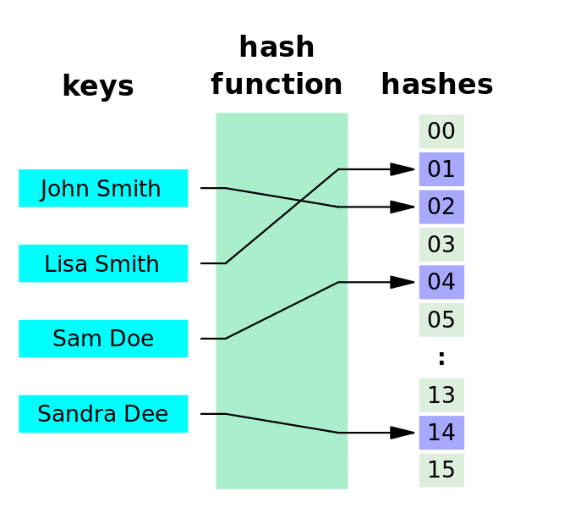
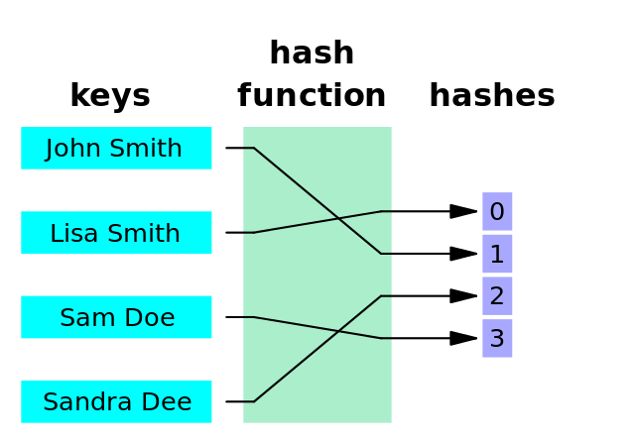
Perfect hash functions
A perfect hash function is a hash function that assigns a unique hash code to every key (no collisions)
A minimal perfect hash function is a perfect hash function that uses every slot in the hash table and wastes no space
Why are hash functions not perfect/minimal?
  Because the input space is unlimited – can’t prepare for everything!
  What if we knew exactly what data and how much data needs to be stored?
  Turns out you can design a perfect hash function if data (input space) is known beforehand!

Slide 7
Hopscotch Hashing
Collision resolution algorithm invented in 2008
Improvement on linear probing
  Constant look-up time
  Worst Case: O(MAX) look-up time
Maximum probing distance
  MAX constant value
  Probes slots distances [0, (MAX – 1)]
  Optimised to computer architecture
  Displacement algorithm if exceeded
Hash table maintains bit array with each hash table slot
  Bit array sized to MAX value
  Indicates which other slots contain keys with the slot’s hash value

Slide 8
Hopscotch Hashing Example
On collisions, perform standard linear probing
  Maximum probing distance → displacement algorithm
  Hash table maintains a “hop” column that associates a bit value with each hash table slot
K | h(K)
A | 7
B | 9
C | 6
D | 7
E | 8
F | 12
G | 11
H | 9
I | 6
…
6
7
8
9
10
11
12
13
14
15
Item | Hop
MAX = 4
C
1000
A
1000
D
1100
0000
0010
E
B
1010
H
1000
0000
G
0010
1000
F
1000
0000

Slide 9
Hopscotch Hashing Example cont.
Improvement on linear probing - constant look-up time
  Maximum probing distance → displacement algorithm
  Hash table maintains a “hop” value associated with each hash table slot
K | h(K)
A | 7
B | 9
C | 6
D | 7
E | 8
F | 12
G | 11
H | 9
I | 6
…
6
7
8
9
10
11
12
13
14
15
Item | Hop
MAX = 4
C
1000
I
1001
A
1100
D
0010
0011
B
1010
E
0000
H
0010
0001
F
0100
1000
G
0000
0000

Slide 10
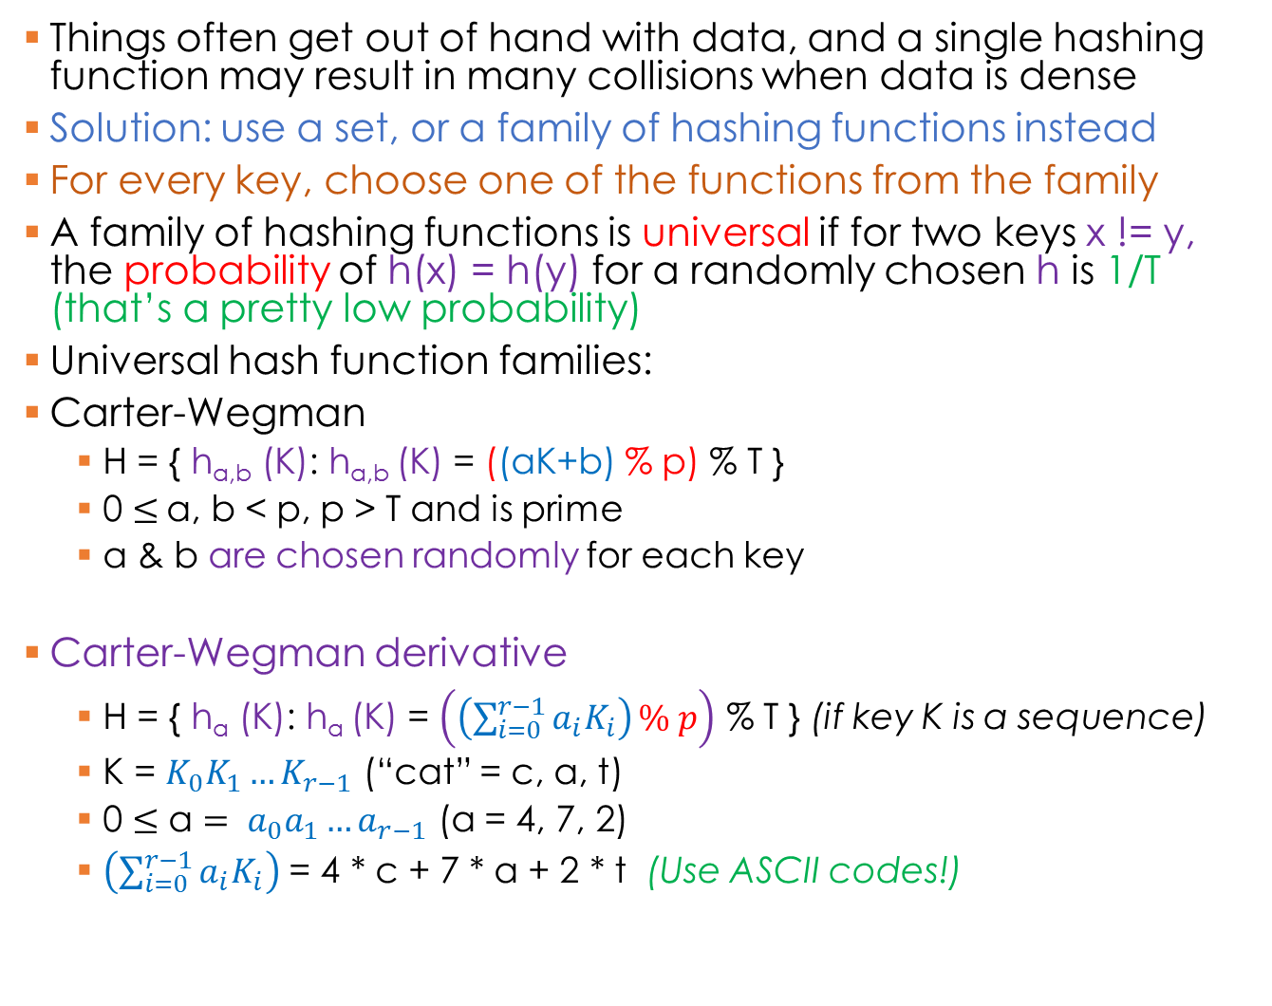
Universal Hashing
Things often get out of hand with data, and a single hashing function may result in many collisions when data is dense
Solution: use a set, or a family of hashing functions instead
For every key, choose one of the functions from the family
A family of hashing functions is universal if for two keys x != y, the probability of h(x) = h(y) for a randomly chosen h is 1/T (that’s a pretty low probability)
Universal hash function families:
Carter-Wegman
  H = { h_{a,b} (K): h_{a,b} (K) = ((aK+b) % p) % T }
  0 $≤$a, b < p, p > T and is prime
  a & b are chosen randomly for each key
Carter-Wegman derivative
  H = { h_{a} (K): h_{a} (K) = $\left.\left(\left(\sum_{i=0}^{r−1}{a_{i}K_{i}}\right)\right.\% p\right)$ % T } (if key K is a sequence)
  K = $K_{0}K_{1}…K_{r−1}$ (“cat” = c, a, t)
  0 $≤\text{a}= a_{0}a_{1}…a_{r−1}$ (a = 4, 7, 2)
  $\left(\sum_{i=0}^{r−1}{a_{i}K_{i}}\right)$ = 4 * c + 7 * a + 2 * t (Use ASCII codes!)
If a and b are random, how are we going to find the key after it is stored?

Slide 11
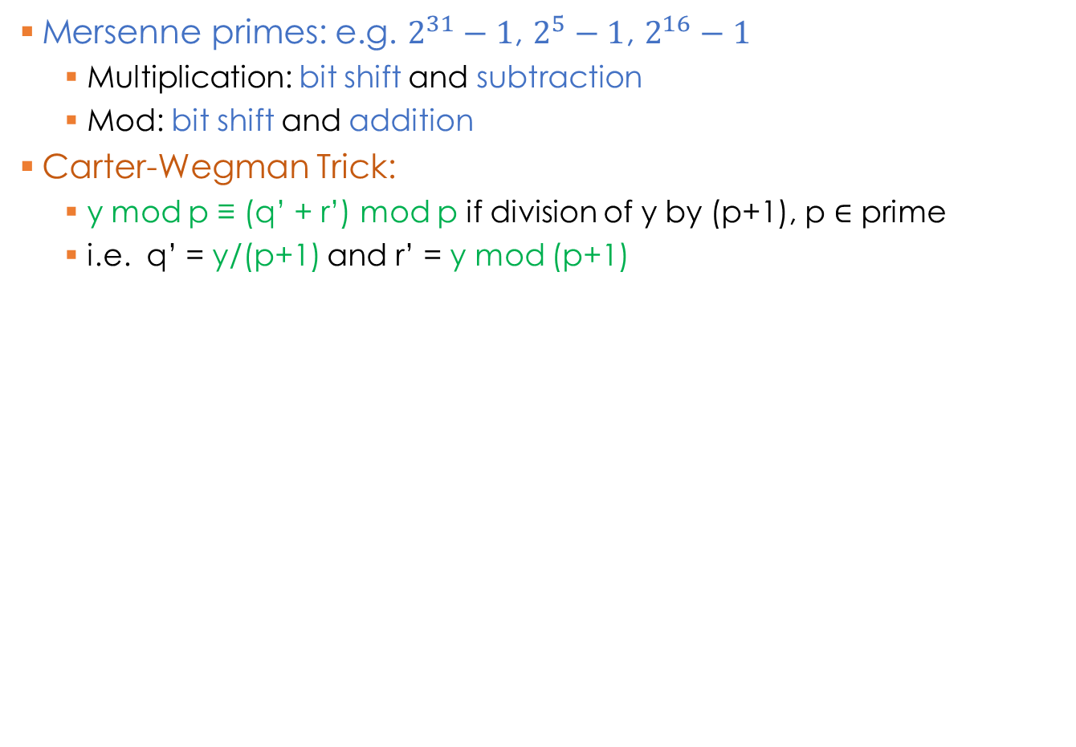
Universal Hashing Example
Mersenne primes: e.g. $2^{31}−1$, $2^{5}−1$, $2^{16}−1$
  Multiplication: bit shift and subtraction
  Mod: bit shift and addition
Carter-Wegman Trick:
  y mod p ≡ (q’ + r’) mod p if division of y by (p+1), p $∈$ prime
  i.e. q’ = y/(p+1) and r’ = y mod (p+1)
public static final int DIGS = 31;
public static final int mersenne_p = (1<<DIGS) - 1;
public static int universalHash(int K, int a, int b, int T)
{
long hashVal = (long) a * K + b;
hashVal = ((hashVal >> DIGS) + (hashVal & mersenne_p));
if (hashVal >= mersenne_p)
hashVal -= mersenne_p;
return (int) hashVal % T;
}

